Slide 1
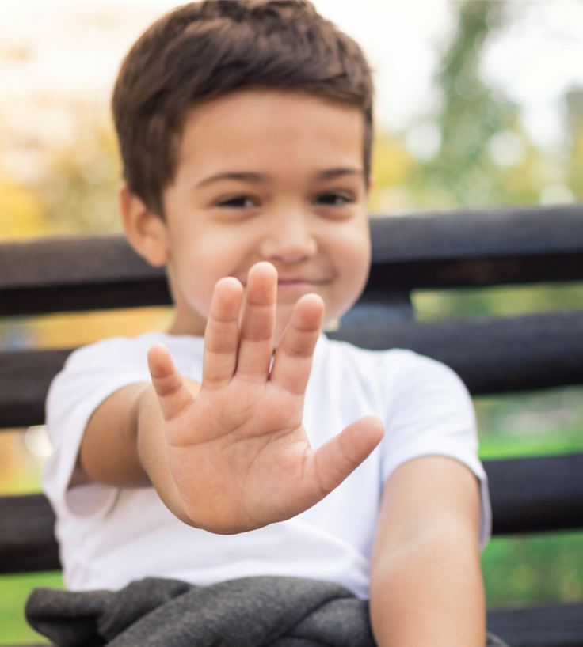
Saying No Kindly
Unit 4: Standing Strong
Lesson 2

Slide 2
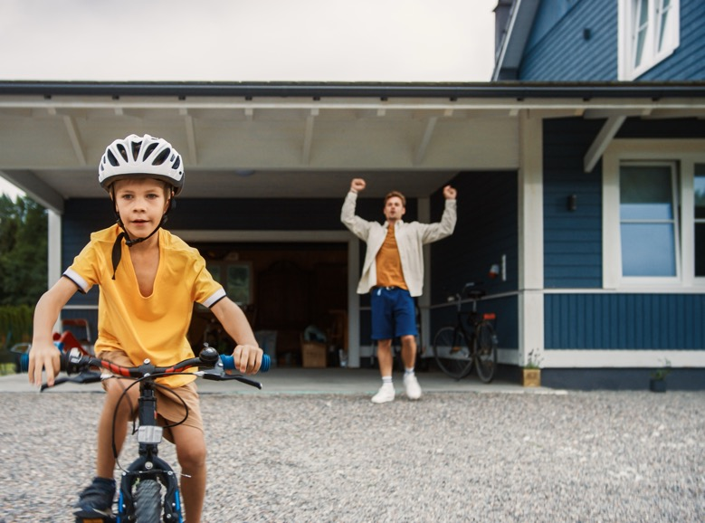
We can be brave and try new things.

Slide 3
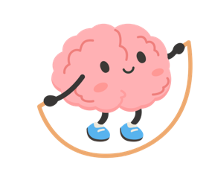
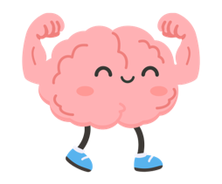
Our brain is like a muscle and every time we try something new, our brain gets stronger.

Slide 4
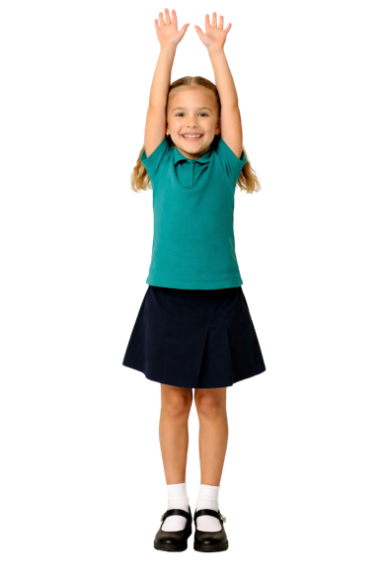
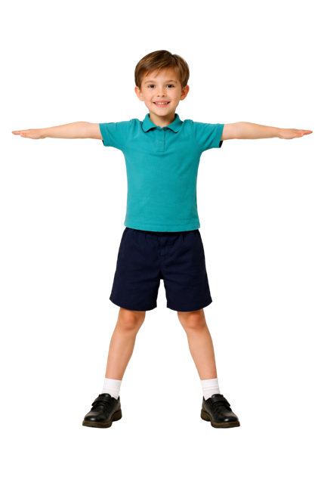
Being brave means never feeling nervous.
yes
no

Slide 5
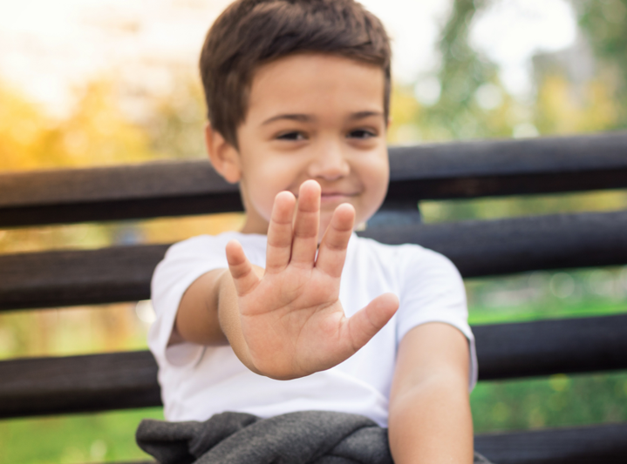
In this lesson, you will practise saying ‘no’ in a friendly way.

Slide 6


You will be successful when you can:
say ‘No’ kindly
use your words and body to show your choice.

Slide 7
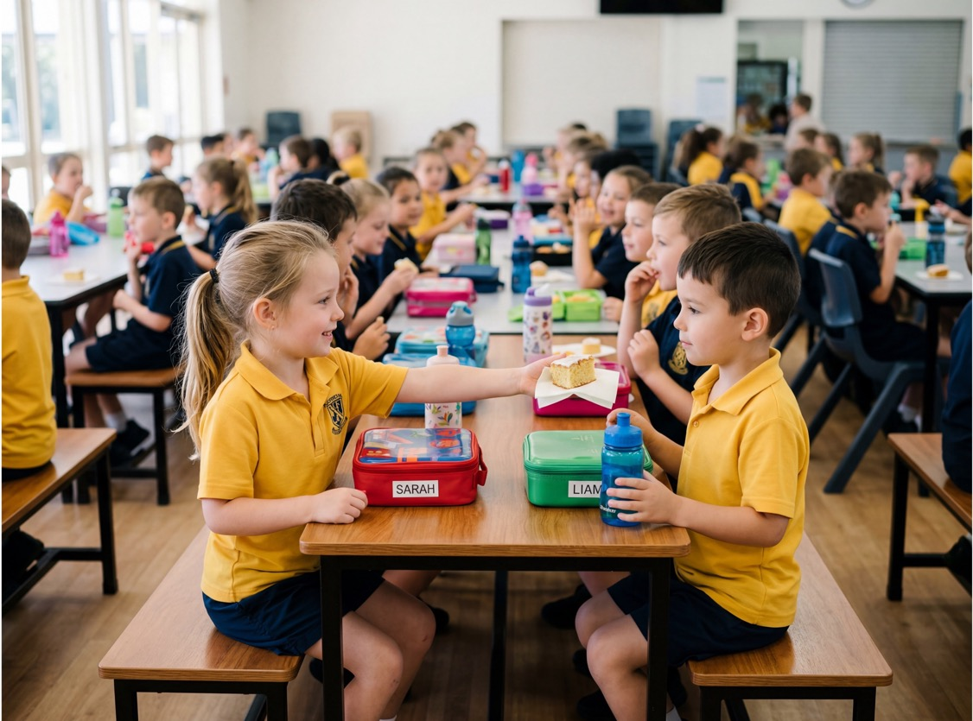
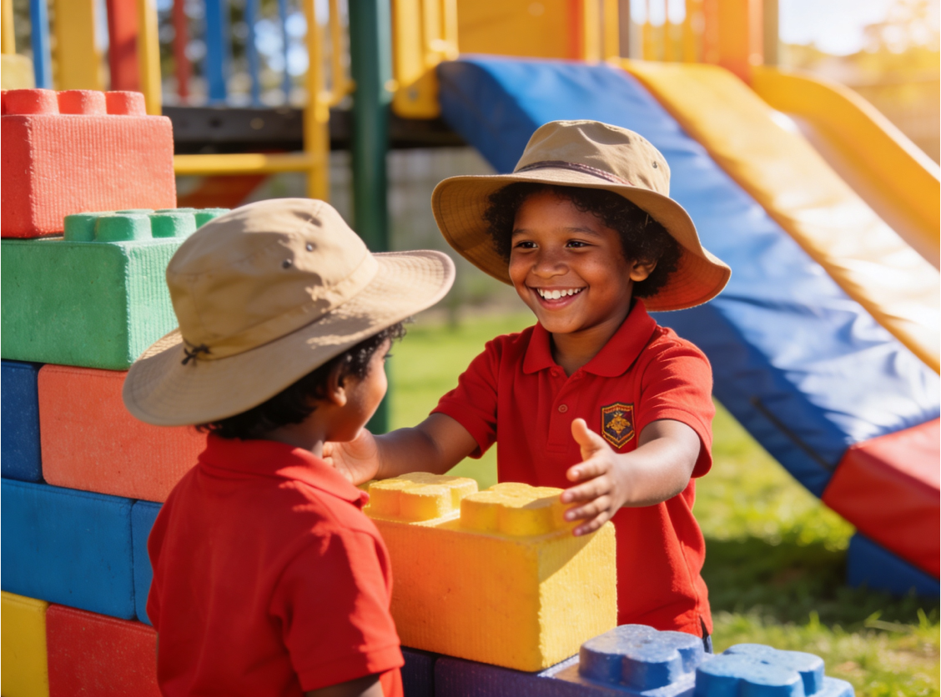
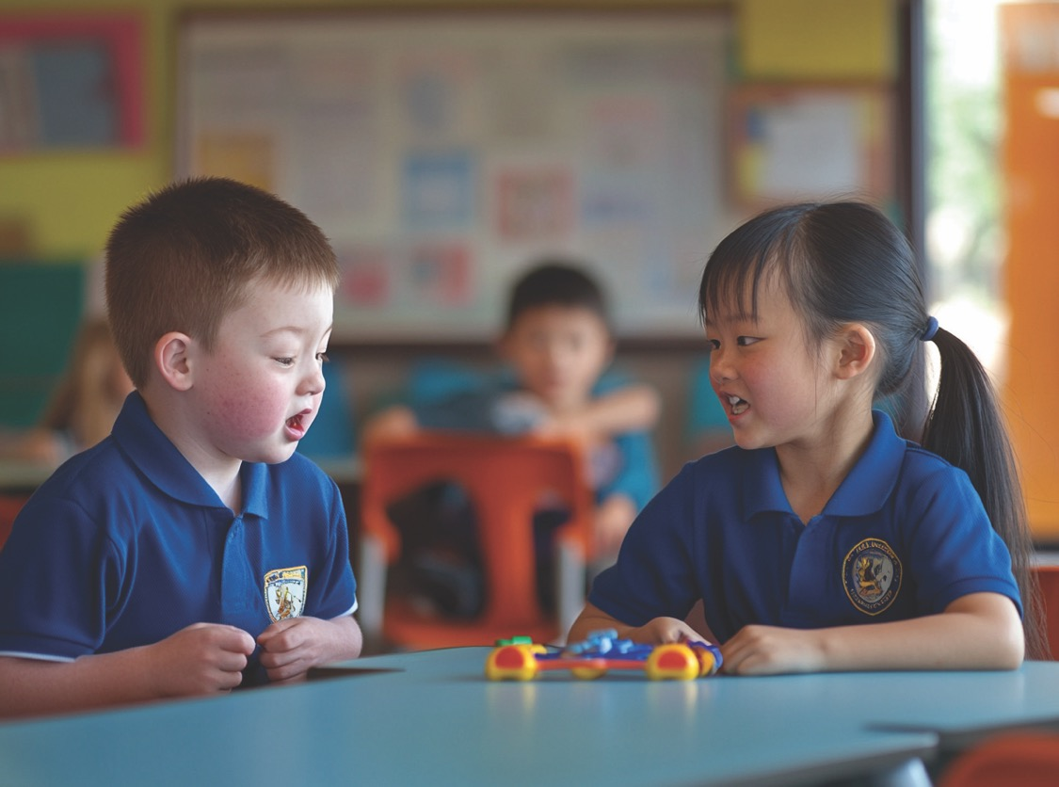

Slide 8
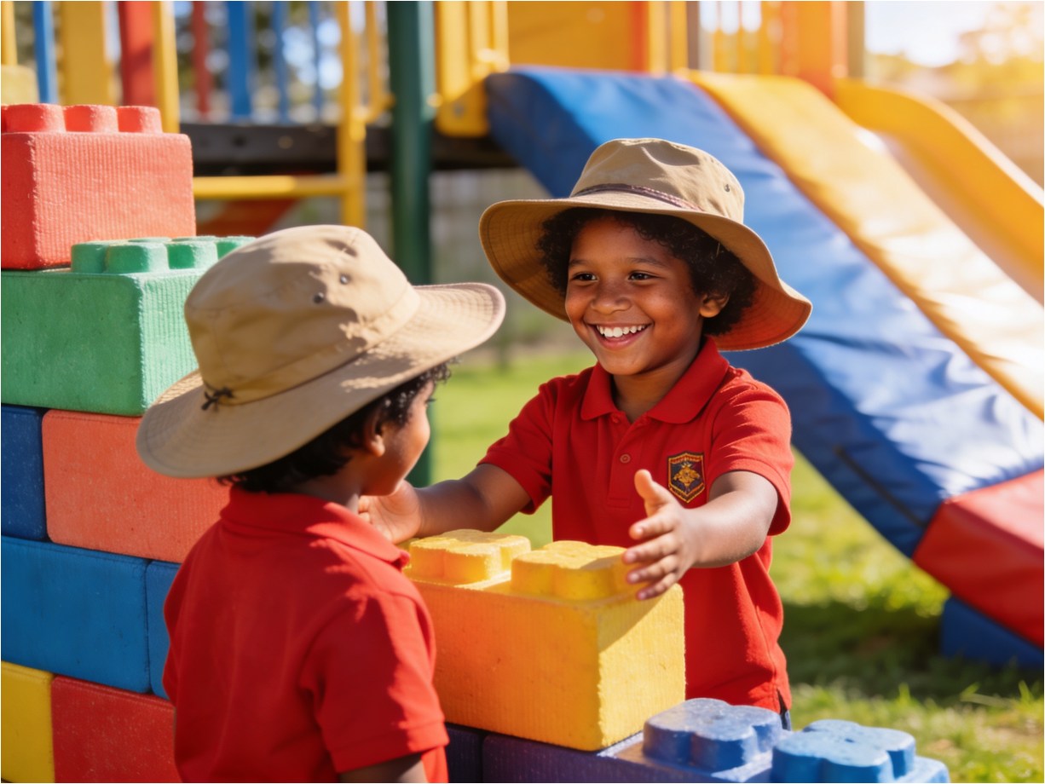

Not right now, but you can play my game.
Saying No with Our Words and Body
No, thank you.
Do you
want to play
this game?

Slide 9
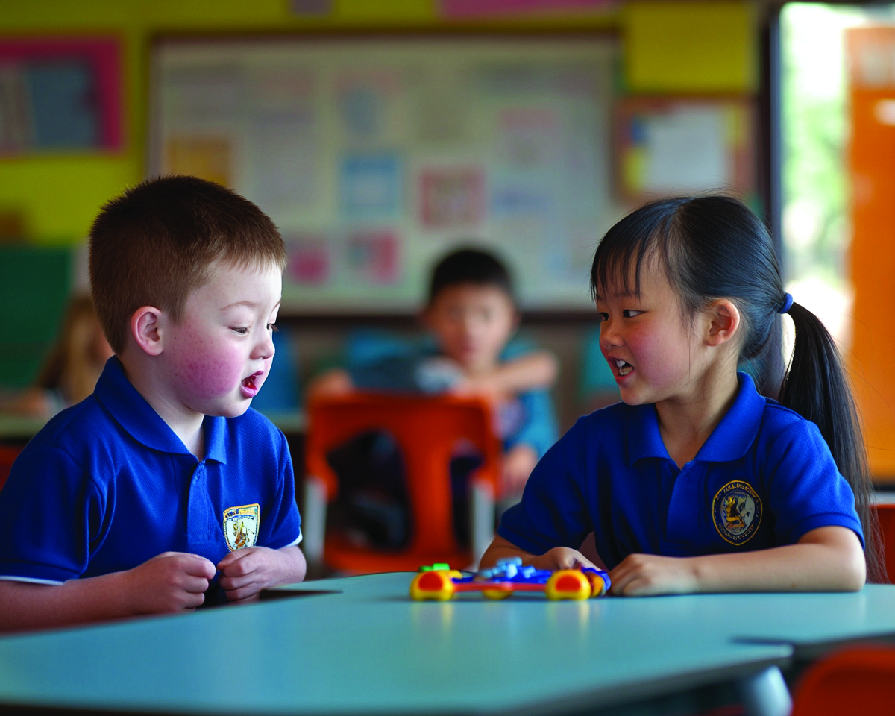
Can I play with your toy?
Saying No with Our Words and Body
I’m still using it, but you can have it next.
We can play with it together.

Slide 10
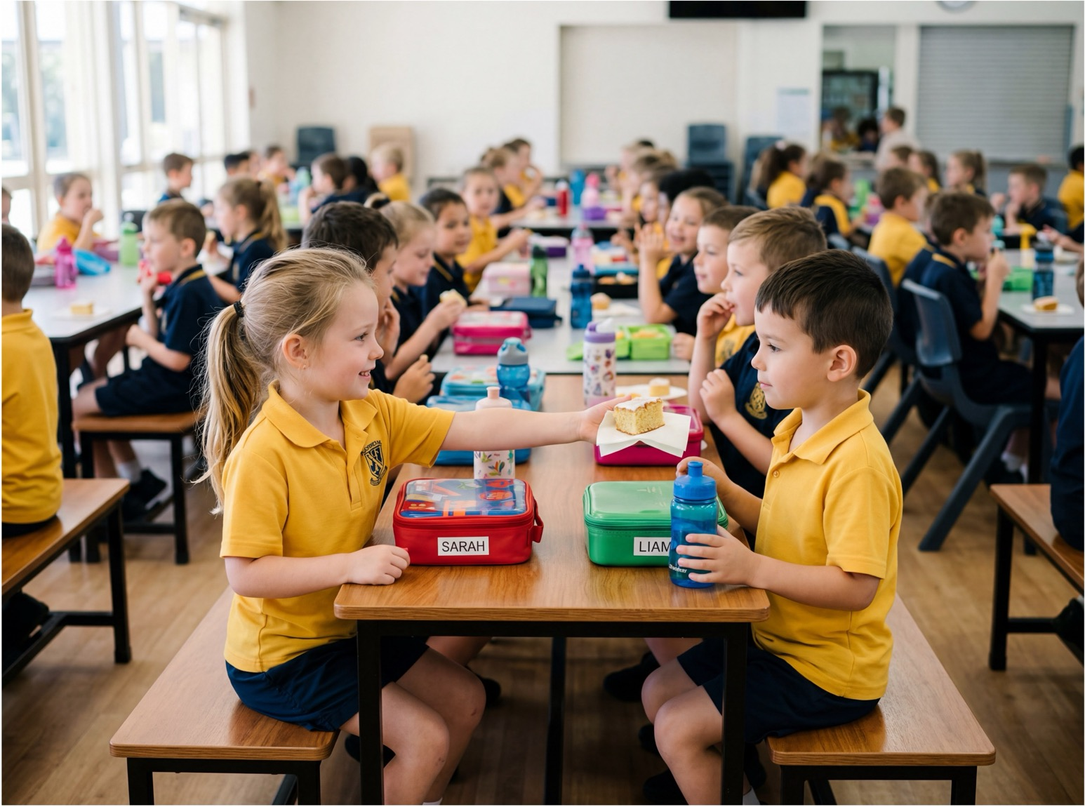
Saying No with Our Words and Body
Do you
want to try
this food?
I am not a big fan of that food, but thanks.
I don’t want any, but thank you.

Slide 11
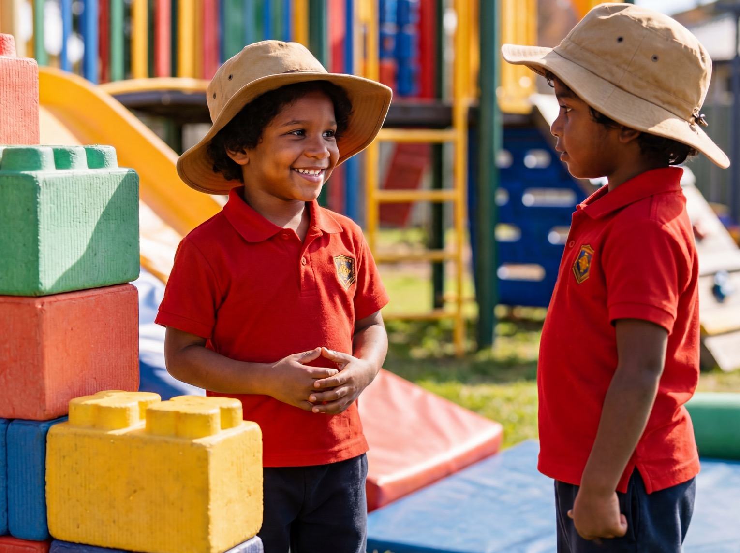
Hearing No
Okay, no worries.

Slide 12
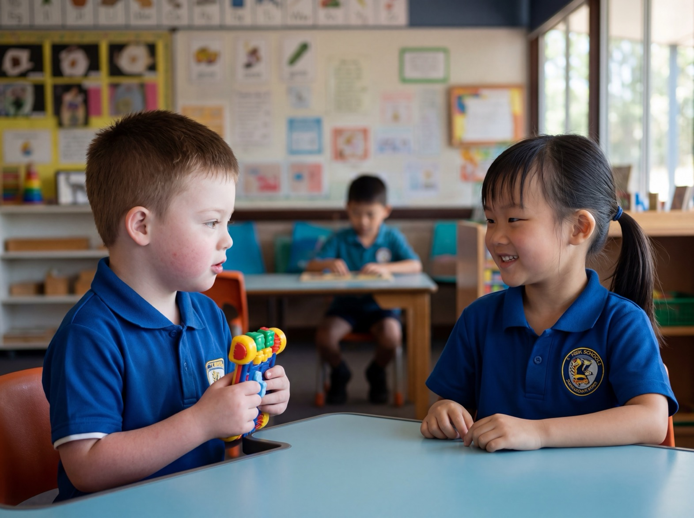
Hearing No
Okay, I
can wait.

Slide 13
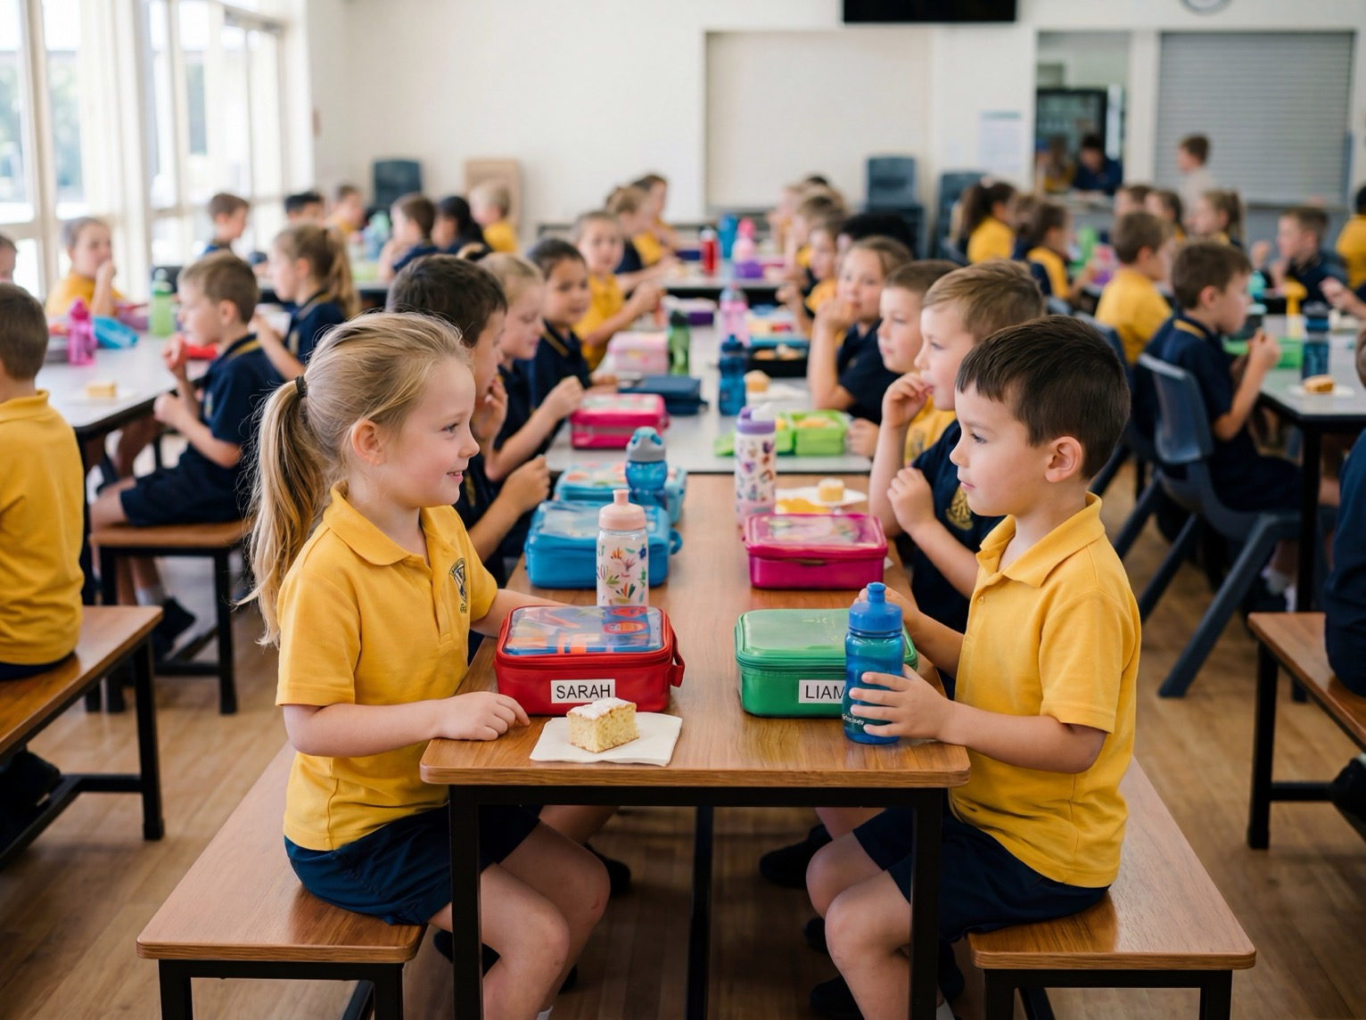
Hearing No
That’s ok.

Slide 14
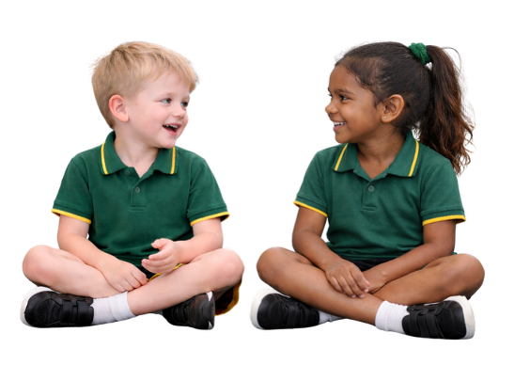
Saying No Kindly
When a friend asks you to play a game you don’t like, how can you kindly say no?

Slide 15
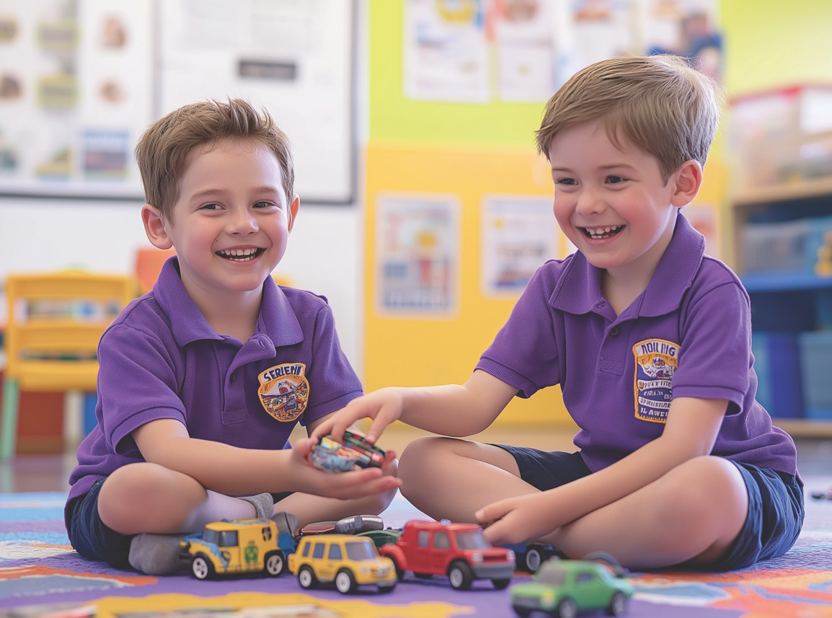
The Nice ‘No’

Slide 16
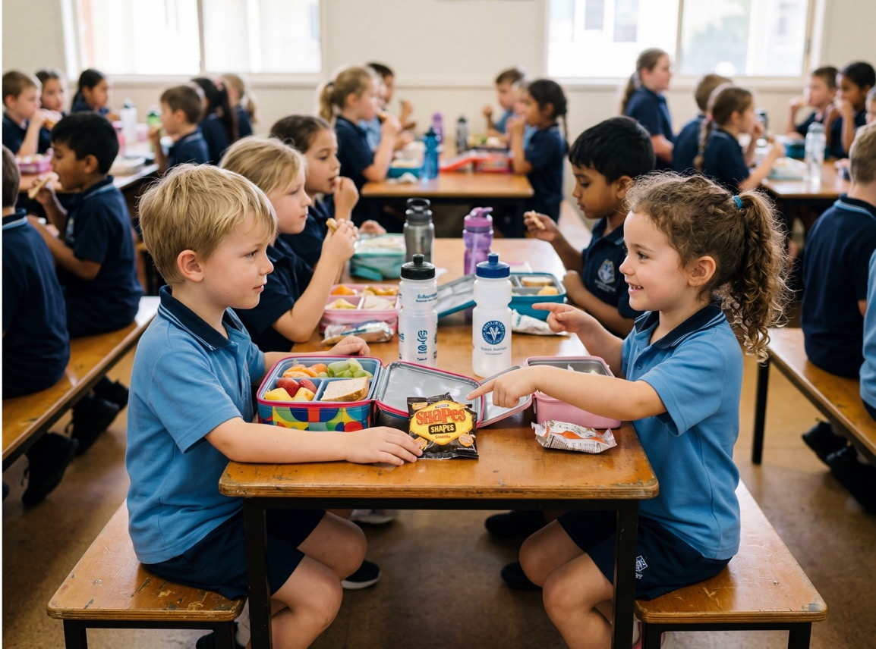
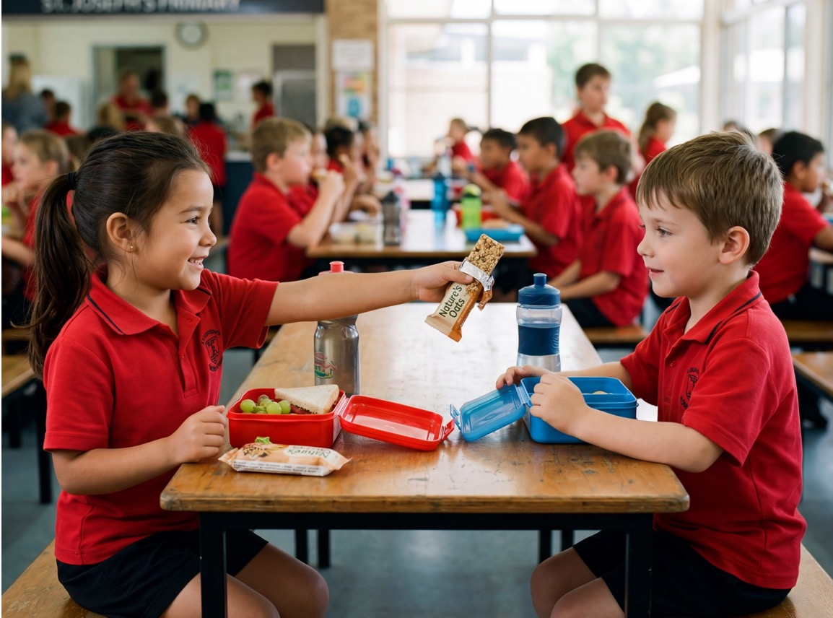
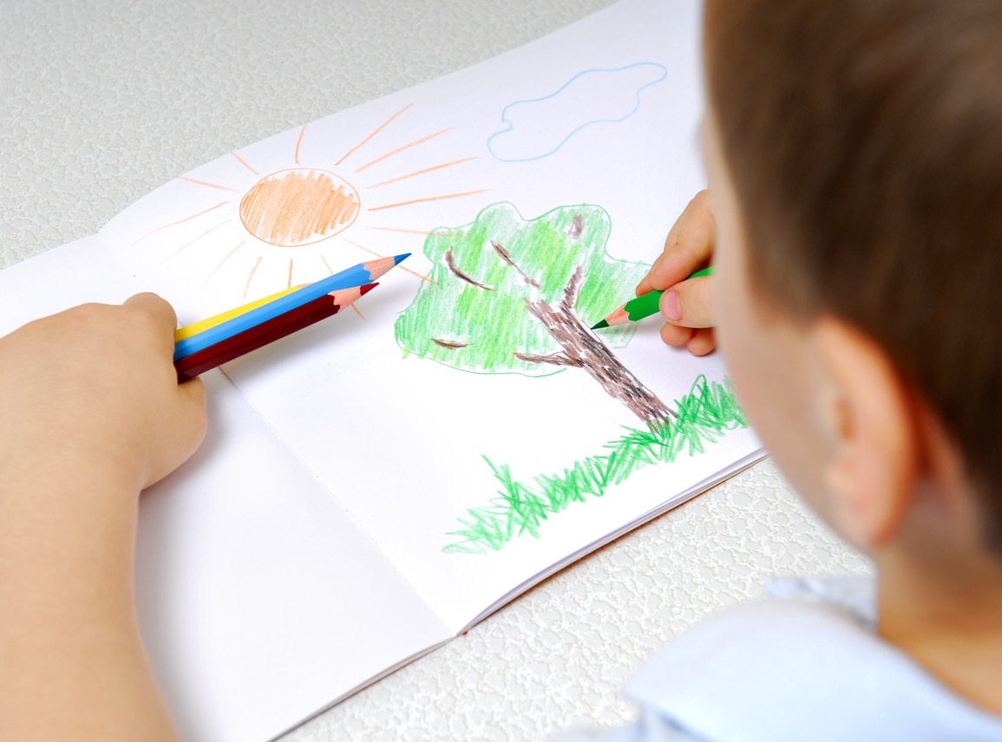
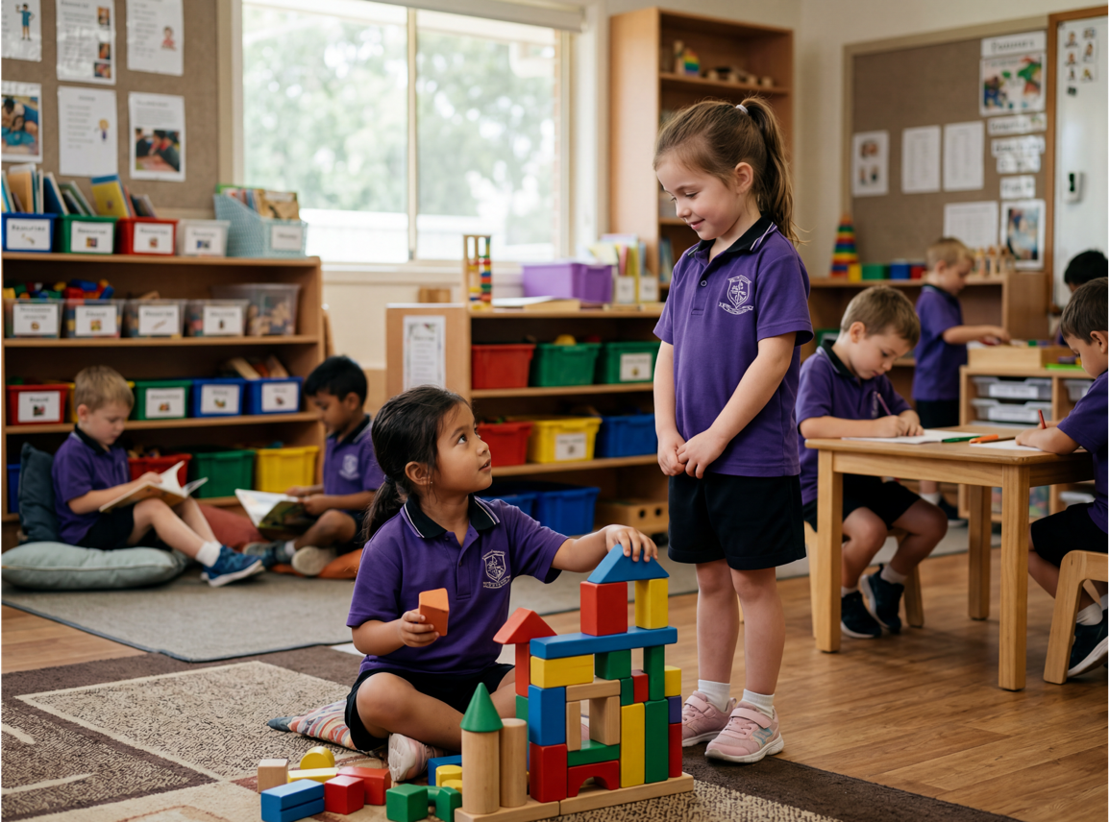
The Nice ‘No’

Slide 17

We can say ‘No’ kindly with our words and body.

Slide 18
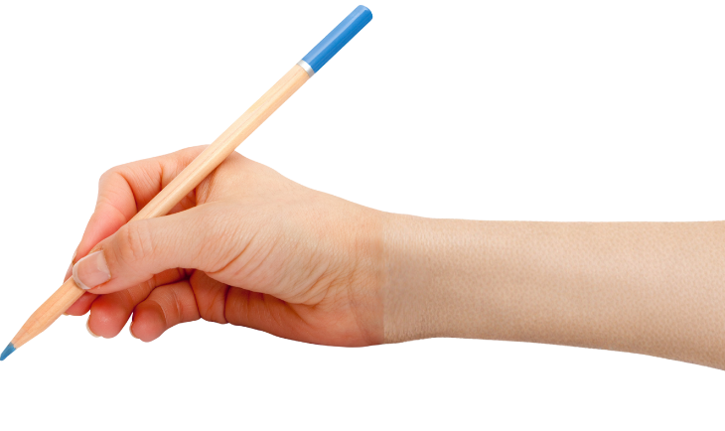



How well did you:
say ‘No’ kindly
use your words and body to show your choice?

Slide 19
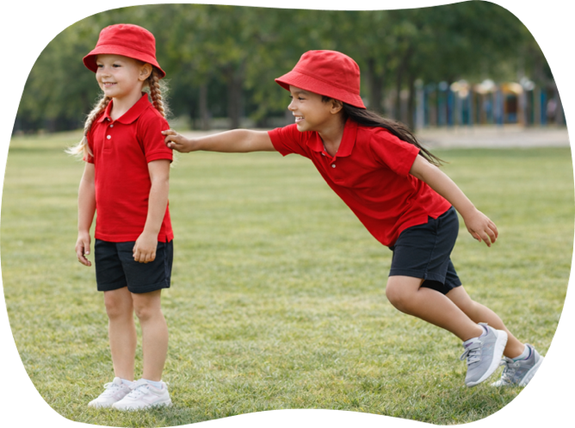
In the next lesson, we will learn how to ask for help more than once.

