Slide 1
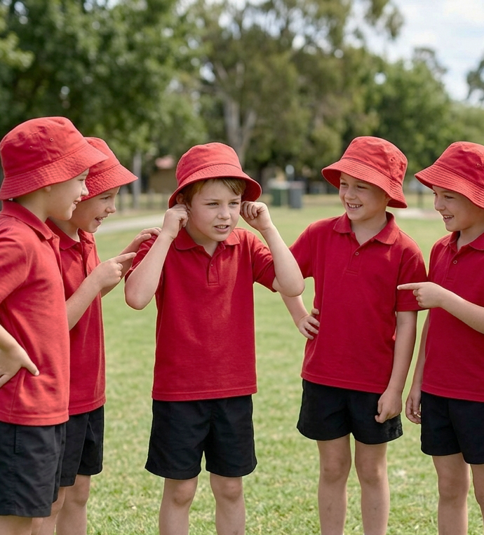
Chain Challenge
Unit 4: Standing Strong
Lesson 2,
Lesson 5 (Extension 1)

Slide 2
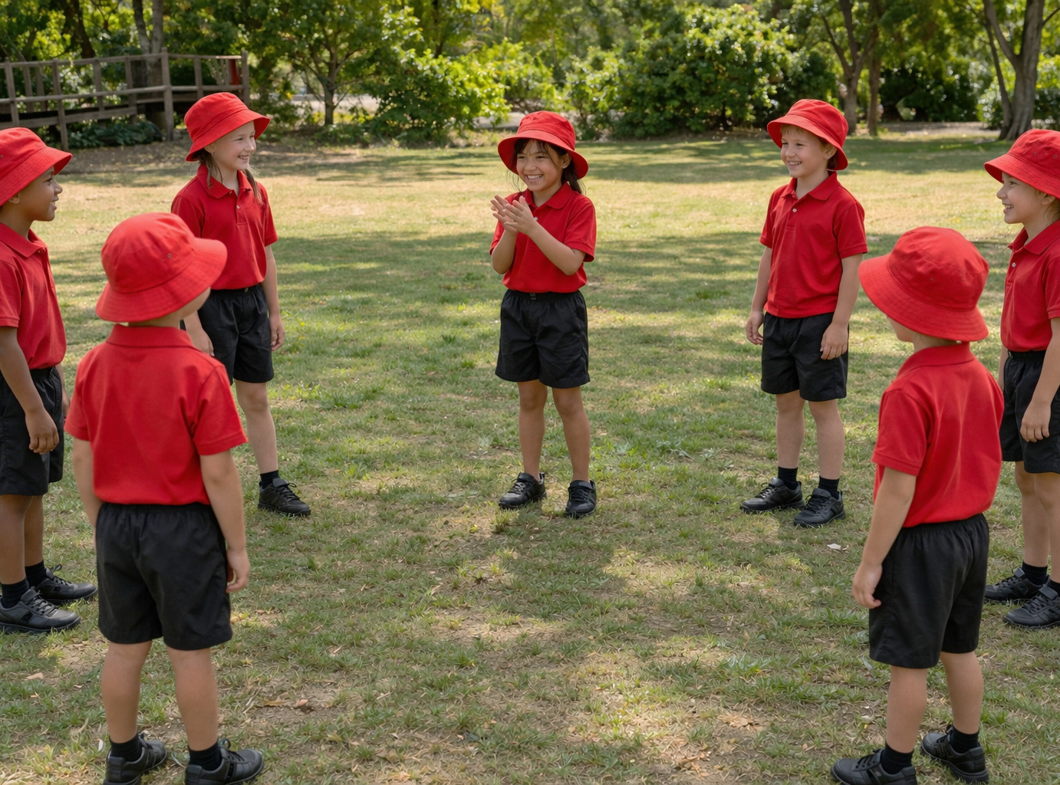
Lesson 2

Slide 3
You will learn that feeling nervous is normal when trying something new – and how to keep going anyway.

Slide 4





Slide 5




Slide 7
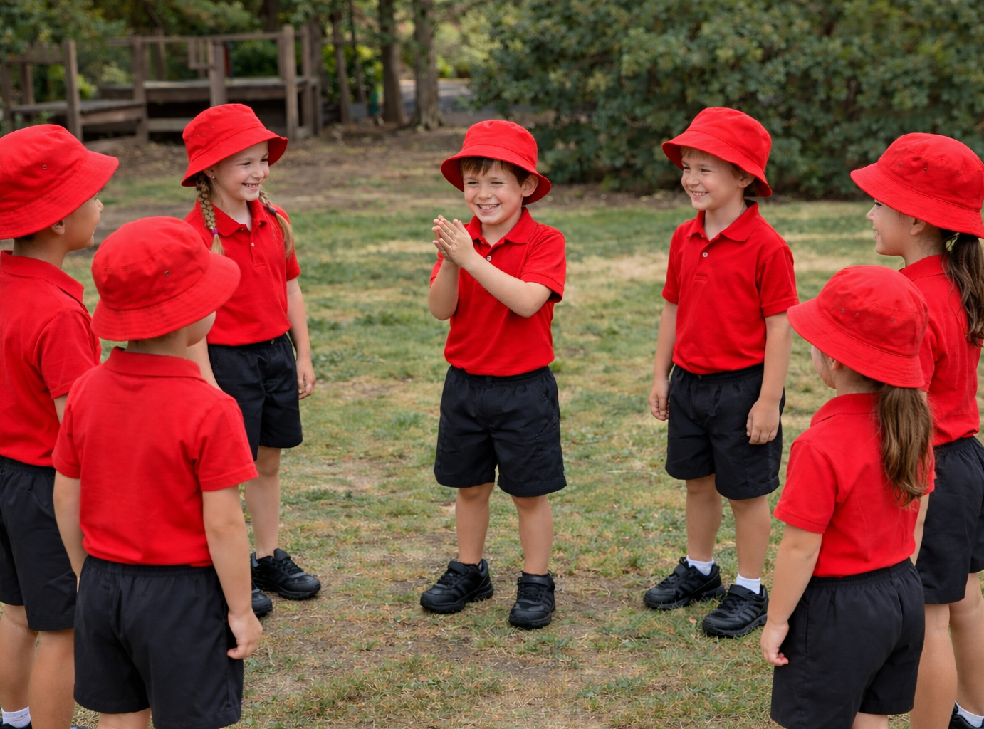
Lesson 5

Slide 8
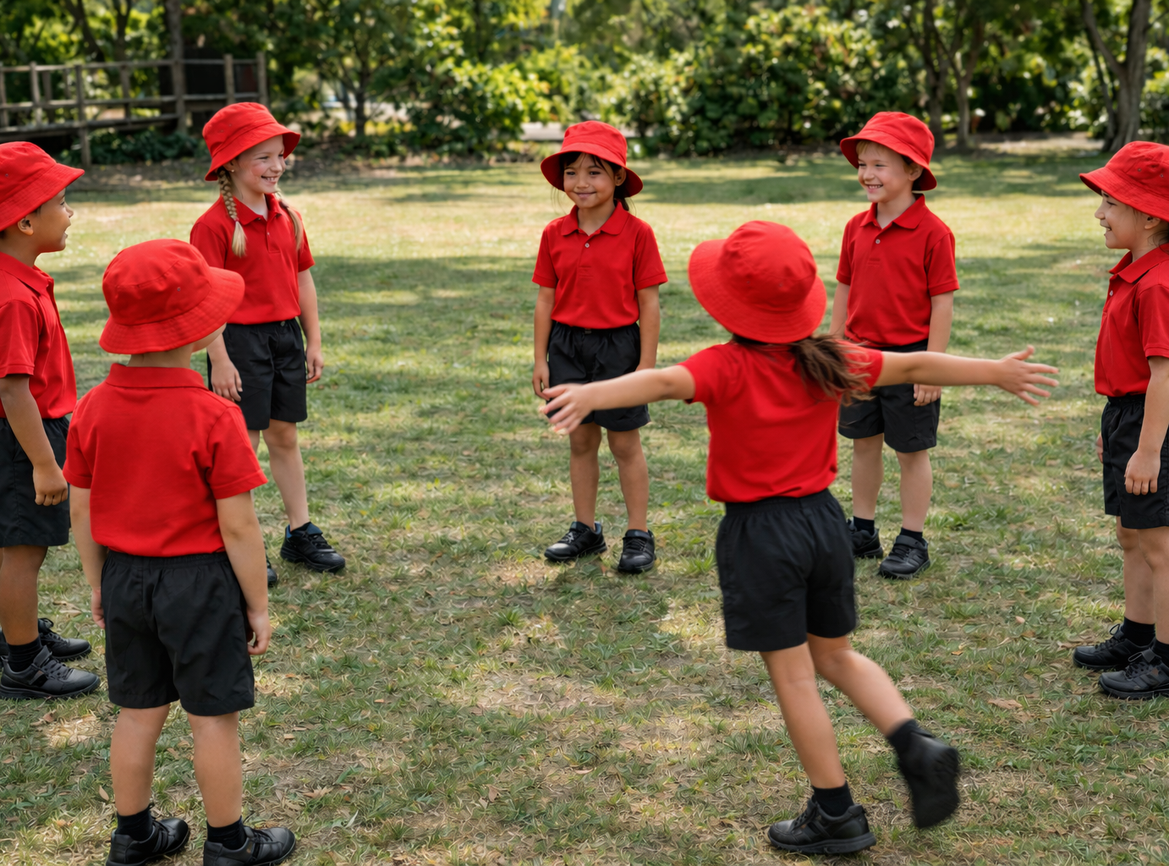
You will learn when and how to ask for help.

