Slide 1
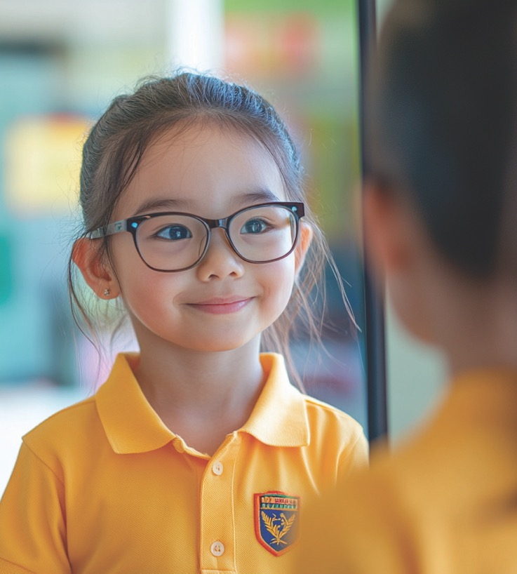
What is Confidence?
Unit 4: Standing Strong
Lesson 1

Slide 2
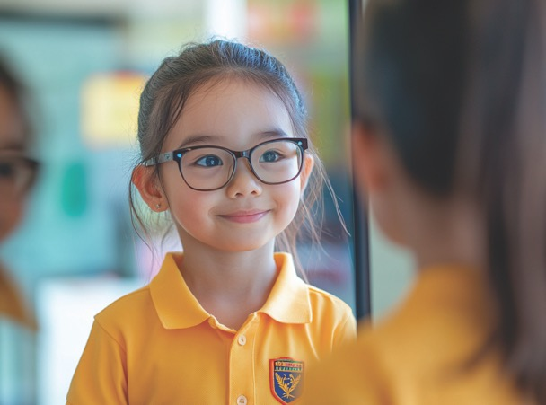
In this lesson, you will learn what confidence is and how it helps you try new things.

Slide 3


You will be successful when you can:
explain what confidence means
show confidence by giving something a go.

Slide 4
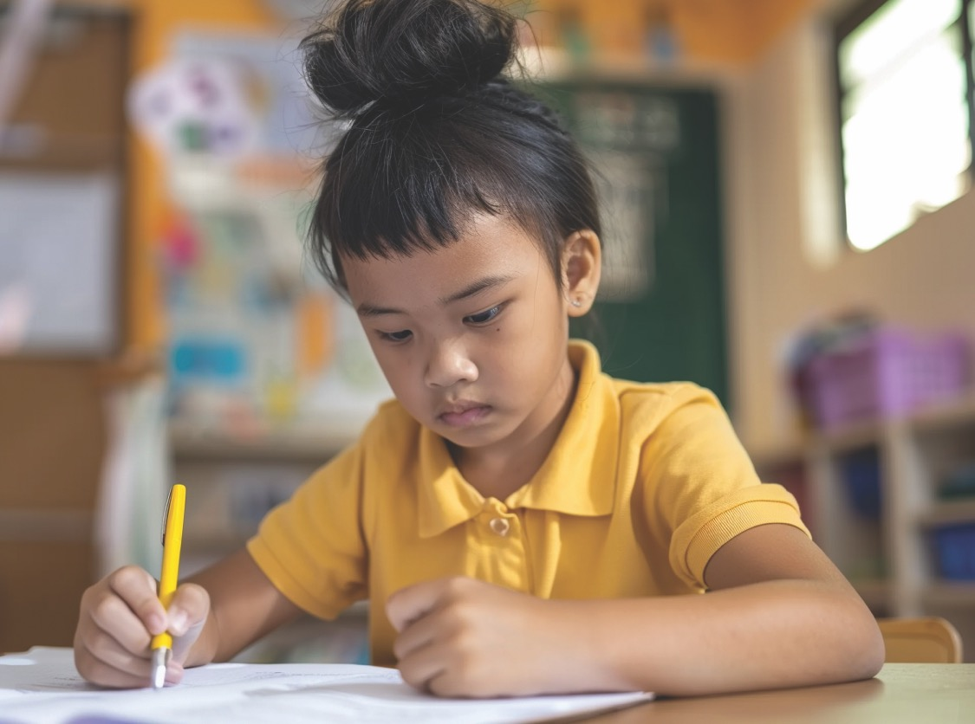
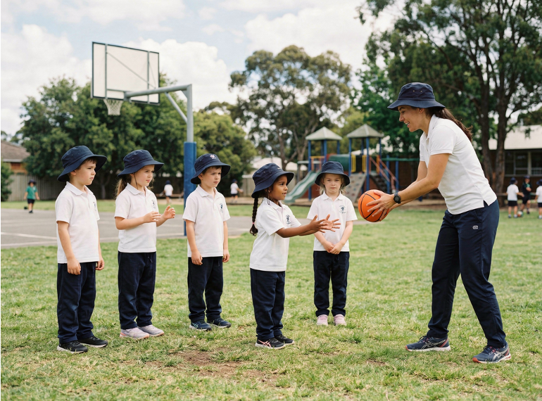


Slide 5

Confidence means believing in yourself and giving something a go, even if it feels a little tricky.

Slide 6
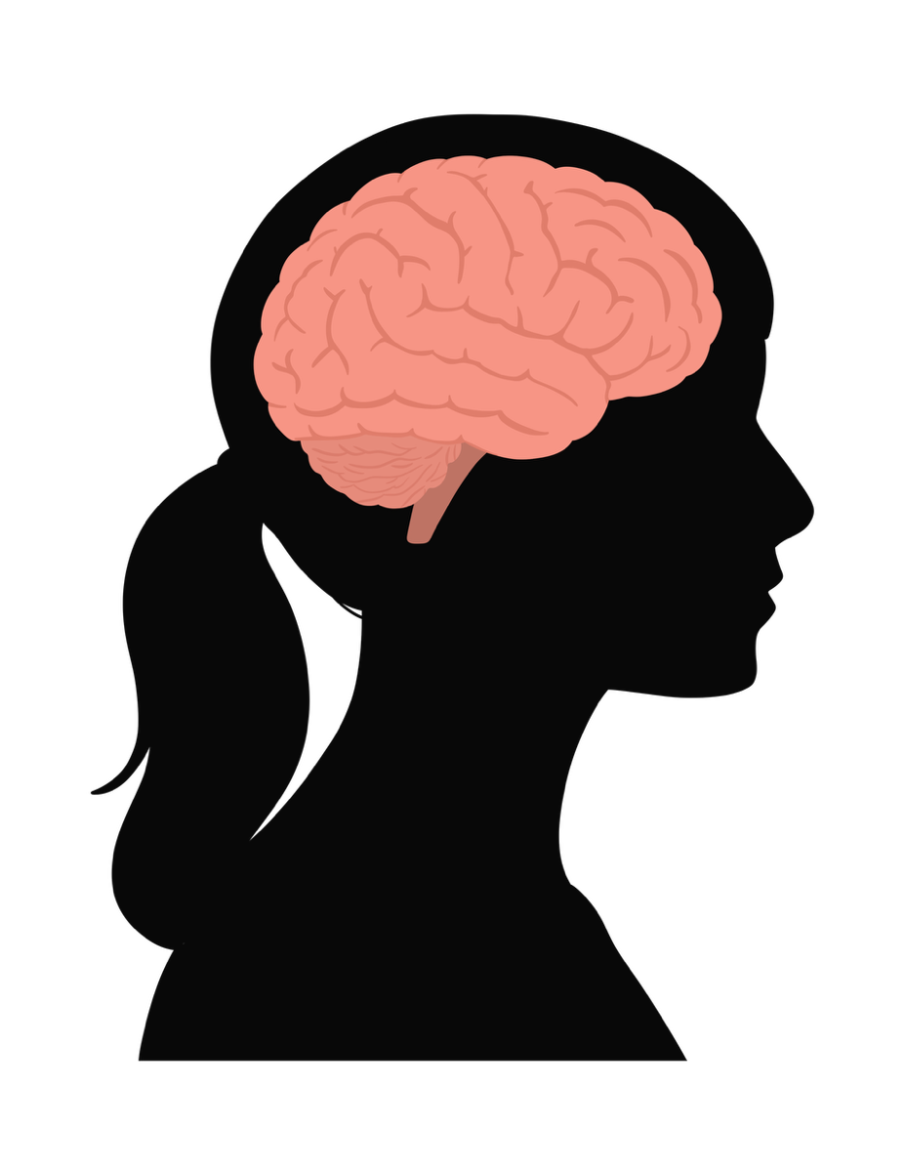
Our Brain

Slide 7
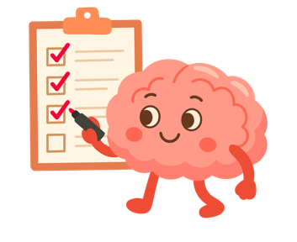
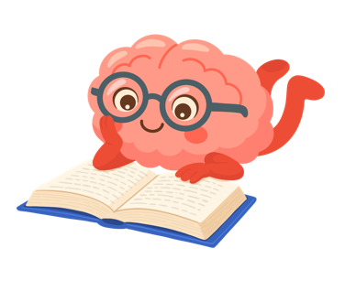
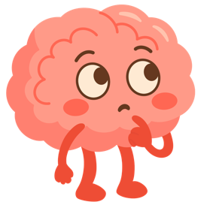

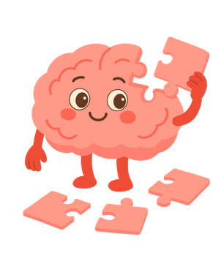
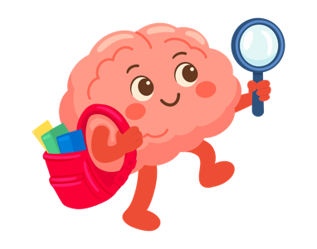
Our Brain

Slide 8
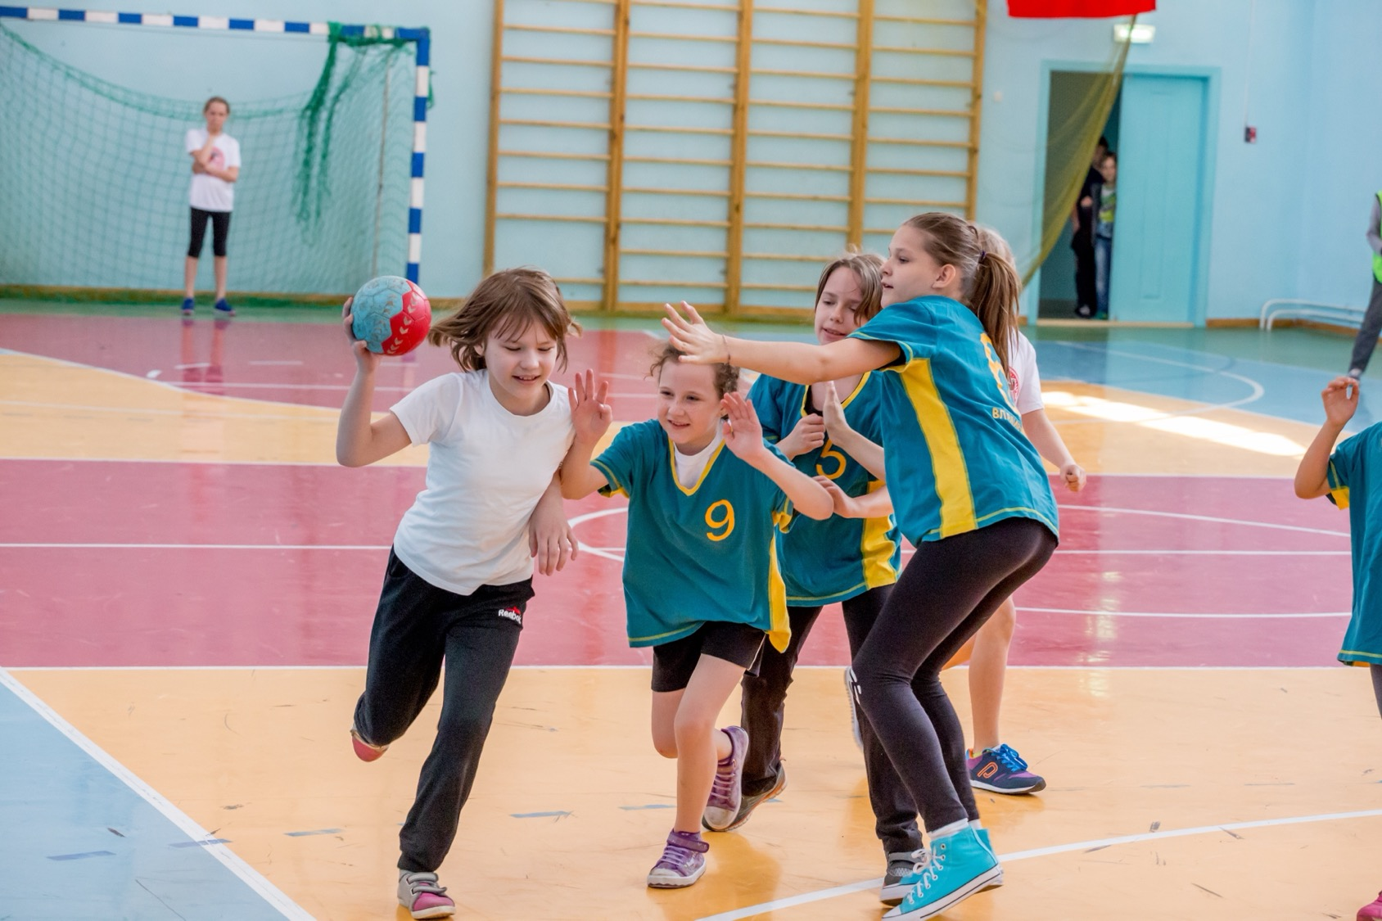
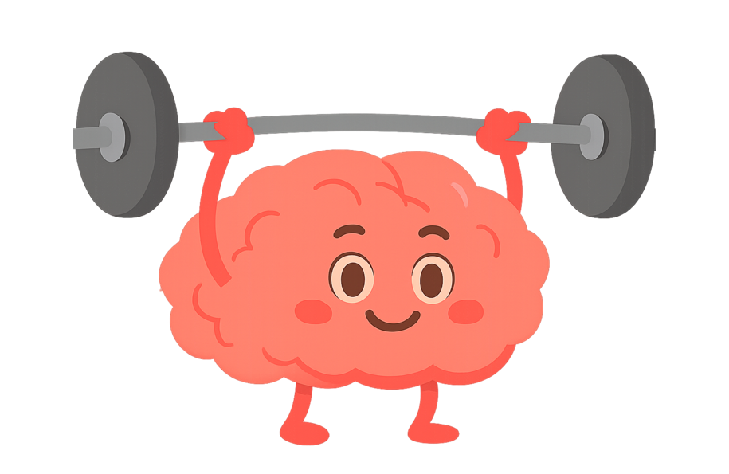
Our Brain

Slide 9


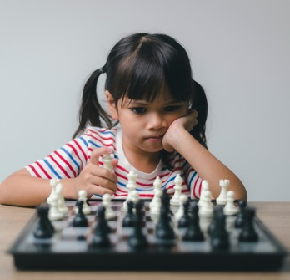

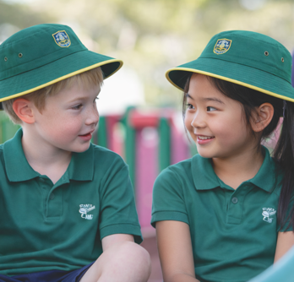
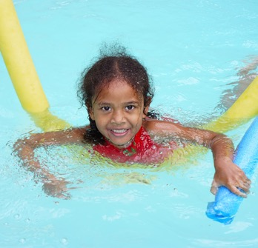
Our Brain

Slide 10
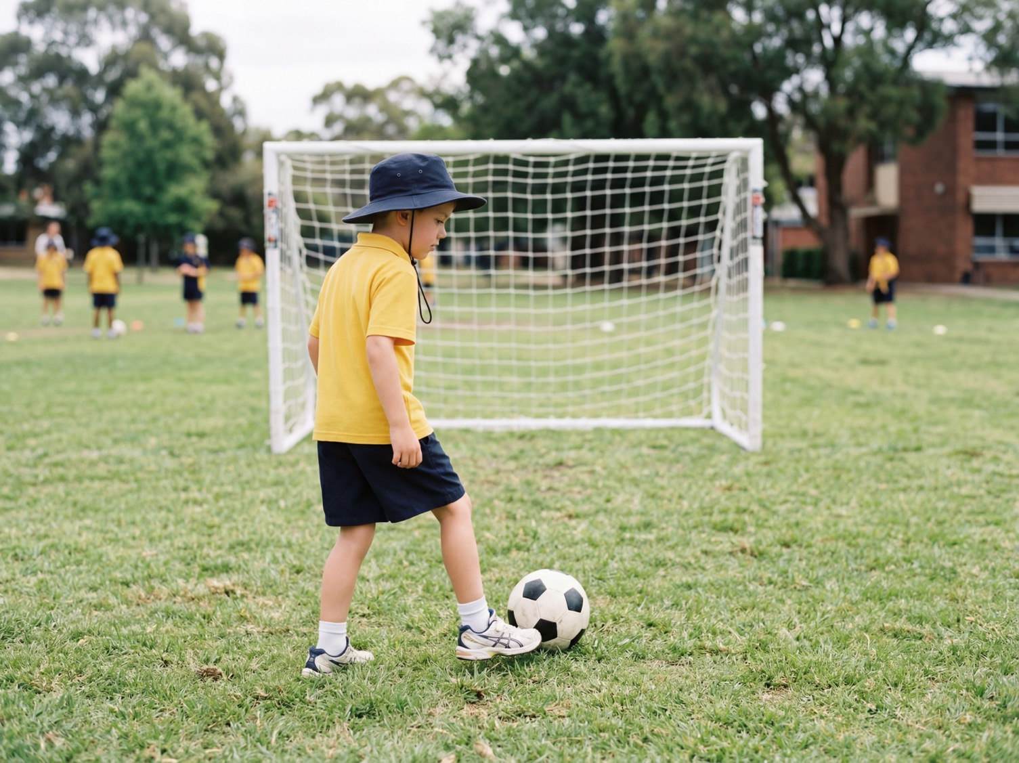
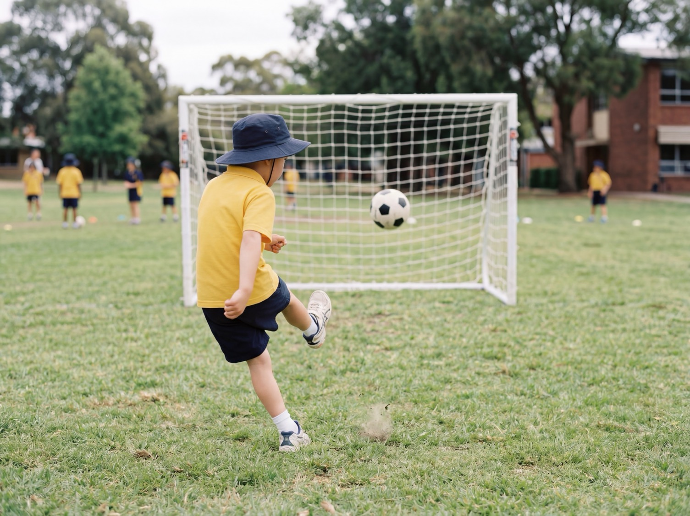
Our Brain

Slide 11


Slide 12

Confidence
What does confidence mean?

Slide 13
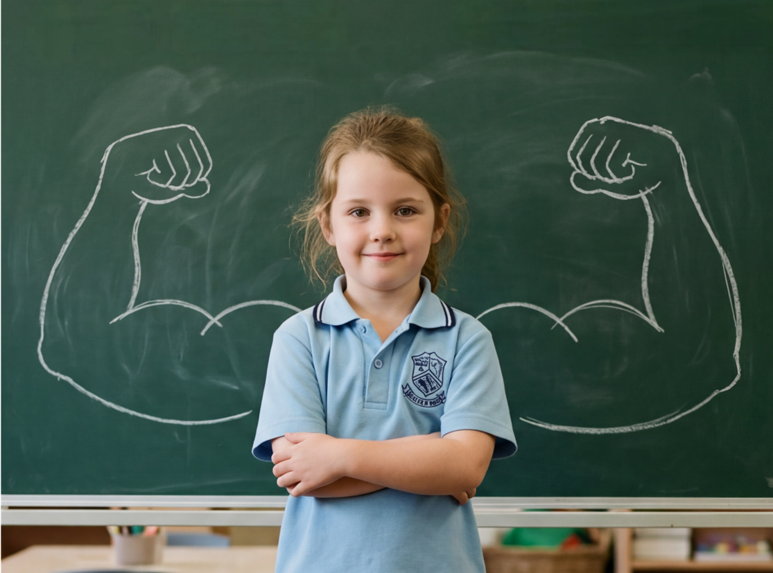
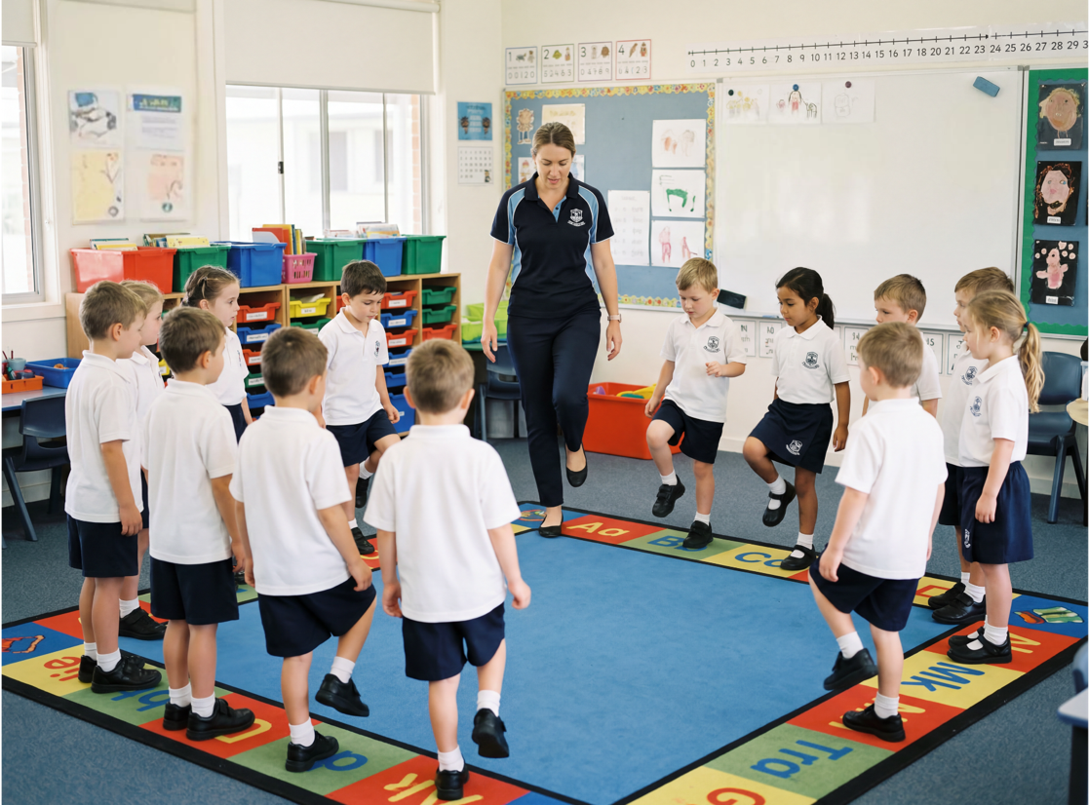
Mini Challenges

Slide 14
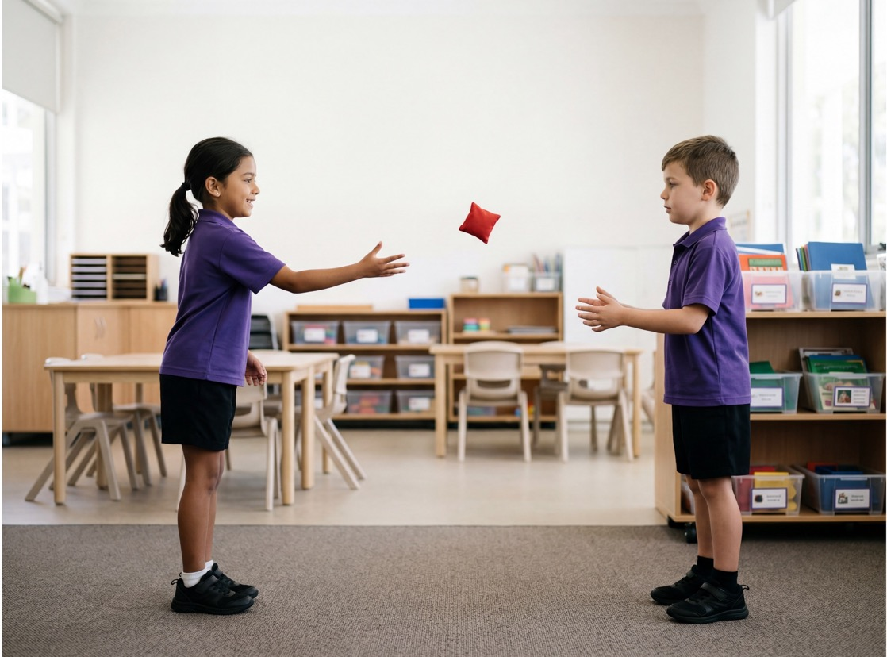
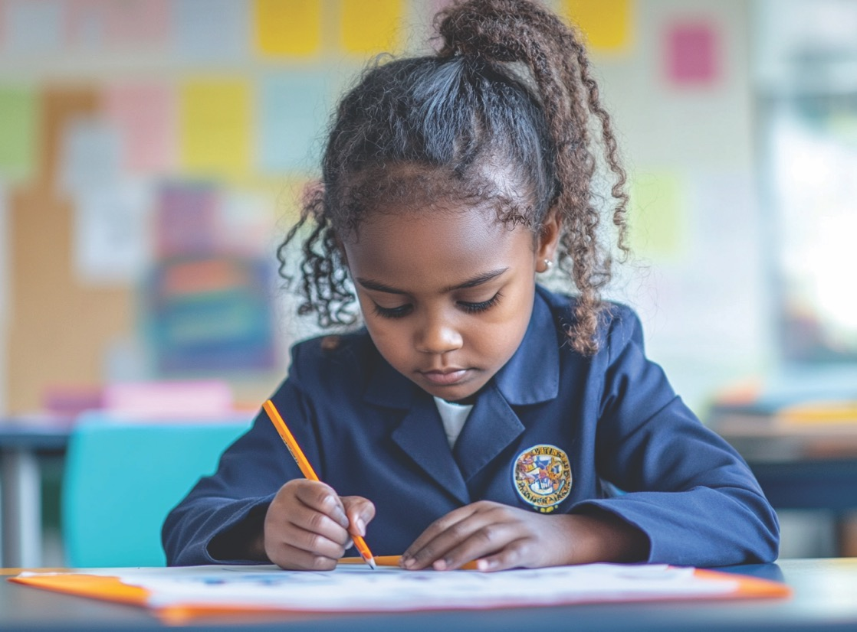
Mini Challenges

Slide 15
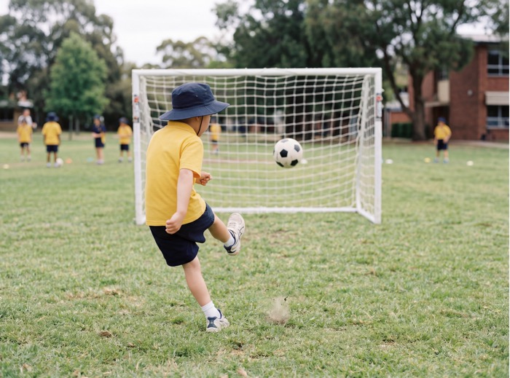
Confidence helps us be brave, keep practising and strengthen our brains.

Slide 16




How well did you:
explain what confidence means
show confidence by giving something a go?

Slide 17
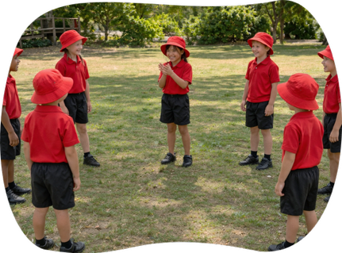
In the next lesson, we will learn that feeling nervous is normal when trying something new, and how to keep going anyway.

