Slide 1
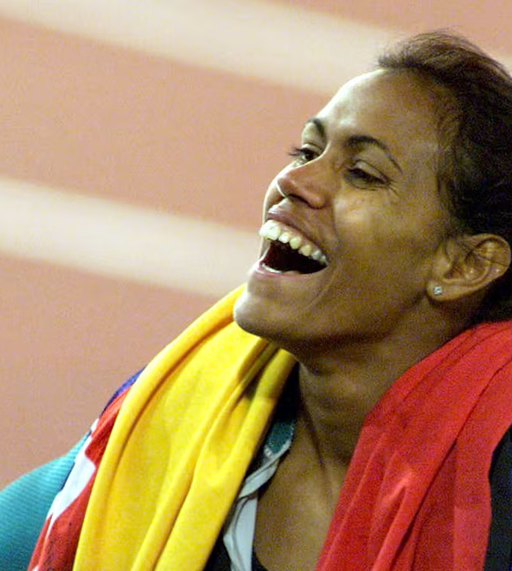
Mantras and Journalling
I’m the world’s greatest athlete.
Unit 2 Big Feelings, Smart Choices
Lesson 3

Slide 2
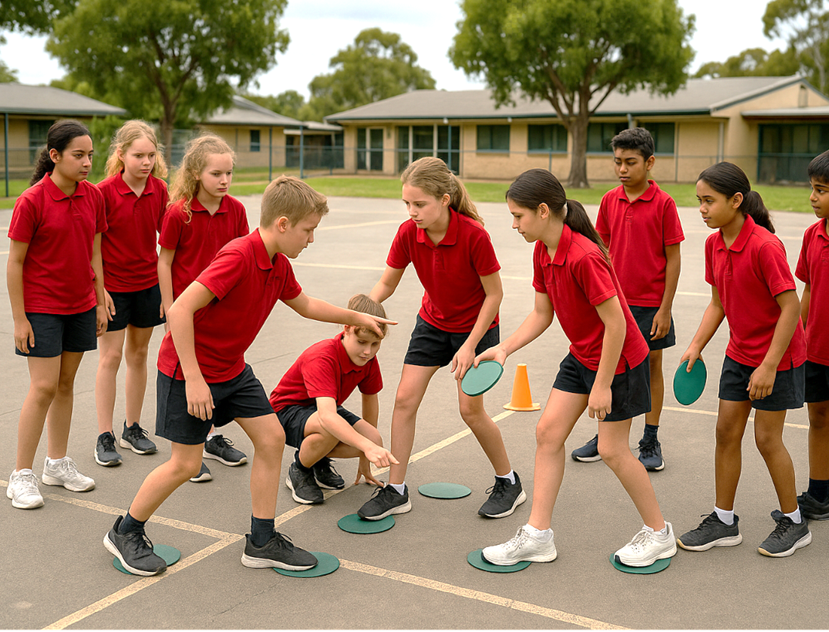
Some problems are outside of our control.

Slide 3
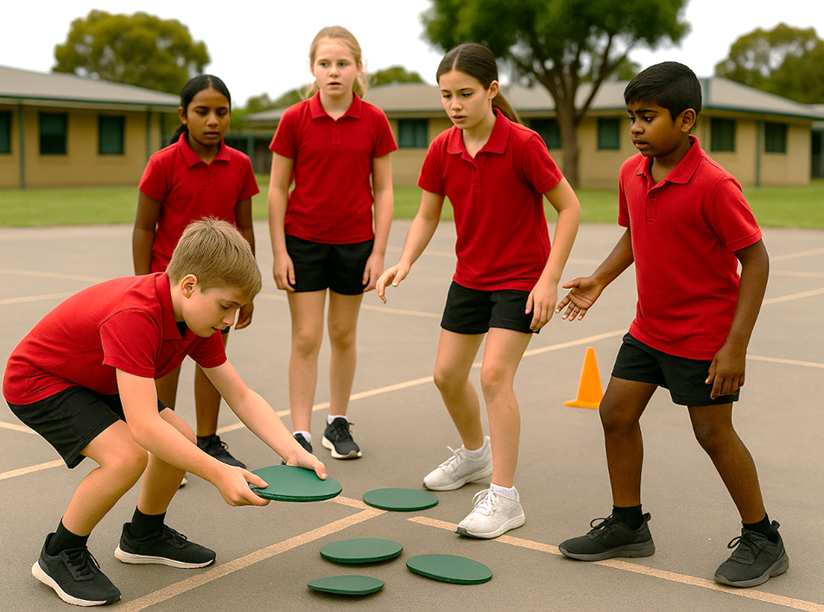
When a problem is outside our control, we cannot change the problem, but we can choose our response.

Slide 4

Imagine it is the day of your class field trip. What might be one problem that comes up that is outside your control?
Pair/share.

Slide 5
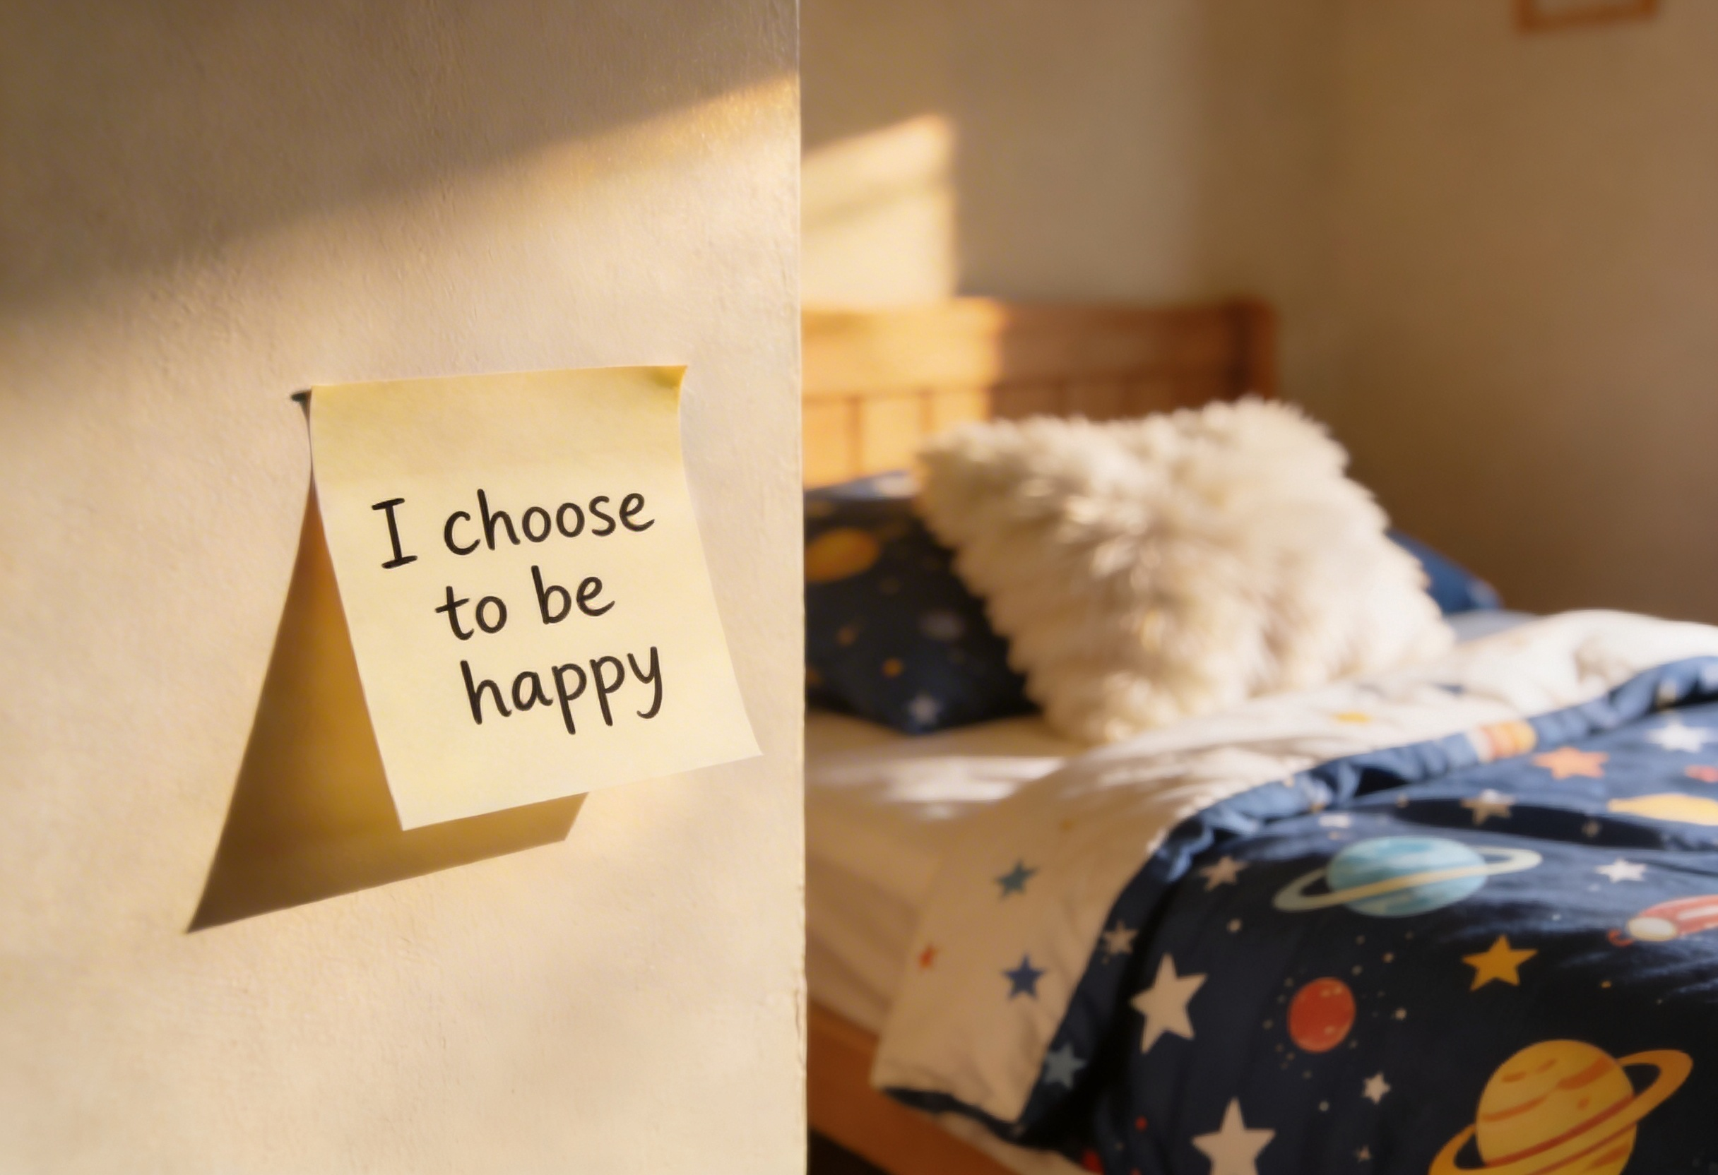
In this lesson, you will learn how mantras and journalling can help you manage difficult emotions.

Slide 6

You will be successful when you can:
write or say a personal mantra that helps you feel strong
use journalling to reflect on how you can overcome difficulties.

Slide 7
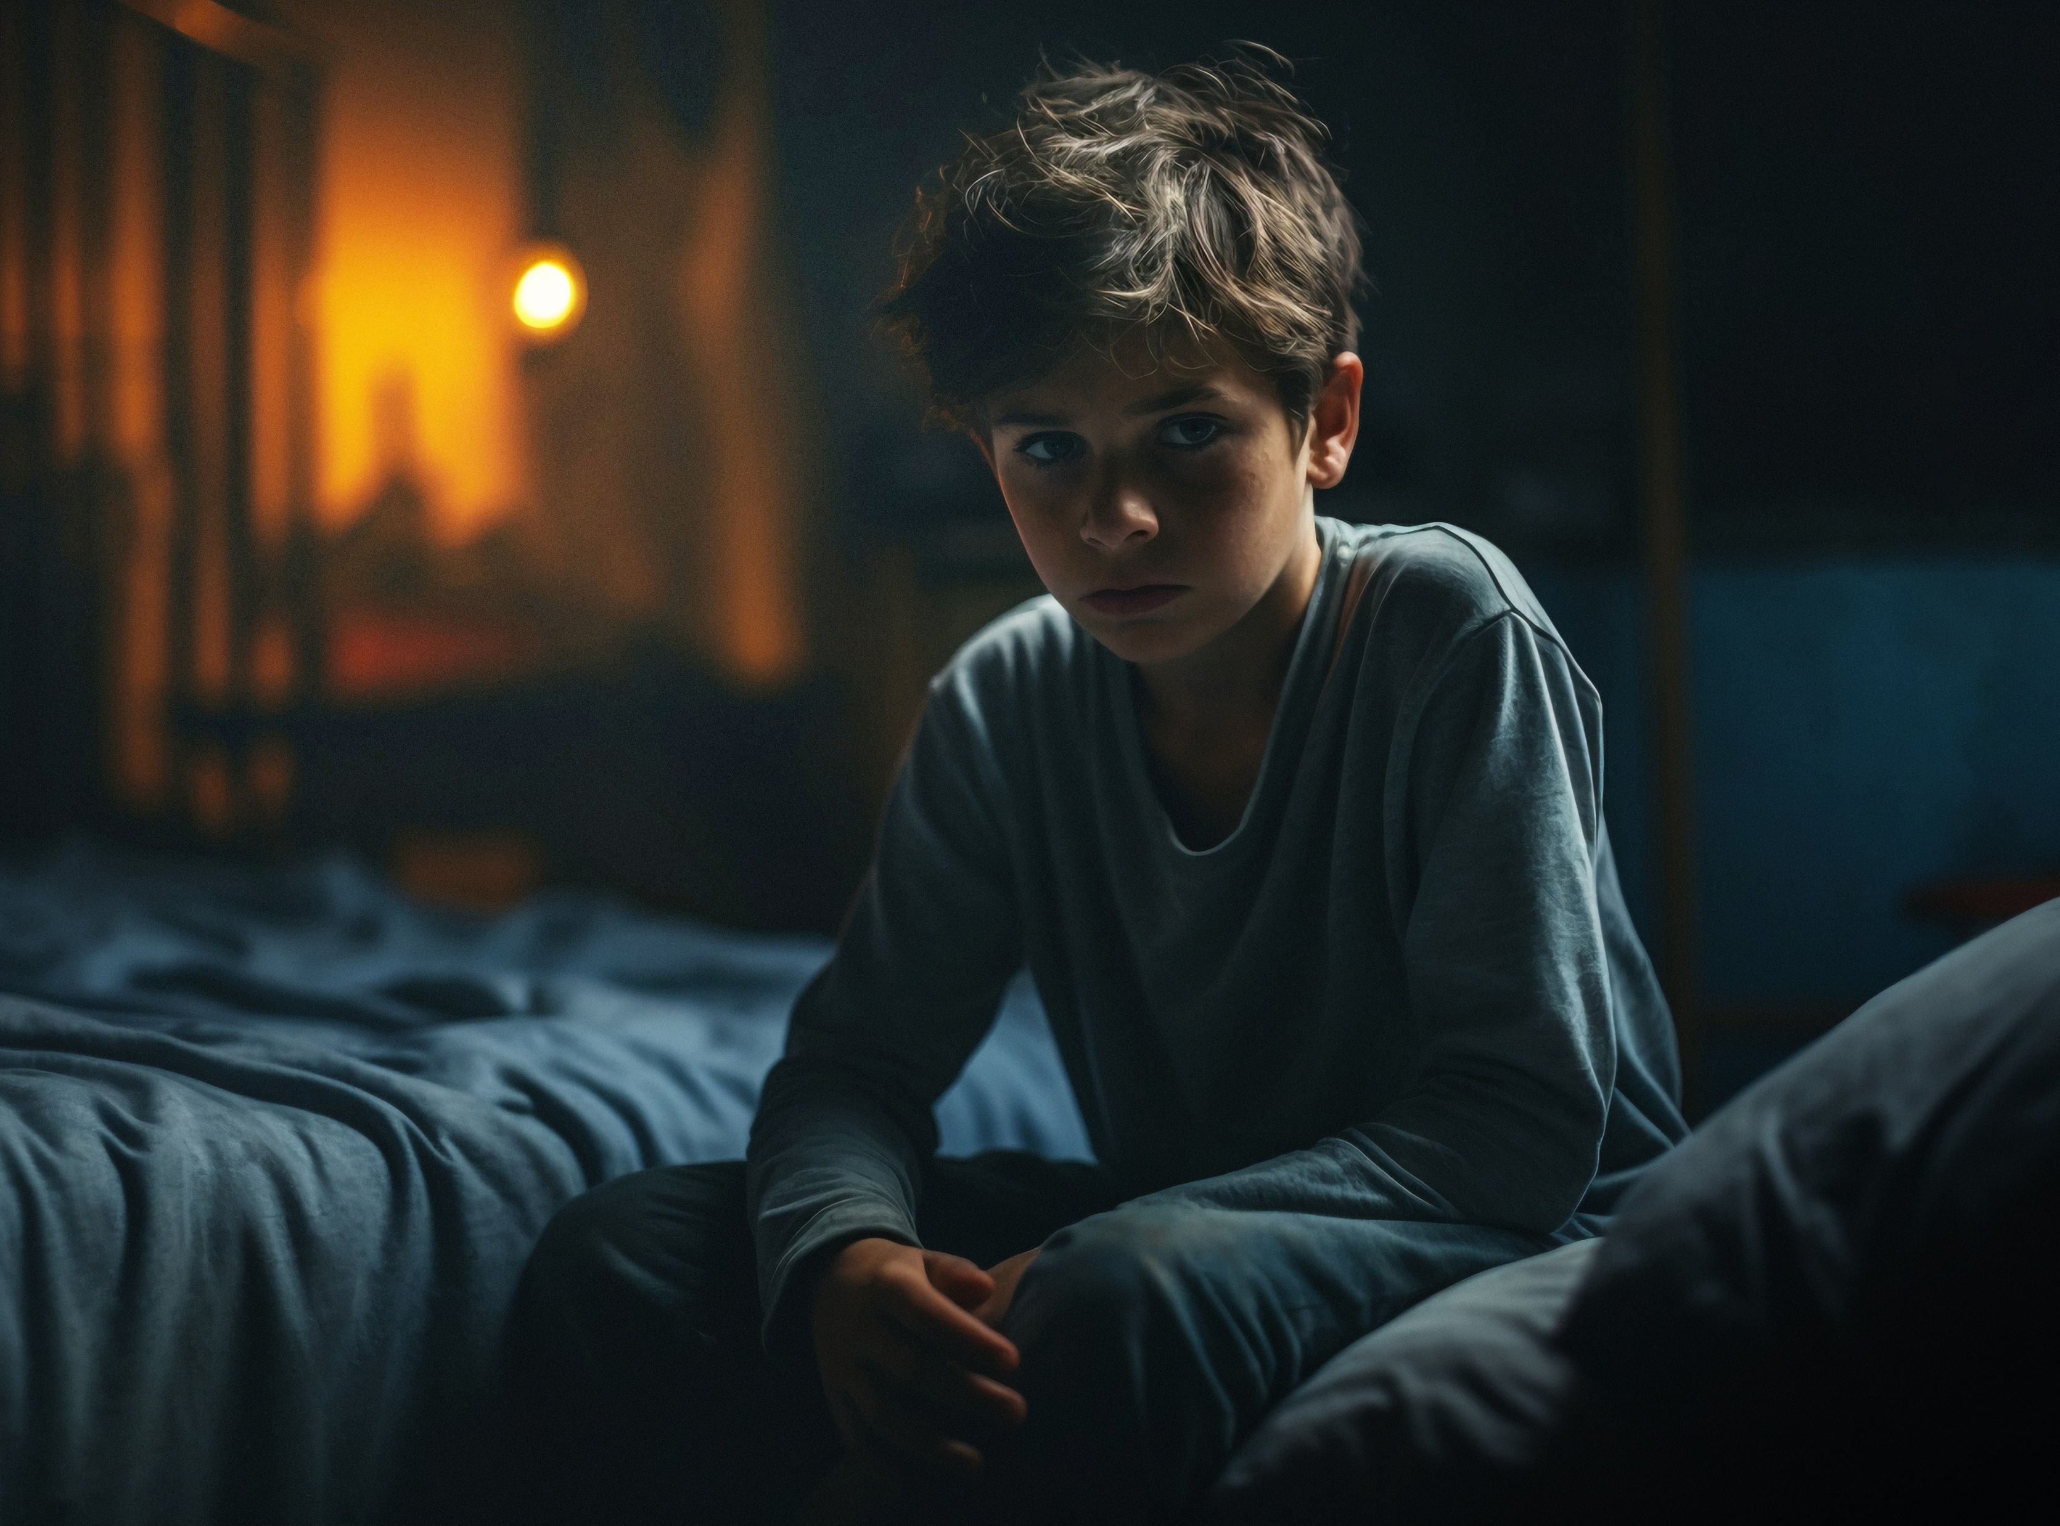
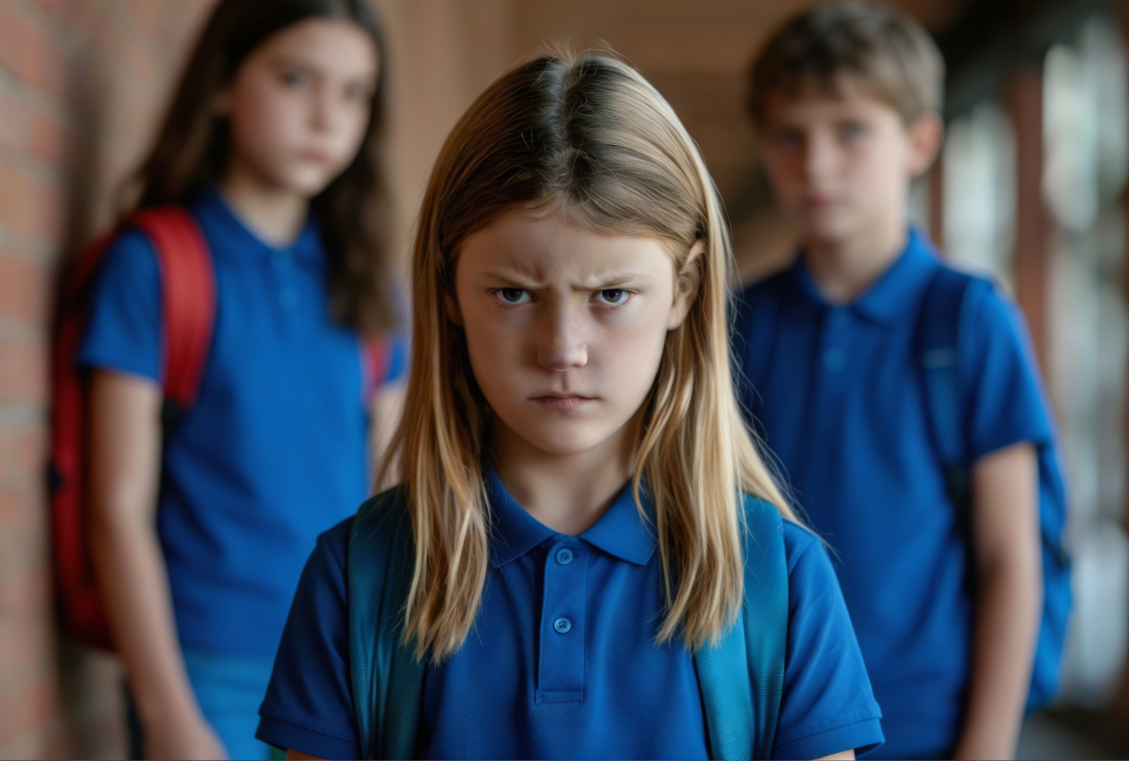


Slide 8
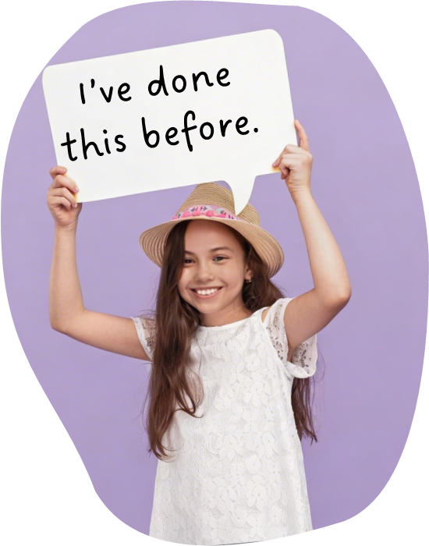
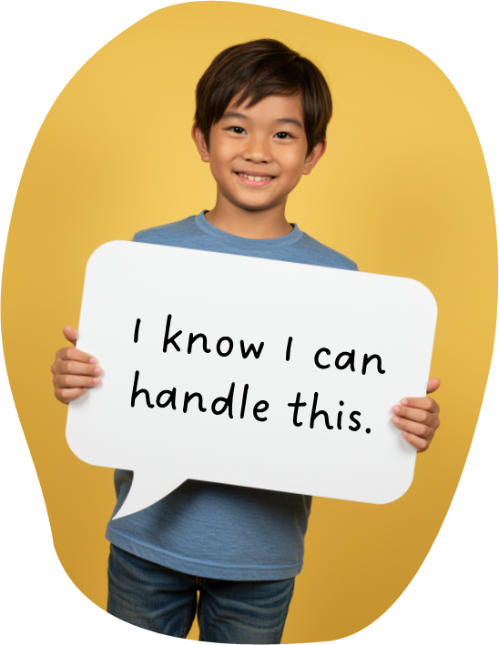


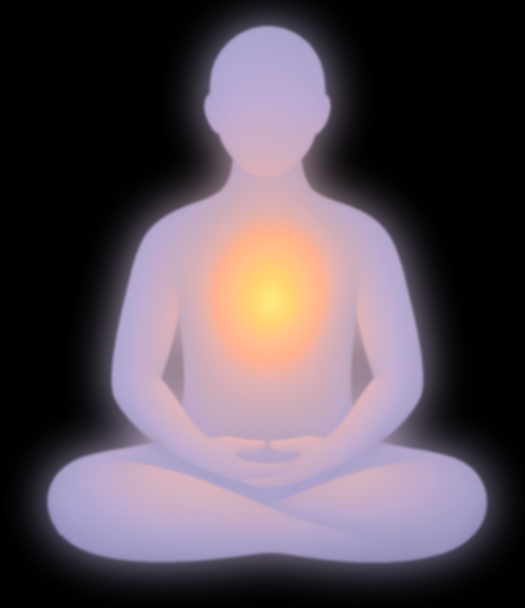
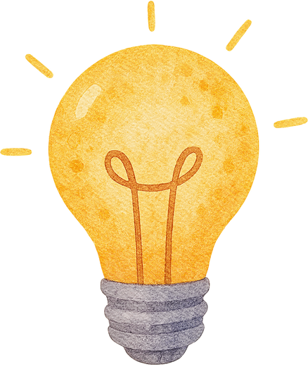
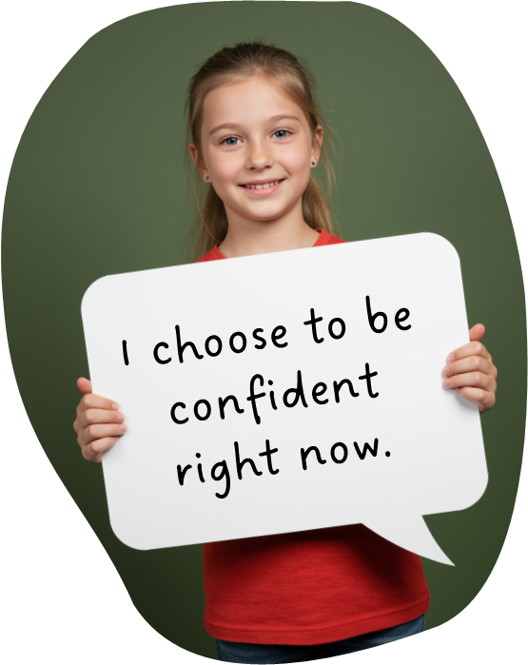
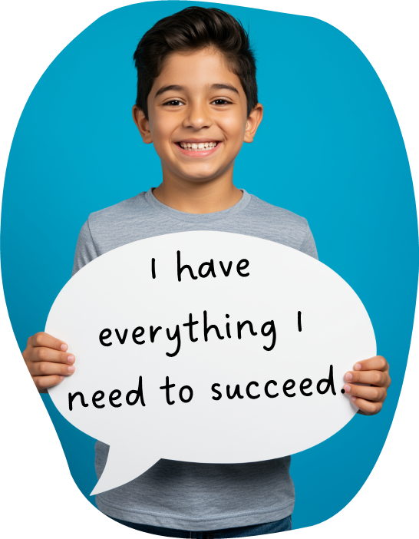
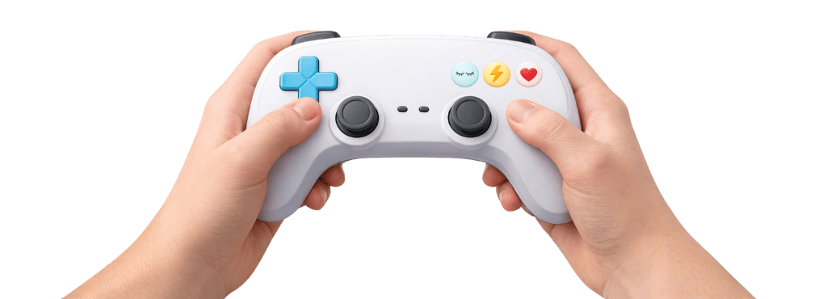

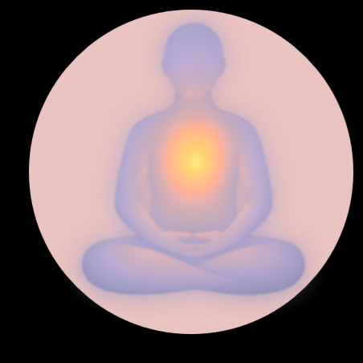

Positive Self-Talk
Pause
Calm
Think

Slide 9
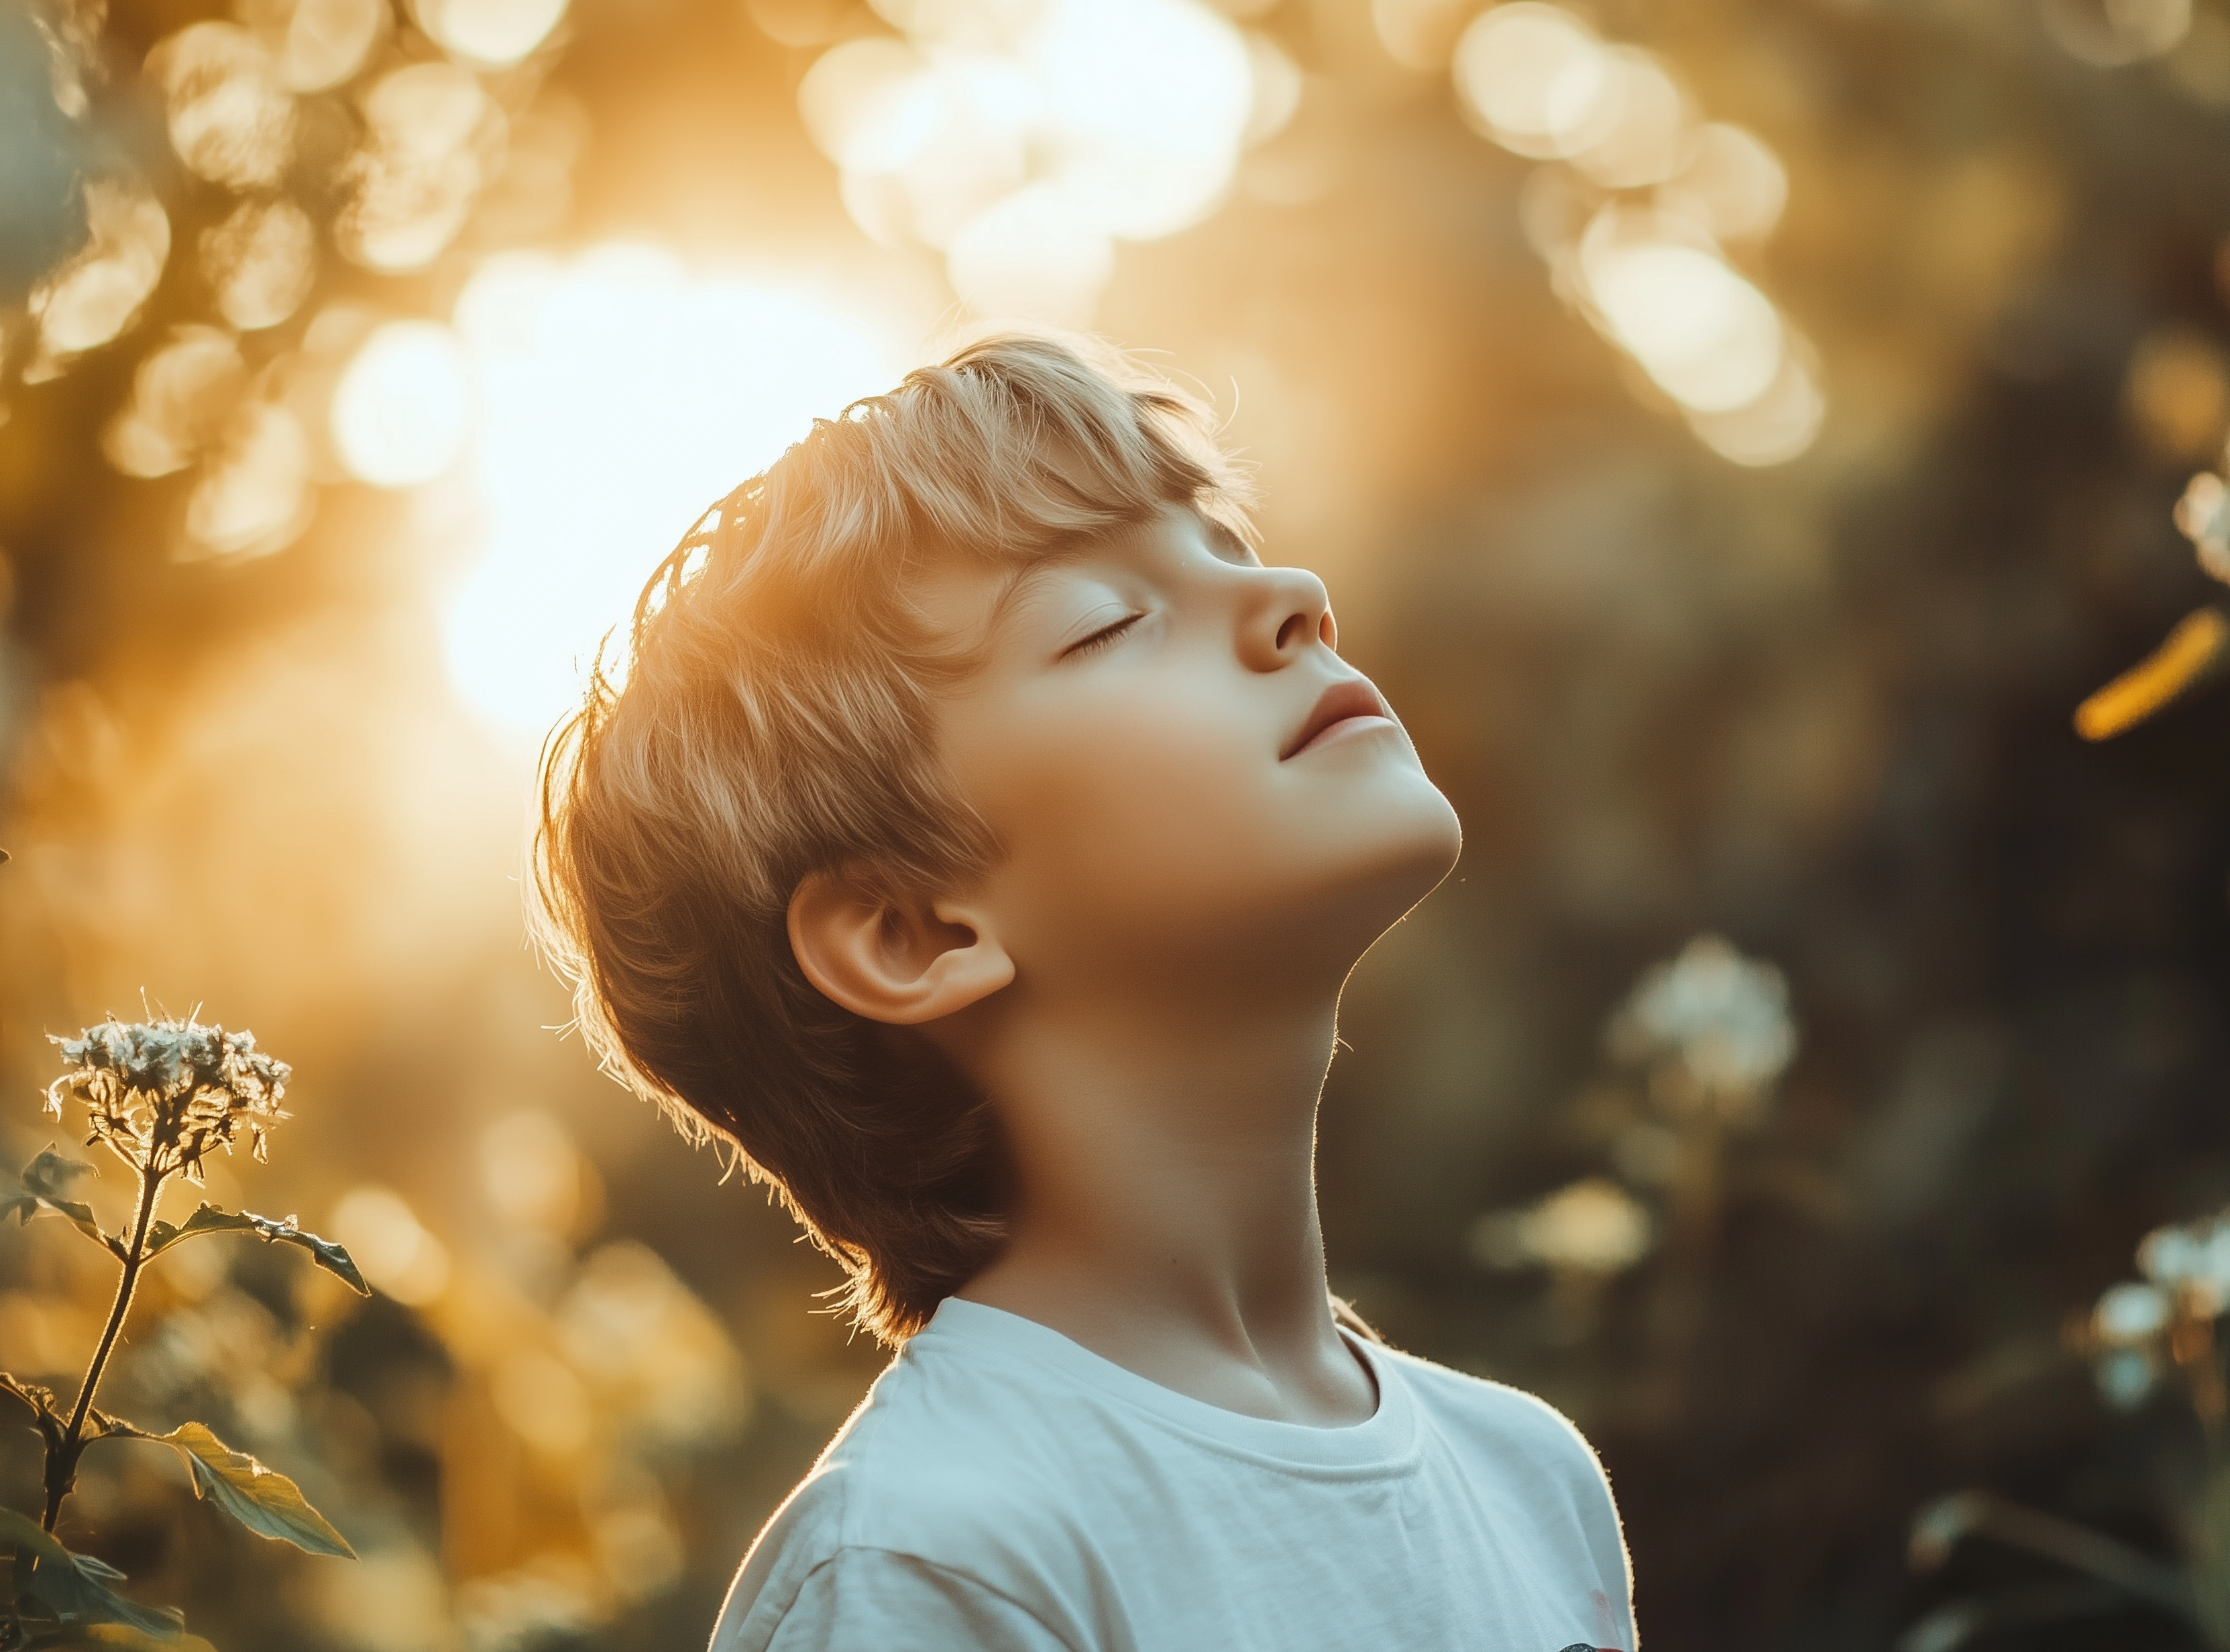
Mantra: a Tool For the Mind
A mantra is a short statement you repeat regularly to help your mind feel calm and peaceful, clear and strong.
Man
Tra
Mind
Tool
A Tool For The Mind

Slide 10
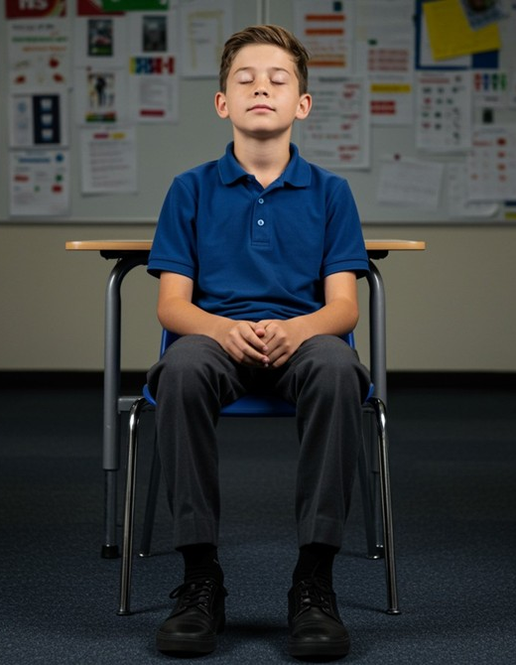
Sound, Rhythm, Identity

Slide 11

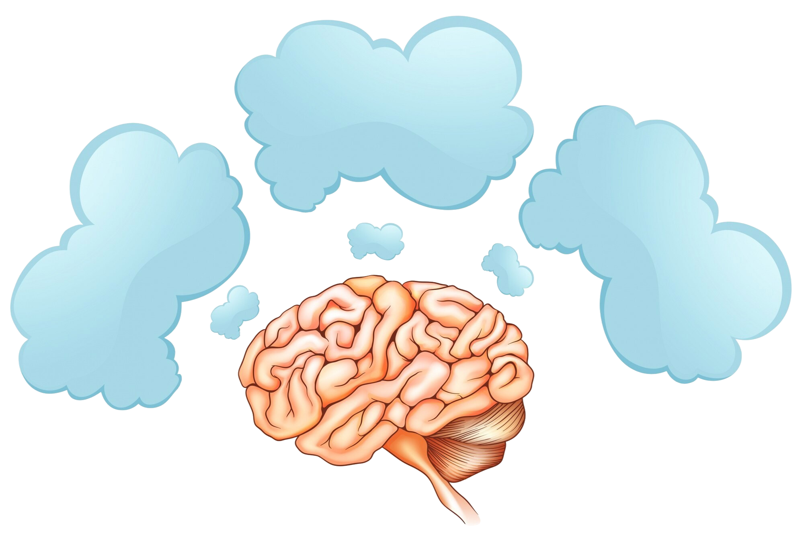

How People Use Mantras
Focus Tool
I choose to be happy and successful today.
I am filled with confidence to make good choices.
Calm Rhythm
Mental Anchor

Slide 12
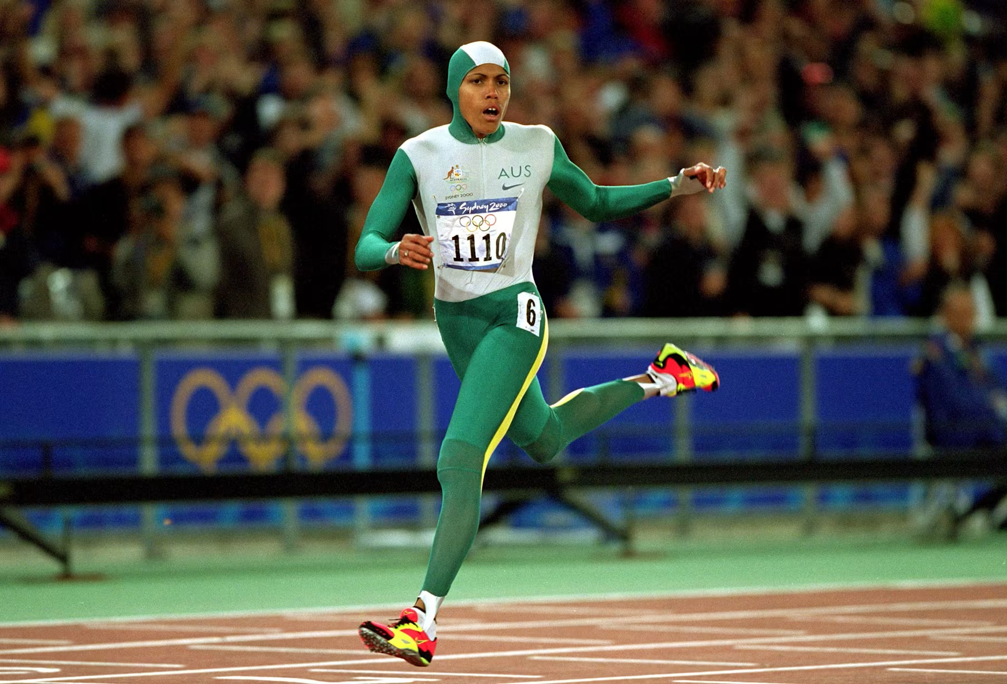

Performance and Confidence
I’m the world’s greatest athlete.

Slide 13

Mantras
A mantra is a short statement repeated regularly in a chant to:
help you sing.
help your mind feel calm and peaceful, clear and strong.
help you learn new words.

Slide 14

Making My Own Mantra
1. Choose words that match who you want to become.
2. Easy to remember and repeat.
3. Use positive words.
4. Write in the present tense.
5. Make it realistic and believable.
6. Give it rhythm.

Slide 15
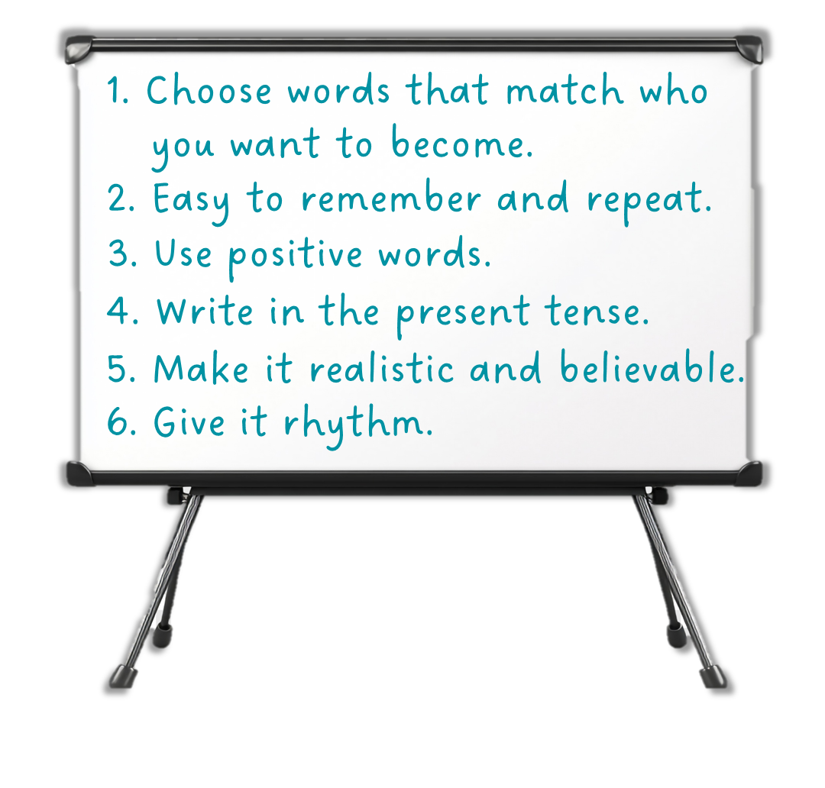
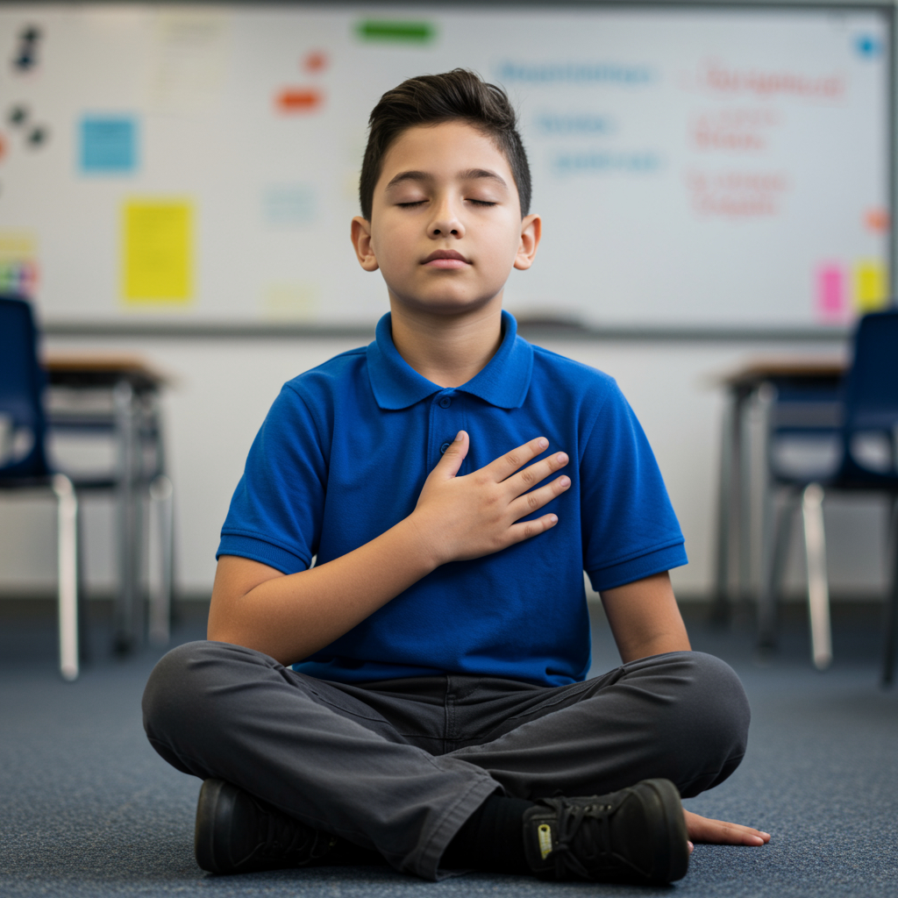
Making My Own Mantra
Calm mind.
Kind heart.

Slide 16


Making Your Own Mantra
I am
thankful and
positive.
Calm
Peaceful
Relaxed
Confident
Brave
Determined
Dedicated
Smart
Capable
Positive
Honest
Kind
Caring
Patient
Helpful
Thankful
Cheerful
Happy
Capable
In control
Thankful thoughts.
Positive
beliefs.
I choose to be thankful and positive.
Thankful.
Positive.

Slide 17

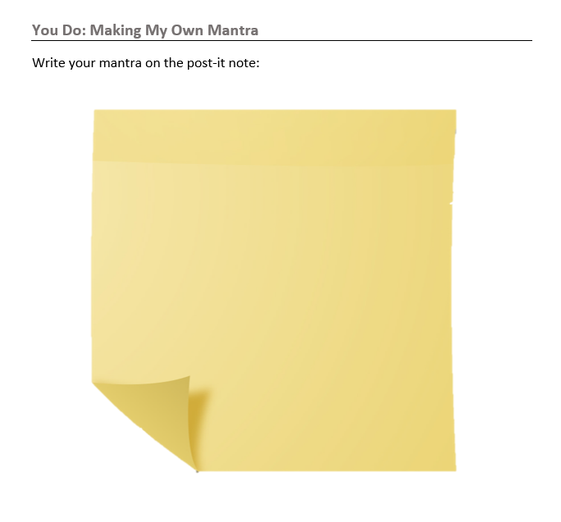
Making Your Own Mantra

Slide 18
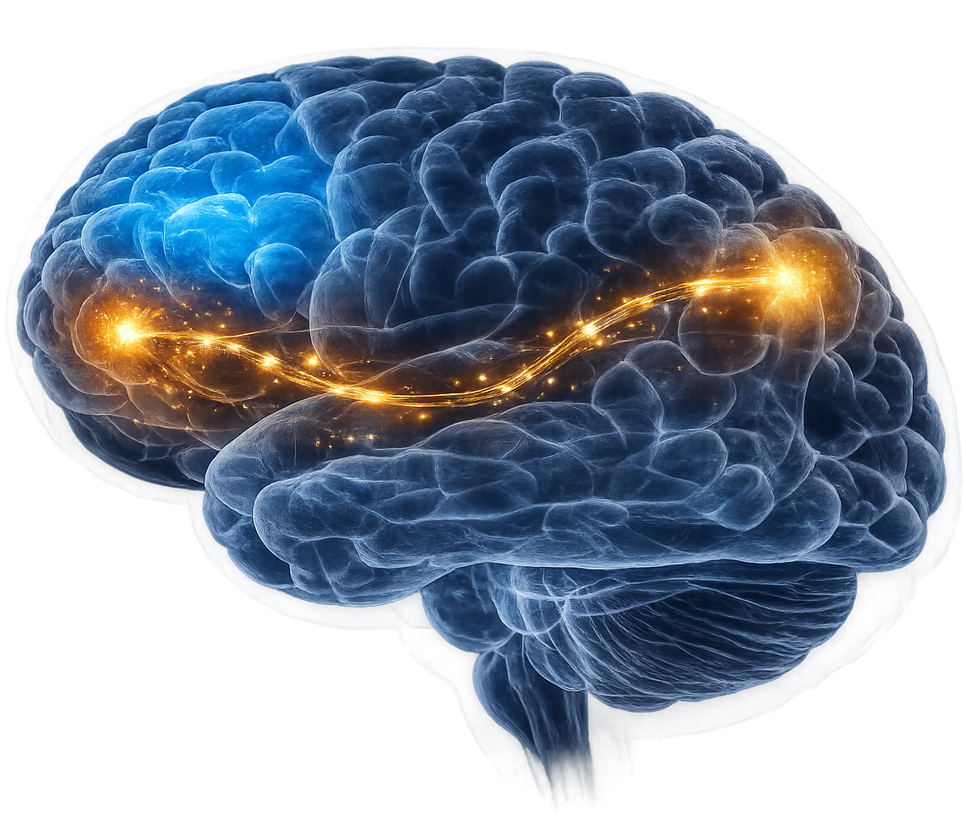
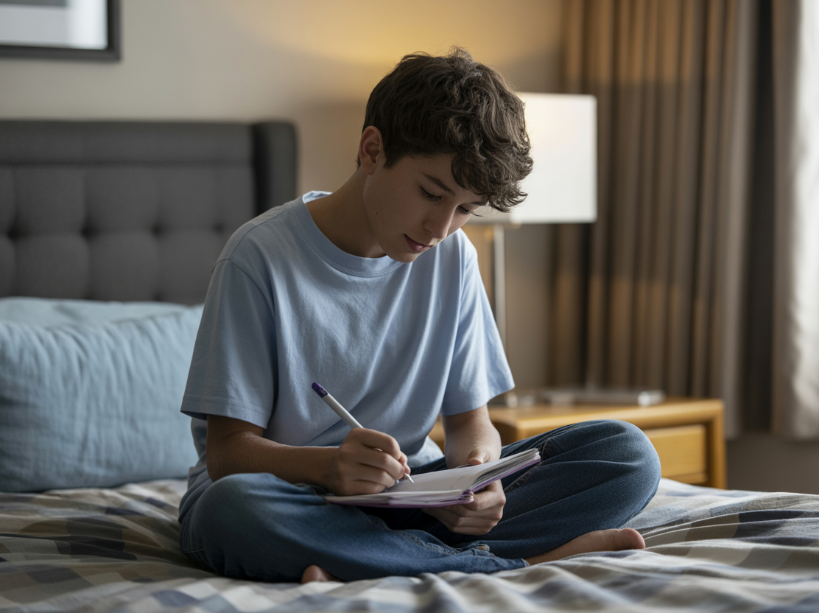
Journalling is a way to note down your thoughts, feelings and experiences and reflecting on these.

Slide 19

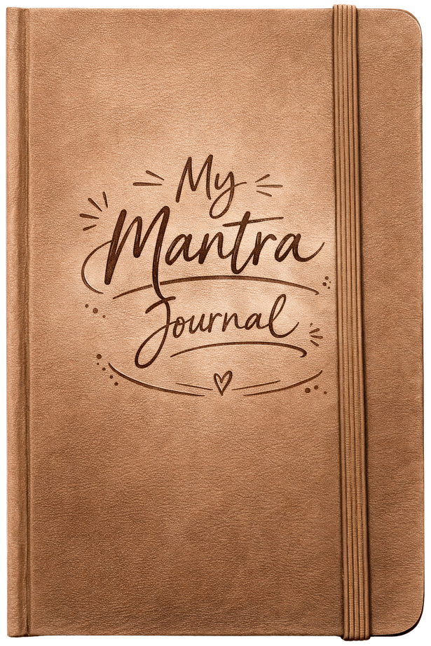
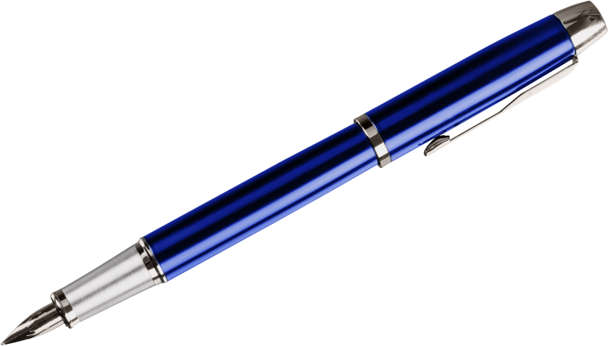

Slide 20






When I will use my mantra:
Calm Mind.
Calm Heart.
I will chant my mantra every morning as I’m brushing my hair in the mirror and when I’m leaving my bedroom.
Why I chose these words:
I know I feel better when my mind is calm and I achieve more. I also want to be kinder to others and myself.
How my mantra will help me:
When I have a tricky situation, I want to stay calm and speak kind words to others around me.

Slide 21
When I will use my mantra:
Why I chose these words:
How my mantra will help me:

Slide 22
A mantra is a short statement repeated regularly in a chant to help your brain connect with the words.
A mantra literally means ‘a tool for the mind’ because it helps the mind become calm and peaceful, clear and strong.
Many people use daily mantras as a focus for the day, to set a positive mindset, and encourage confidence for the day.
Journalling is a way to note down your thoughts, feelings and experiences and reflect on these.

Slide 23
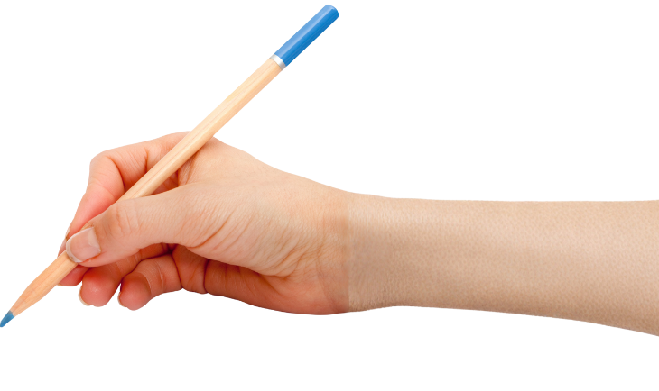


How well did you:
write or say a personal mantra that helps you feel strong
use journalling to reflect on how you can overcome difficulties?

Slide 24
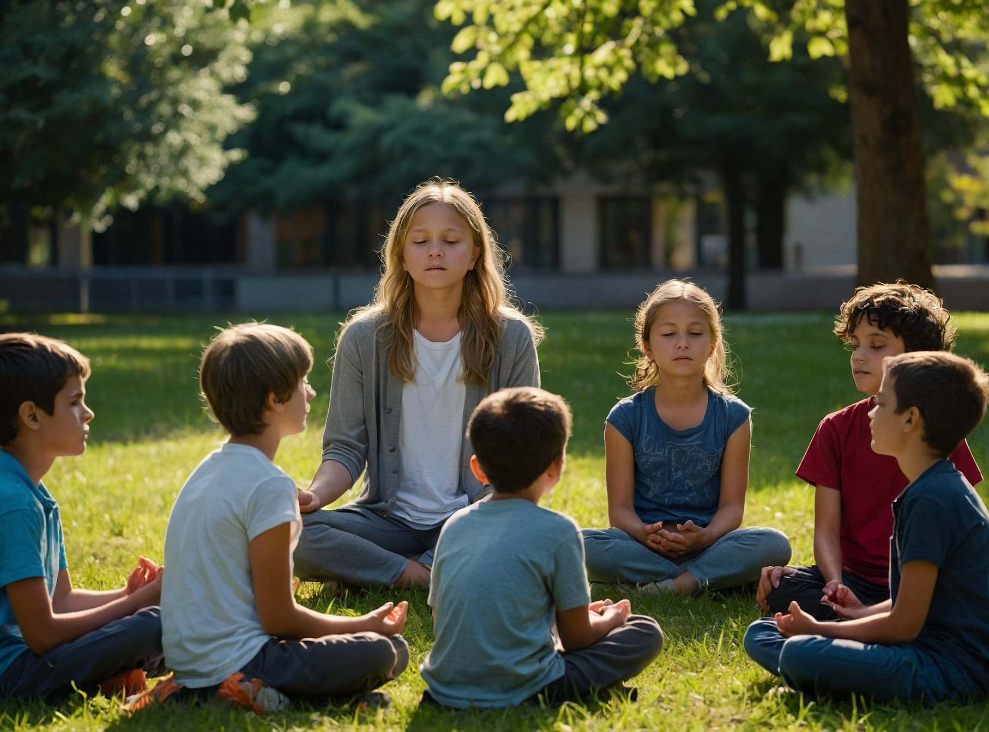
In the next lesson, we will use guided meditation to help your mind and body reset.

