Slide 1
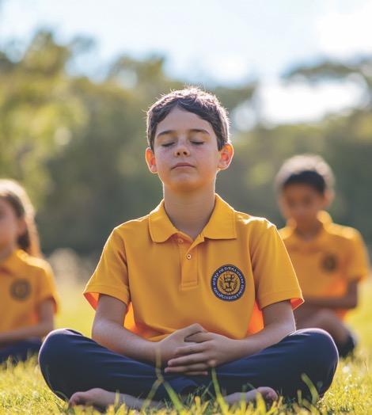
Visualising Calm
Unit 2 Big Feelings, Smart Choices
Lesson 2

Slide 2
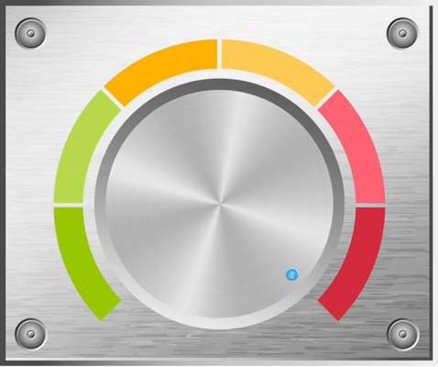
Our body has a sort of volume button like the volume button on a tablet or TV remote.

Slide 3


The volume goes up and down, louder and quieter, depending on what’s happening around us and what we feel inside.

Slide 4
Two people can be in the same place, at the same time, experiencing the same situation and still feel very different inside. Their volumes will be different.
agree
disagree

Slide 5

In this lesson, you will learn how to use visualisation to feel calm and ready before you act.

Slide 6


You will be successful when you can:
picture a calm place or memory in your mind
identify how visualisation can help your brain.

Slide 7

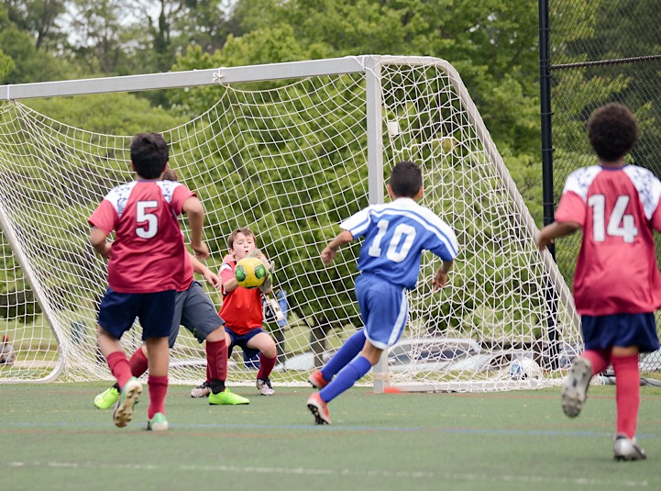
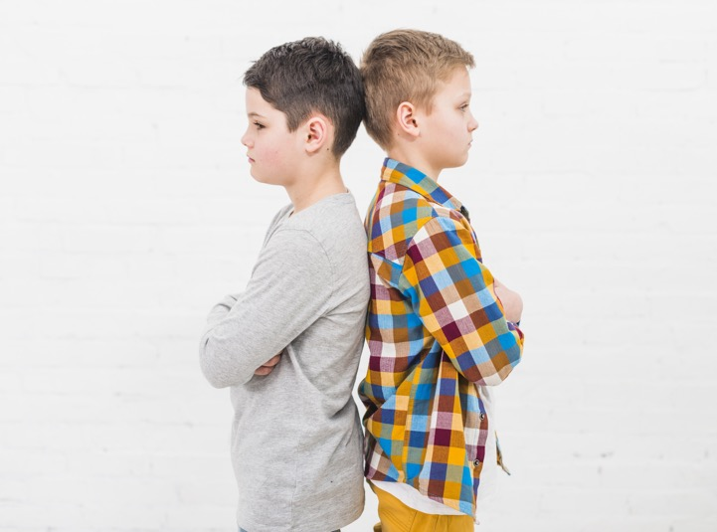
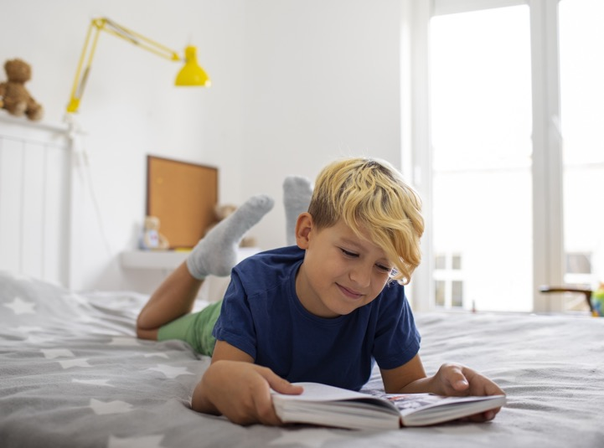

Slide 8
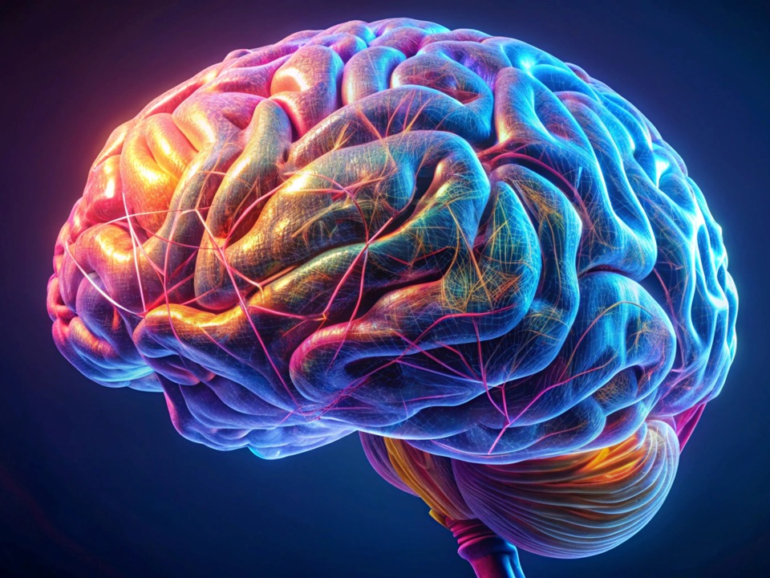

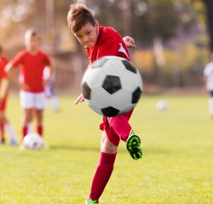

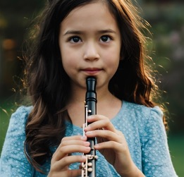



My Brain

Slide 9
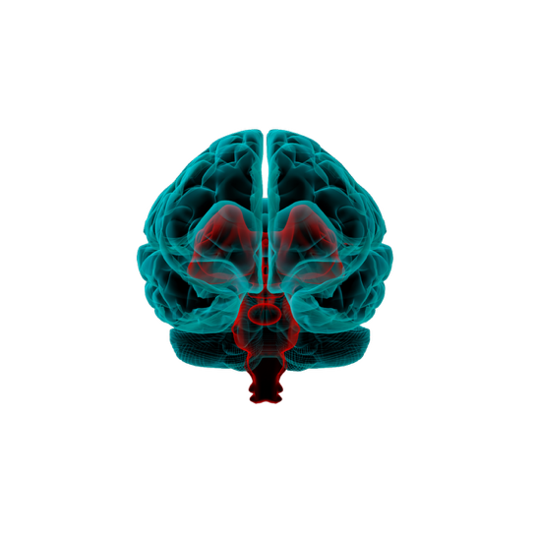

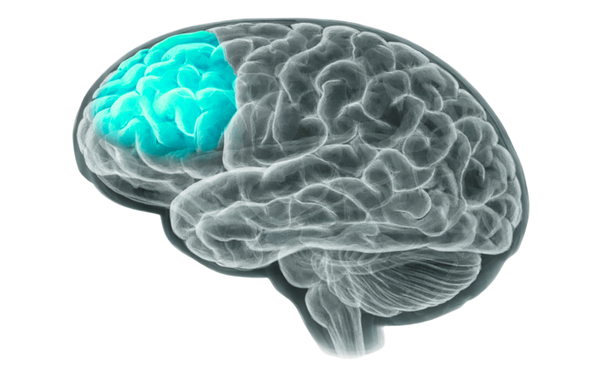
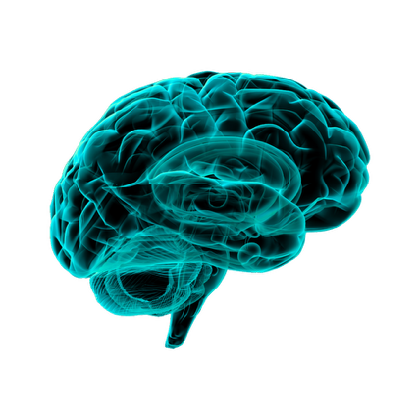
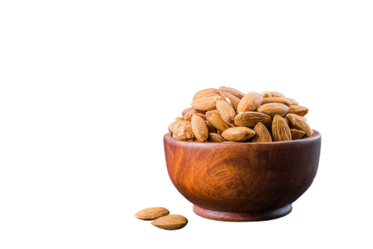
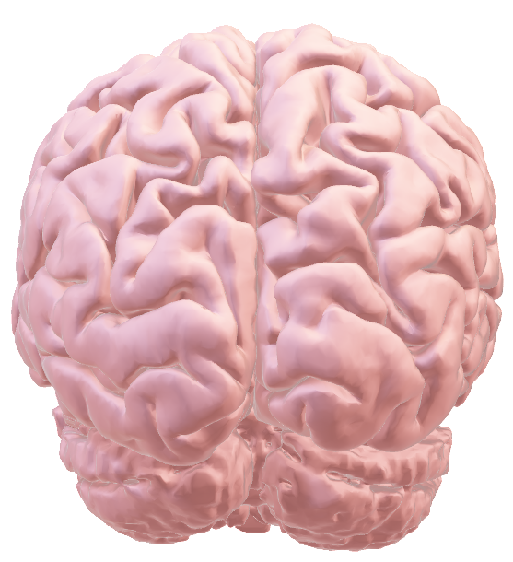
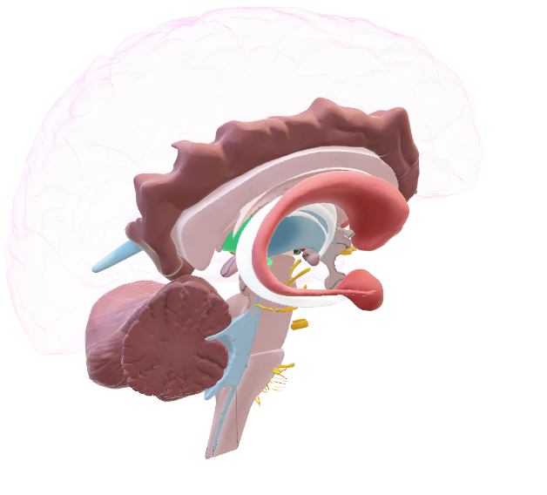

Small But Important

Slide 10
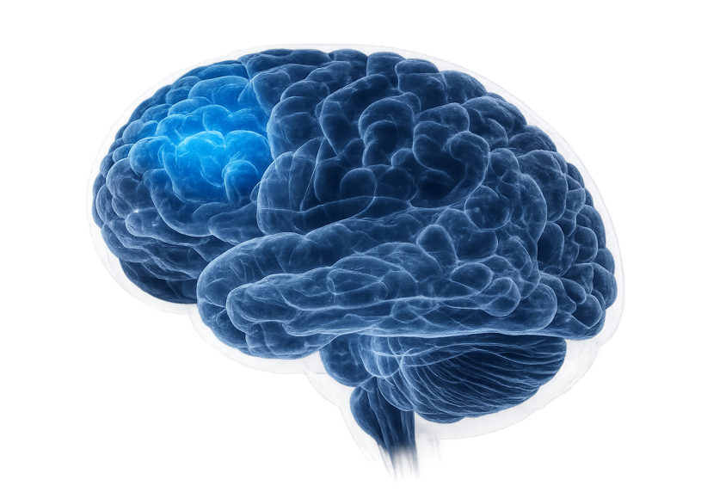
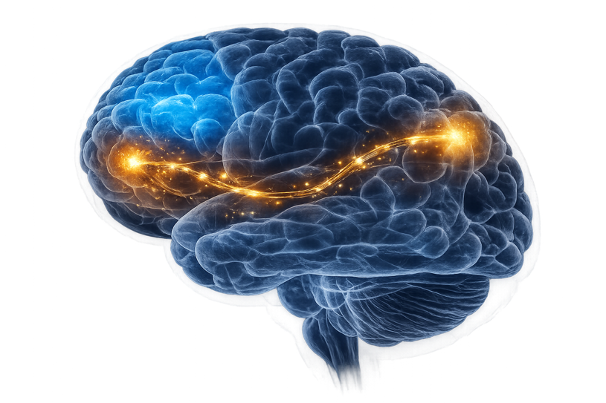
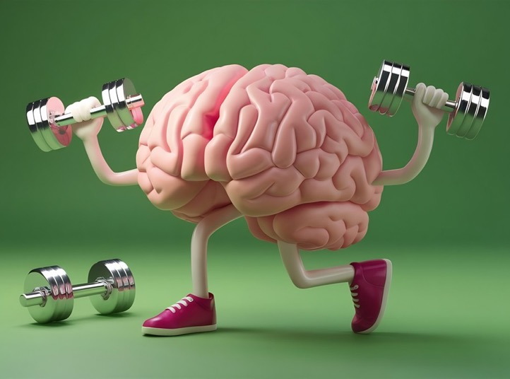
Train Your Brain

Slide 11
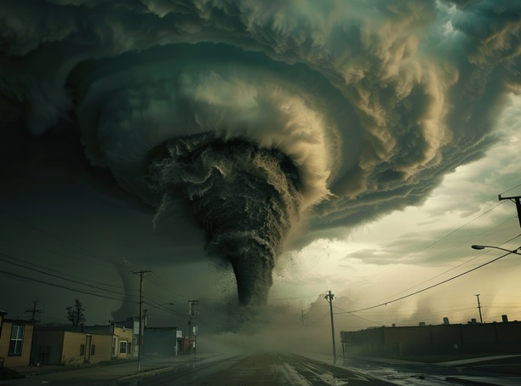
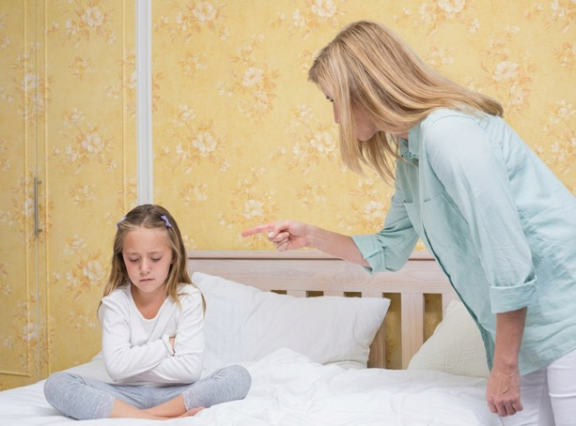
Small But Important
Sometimes, our feelings can be really loud, like a violent storm.

Slide 12
Train Your Brain
We can train our brain to ___________________.
1
lower the volume of our loud feelings
2
be confused by what we are doing
3
forget what we have done

Slide 13

Visualisation
Visualisation is when you use your imagination to make pictures in your brain to help you feel calm, relaxed and happy so you can gain control of your feelings.

Slide 14
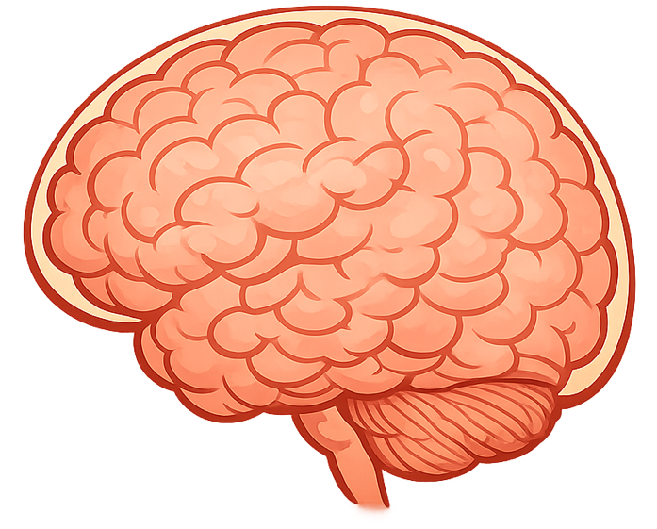
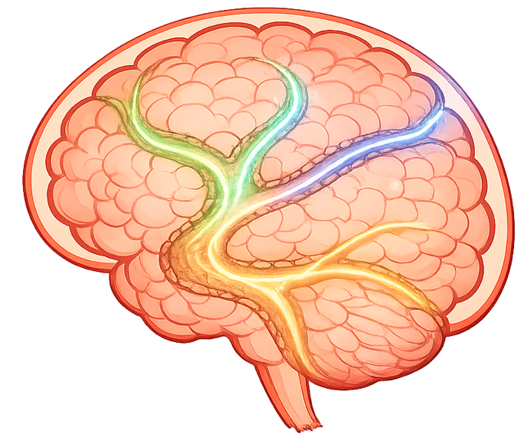
Paths In Our Brain

Slide 15
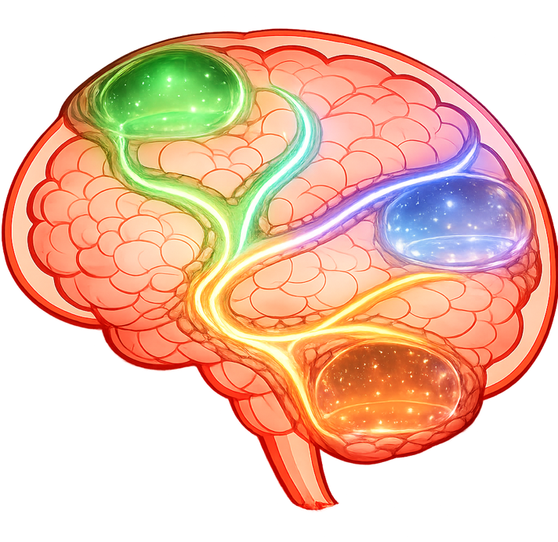
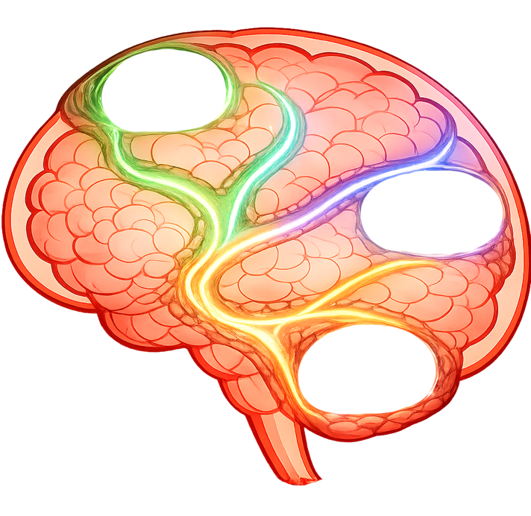



Paths In Our Brain
Safe, Cosy Place
Happy Memory
Peaceful Place

Slide 16
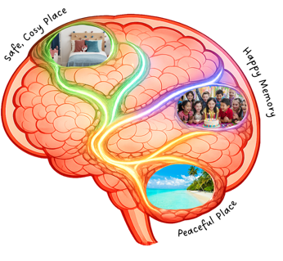
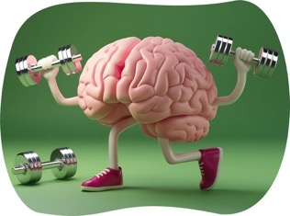
Where did the three paths in your brain take you?
How do we train our brain to lower the volume of our loud feelings?

Slide 17
Inside our brain is a very special part that controls our feelings. Even though it is really small, it is incredibly important!
We can train our brain to get better at lowering the volume of our loud feelings by teaching ourselves new ways to be calm.
To train our brain, we can practise using a visualisation of three calming paths in our brain that take us to different places.
By training our brain, it gets better at helping us feel calm and relaxed, so we can make smart choices.

Slide 18
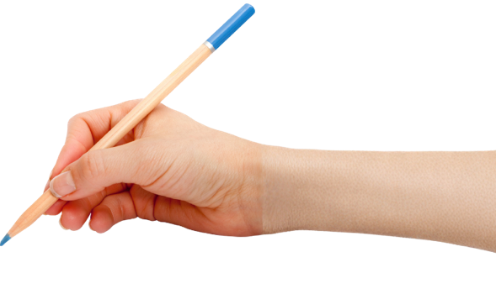



How well did you:
picture a calm place or memory in your mind
identify how visualisation can help your brain?

Slide 19
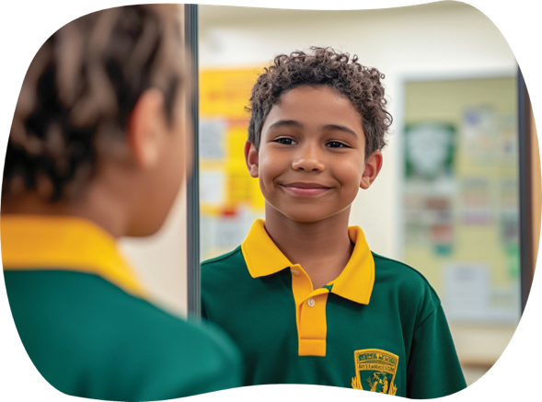
In the next lesson, we will learn how to use positive self-talk to guide your actions and manage strong feelings.

