Slide 1

Big Feelings Happen!
Unit 2: Big Feelings, Smart Choices
Lesson 1

Slide 2
In this lesson, you will learn that big feelings like anger or worry are normal and can be managed.

Slide 3
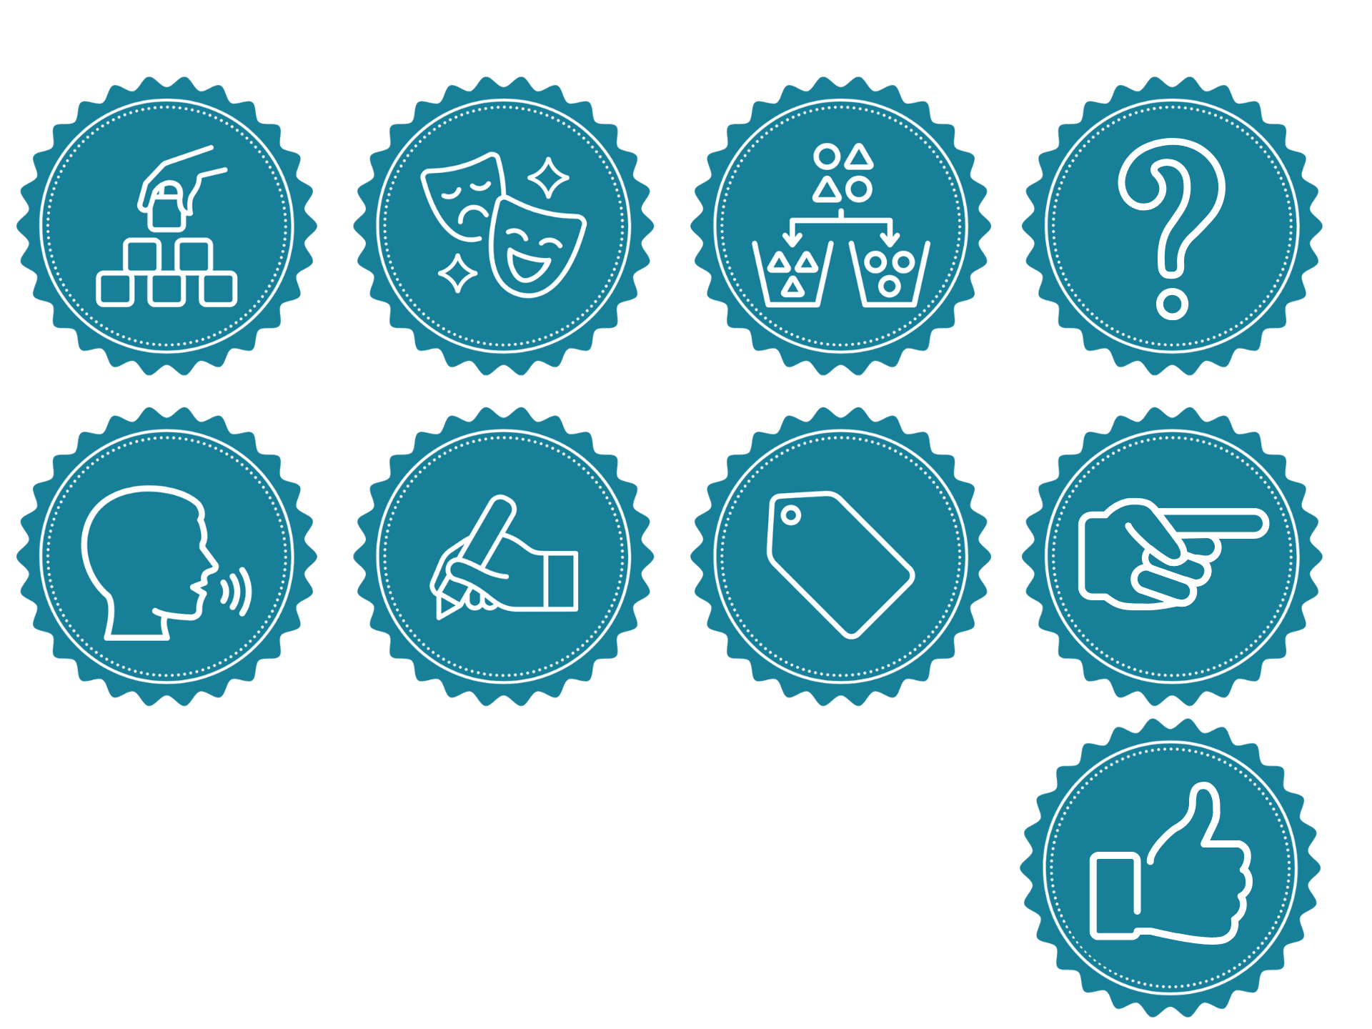
You will be successful when you can:
say a big feeling
name a calming tool you can use when you have a big feeling.

Slide 4
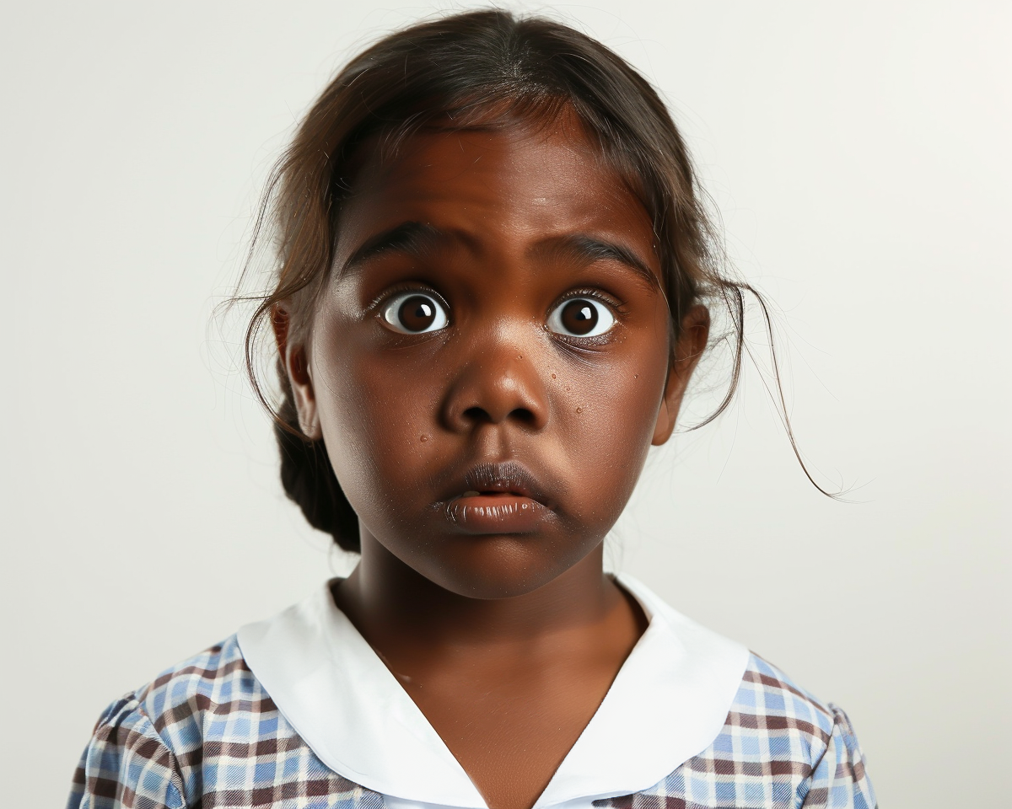
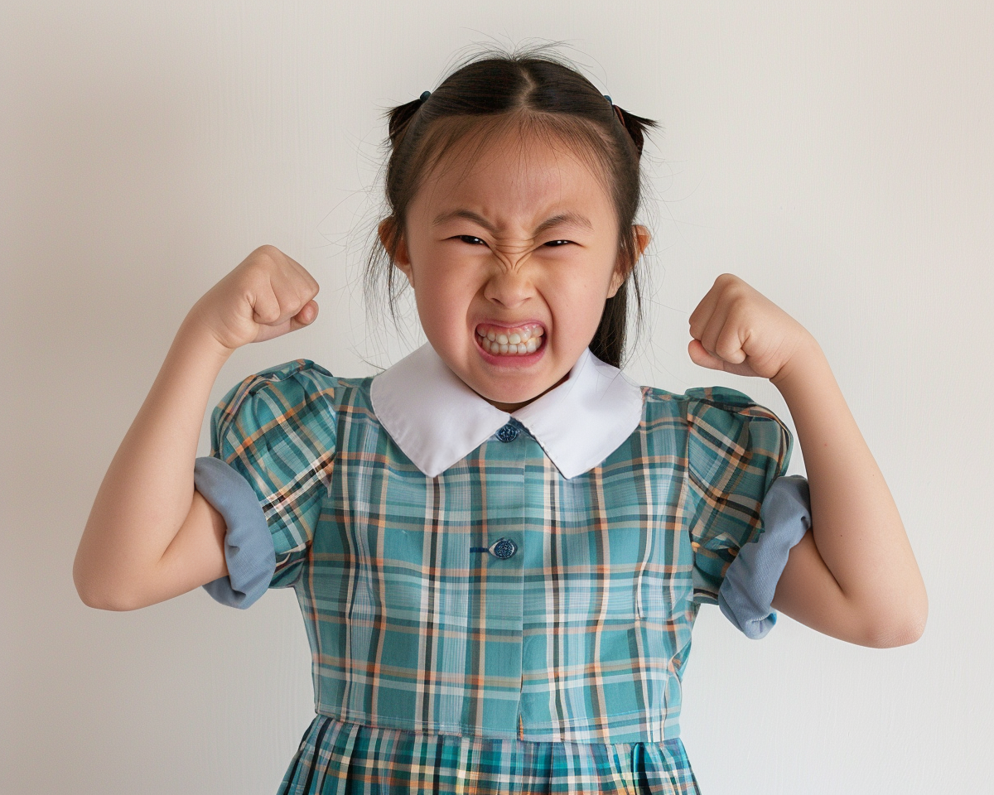

Slide 5
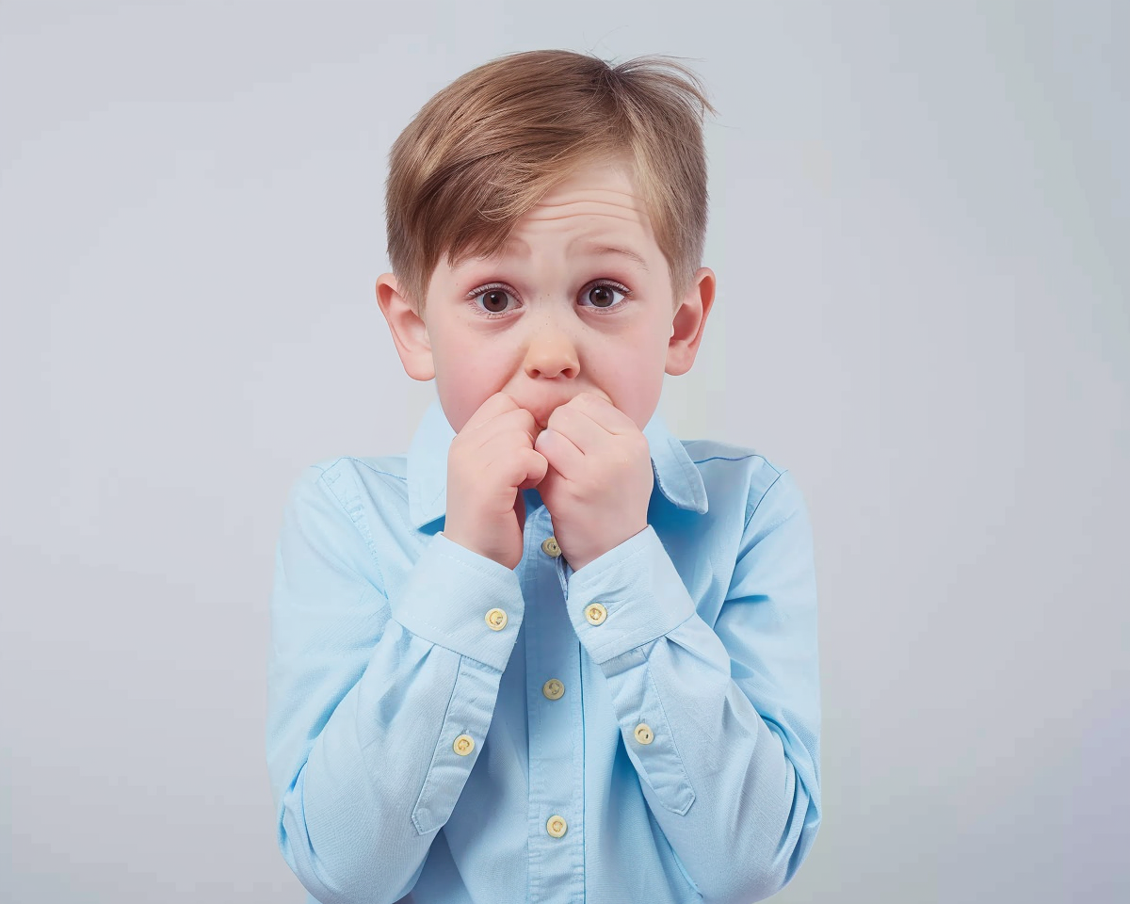
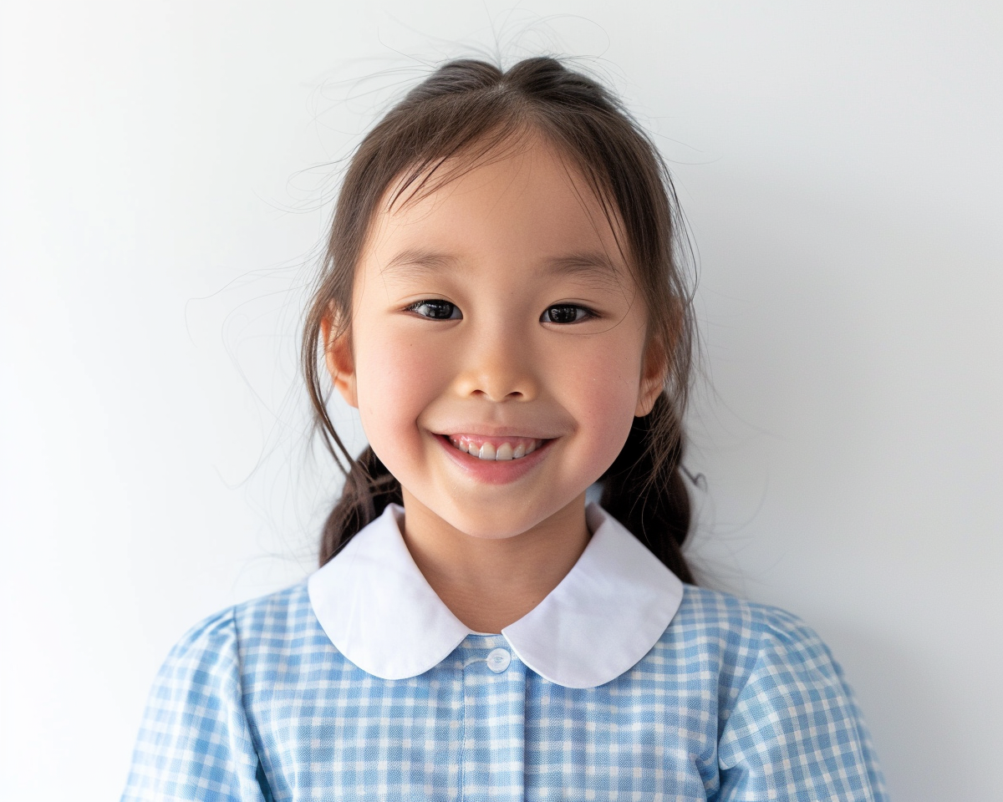
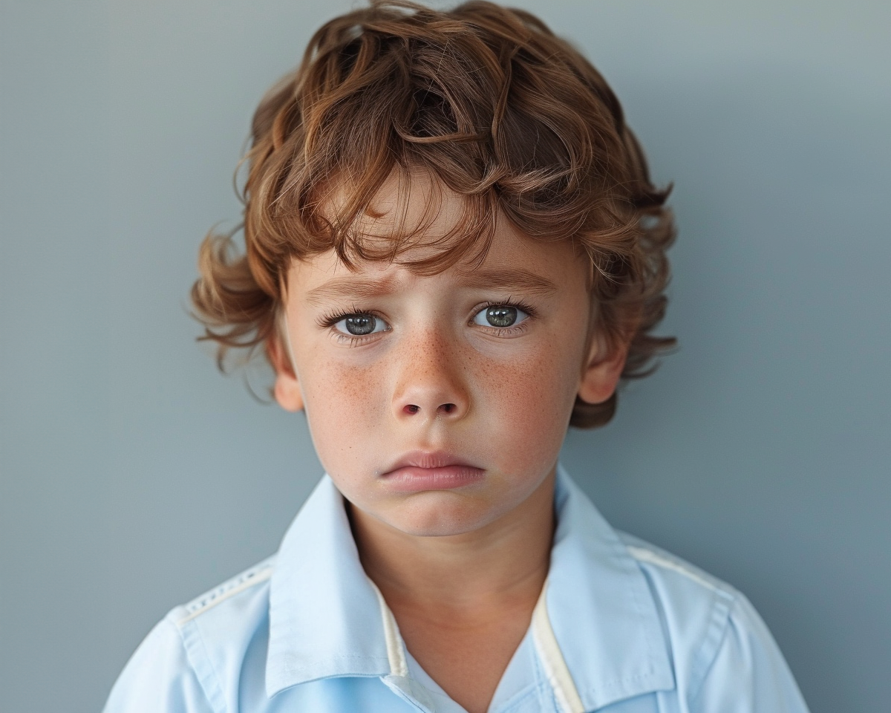
React is how you act because of what you feel.
Big feelings are feelings that make us react in big ways.

Slide 6


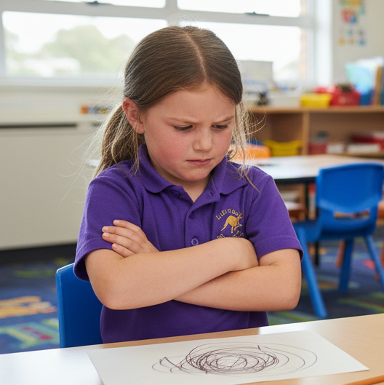
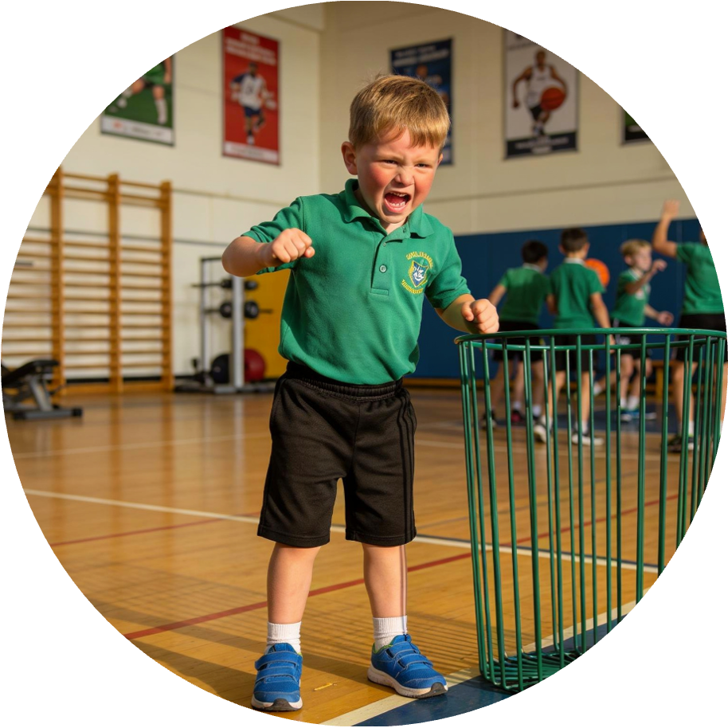
Small and Big Feelings

Slide 7
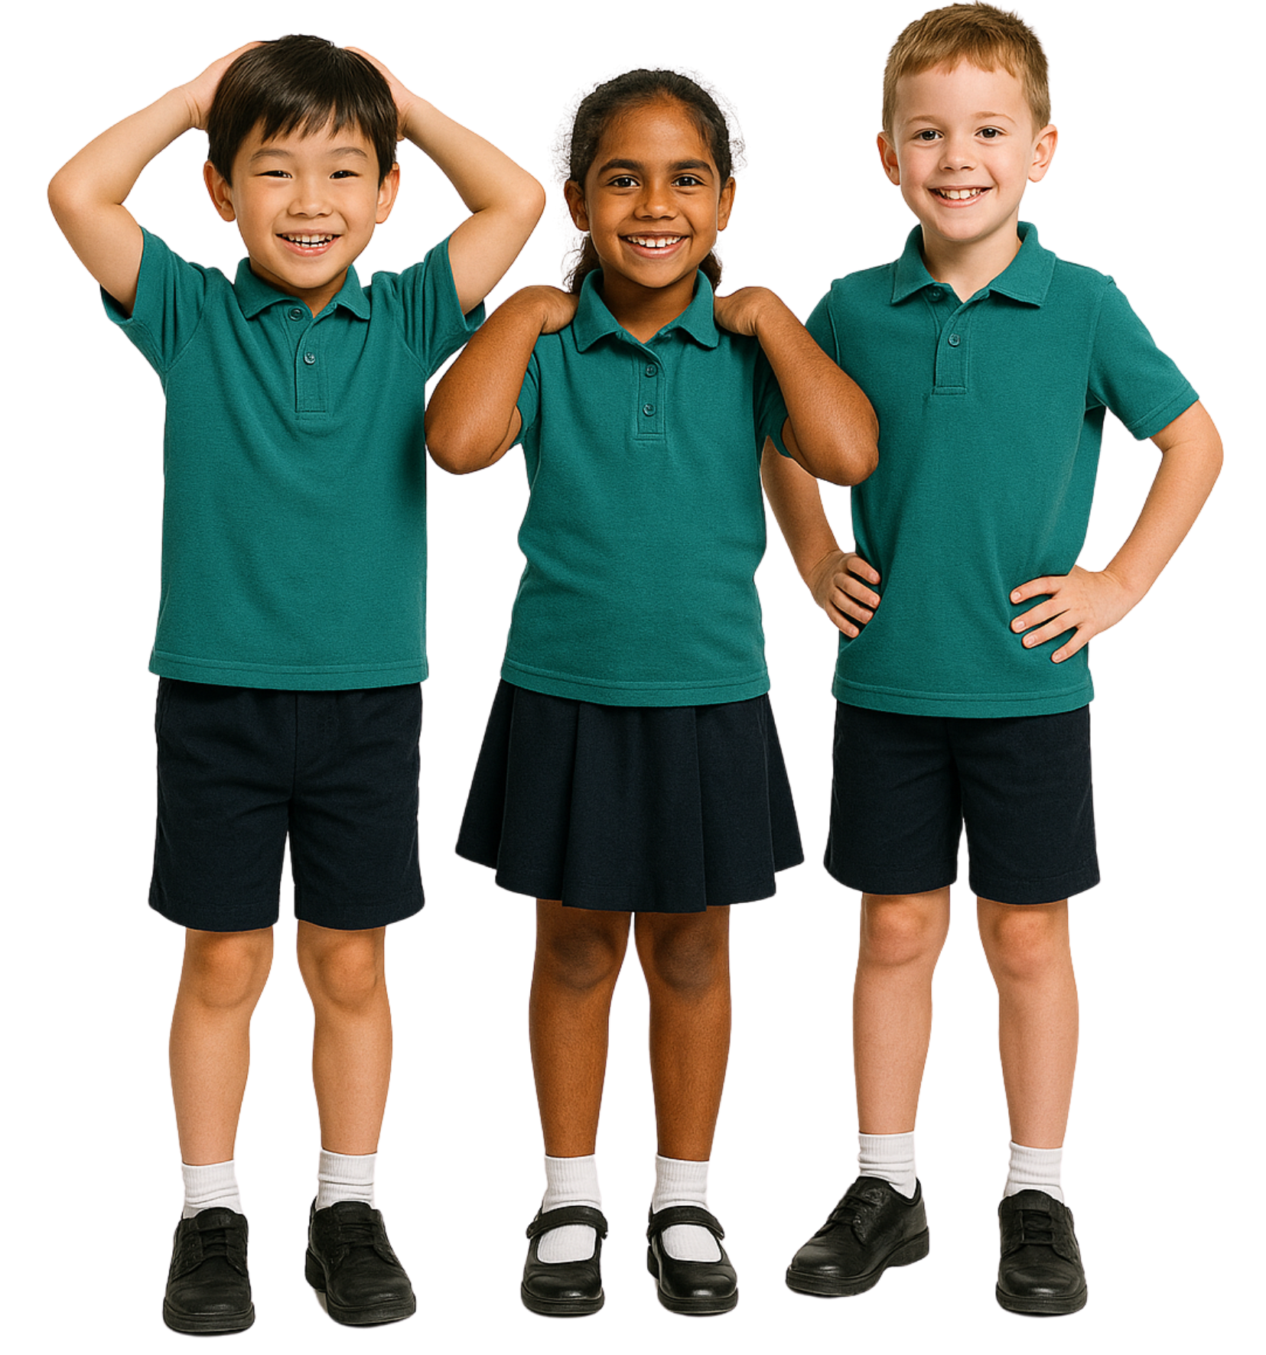
Big Feelings
Big feelings are feelings that…
only grown-ups have
take up a lot of space in our mind and body.
go away quickly

Slide 8

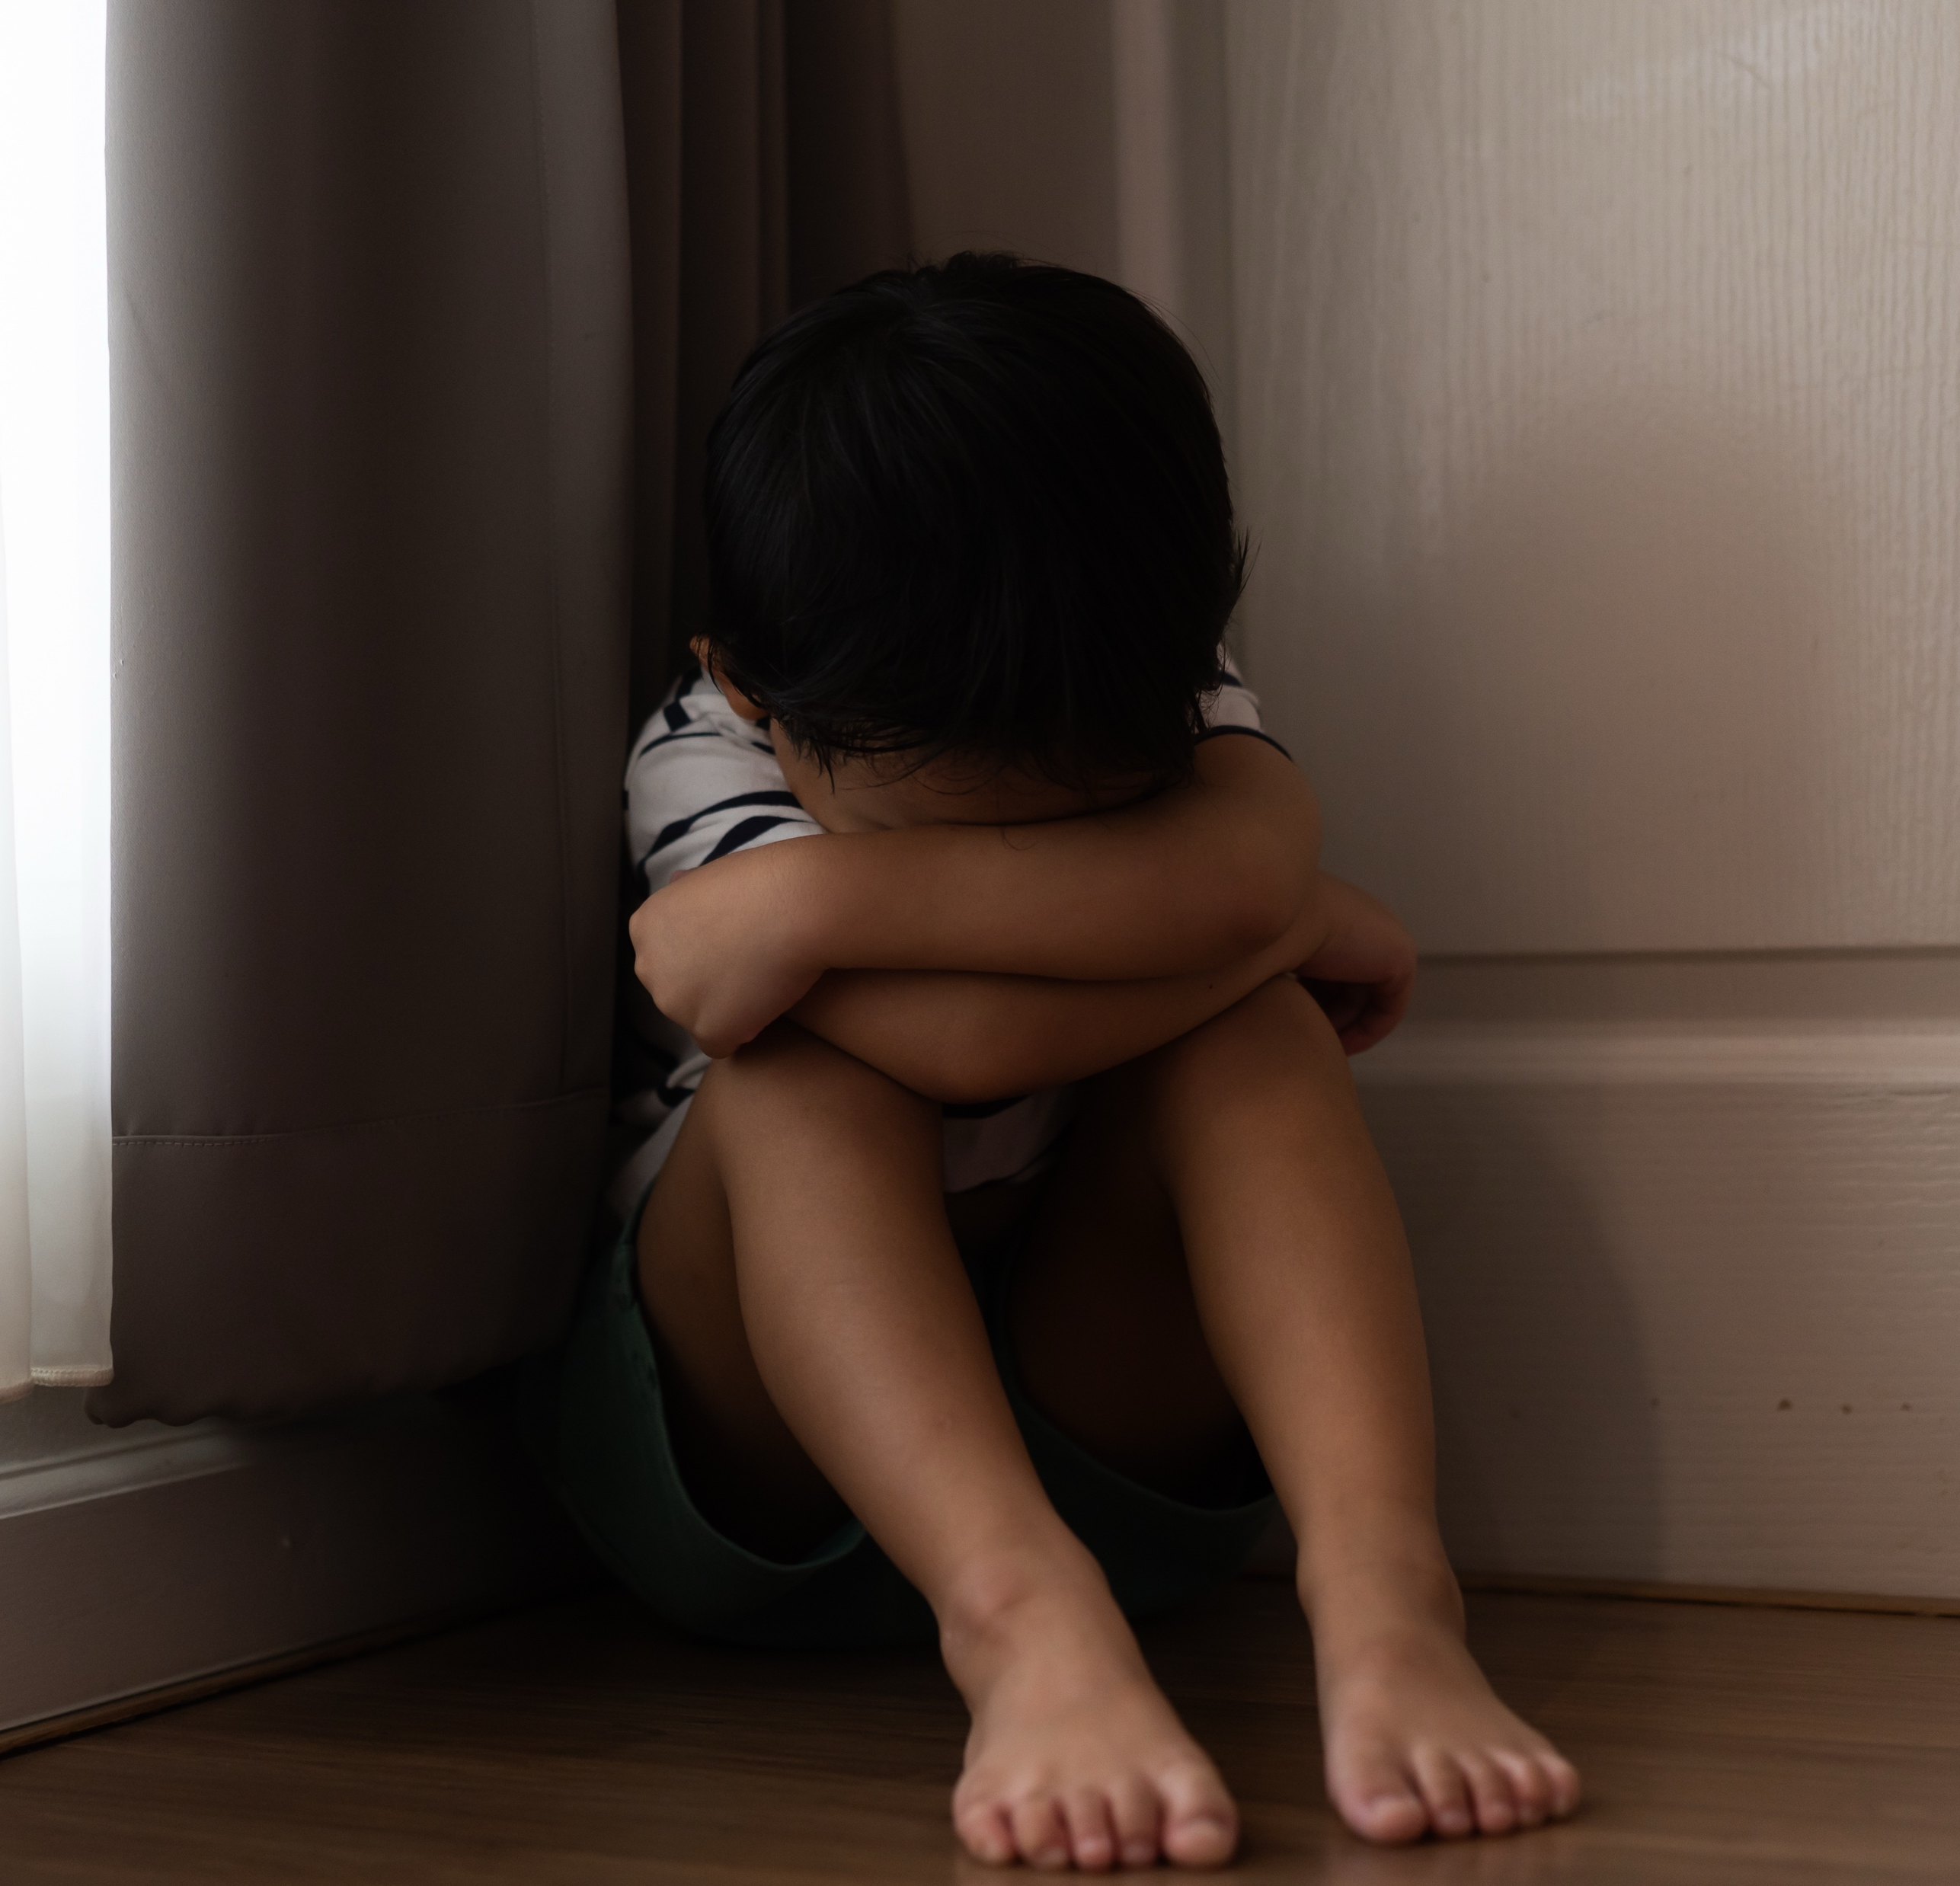

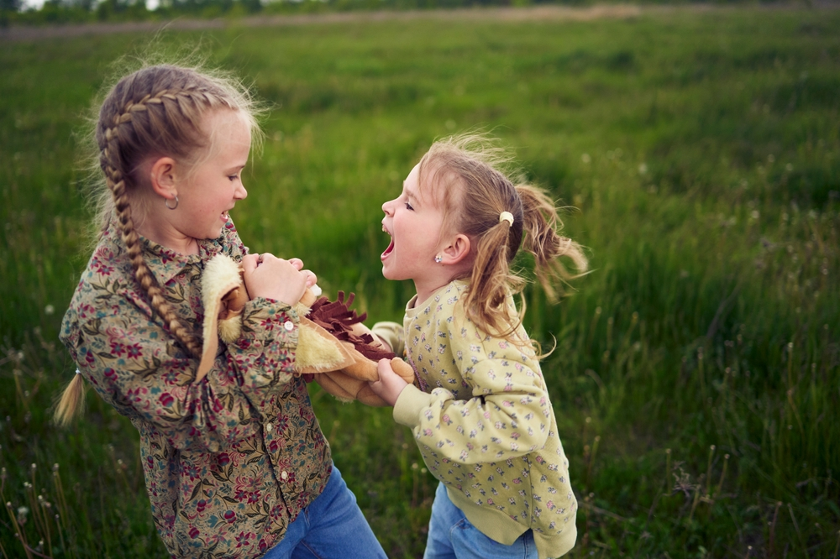
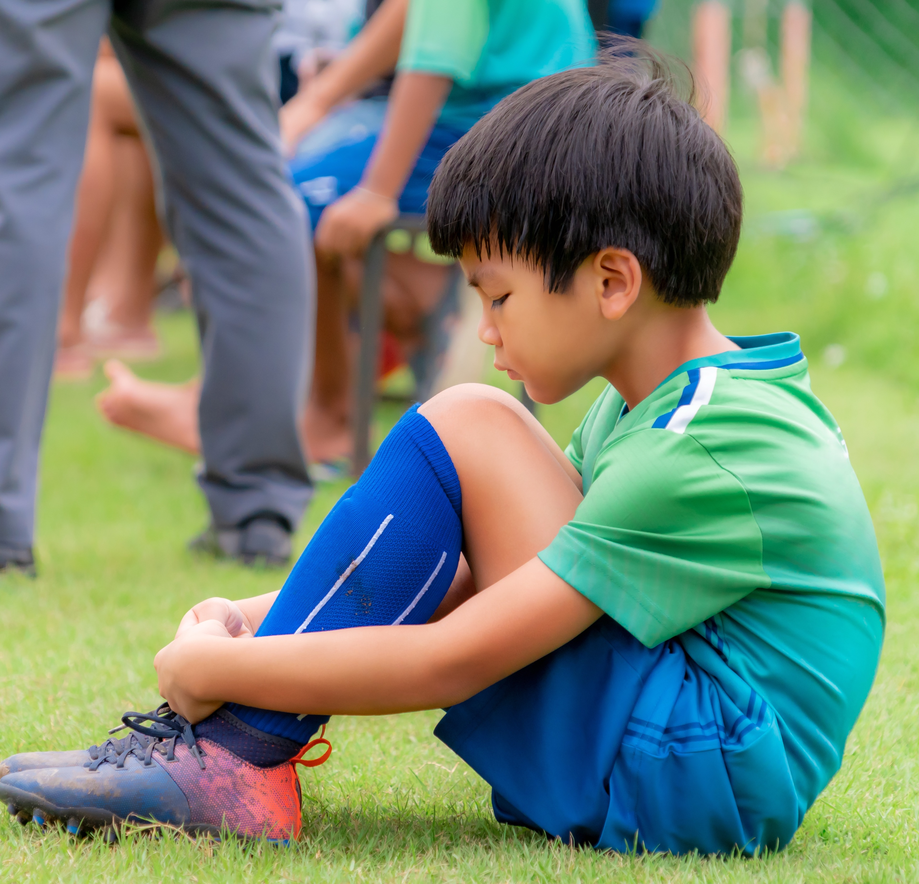
Big Feelings, Calm Choices

Slide 9
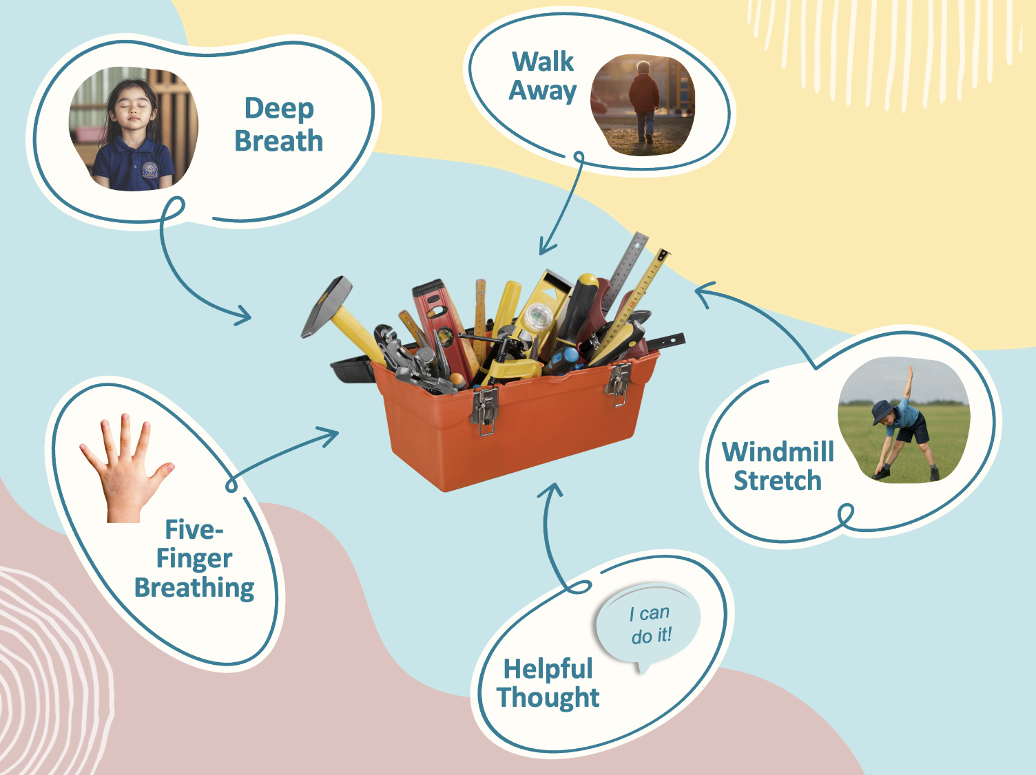



SPIN

Slide 10
SPIN

Slide 11

SPIN

Slide 12
SPIN

Slide 13
SPIN

Slide 14

SPIN

Slide 15
We can use tools to help us feel calmer when we have big feelings.
Notes:
We can use tools to help us feel calmer when we have big feelings.

Slide 16
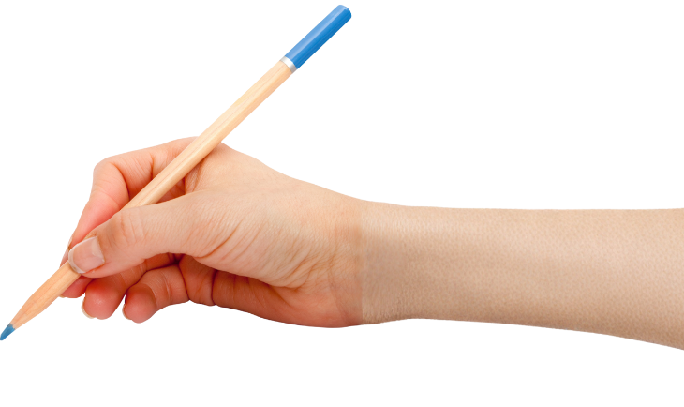

How well did you:
say a big feeling
name a calming tool you can use when you have a big feeling?

Slide 17
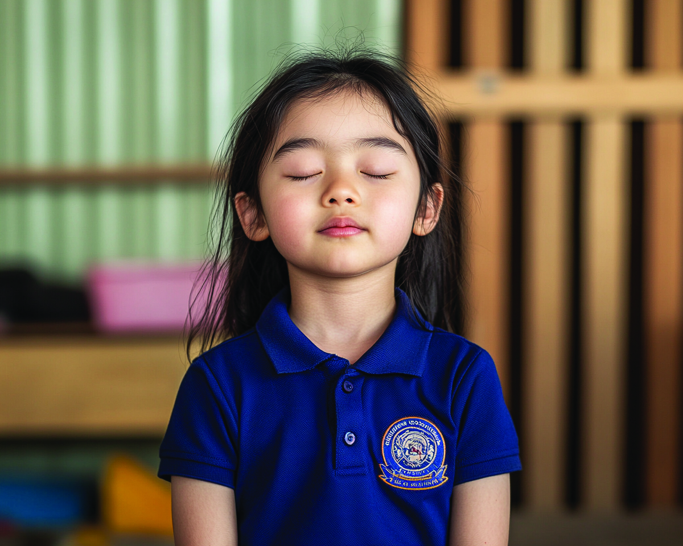
In the next lesson, we will practise using our breath to help our body and brain feel calm.

