Slide 1
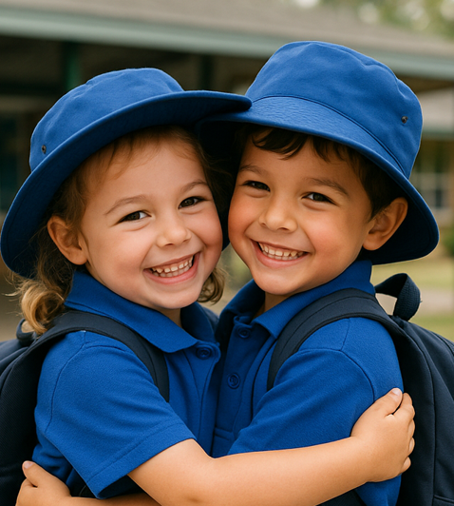
How Do I Feel Today?
Unit 1: Knowing Me, Knowing You
Lesson 1

Slide 2
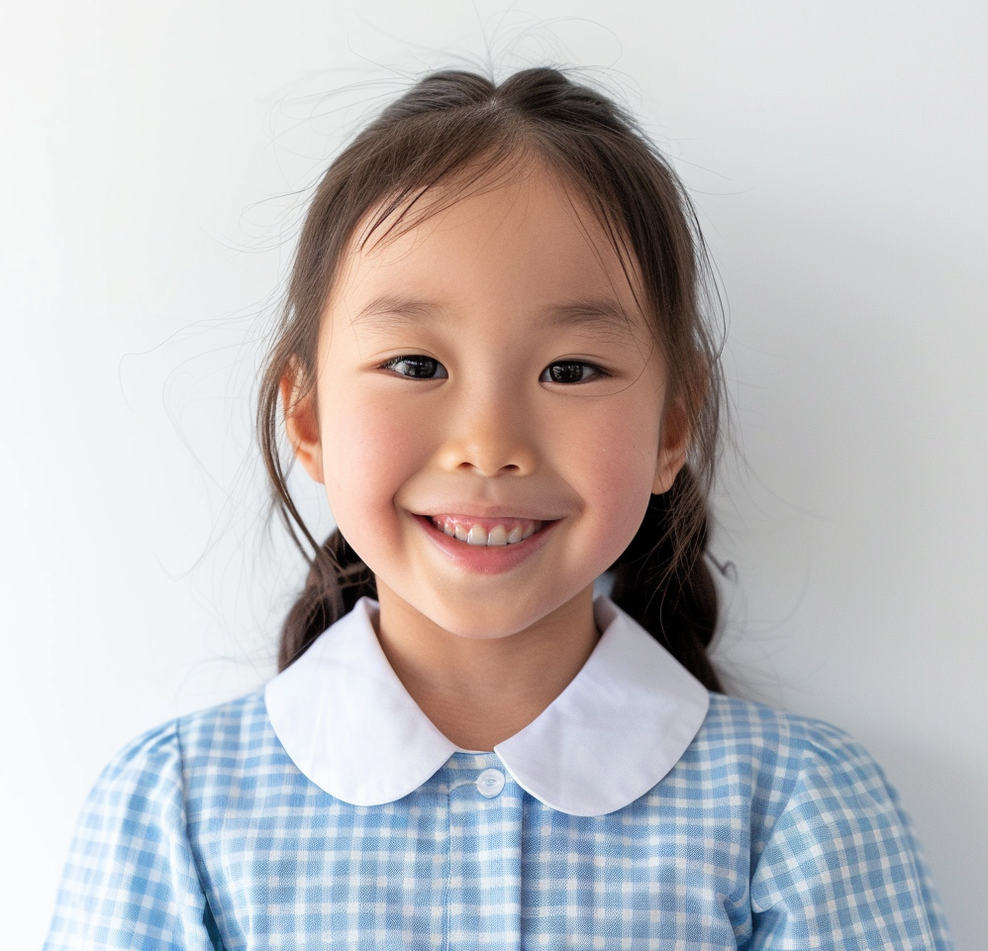
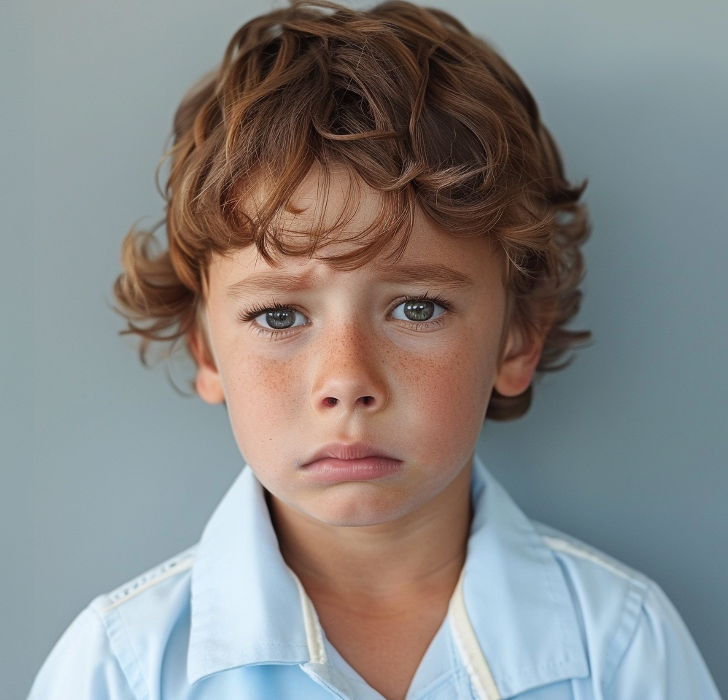
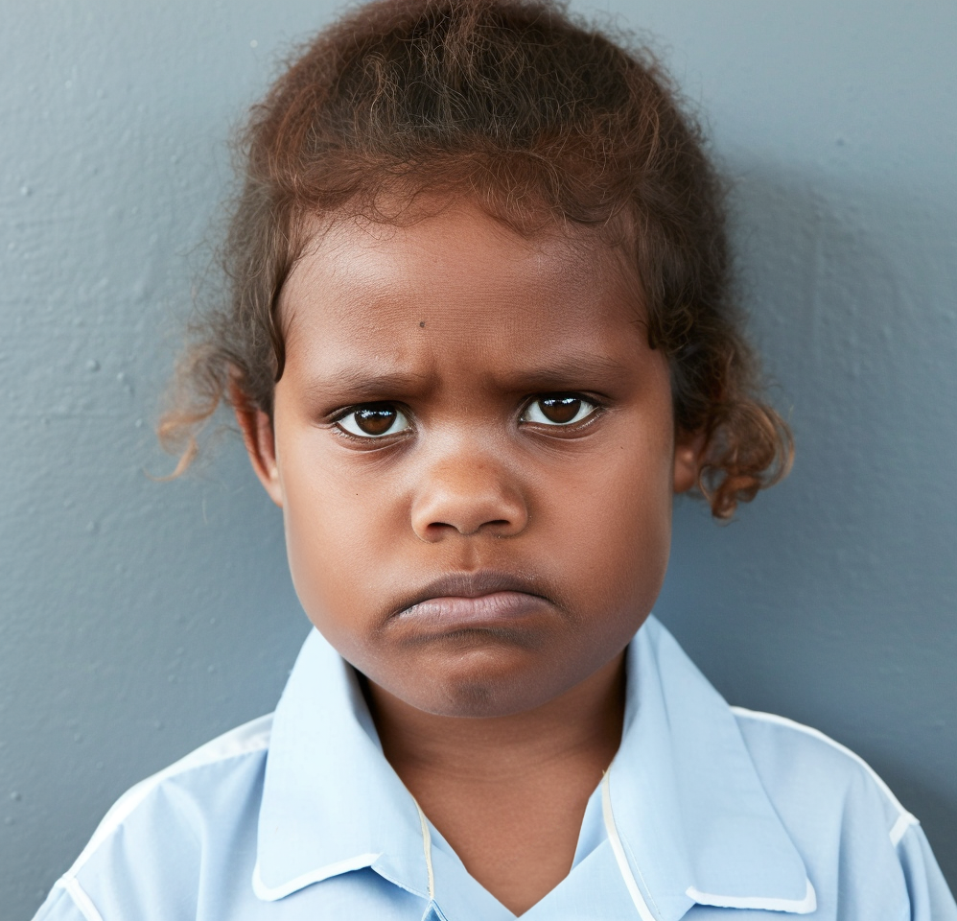
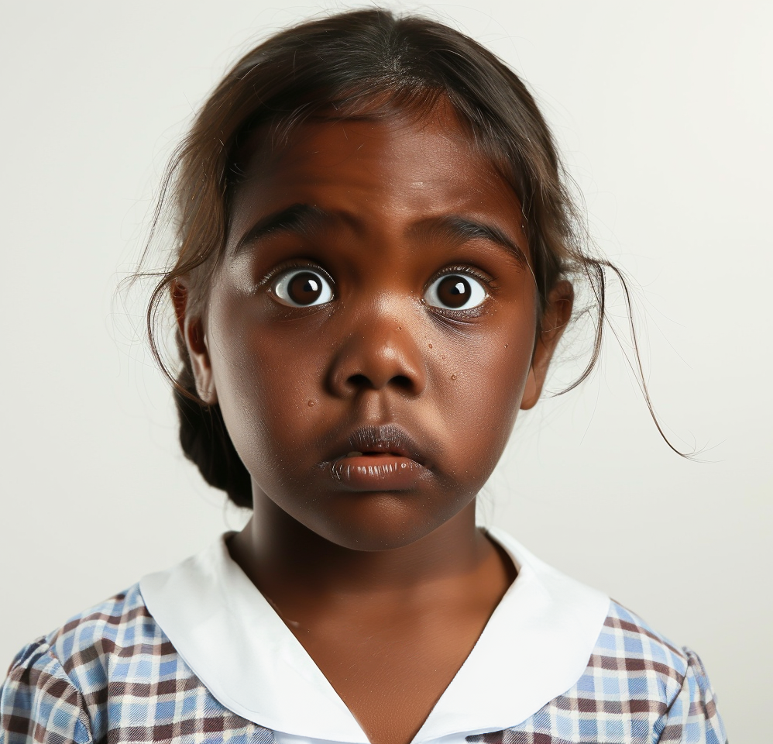
In this lesson, you will name how you are feeling using words like happy, sad, mad or scared.

Slide 3
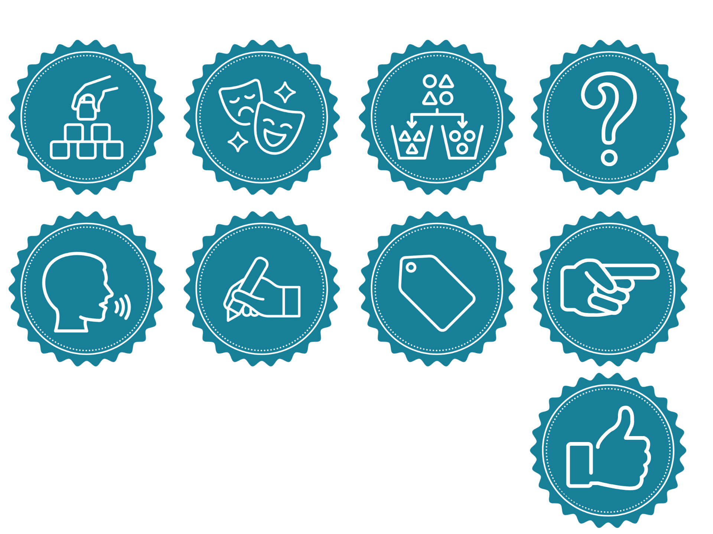
You will be successful when you can:
say an ‘I feel’ statement to share your feelings
choose a face or gesture that shows how you could feel in different situations.
You will be successful when you can
Use an ‘I feel’ statement to share your feelings.
Say ‘I feel ____’ using the right feeling word.
Choose a face or gesture that shows how you could feel in different situations.

Slide 4
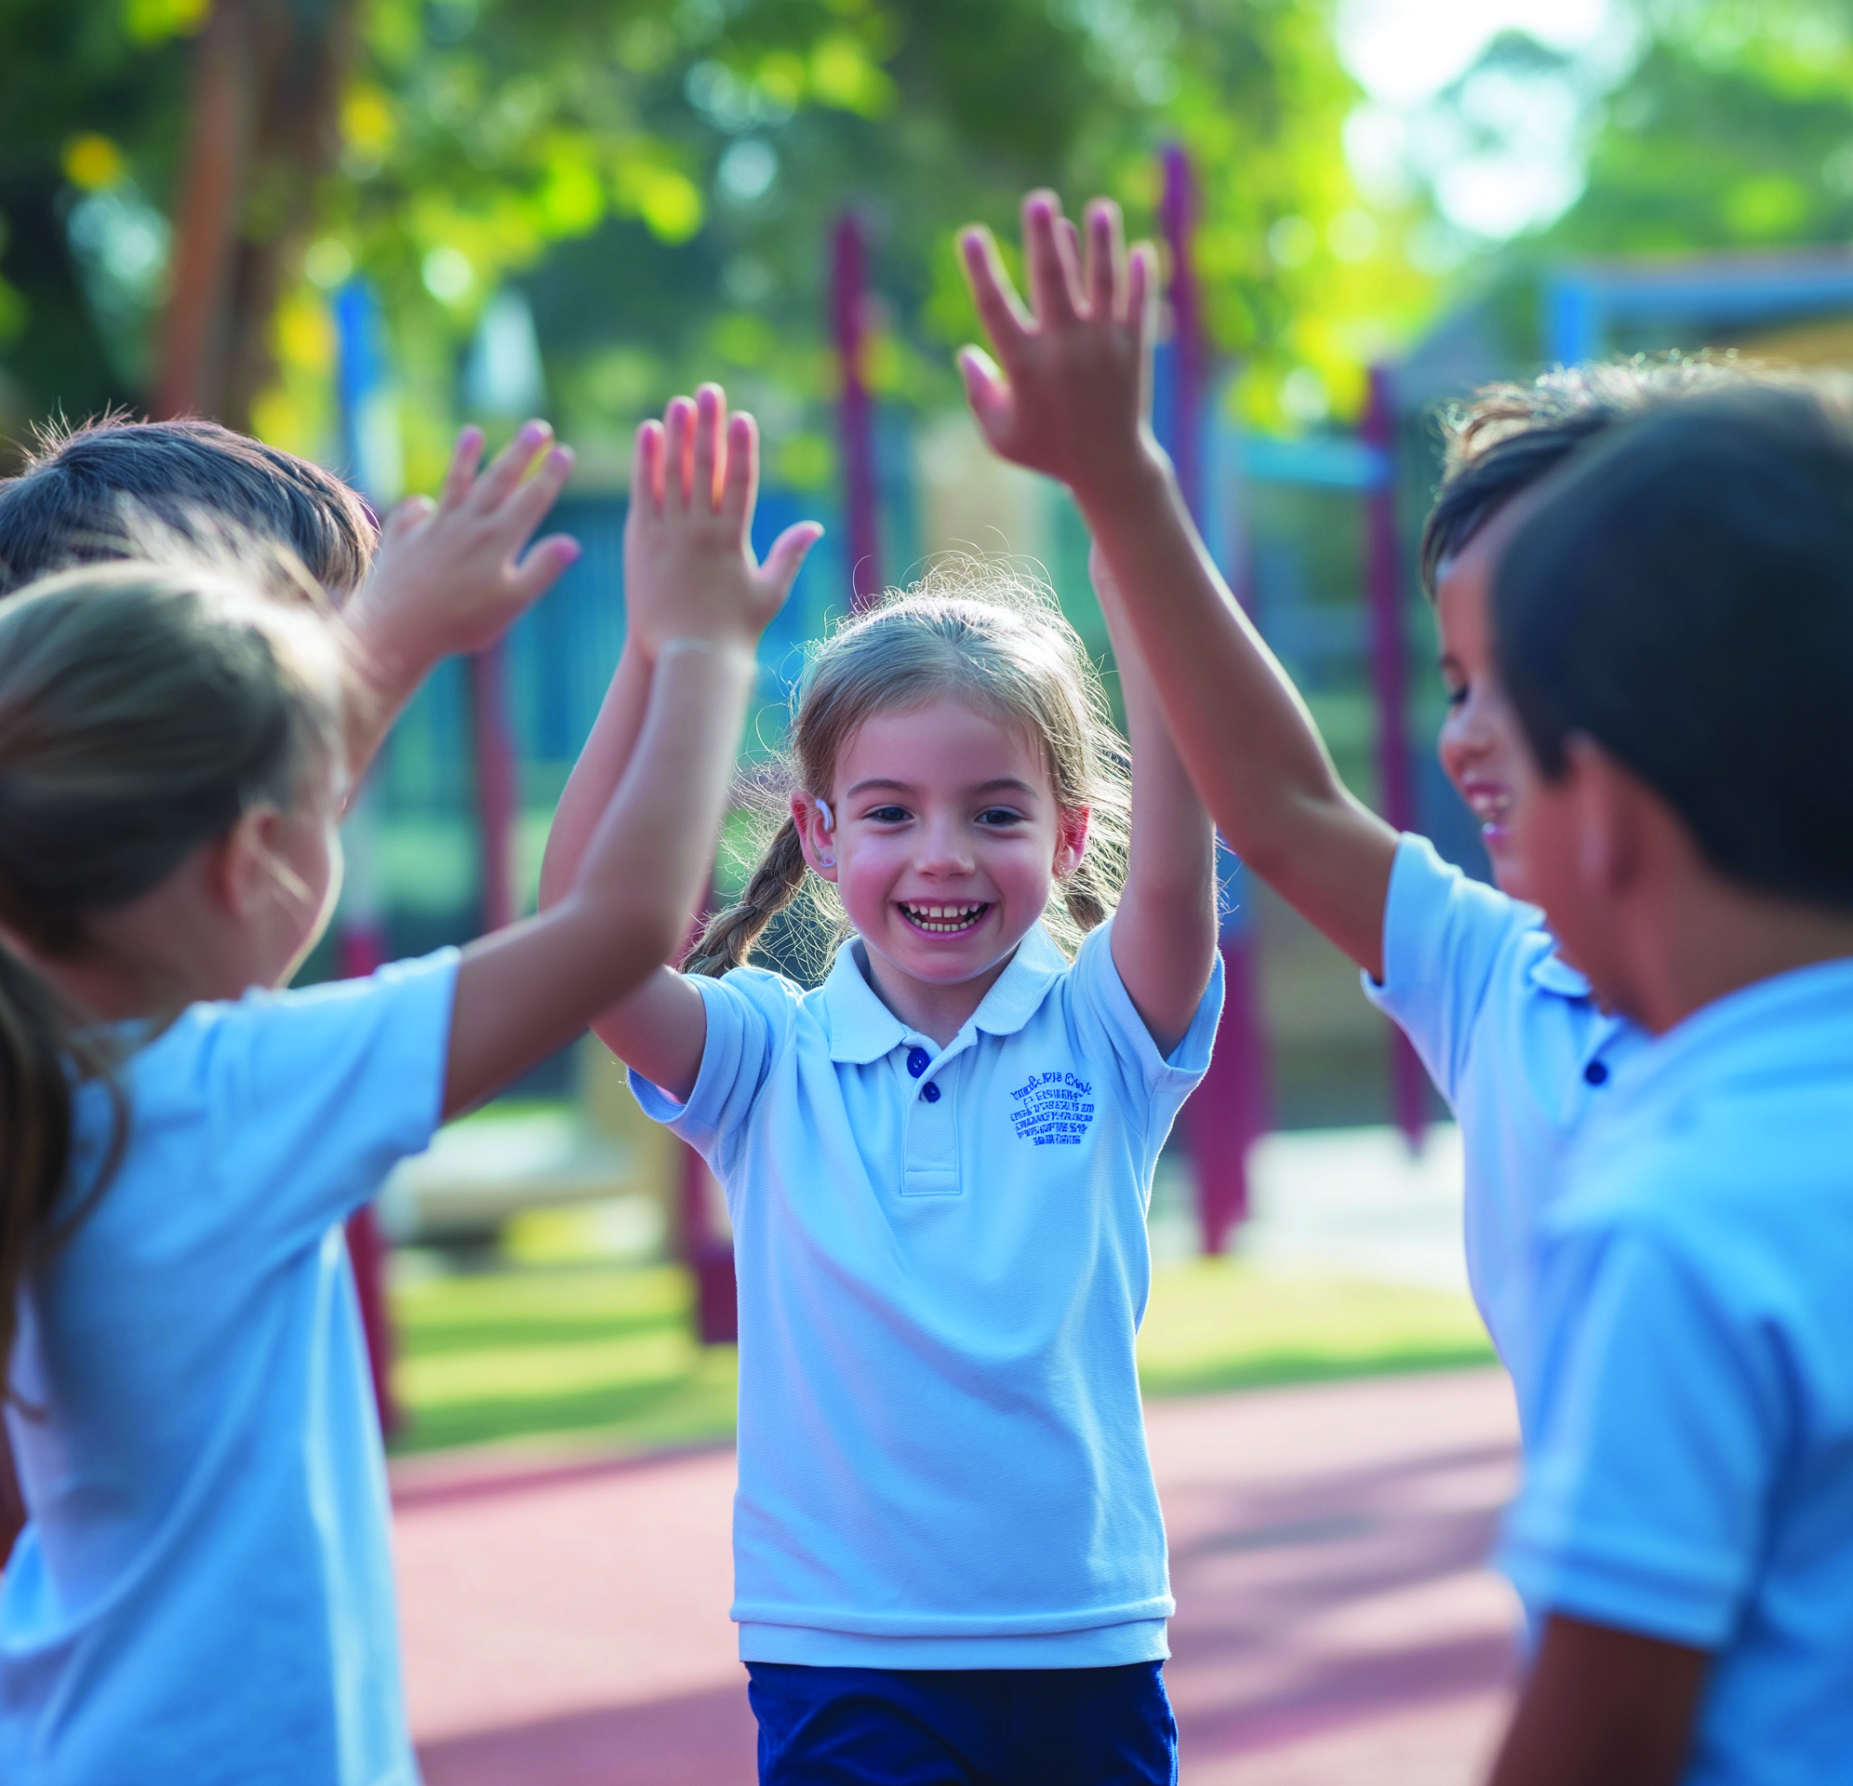
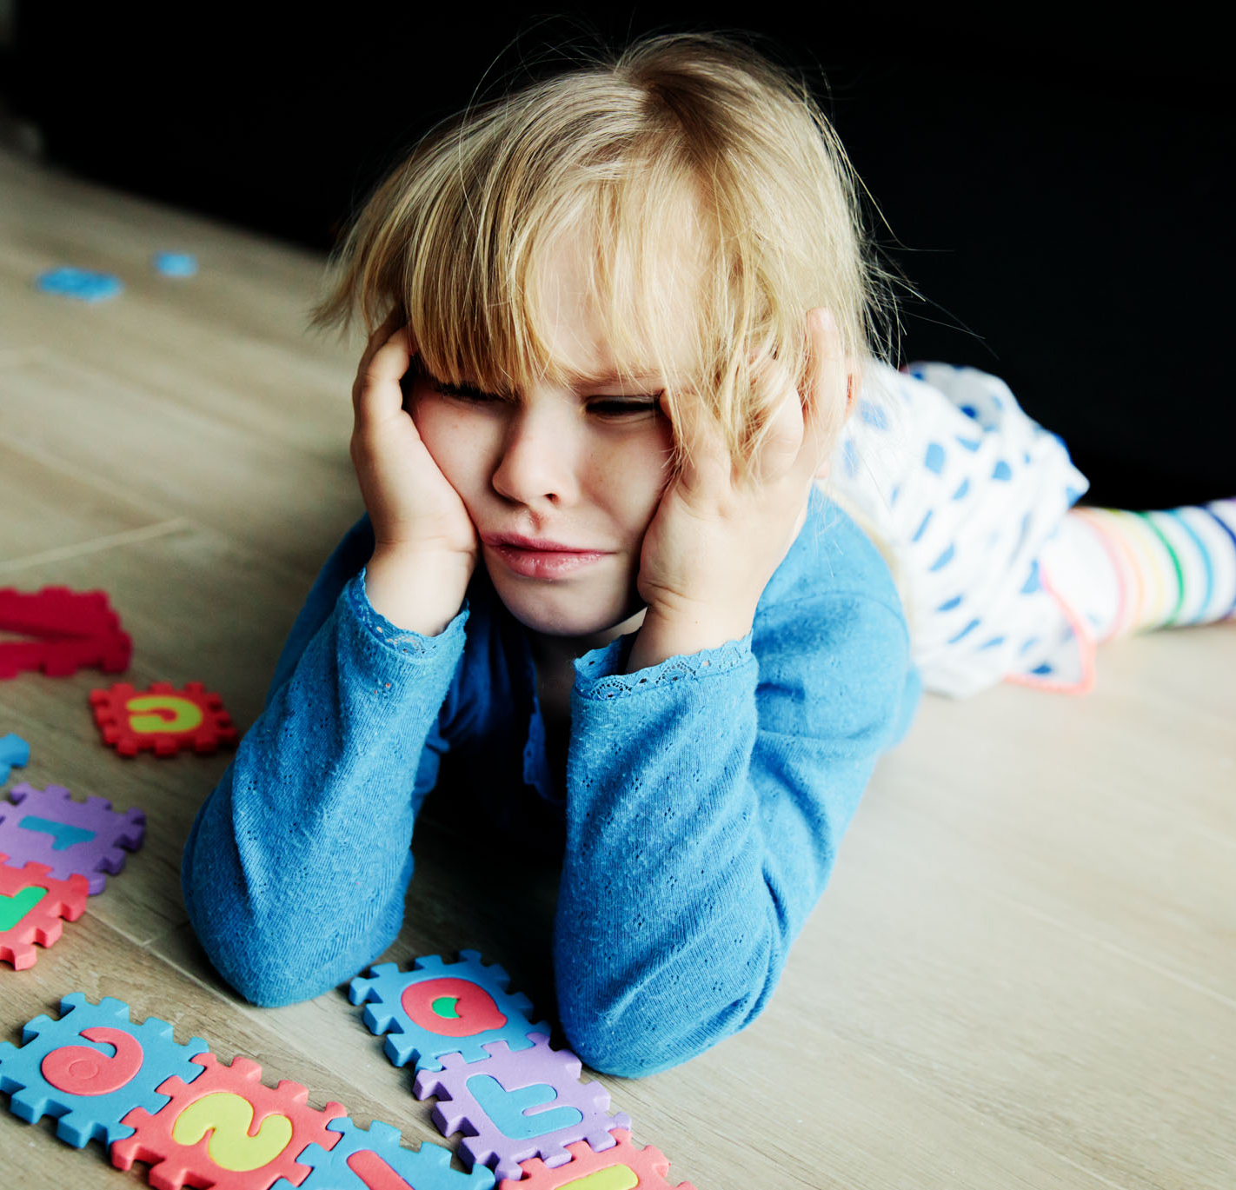
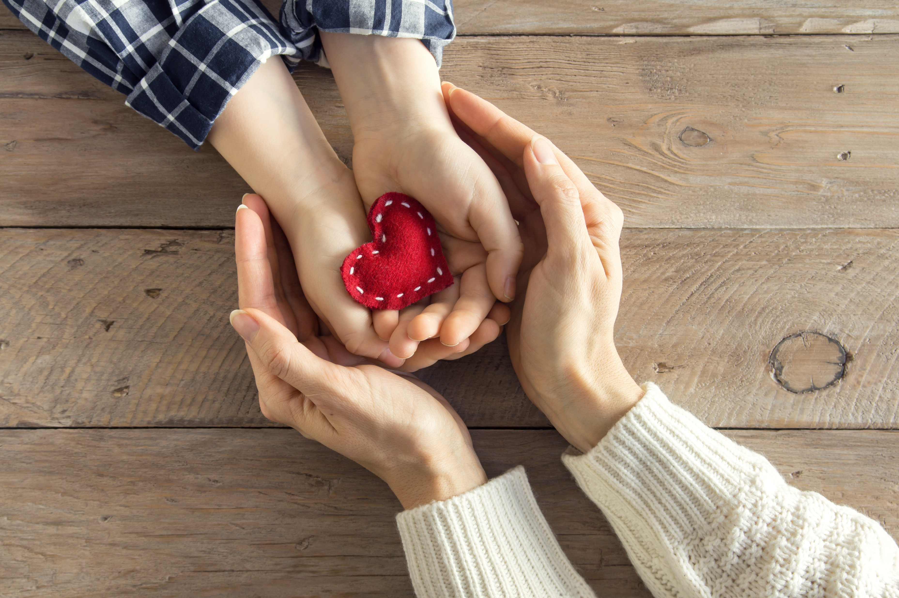
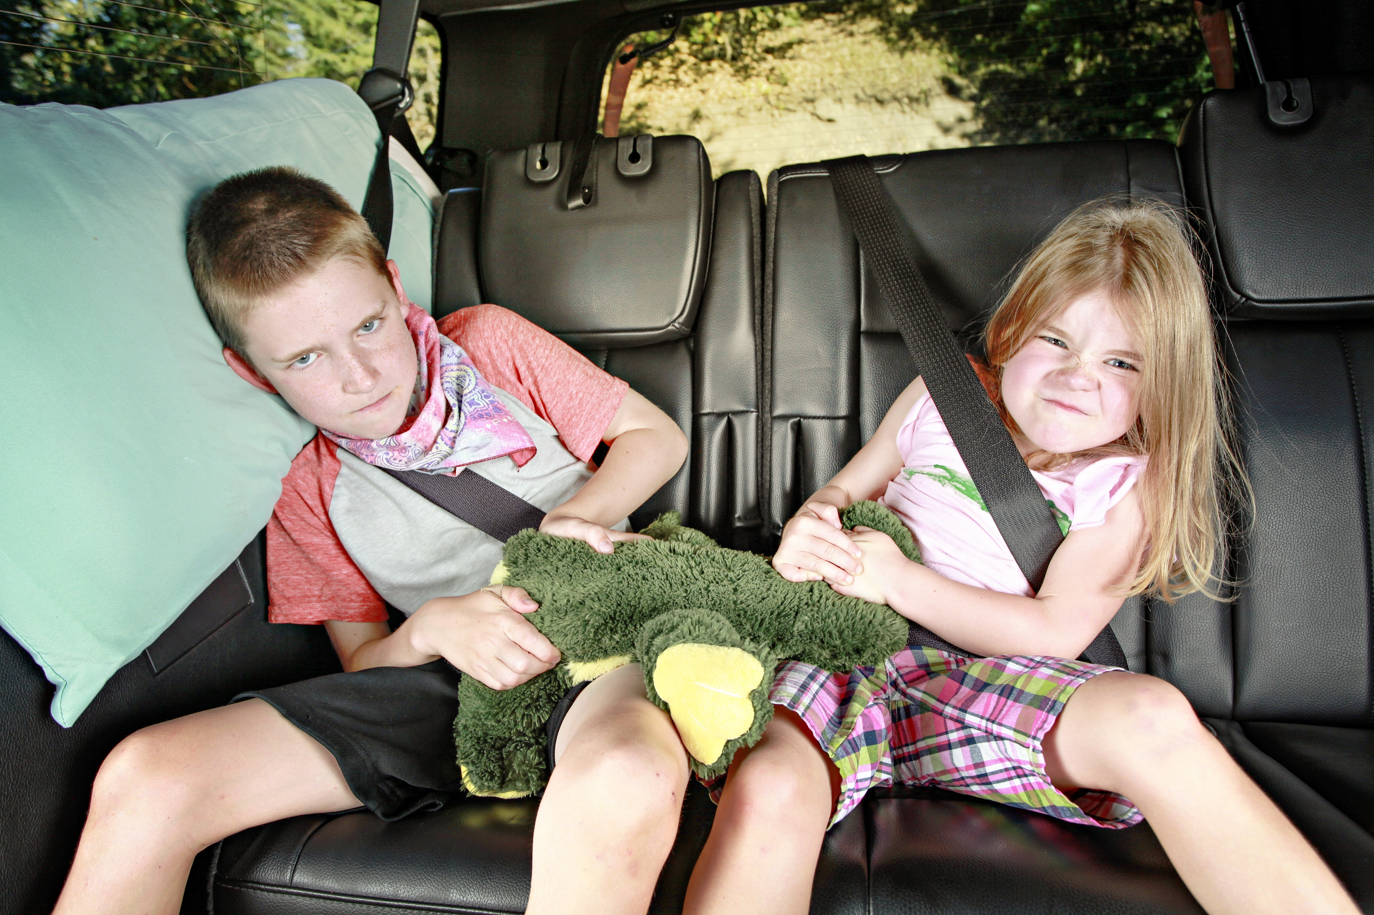



Slide 5
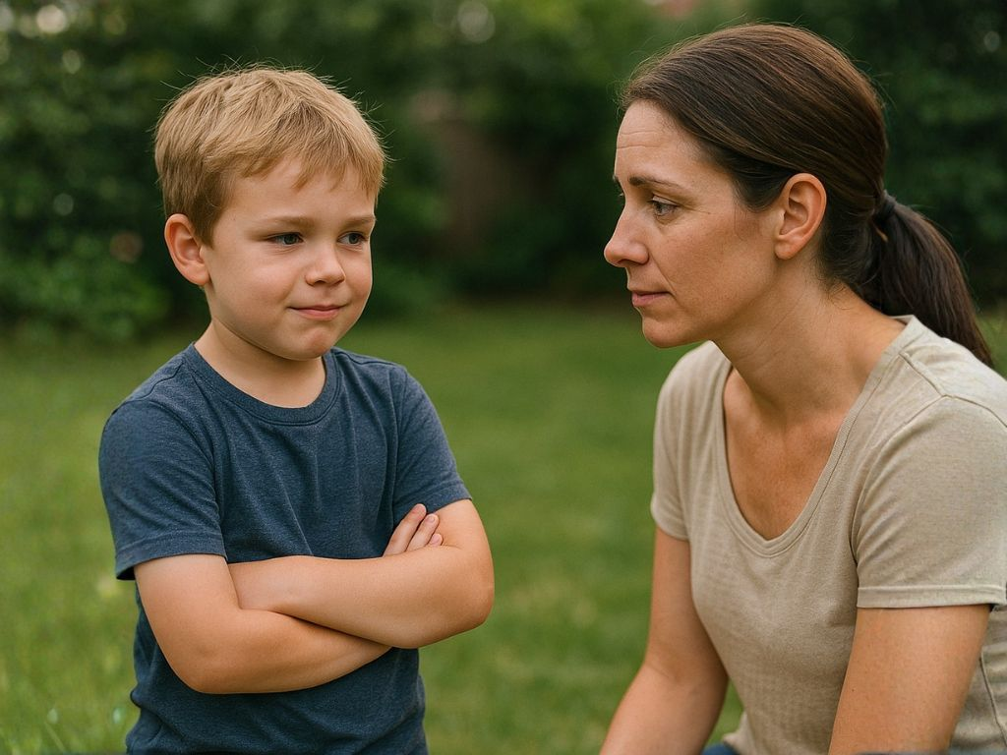
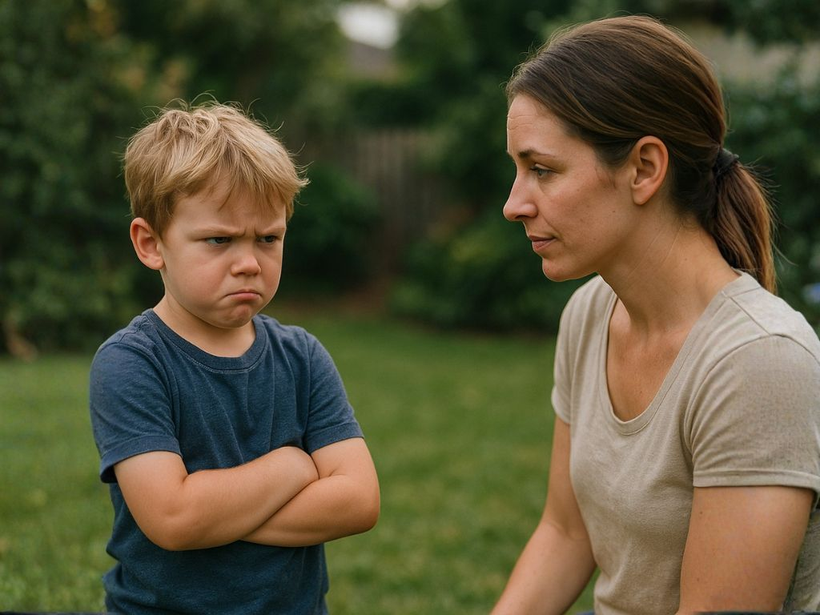
Sharing and Showing Feelings
I feel...
I feel mad.

Slide 6
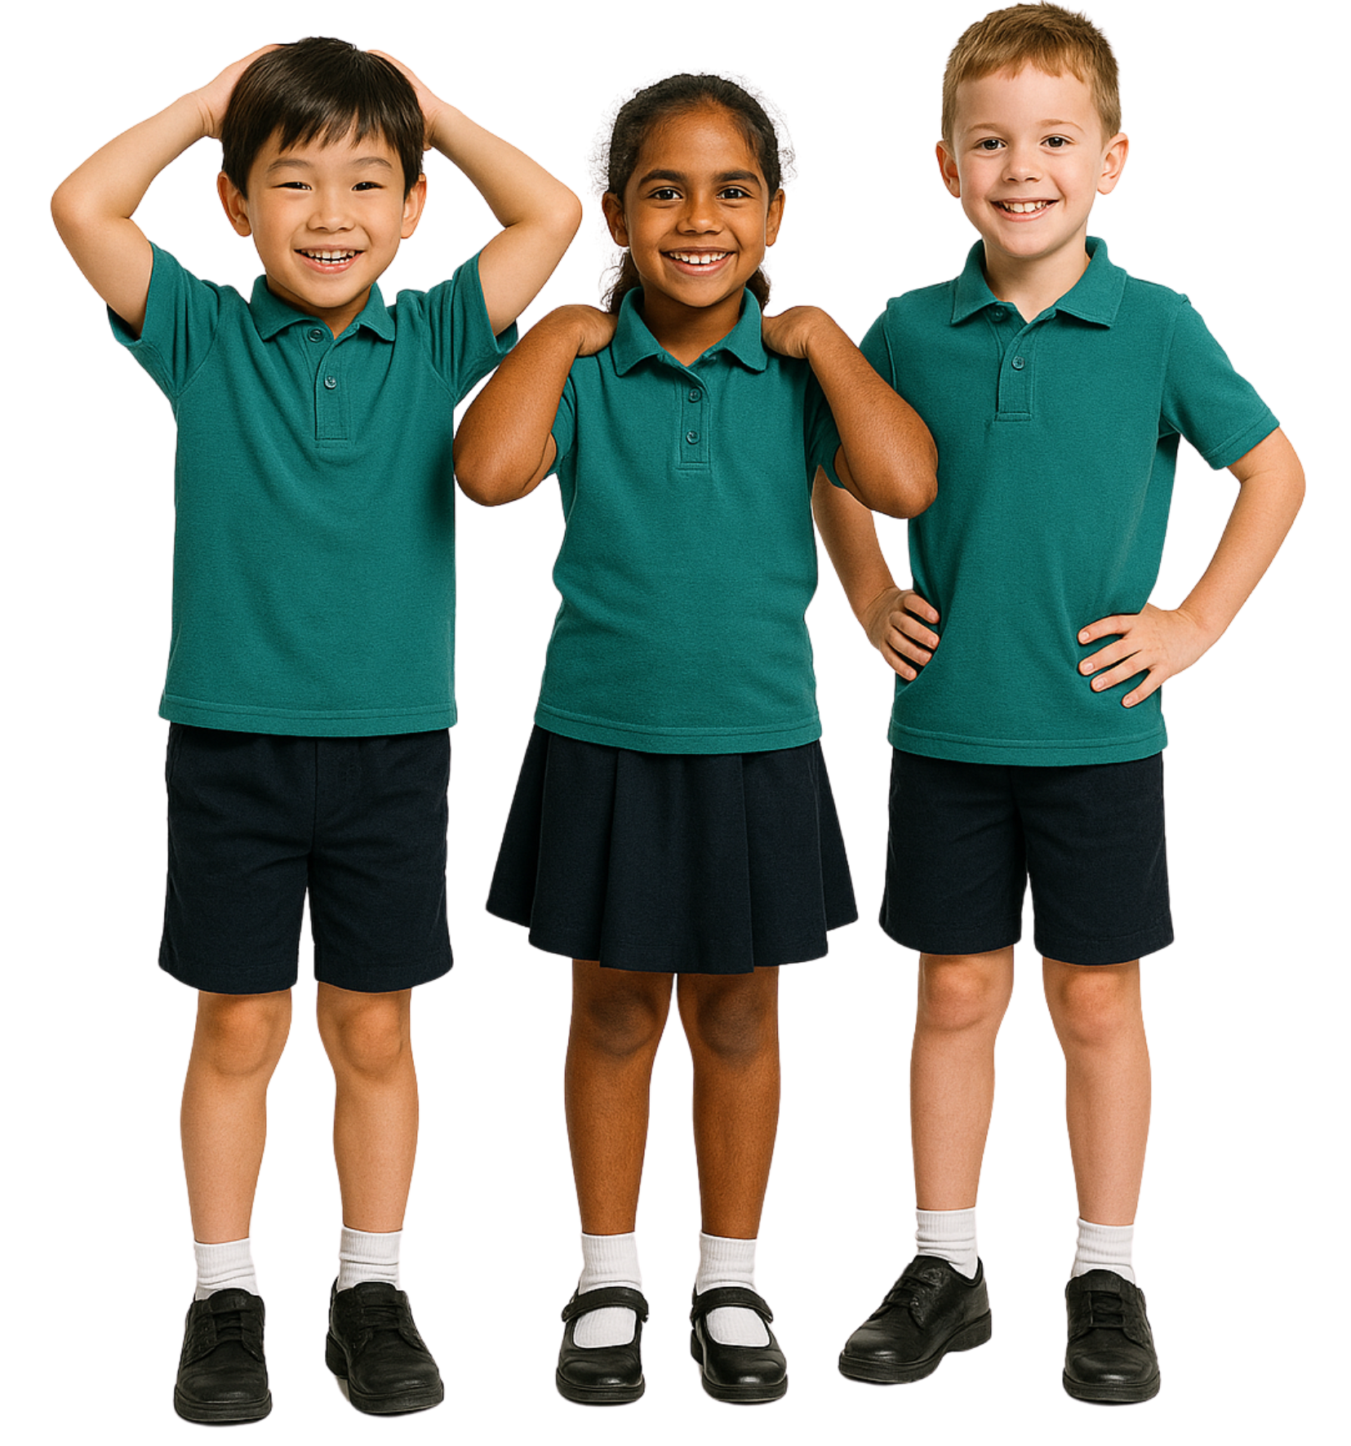
Sharing Our Feelings
When we share our feelings, it can help us…
Take naps
Ask for what we need and make good choices
Get candy

Slide 7


Slide 8

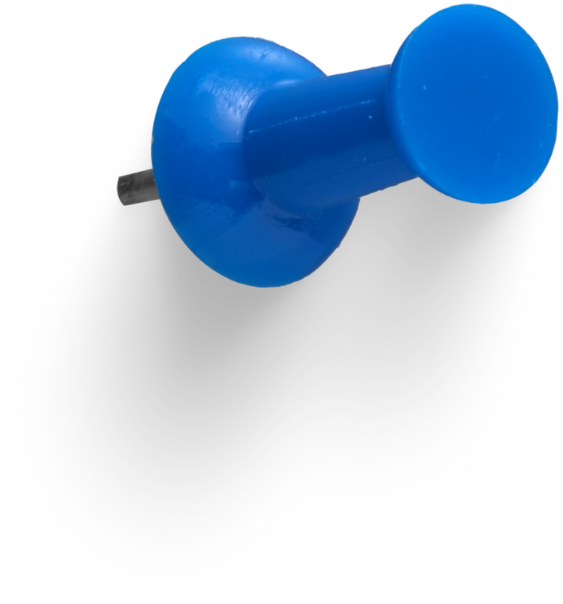
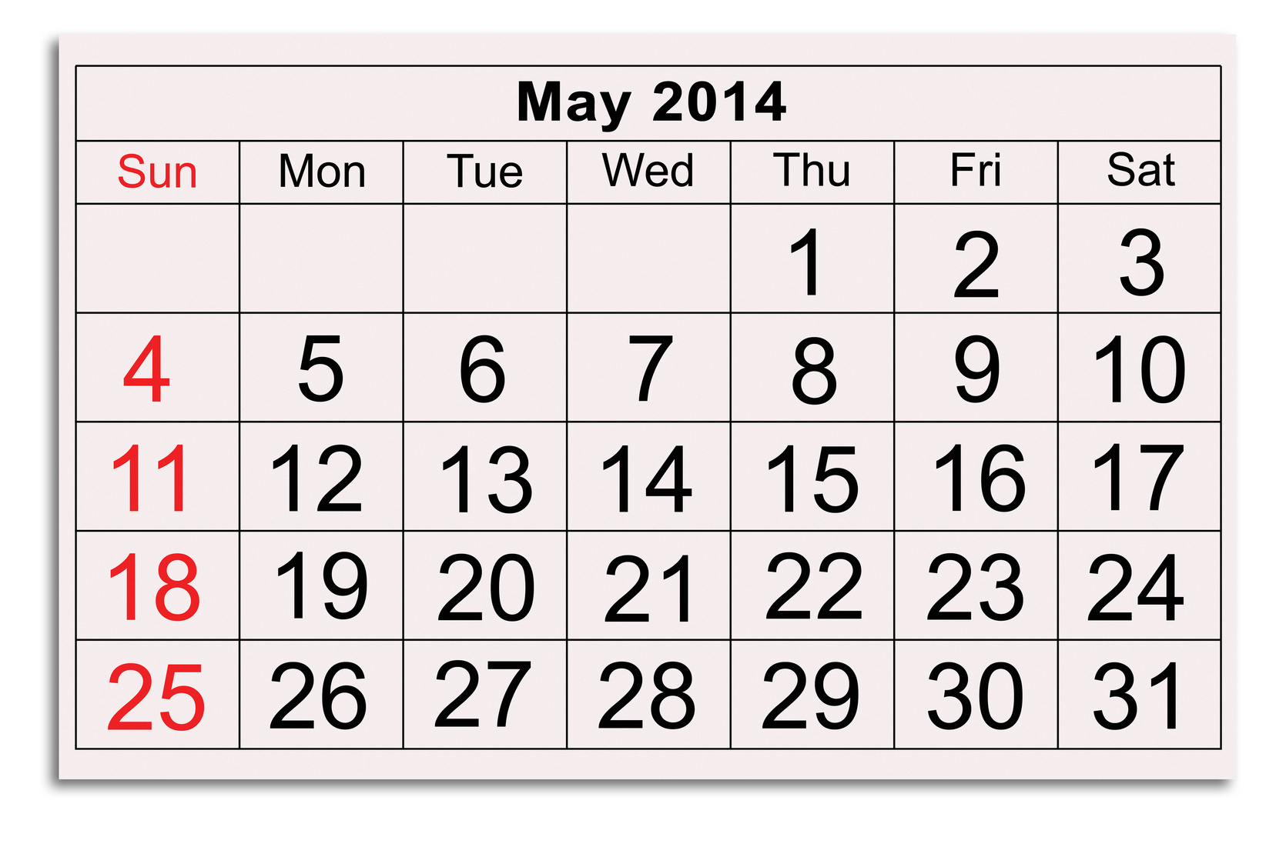

Slide 9
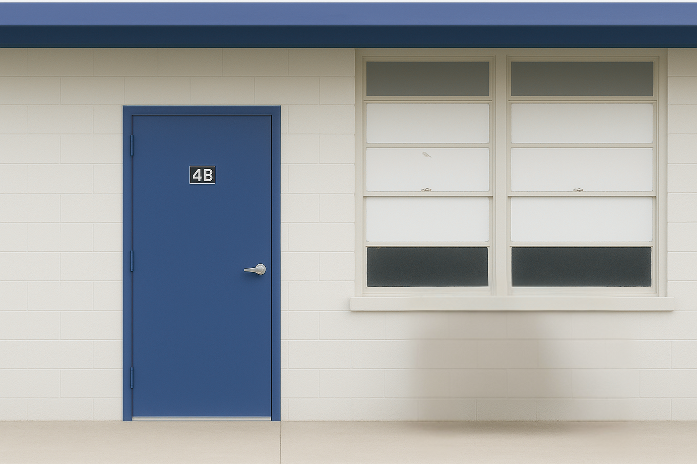




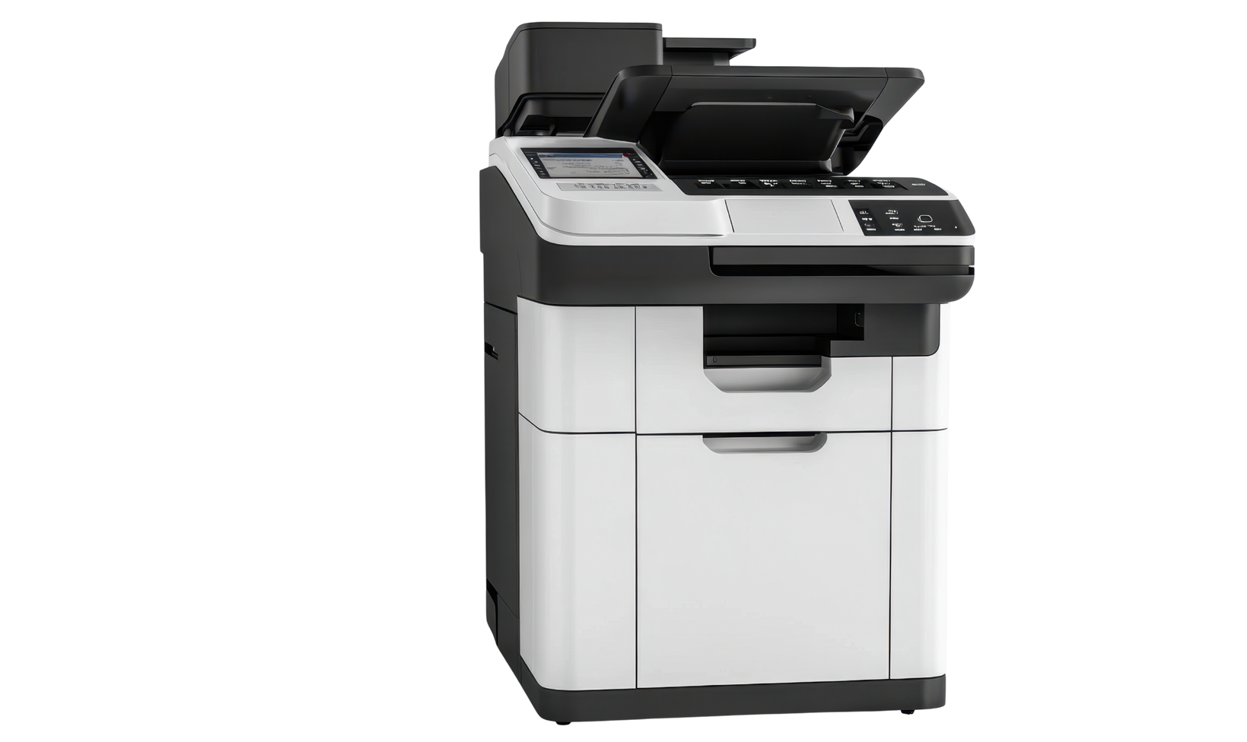
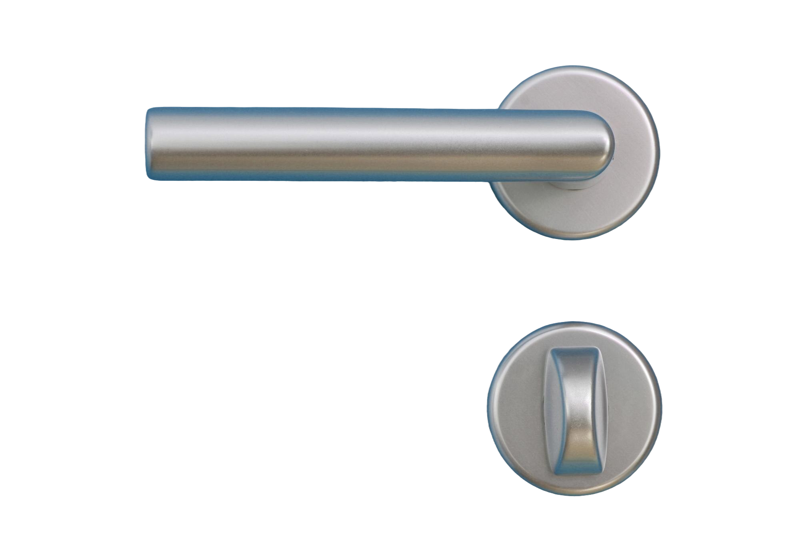


Slide 10
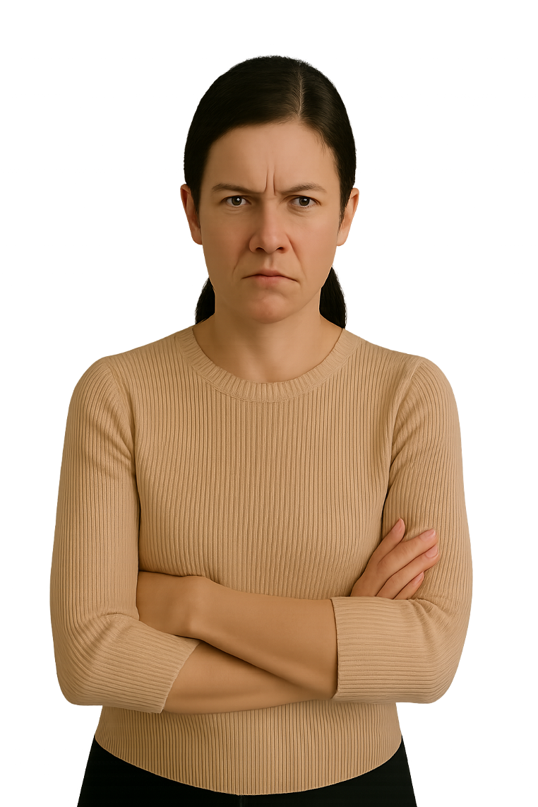

Slide 11
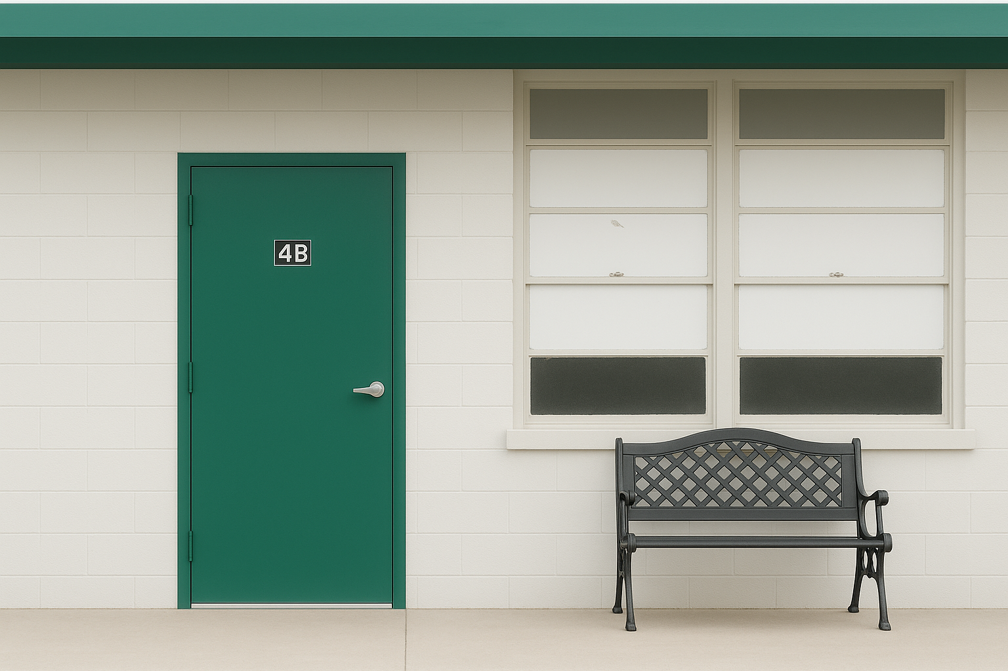
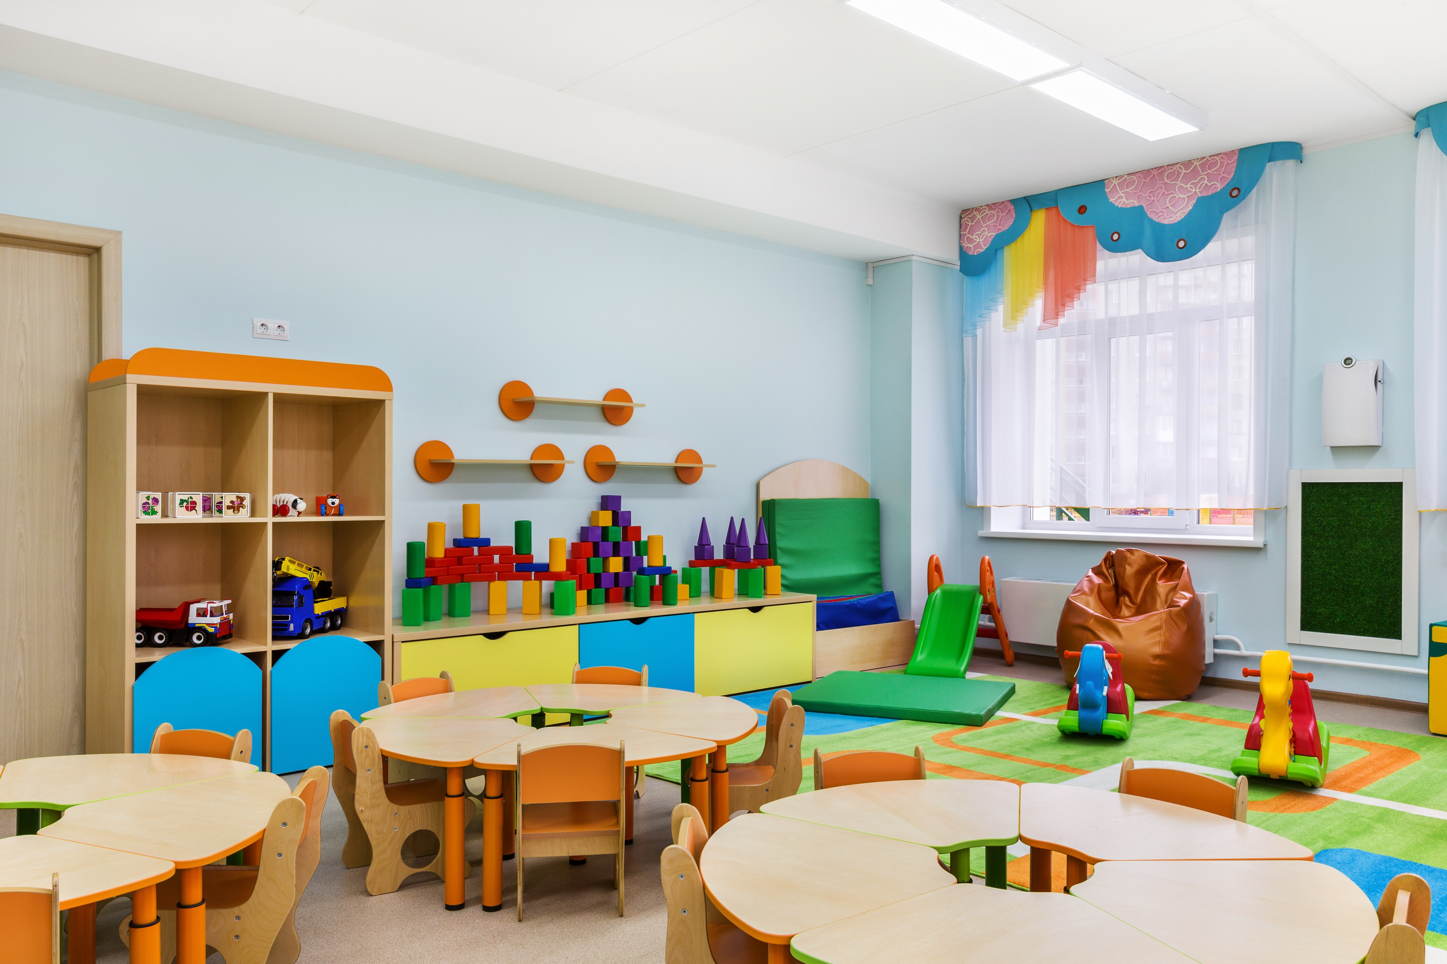

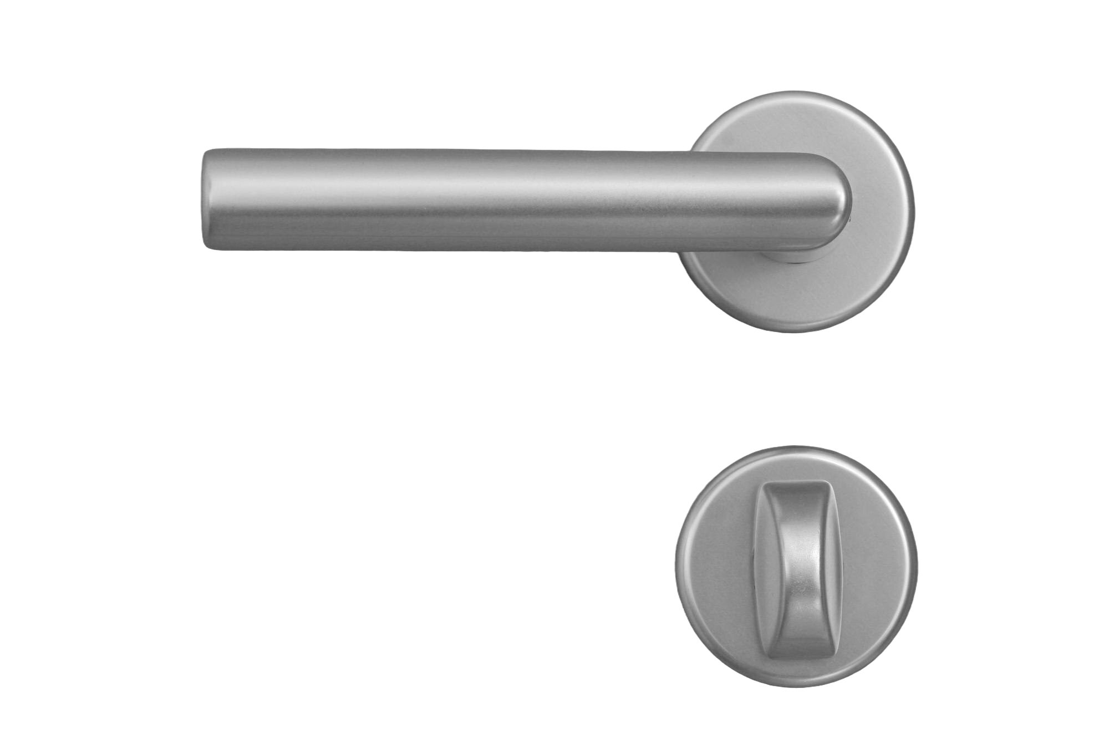




Slide 12
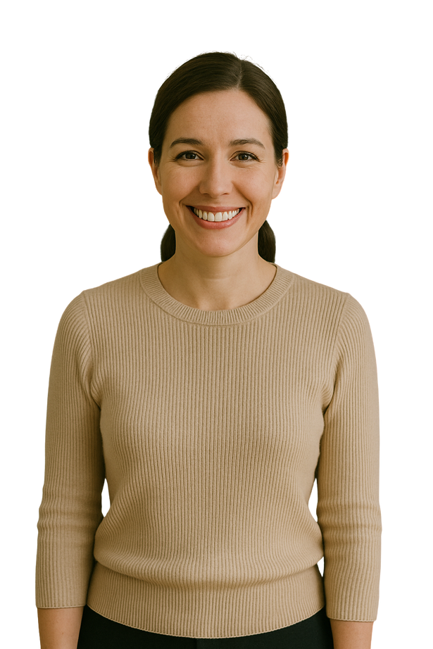
Notes:
.

Slide 13

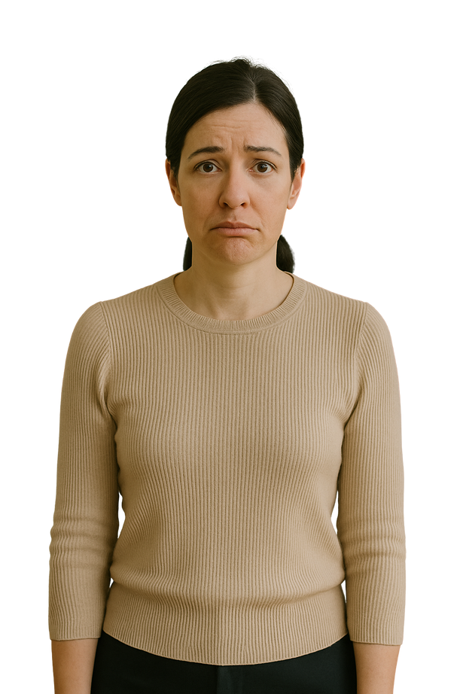
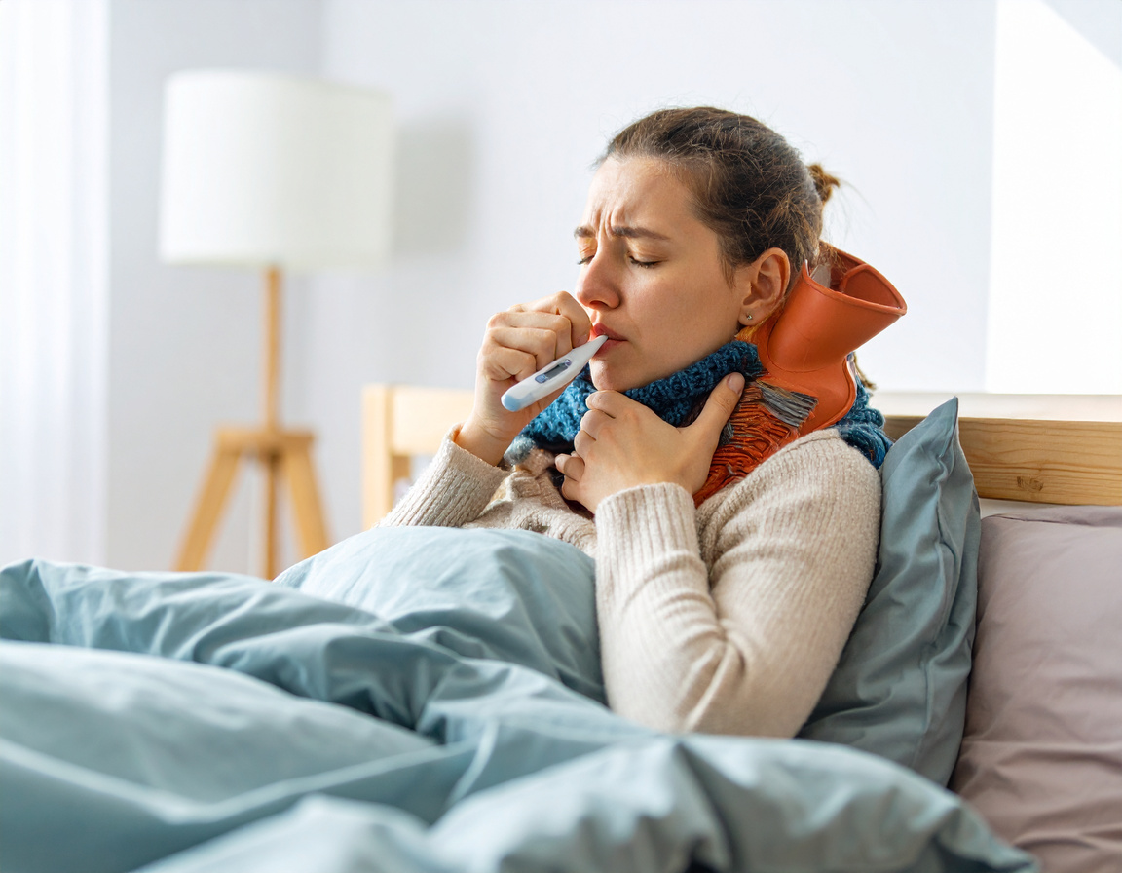

Slide 14
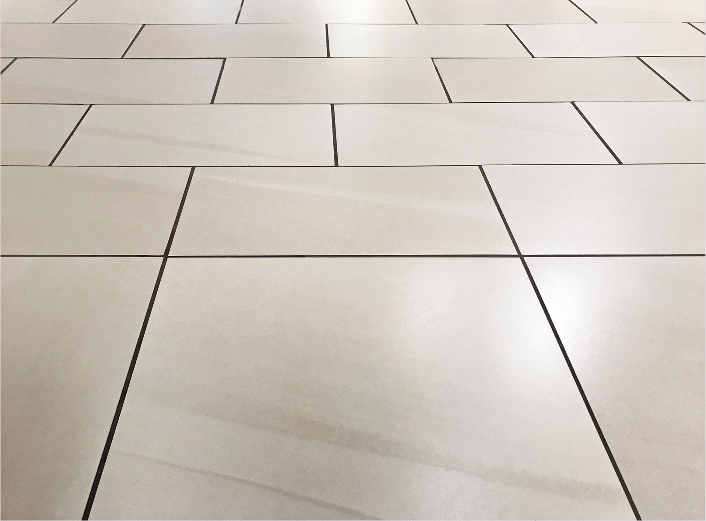
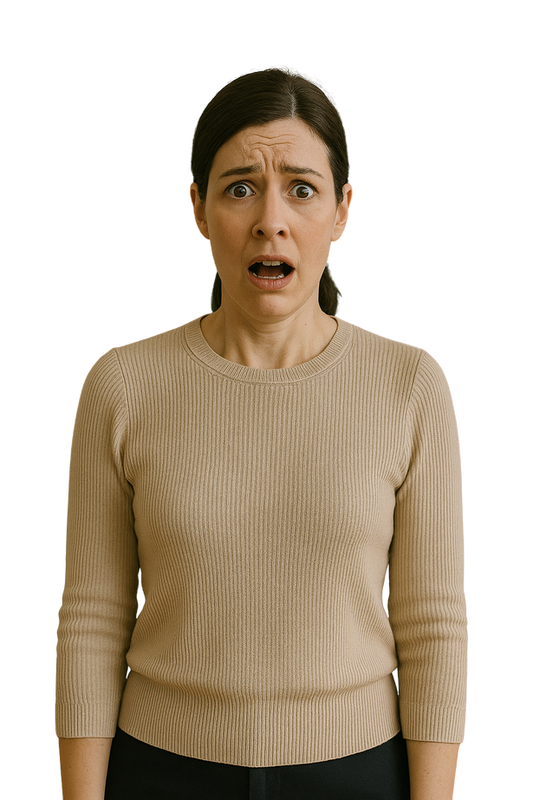
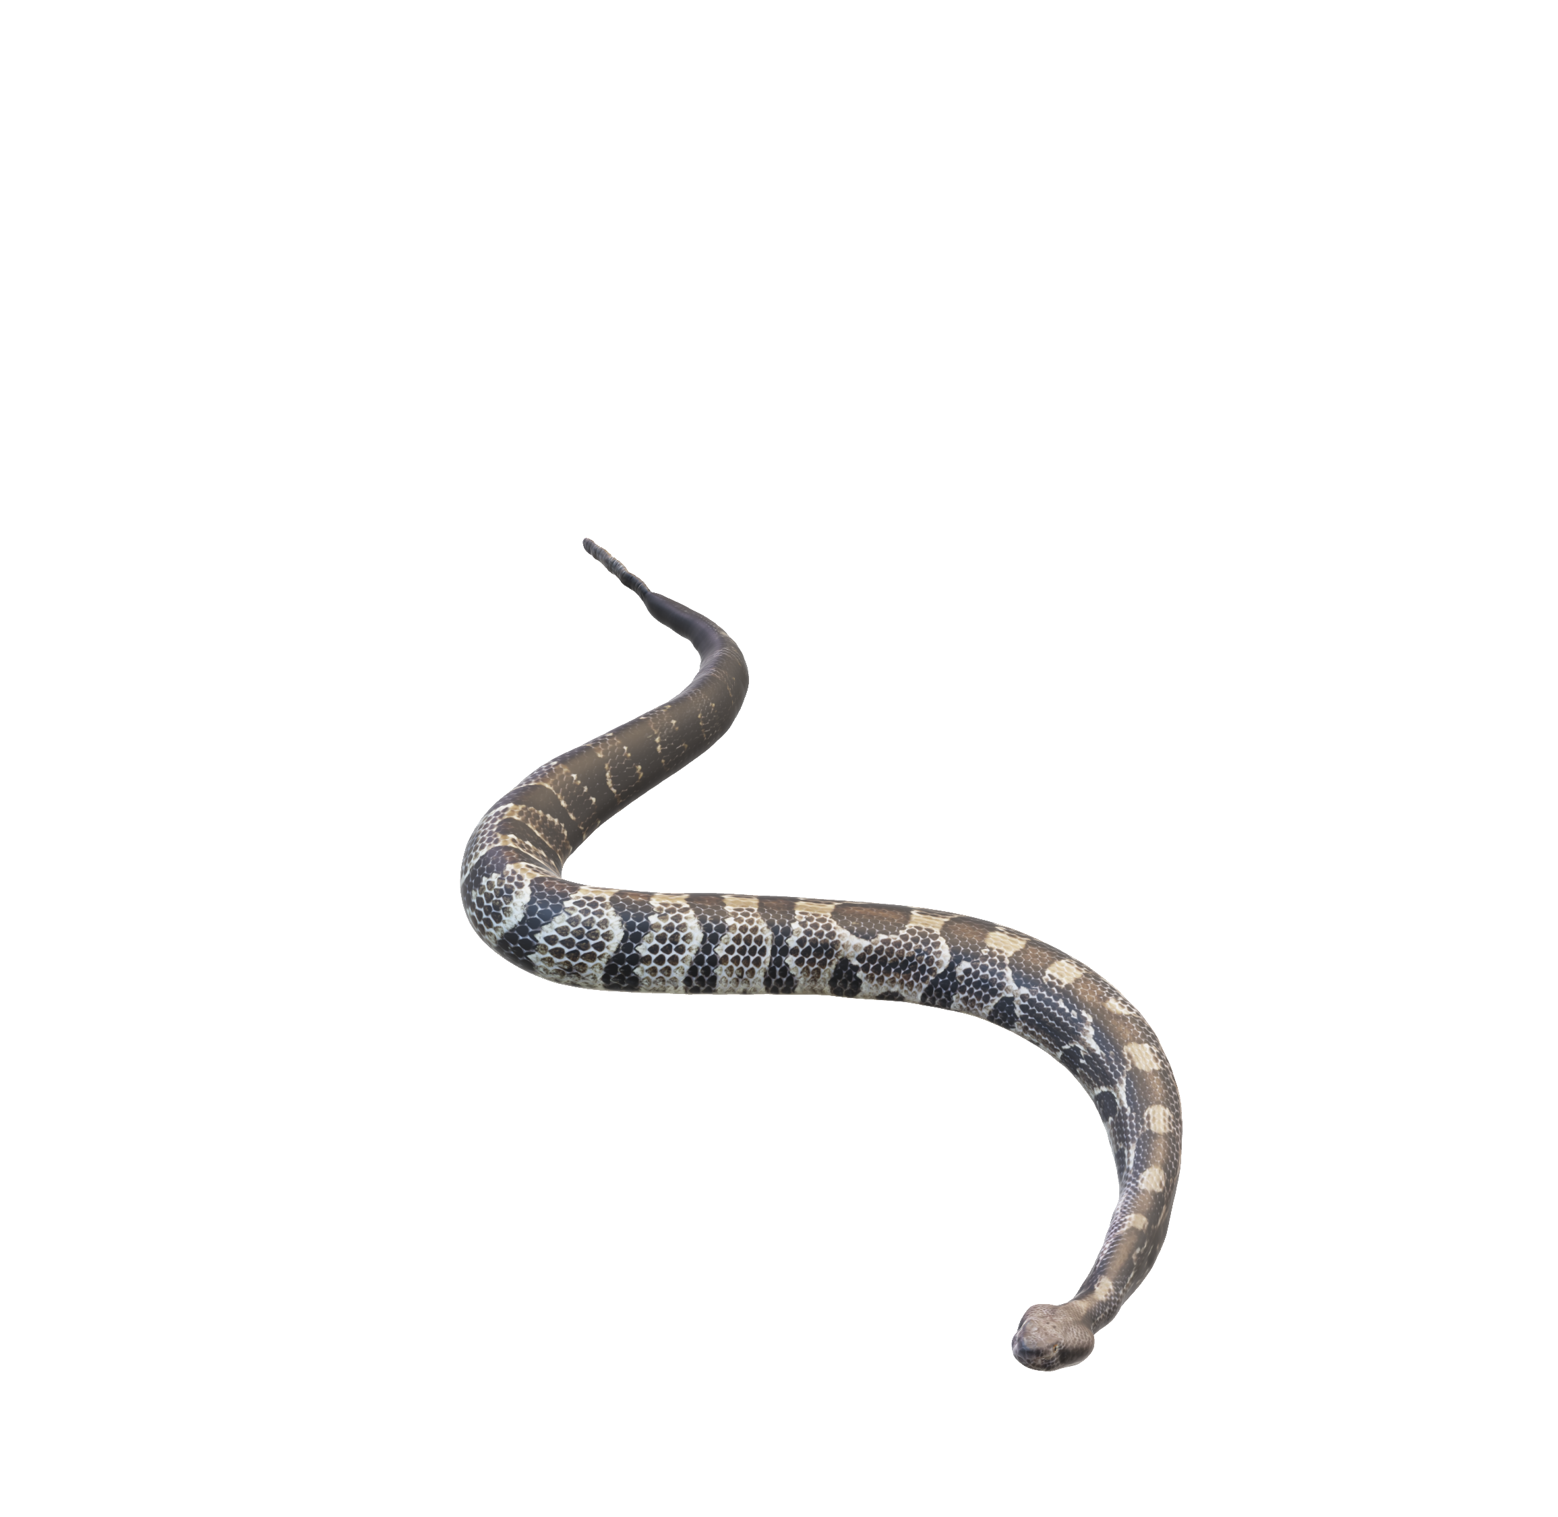

Slide 15
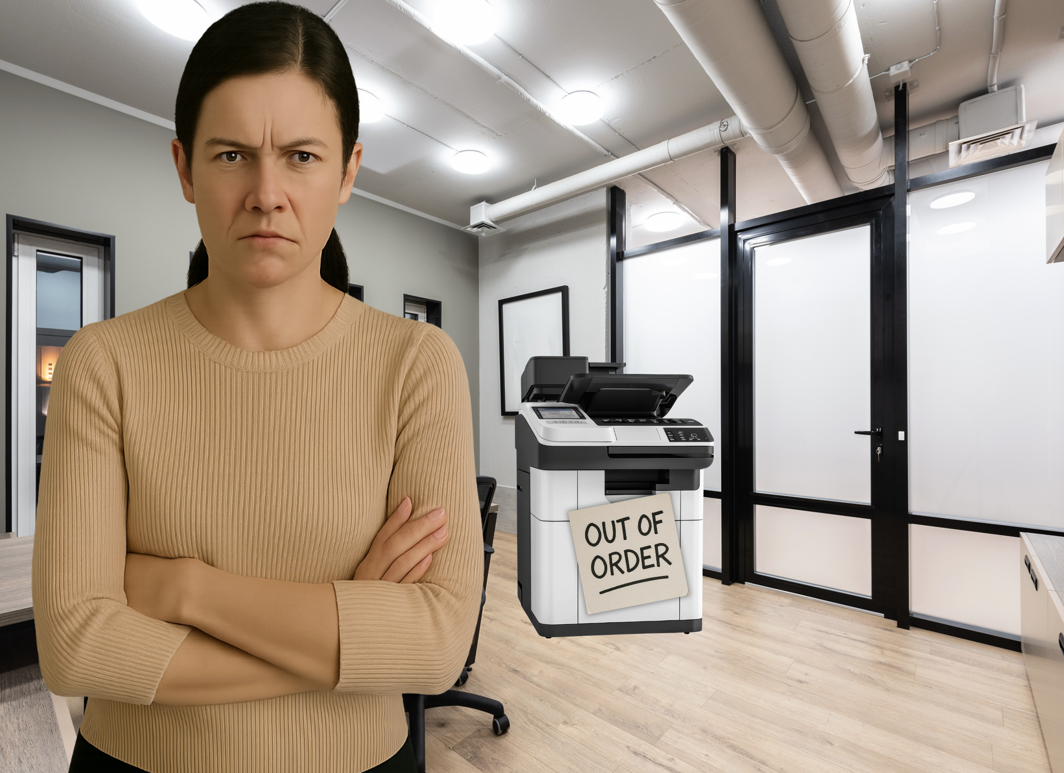
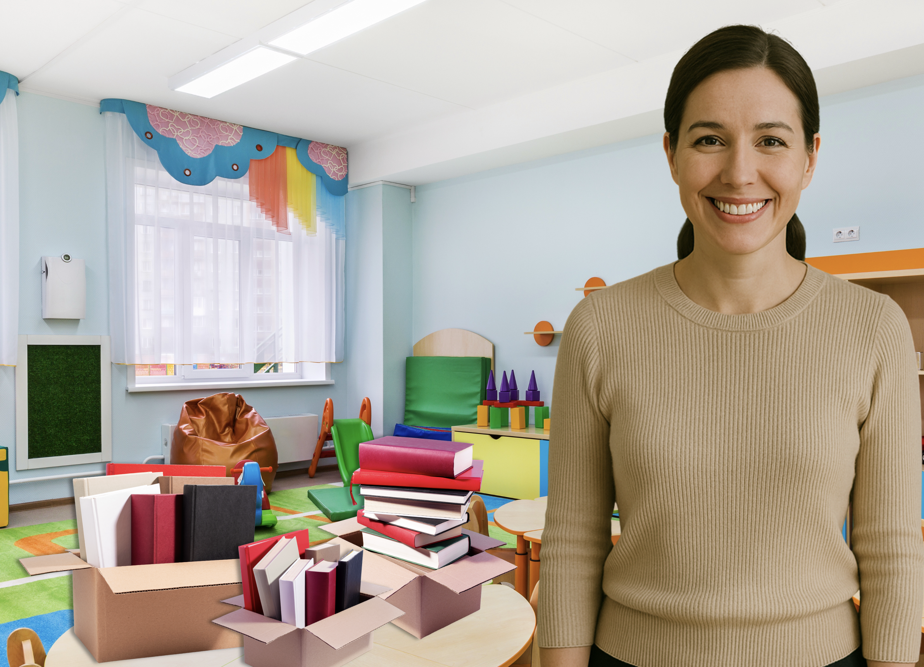
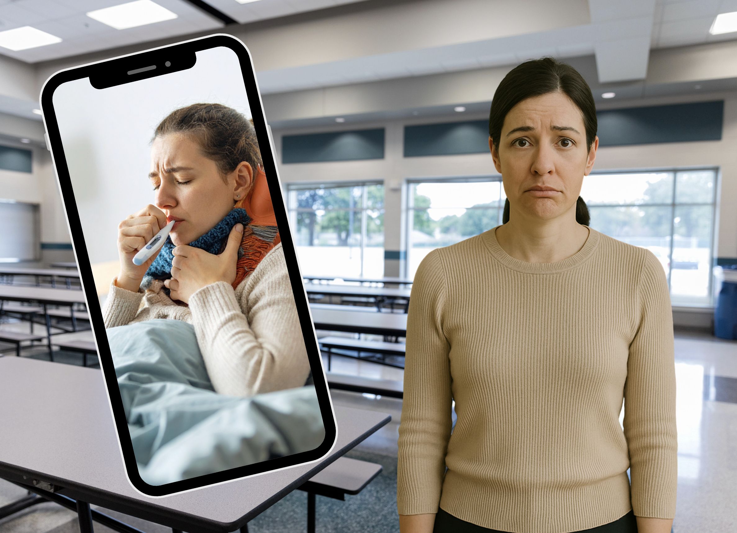
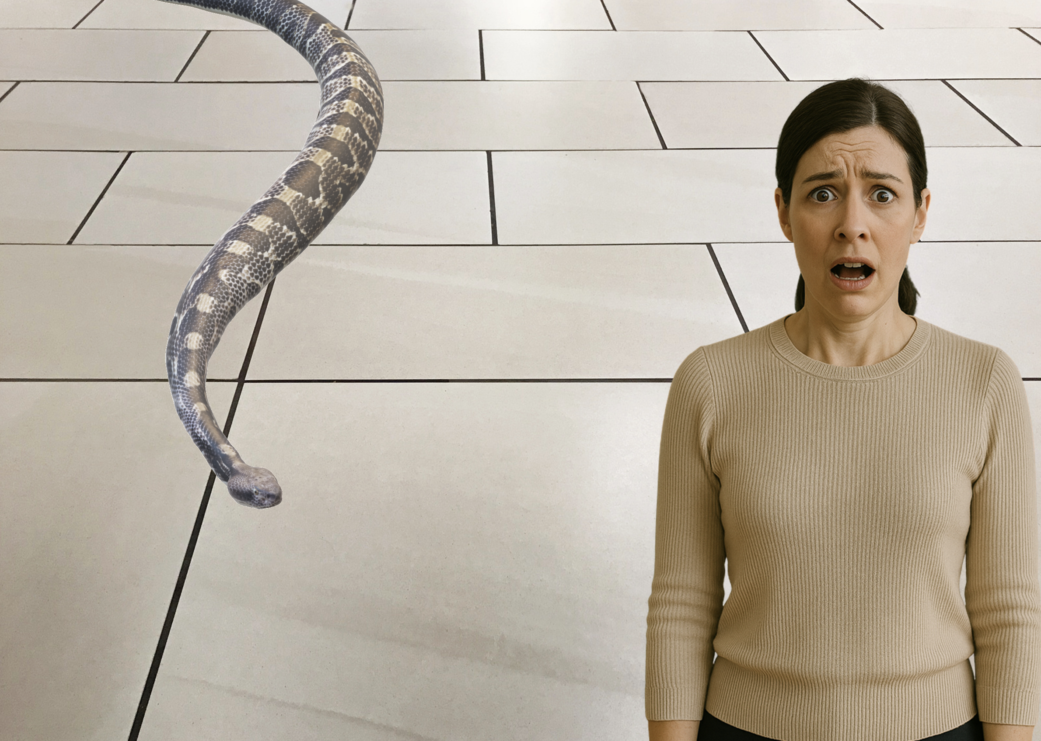

Slide 16
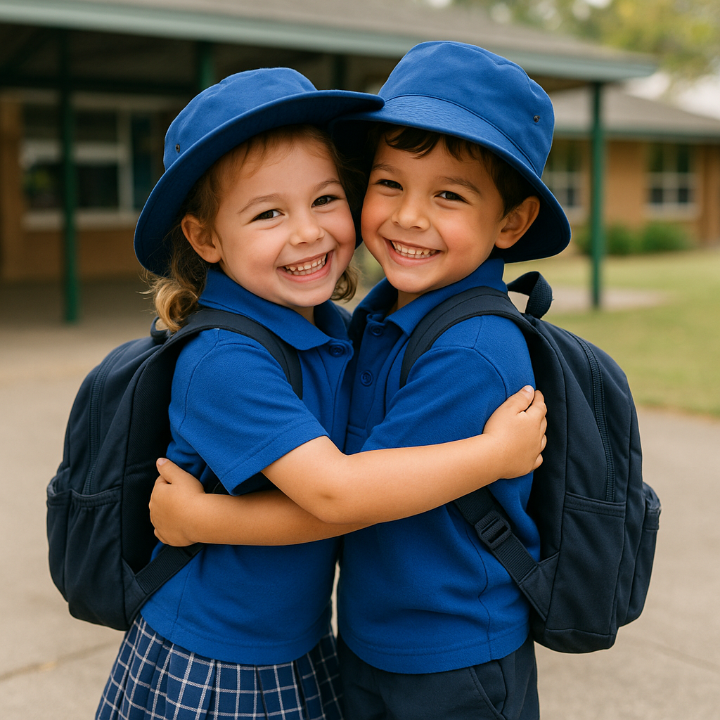
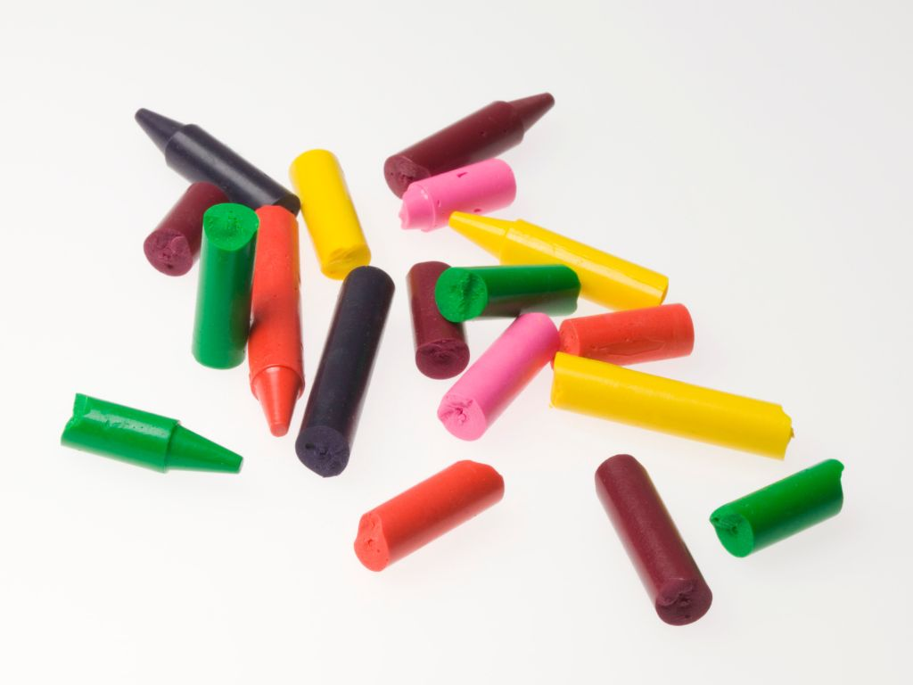
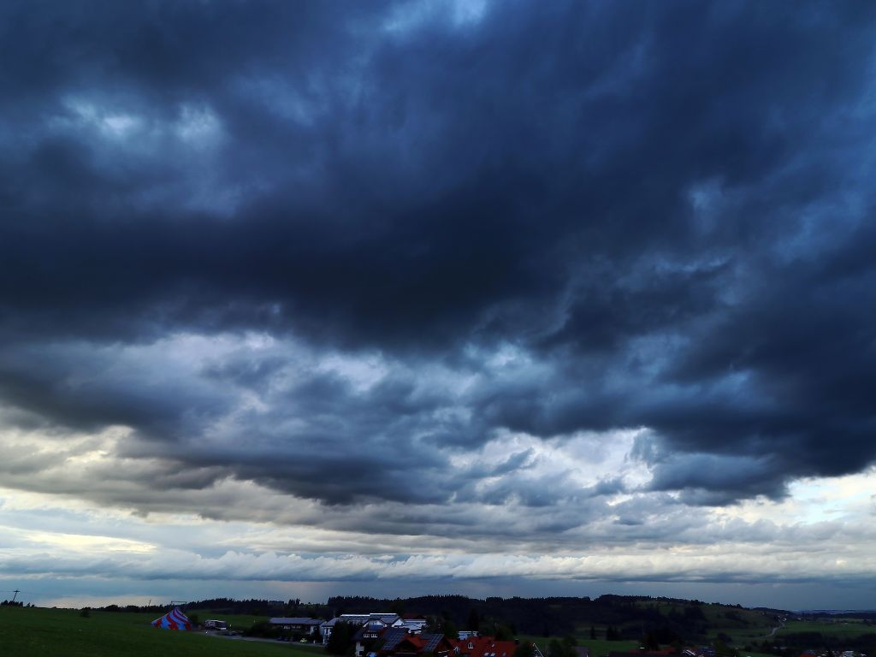
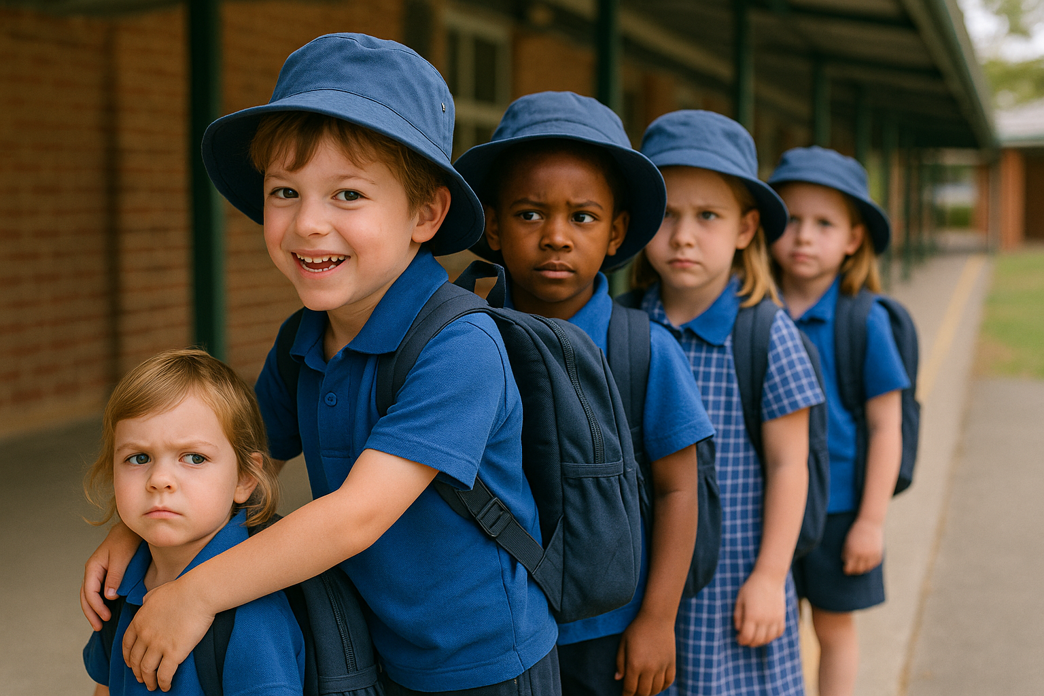
I feel scared.
I feel
sad.
I feel
happy.
I feel
mad.

Slide 17
I feel...

Slide 19
I feel...

Slide 21
I feel...

Slide 23
I feel...

Slide 25
When we notice our feelings, we can share them with others.
I feel mad!

Slide 26
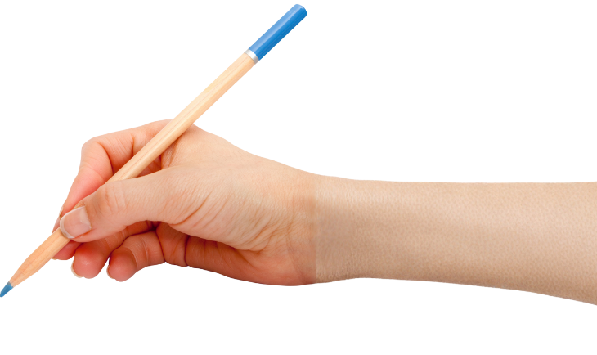

How well did you:
say an ‘I feel’
statement to share your feelings
choose a face or gesture that shows how you could feel in different situations?
Notes:
​

Slide 27

In the next lesson, we will share things we like and talk about things we are good at.

