Slide 1
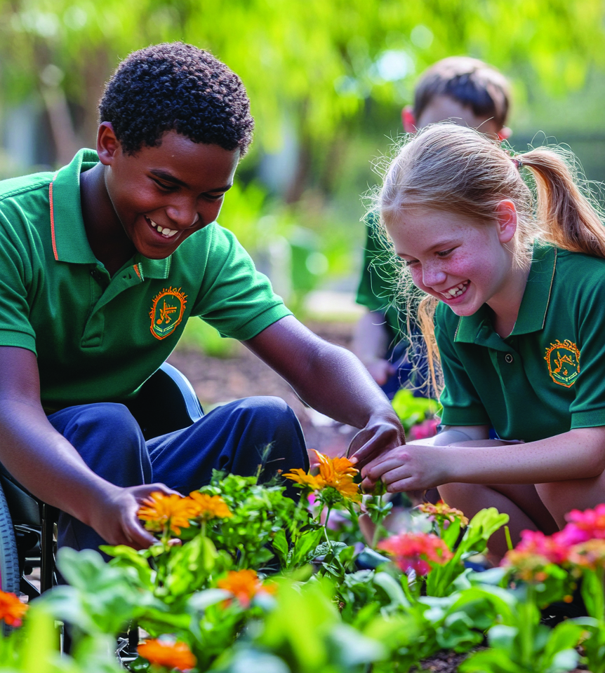
What Does Kindness Look Like?
Unit 1: Knowing Me, Knowing You
Lesson 1

Slide 2

In this lesson, you will explore how kindness can look, sound and feel in real-life situations.

Slide 3
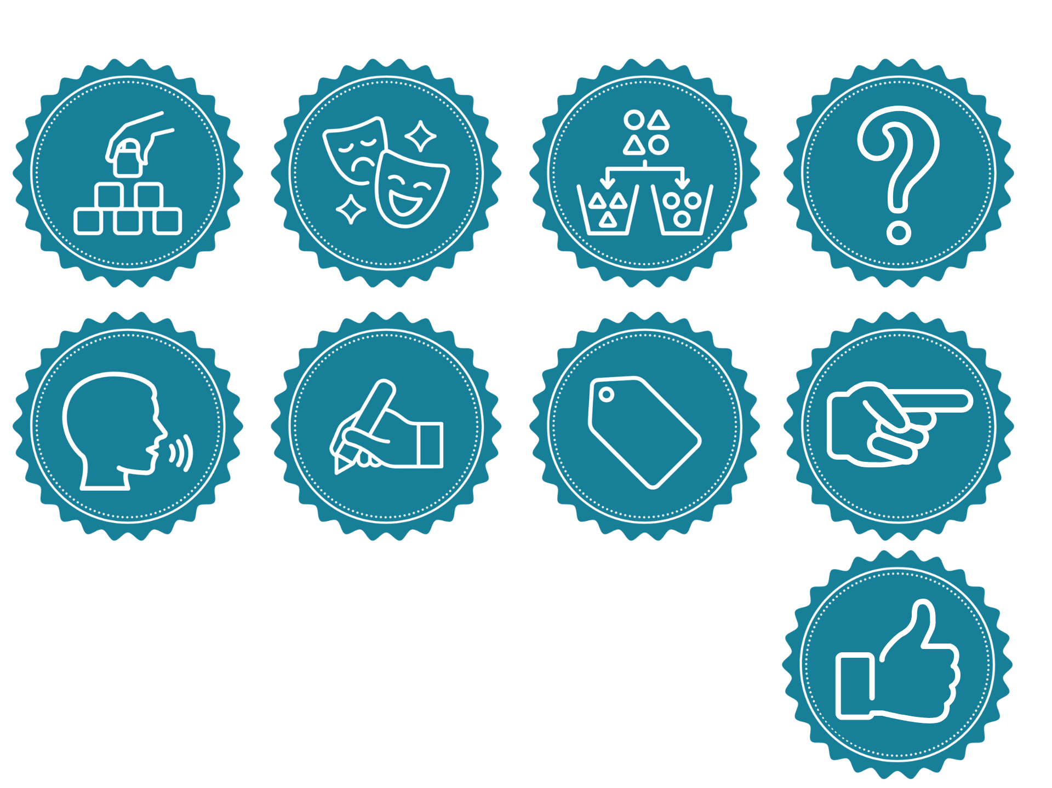
You will be successful when you can:
describe kind phrases and actions
explain how kindness makes others feel.

Slide 4
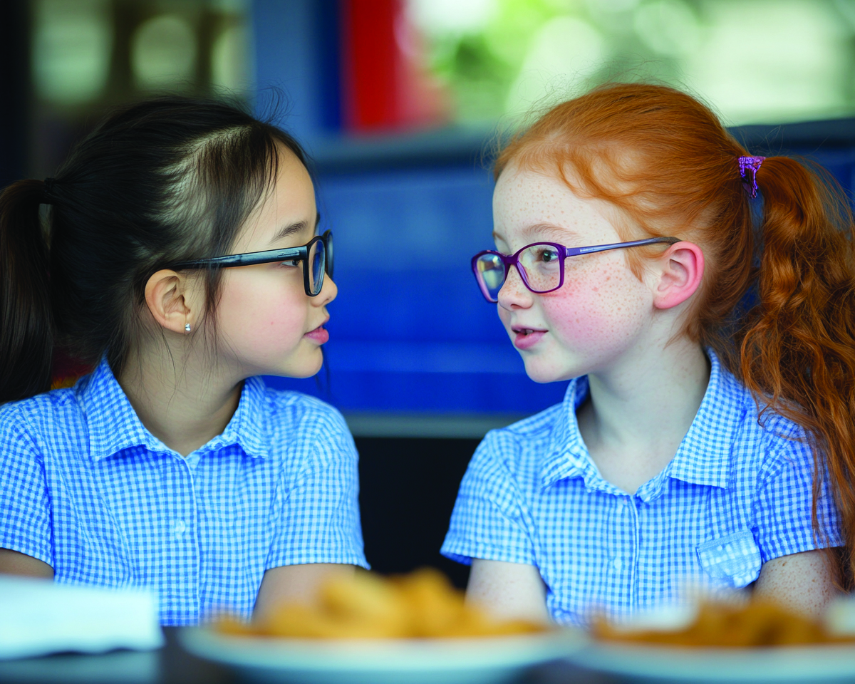
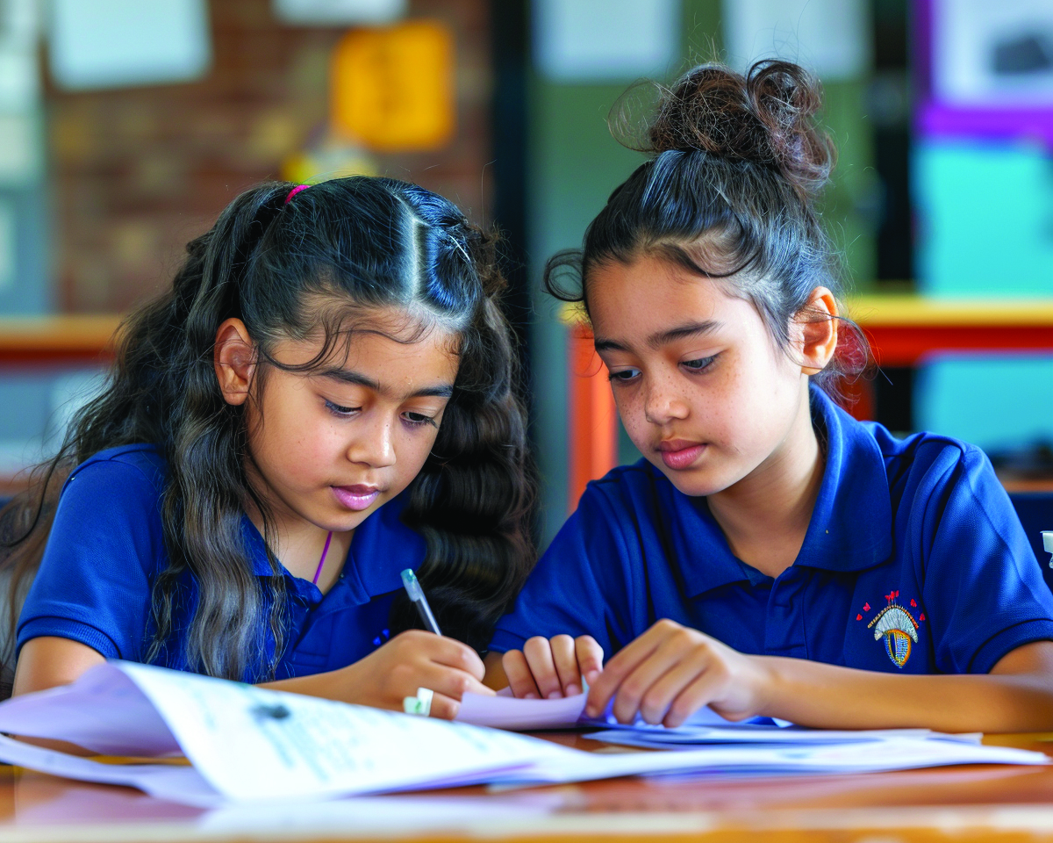
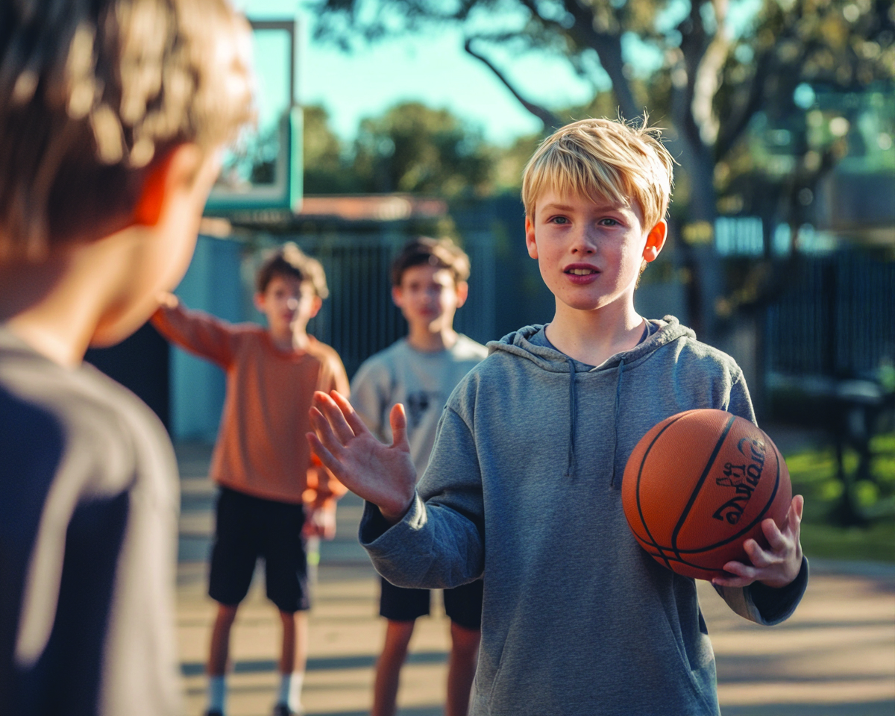

Slide 5
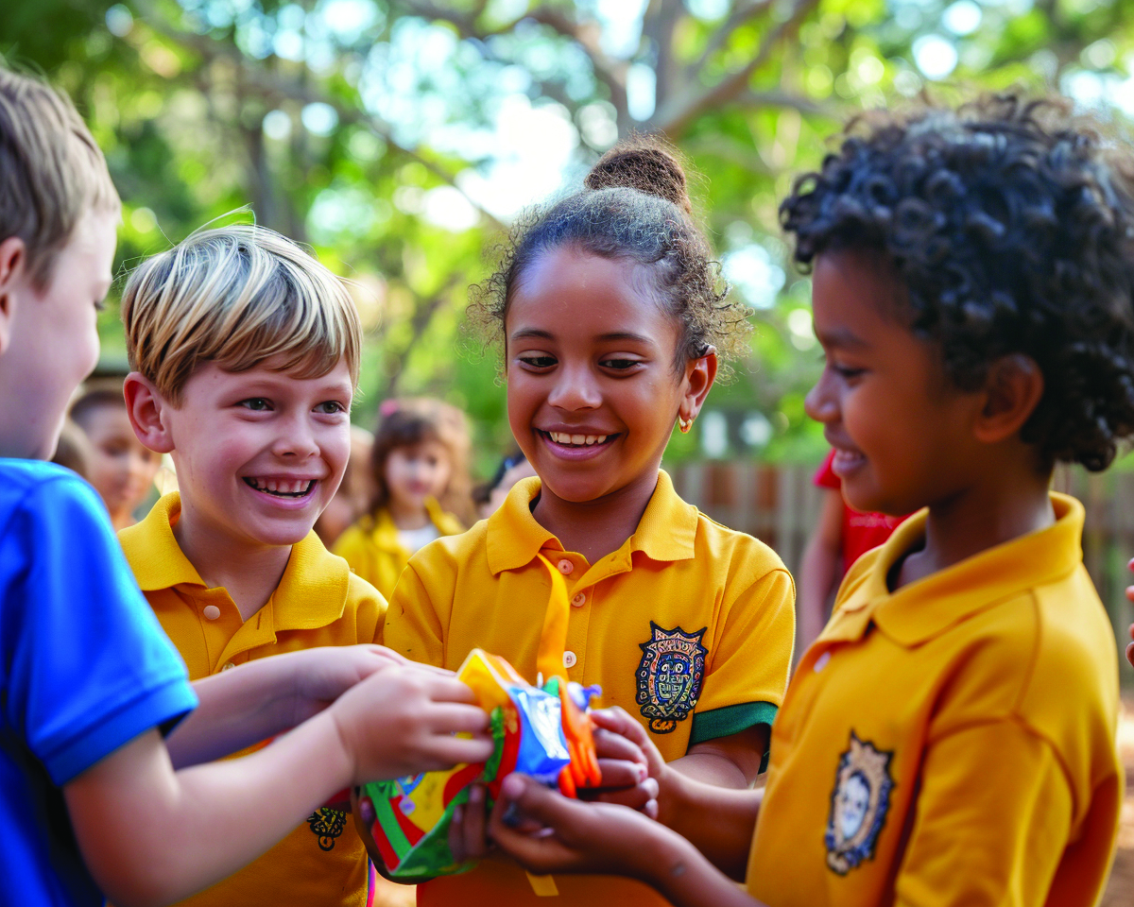
Kindness
Kindness is using our words or actions to help others feel cared for and included.

Slide 6
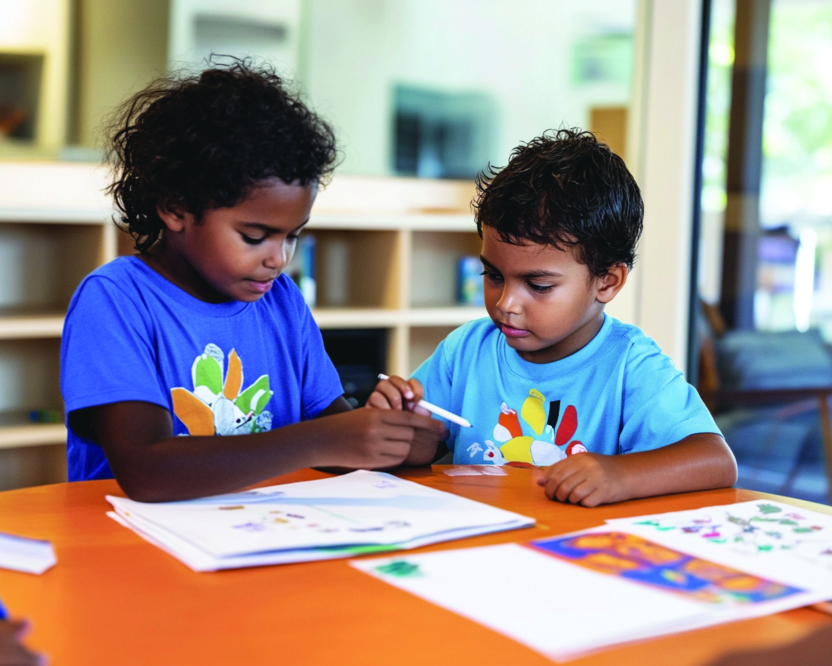
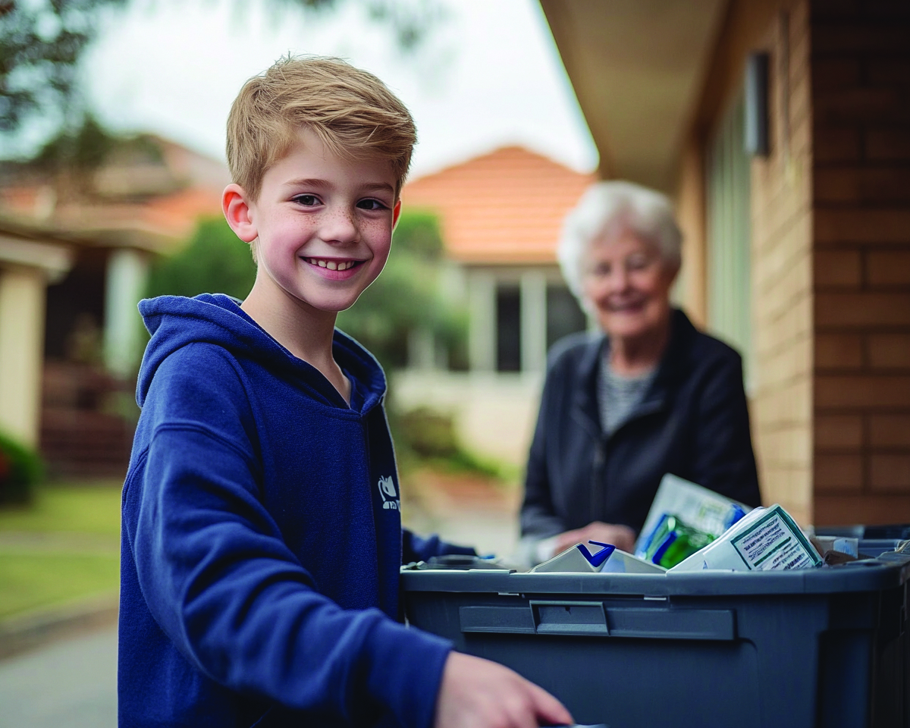
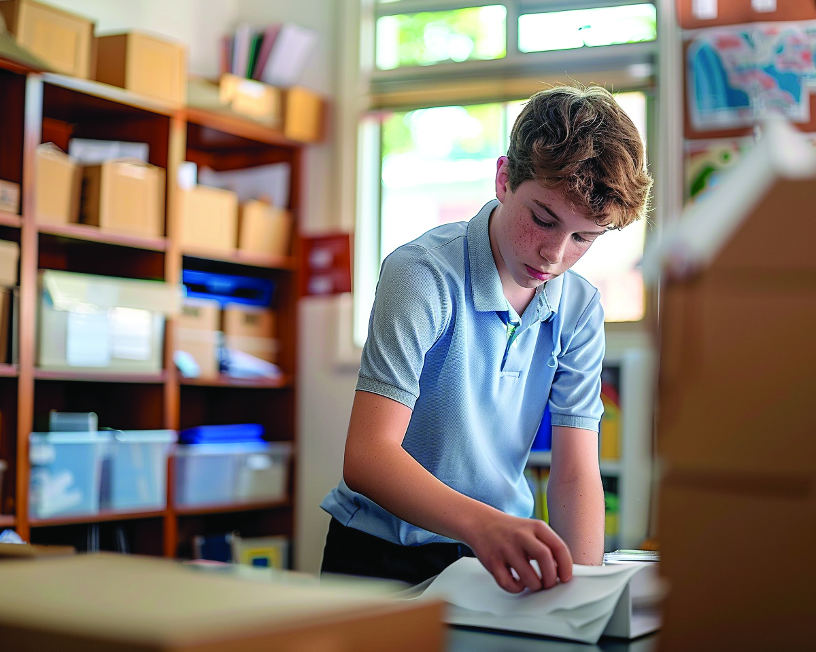
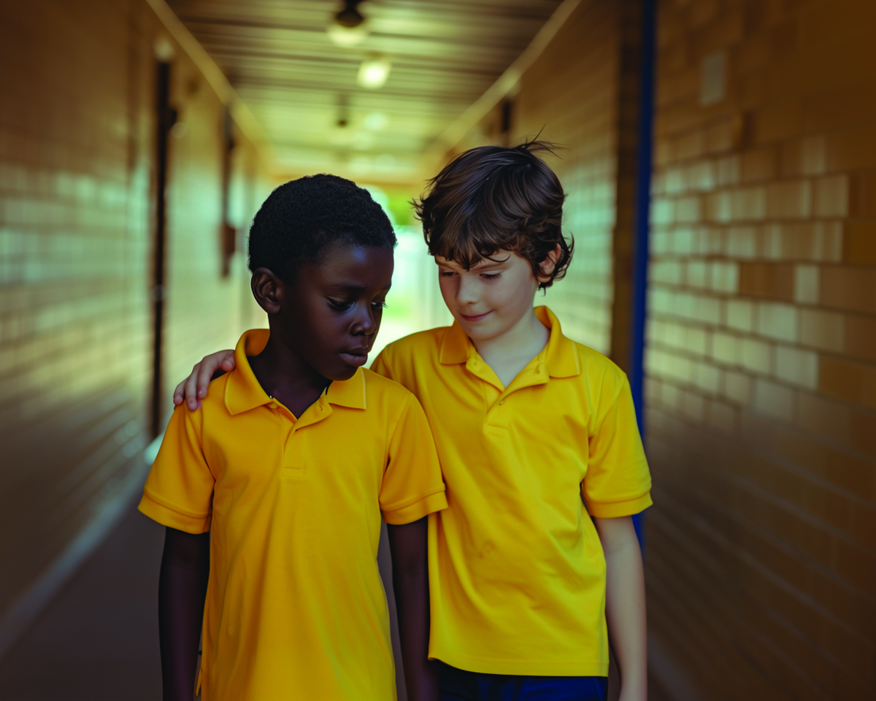
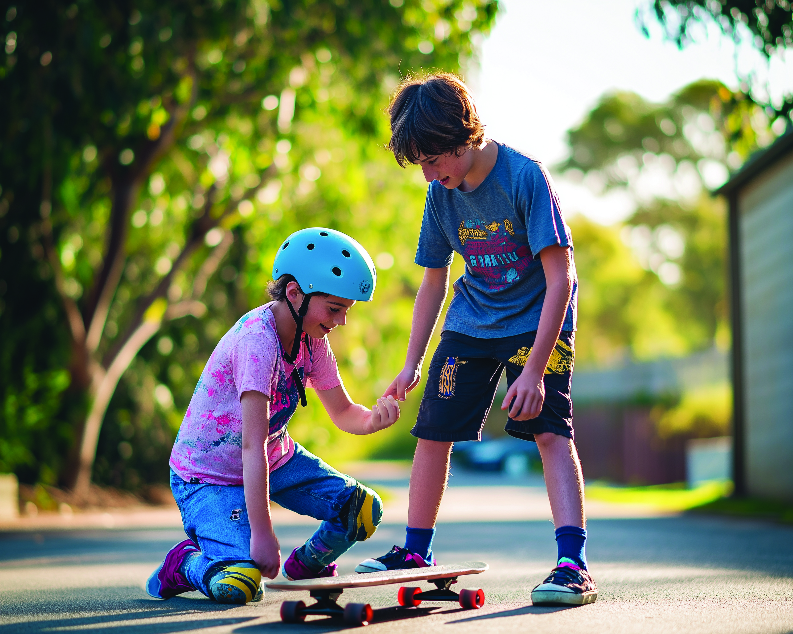

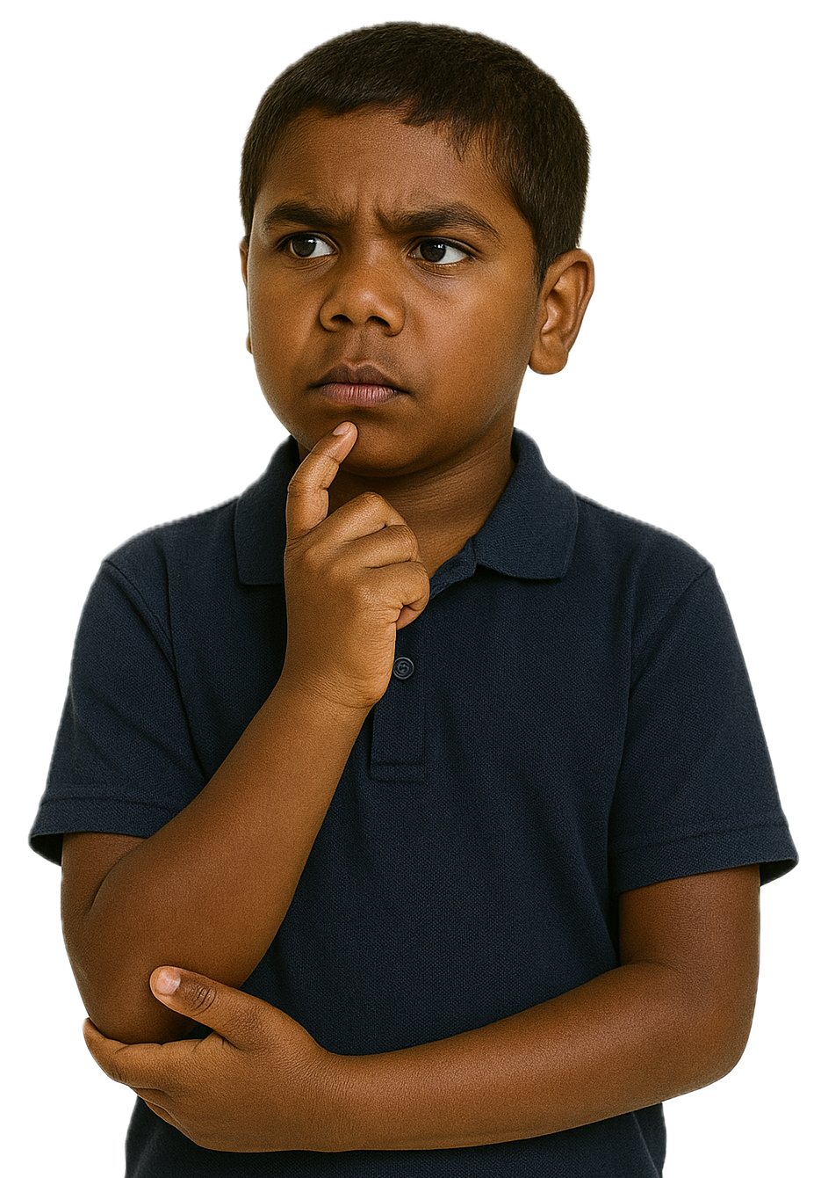
Kind Actions
Showing kindness to others means doing nice things that help people feel happy and cared for.

Slide 7

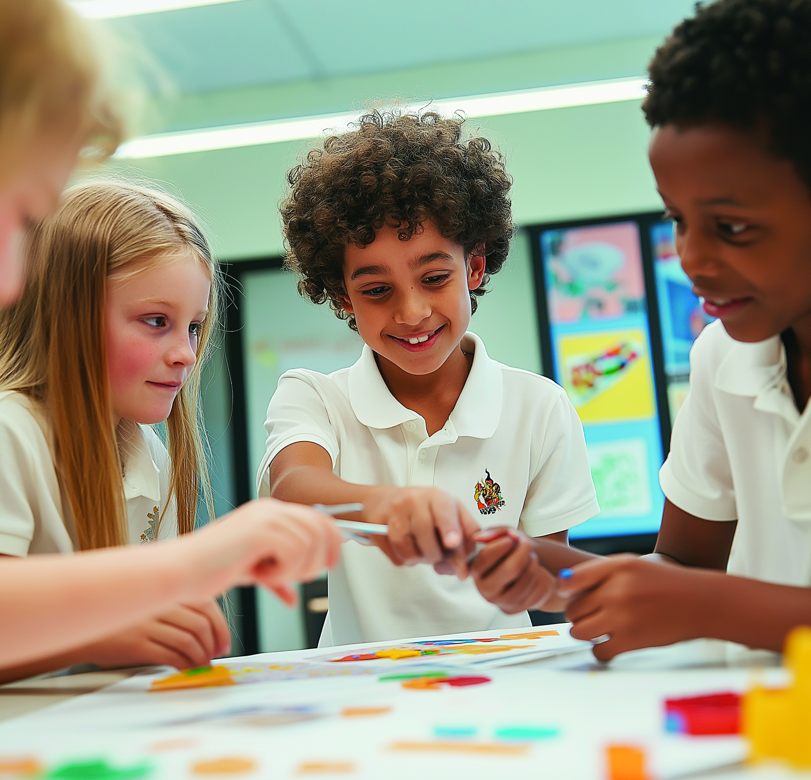
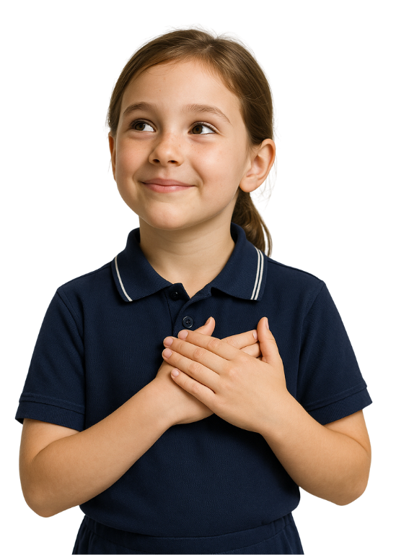
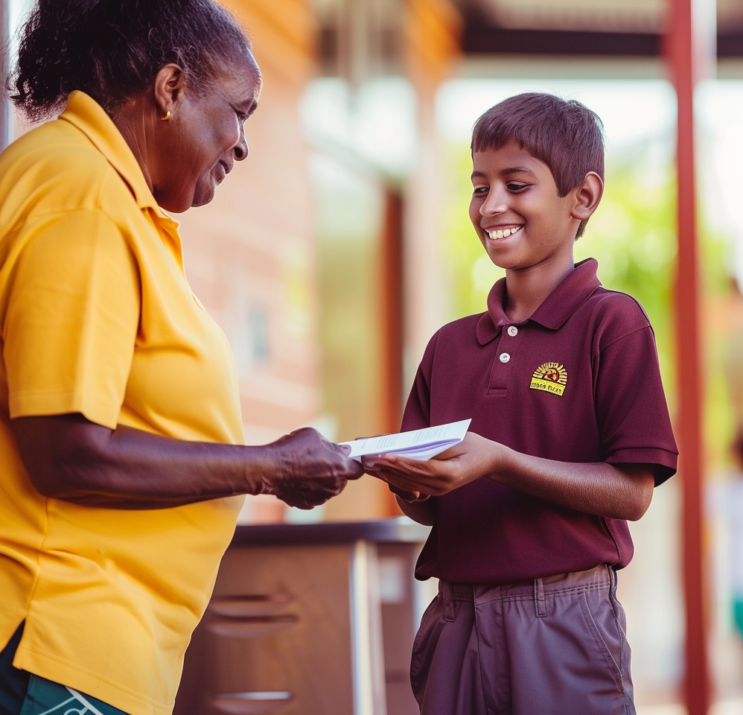
Kindness Looks Like...

Slide 8

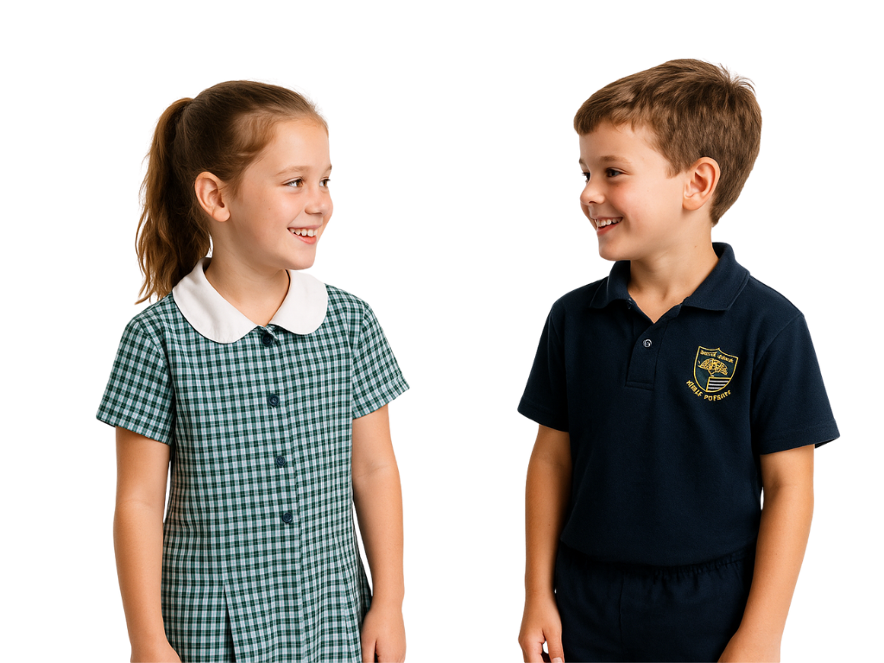
Kind Words
You can also show kindness to others by using caring and friendly words to make others feel happy and included.
You did a great job!
How are you today?

Slide 9
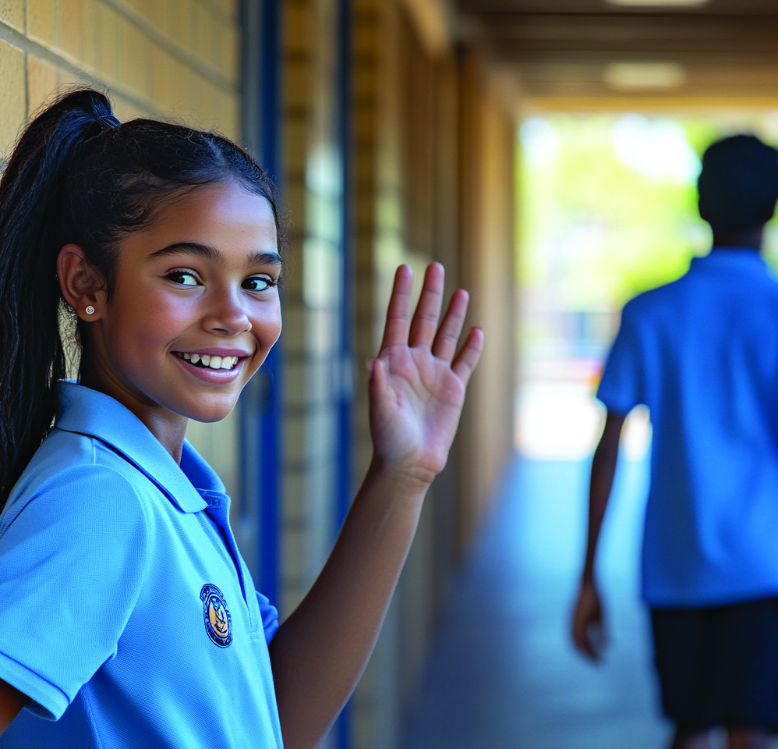
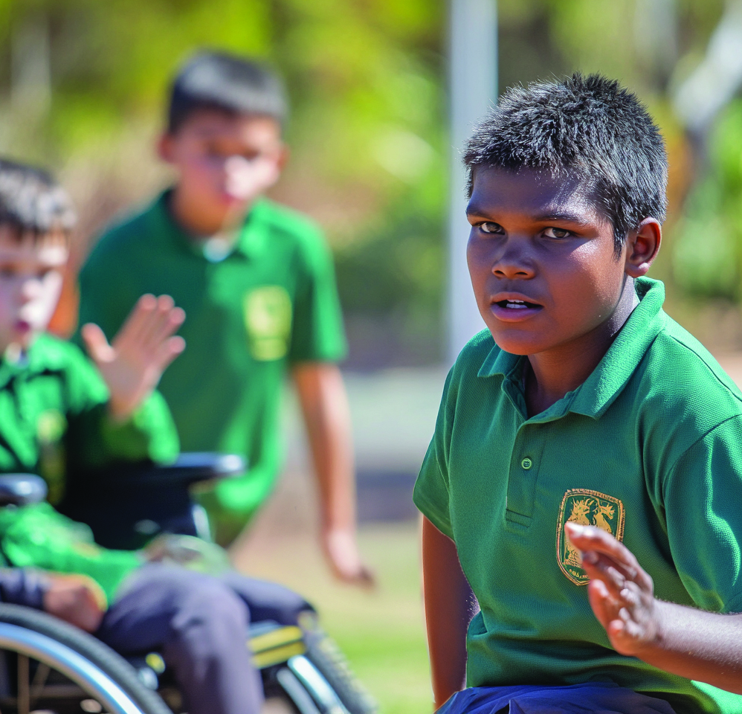
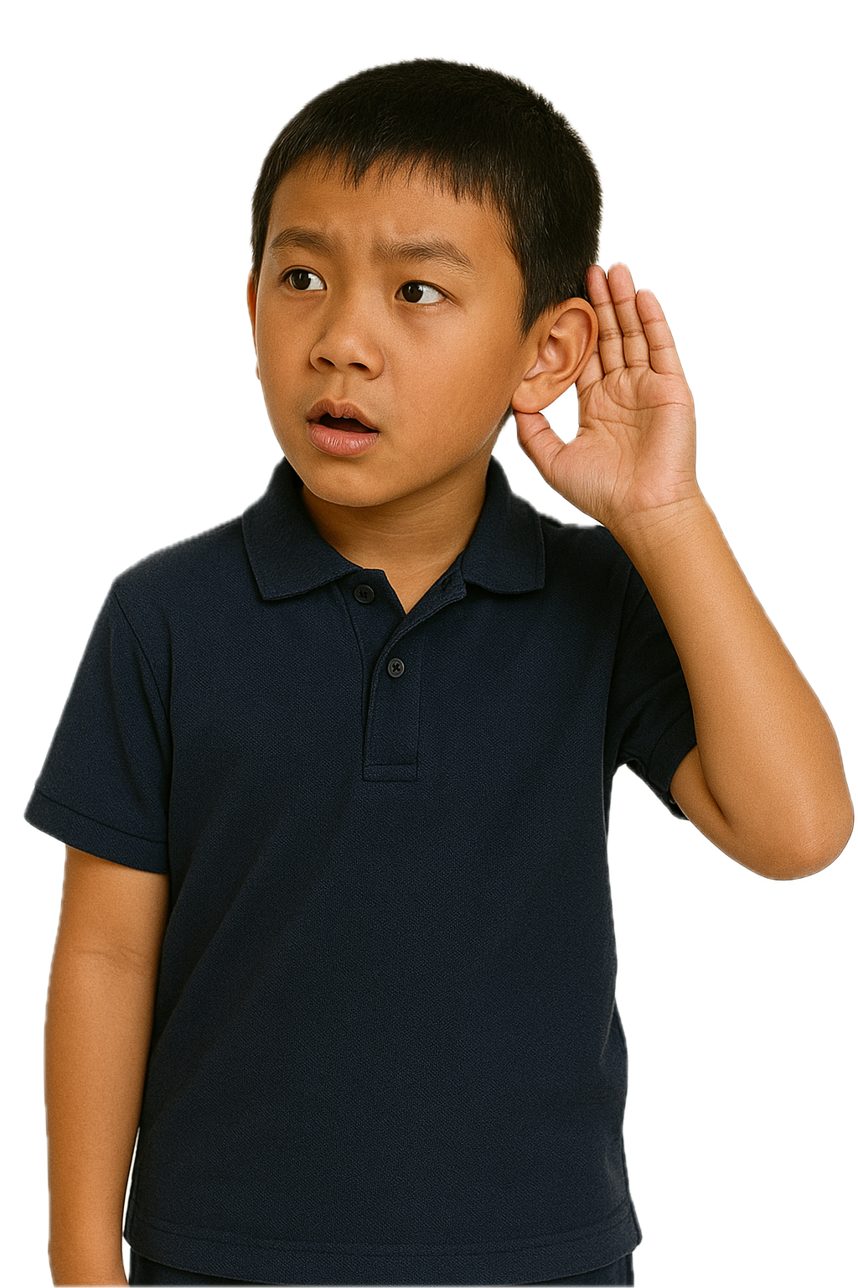
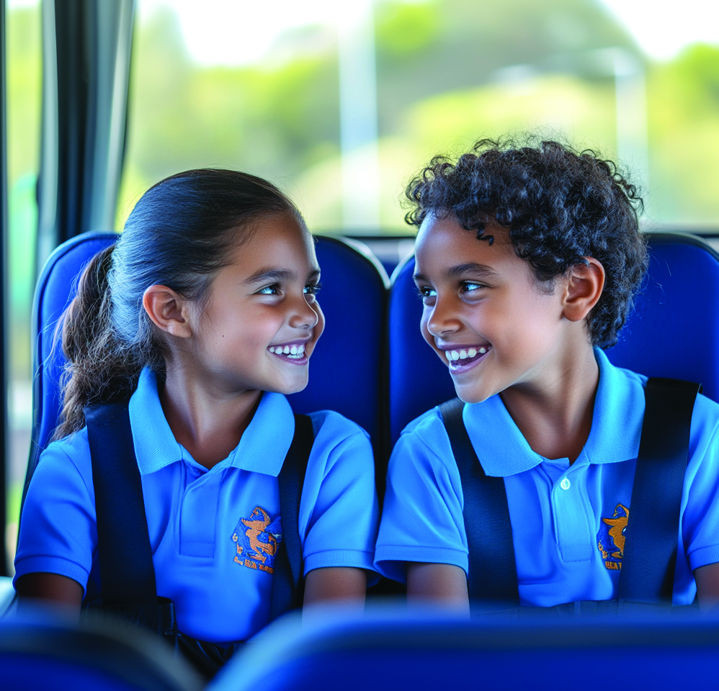
Kindness Sounds Like...

Slide 10
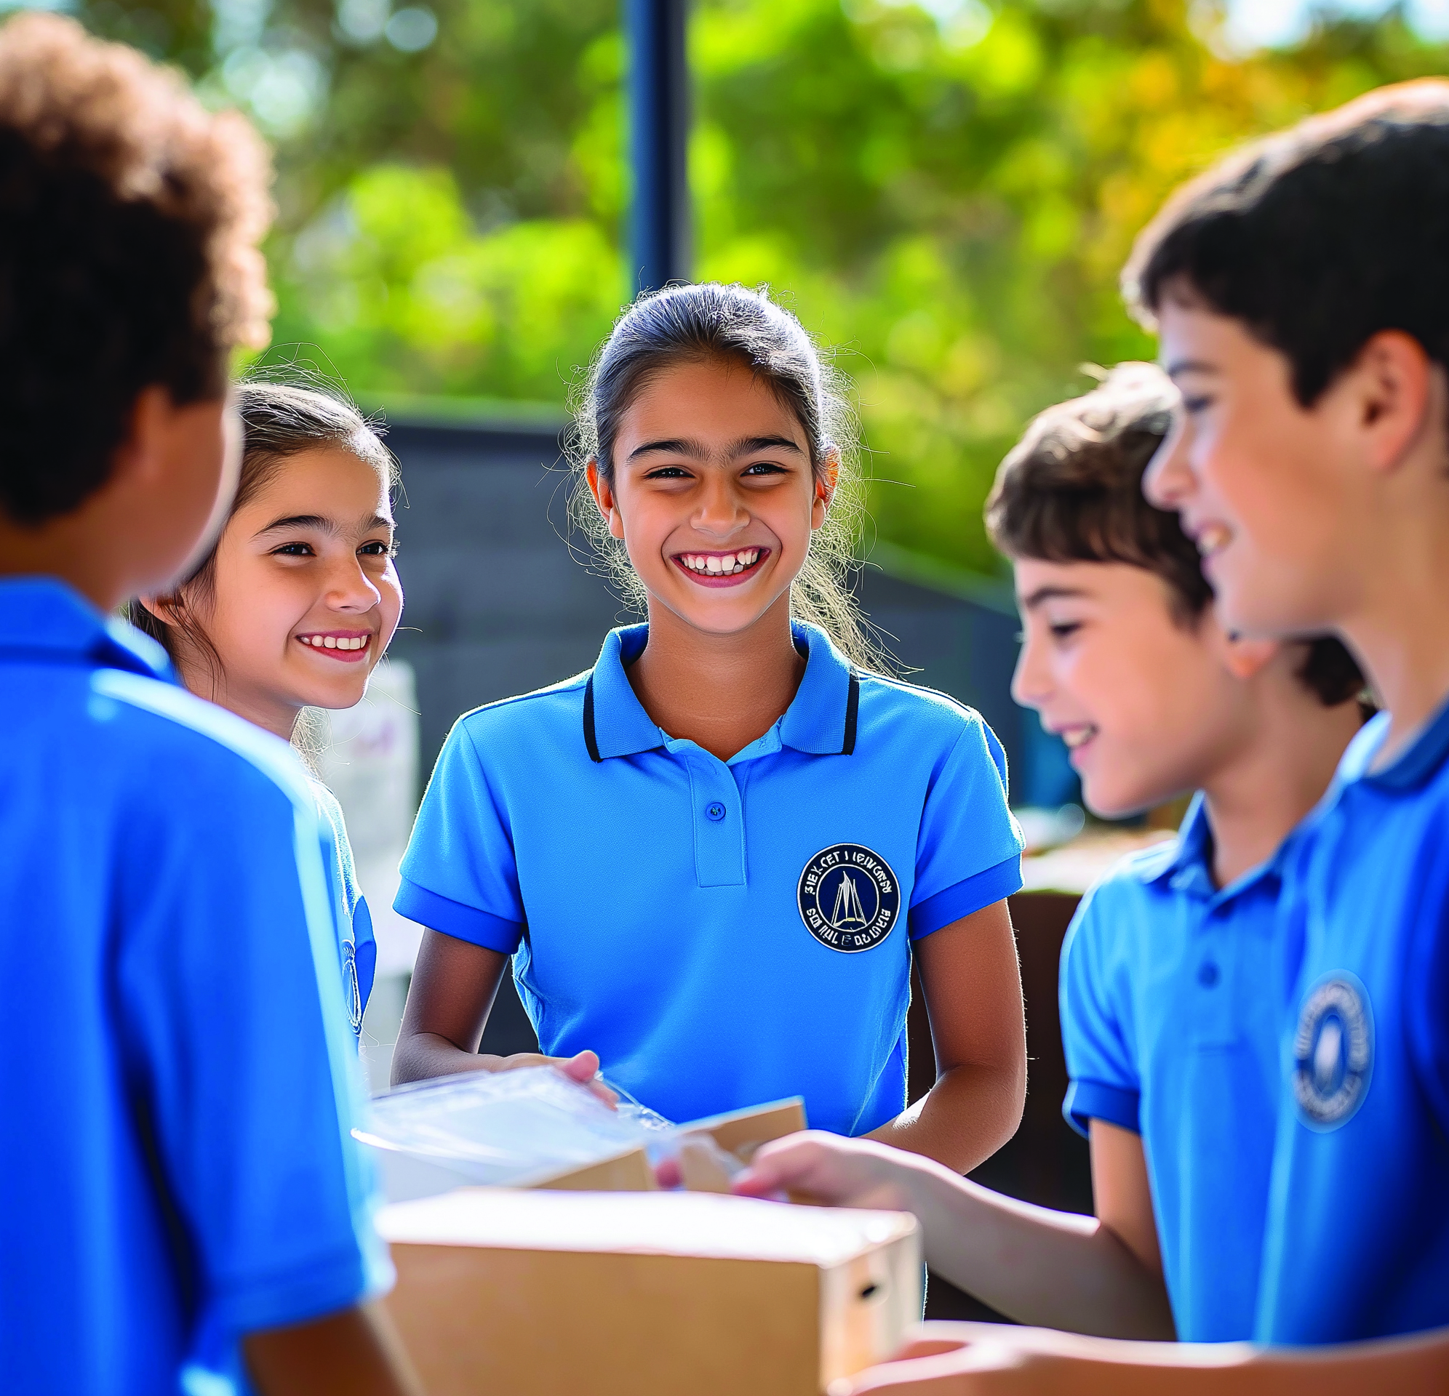
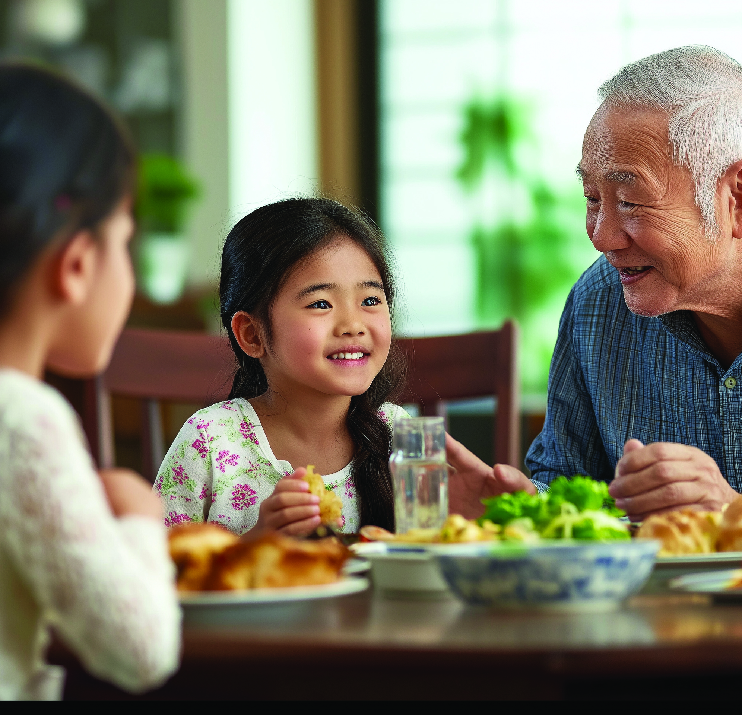
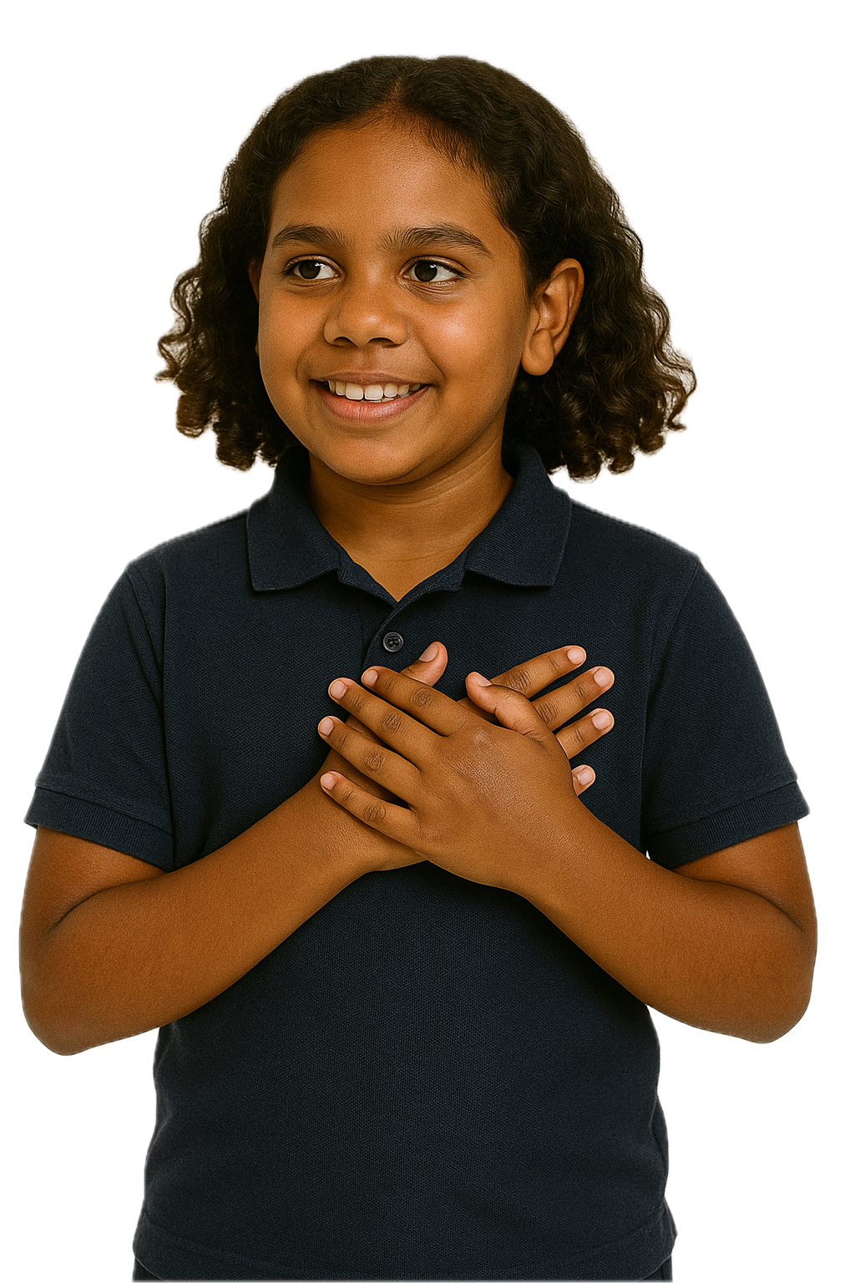
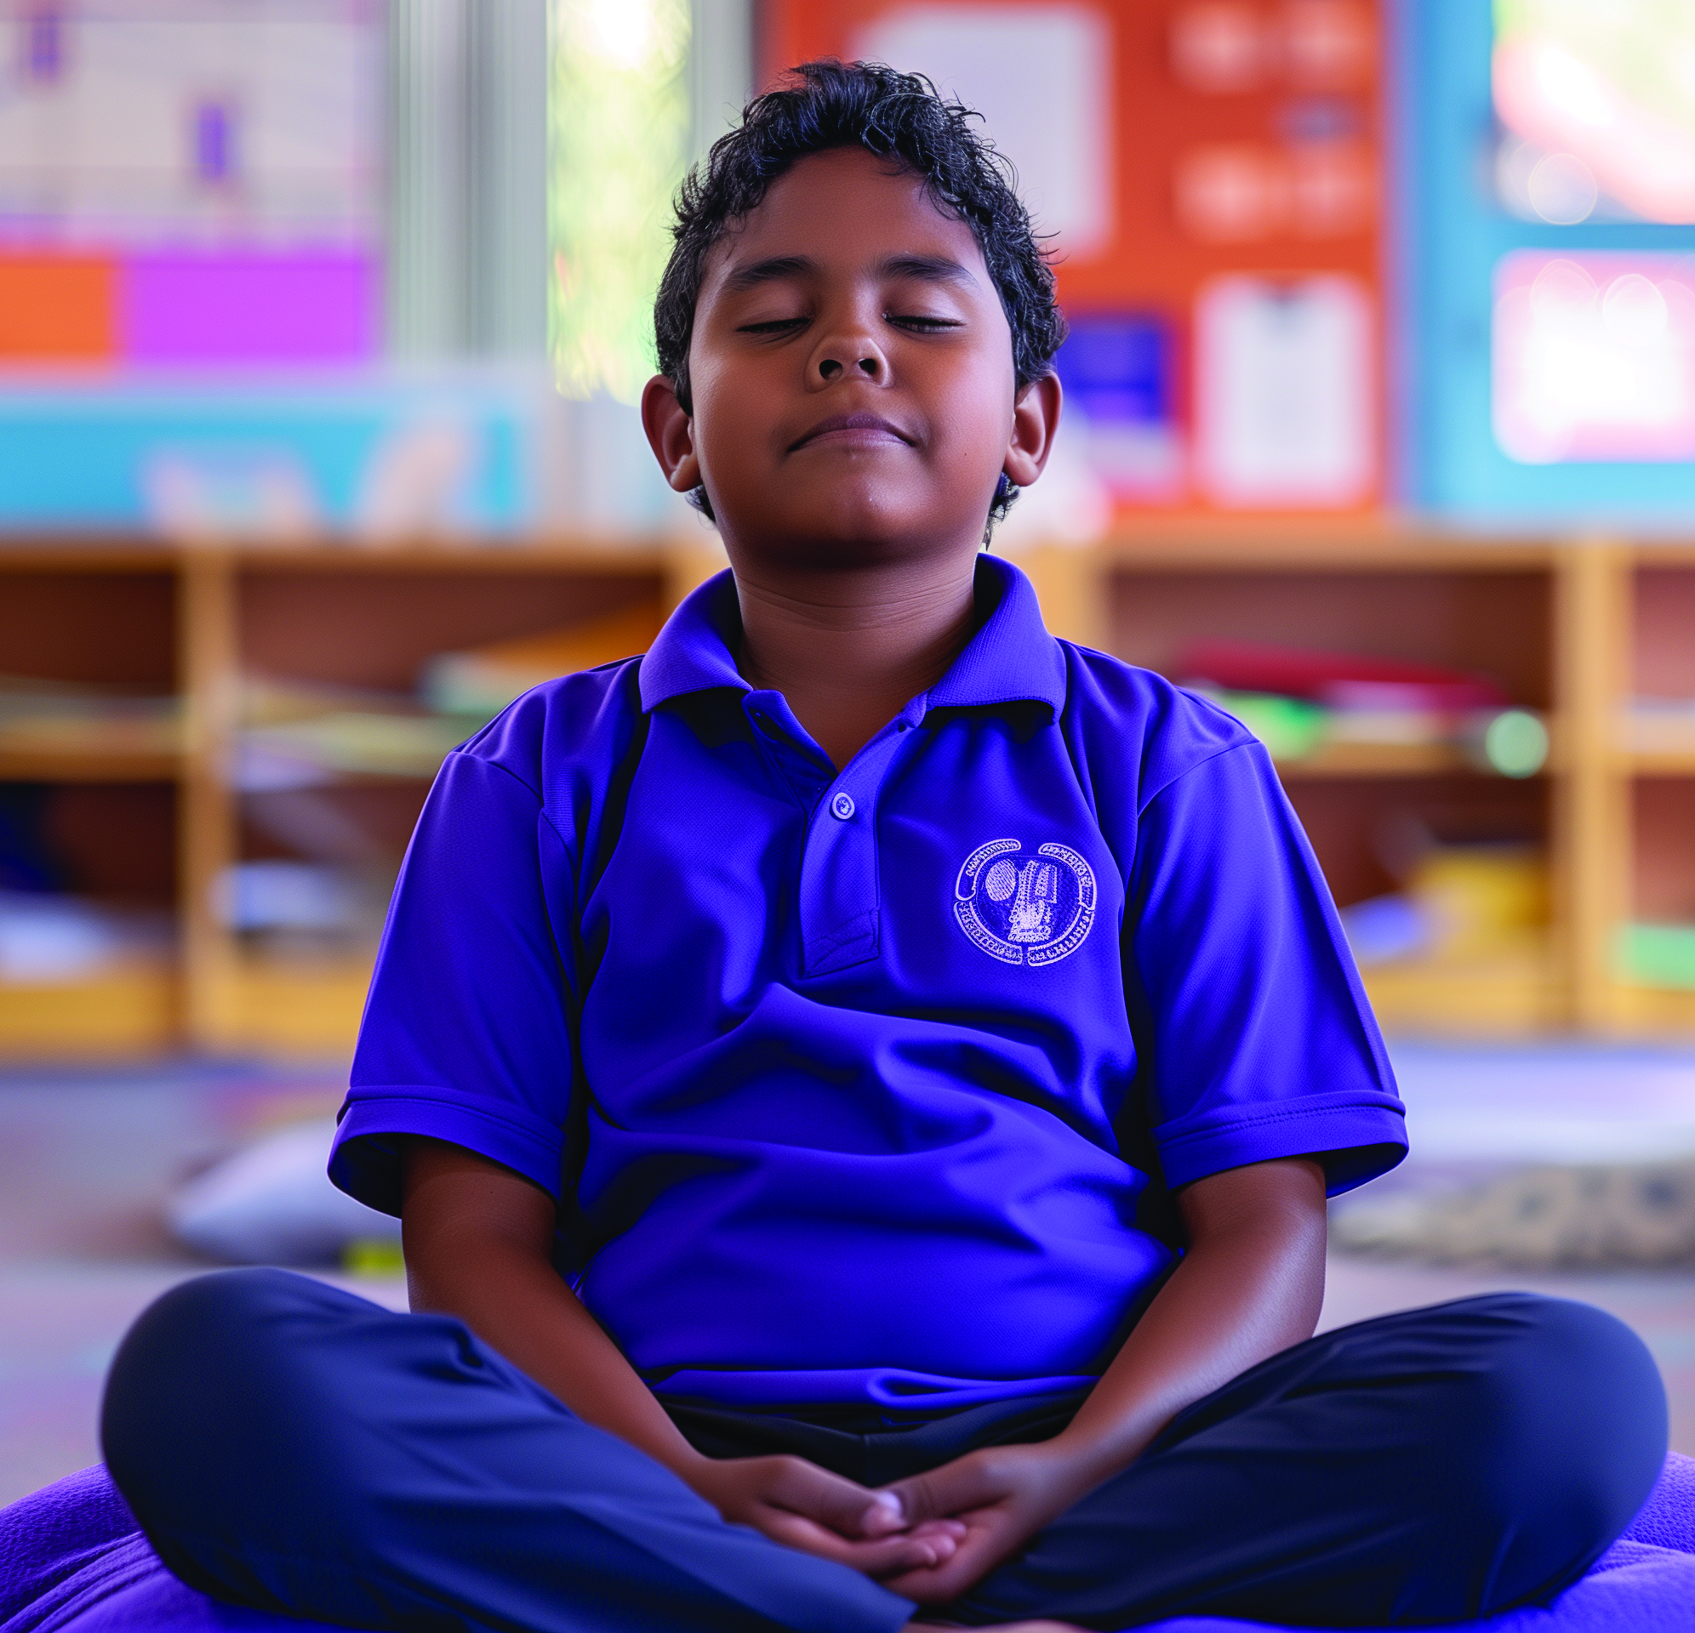
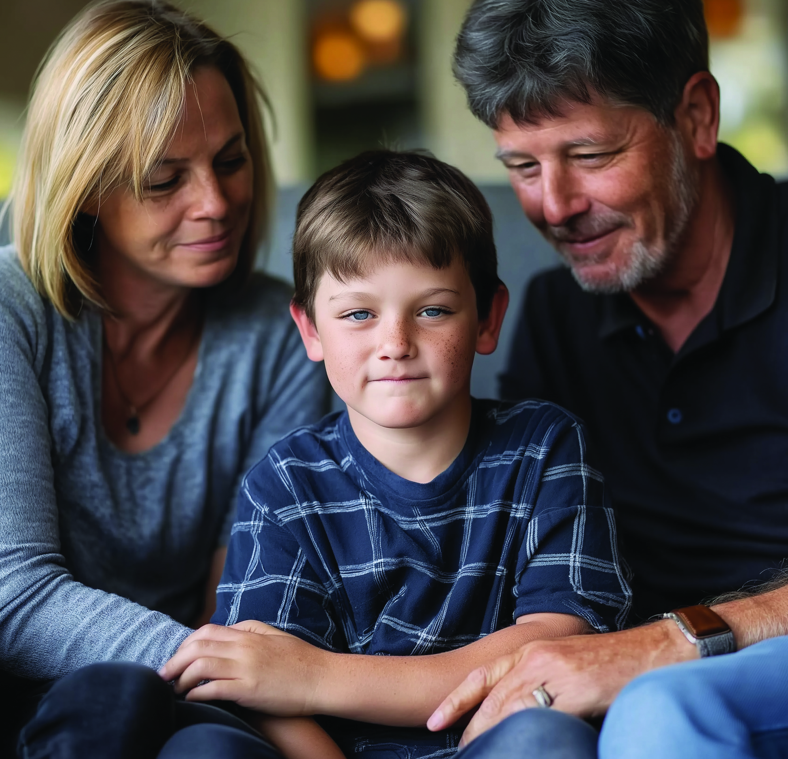
Kindness Feels Like...

Slide 11


Kindness Looks Like...
Kindness can look like sharing, making space or lending a helping hand to others.
Yes
No

Slide 12
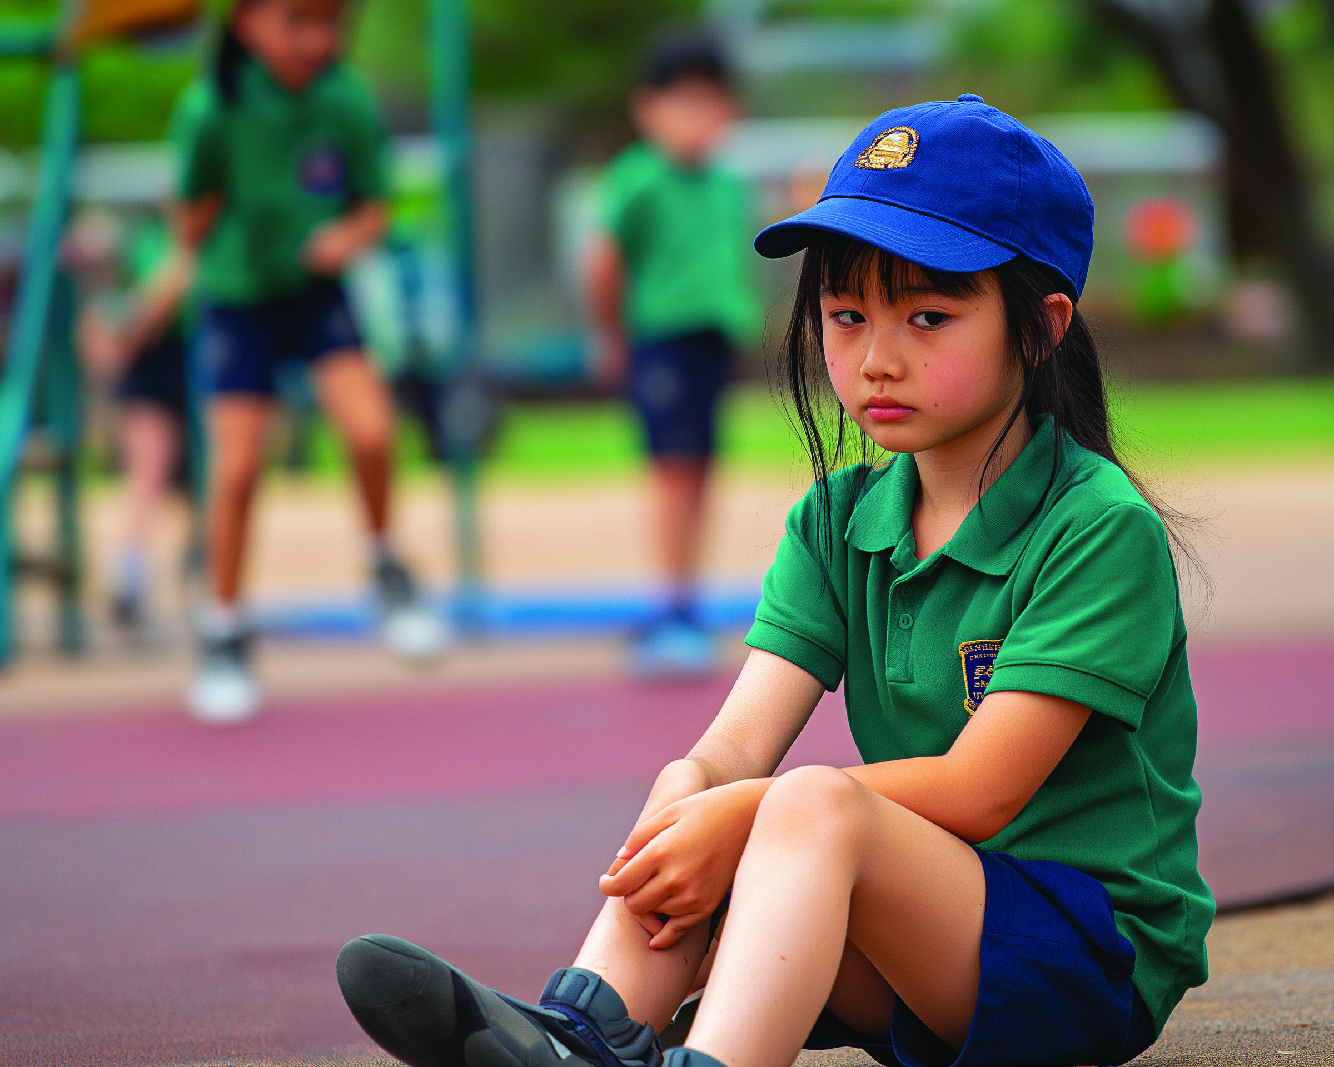
Kindness Snapshots

Slide 13
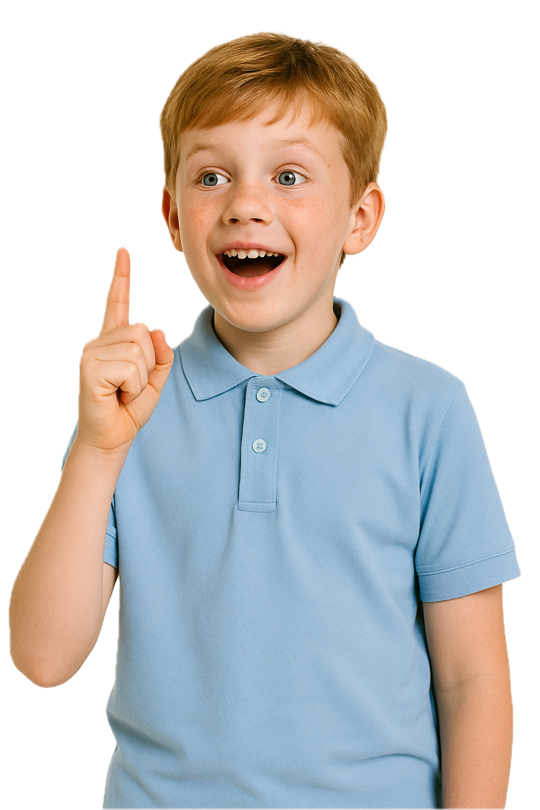
Kindness Snapshots
Feels Like
Sounds Like
Looks Like
Included
Calm
Thankful
Safe
Complimenting
Asking someone to join you
Asking someone if they need help
Encouraging
Sharing
Helping
Making space
Including others
Smiling

Slide 14
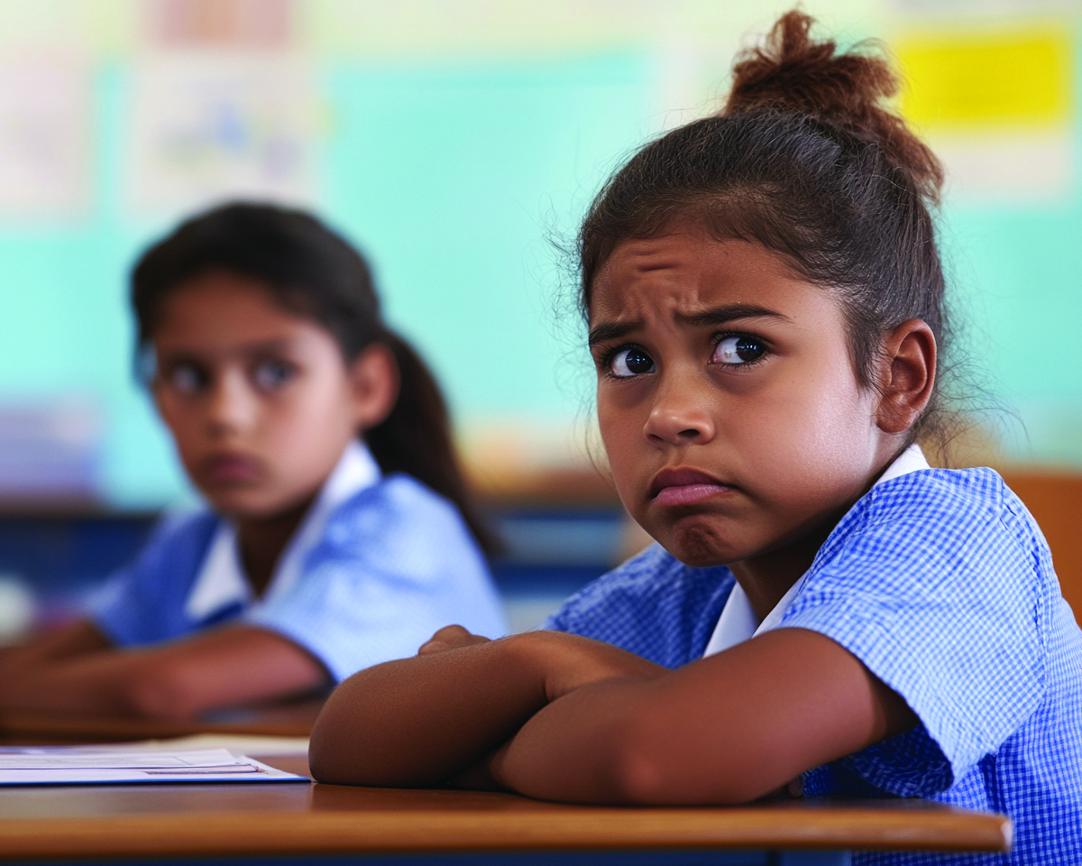
Kindness Snapshots

Slide 15
Kindness Snapshots
Feels Like
Sounds Like
Looks Like
Included
Calm
Thankful
Safe
Complimenting
Asking someone to join you
Asking someone if they need help
Encouraging
Sharing
Helping
Making space
Including others
Smiling

Slide 16
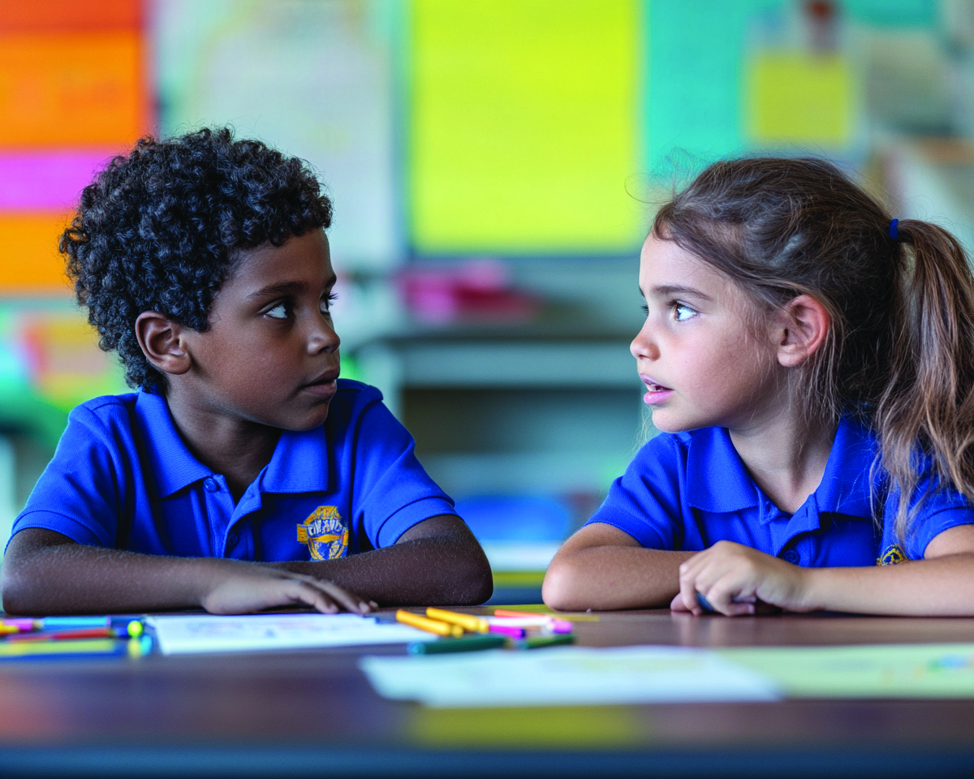
Kindness Snapshots

Slide 17
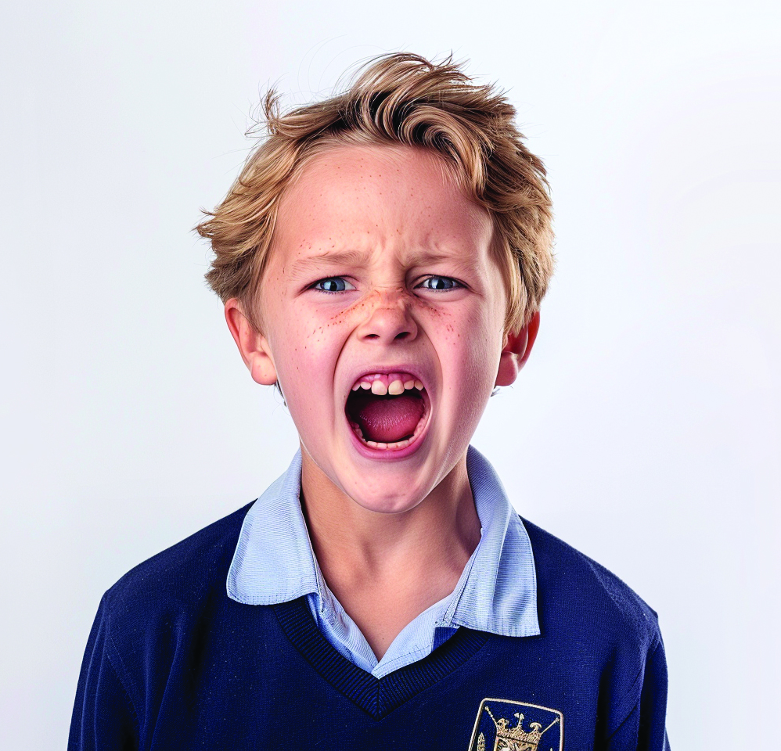
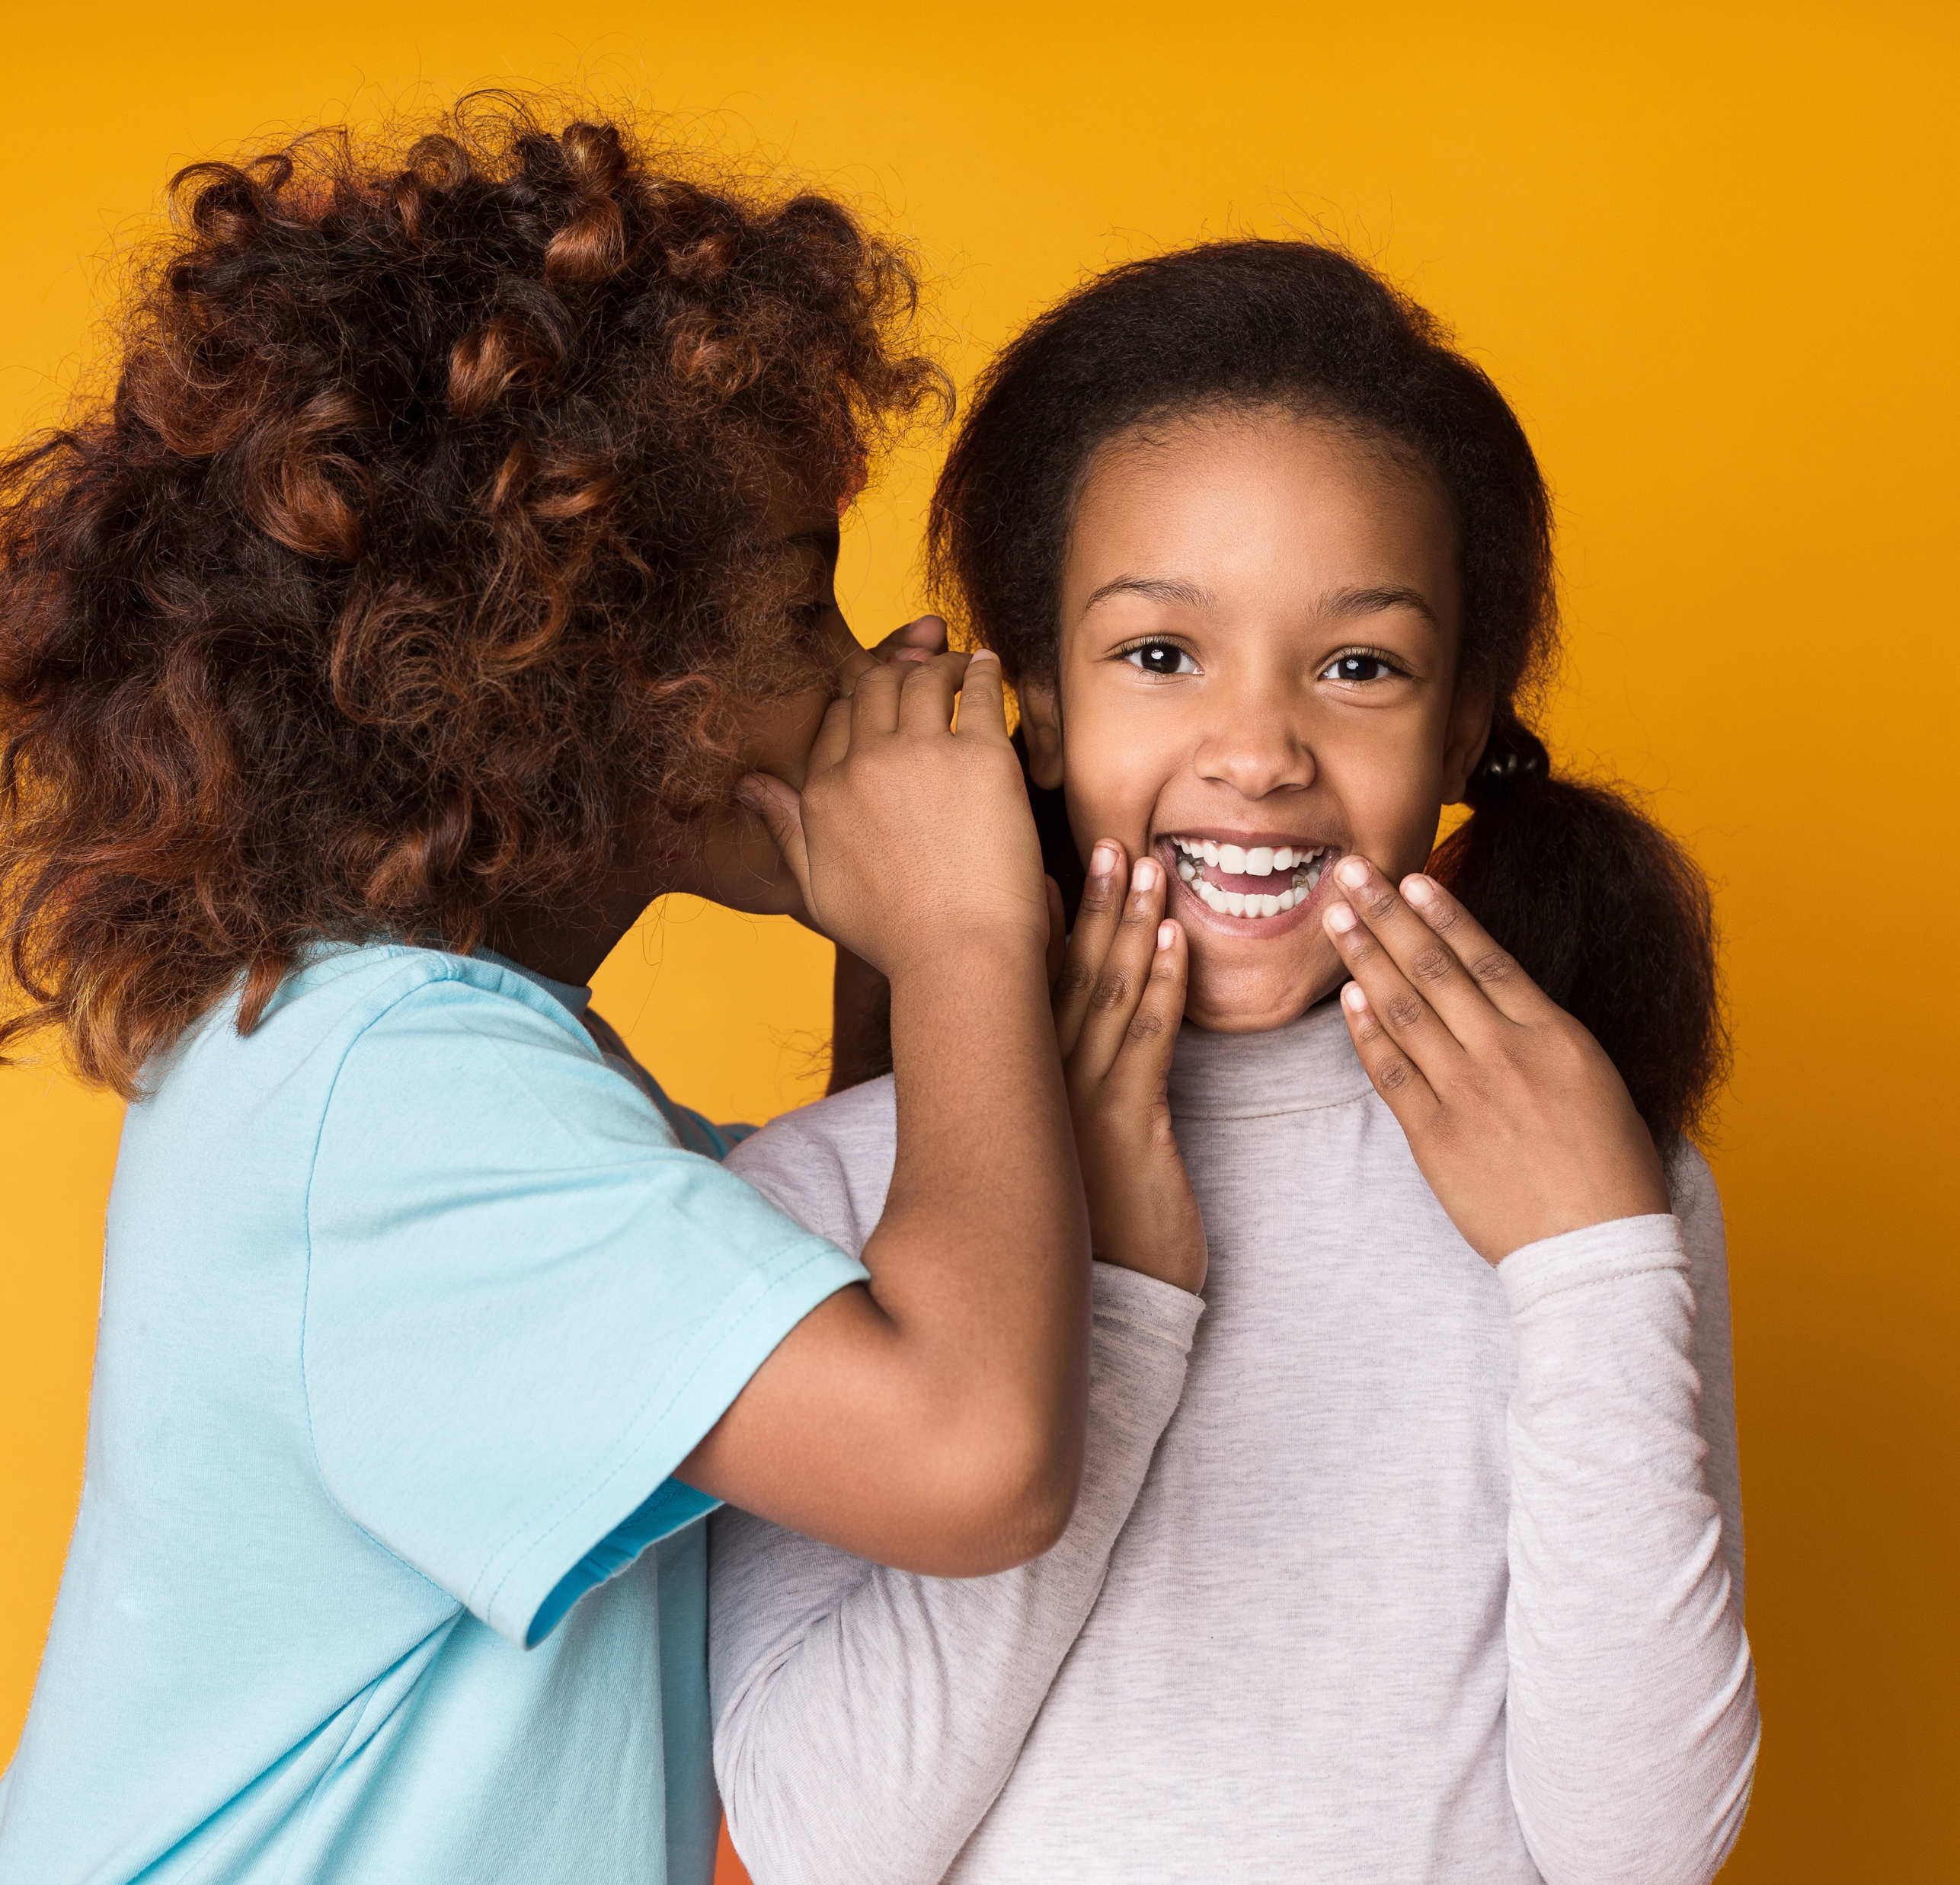
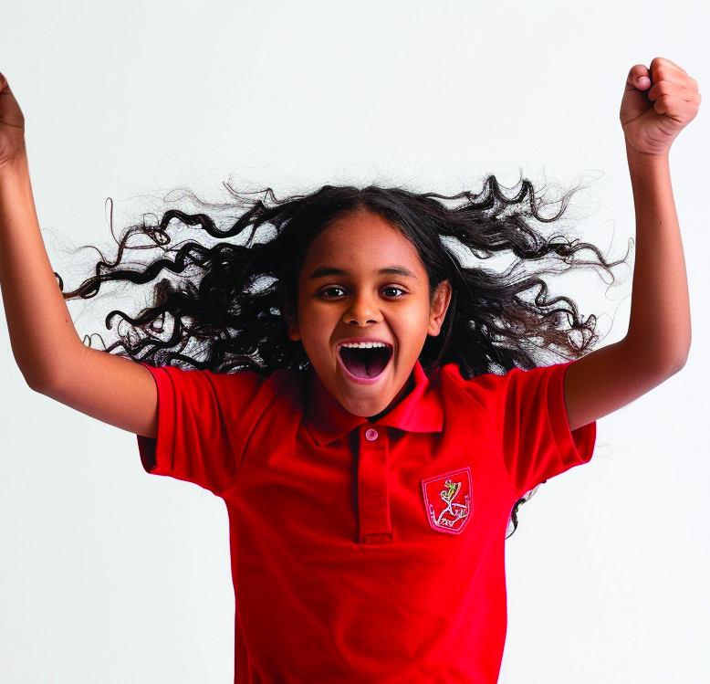
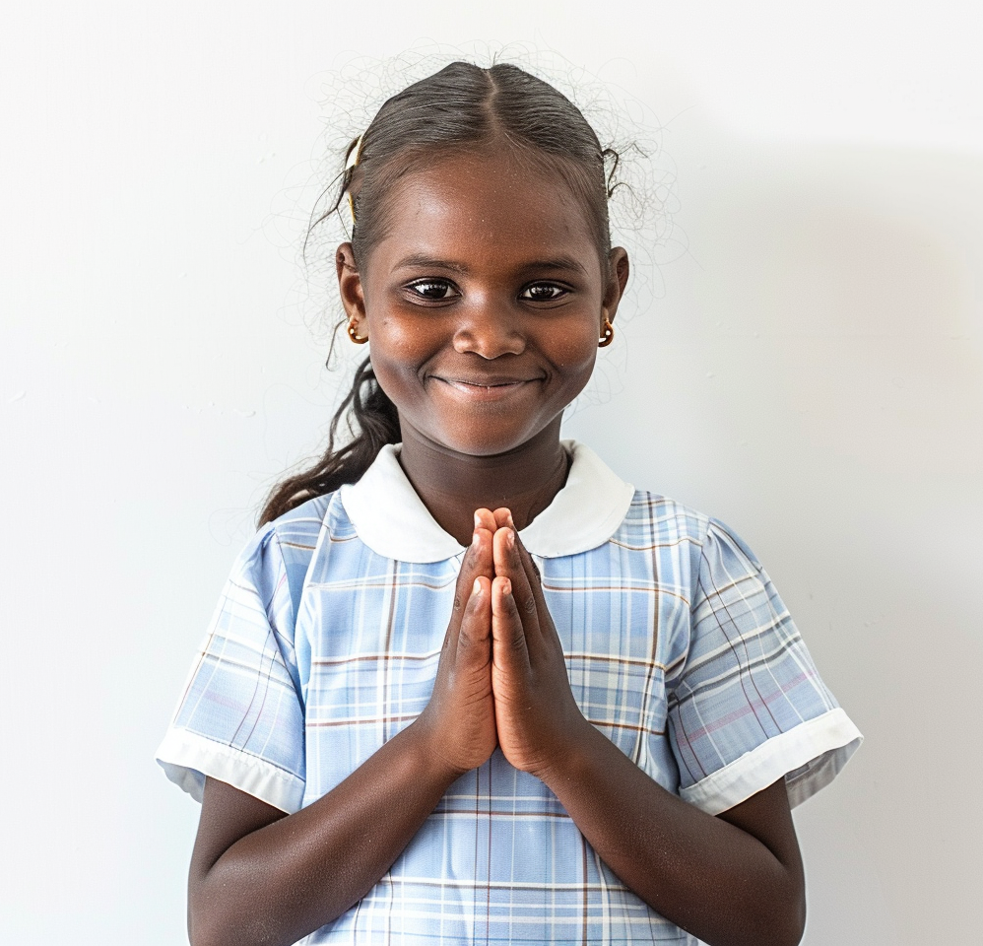
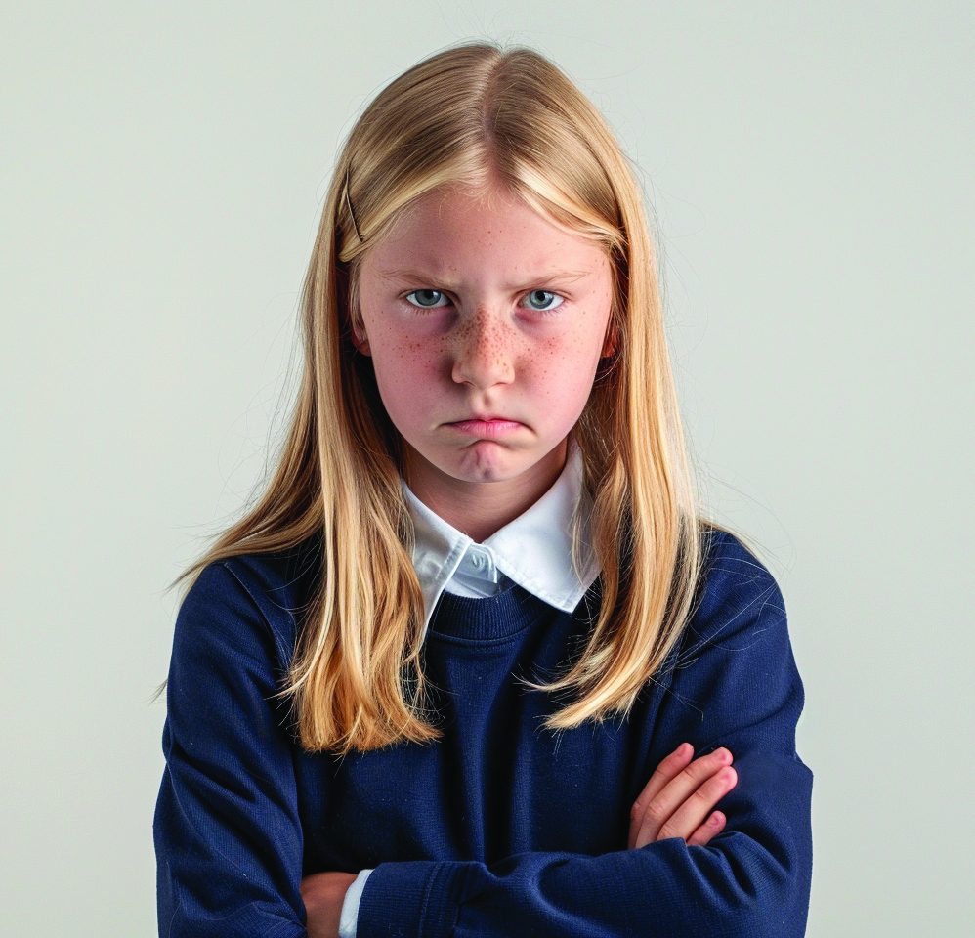
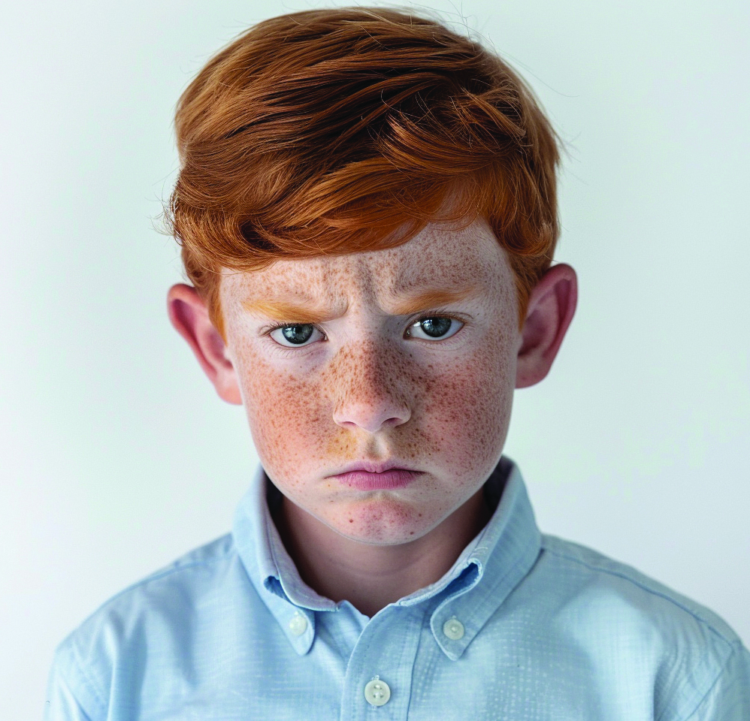
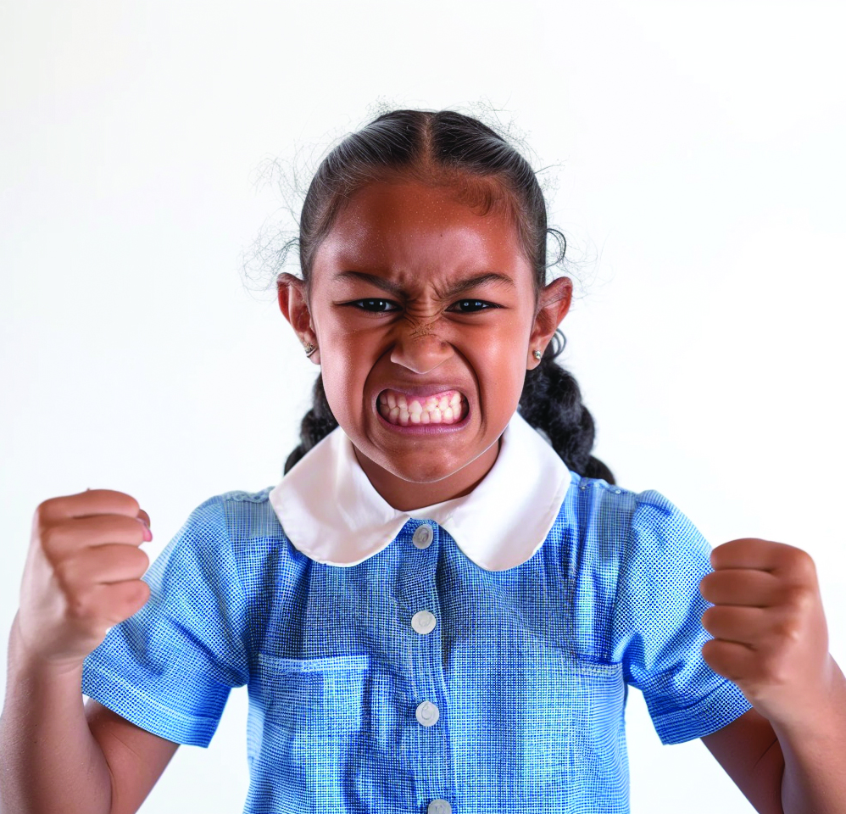
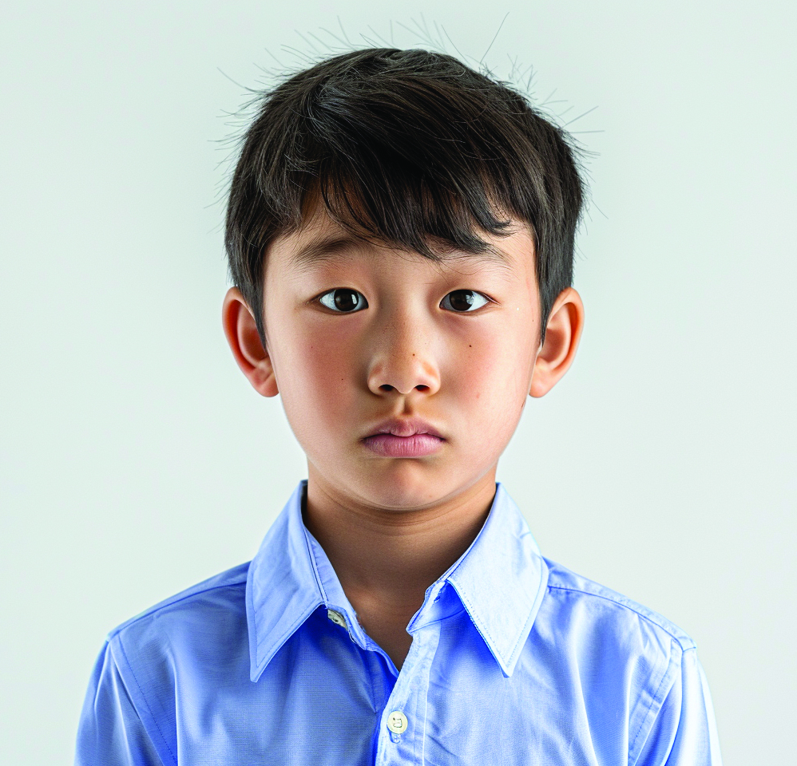
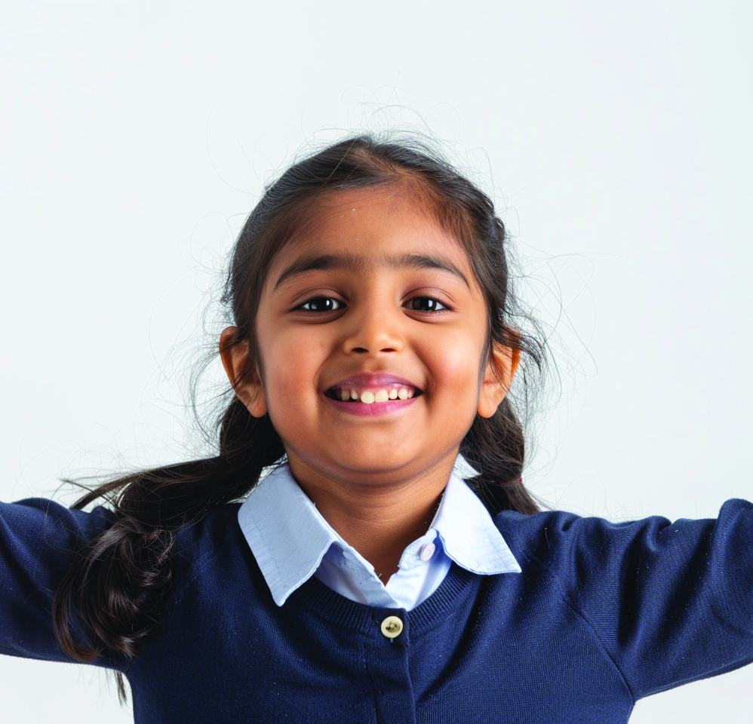
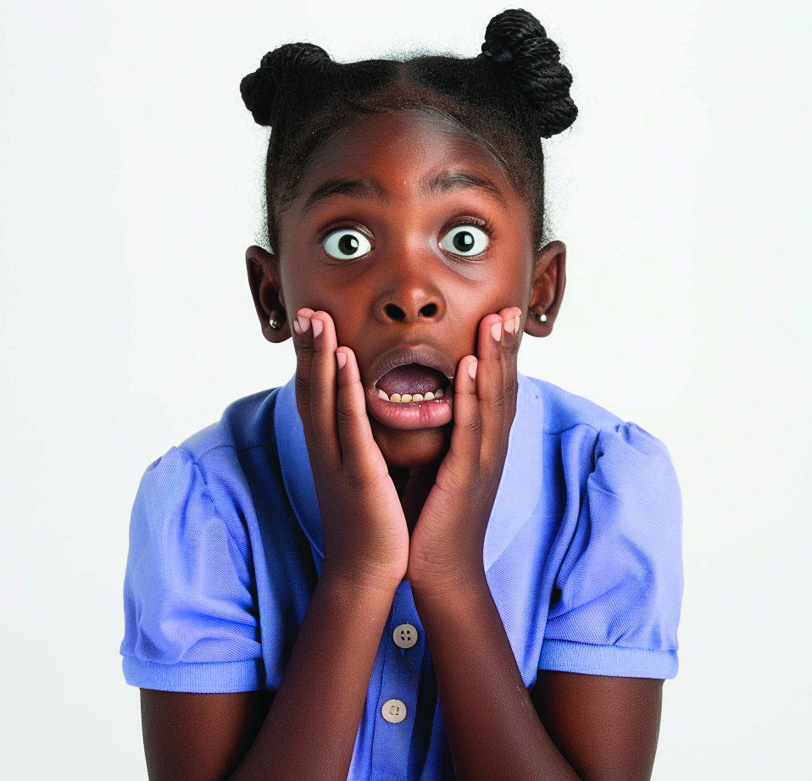
Kindness Snapshots
Looks Like
Sounds Like
Feels Like
Sharing
Helping
Making space
Including others
Smiling
Complimenting
Asking someone to join you
Asking someone if they need help
Encouraging
Included
Calm
Thankful
Safe

Slide 18
Kindness is using our words or actions to help others feel cared for and included.
When you show kindness, it helps make your school, home or community a better place.
Kindness looks like sharing, helping, making space or including others.
Kindness helps others feel included, calm, thankful and safe.

Slide 19



How well did you:
describe kind words and actions
explain how kindness makes others feel?

Slide 20
In the next lesson, we will learn how to notice and understand other people’s feelings.

