Slide 1
What Do I Like?
Unit 1 Knowing Me, Knowing You
Lesson 2

Slide 2
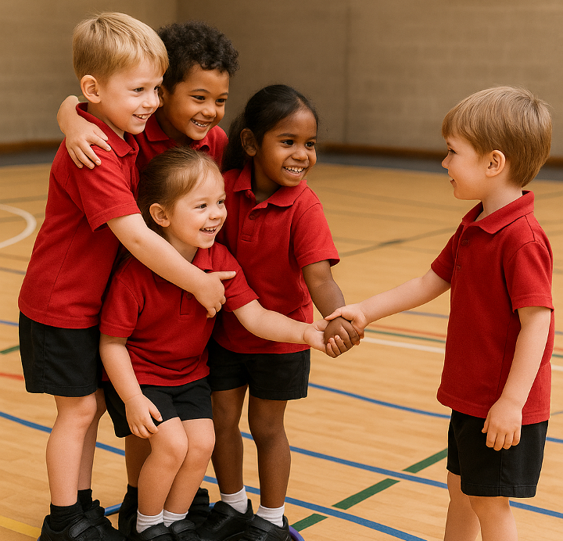
We can help others belong through invitations and actions.

Slide 3
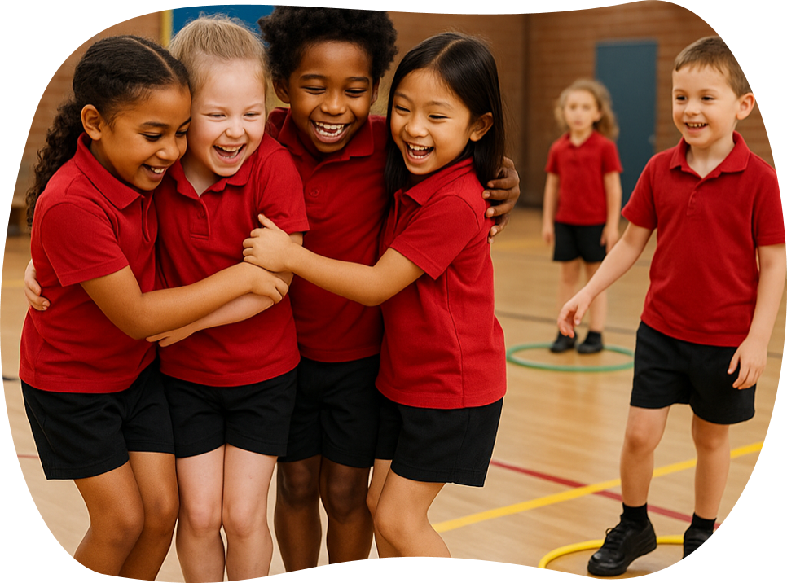
Our class is stronger when we make sure no one is left out.

Slide 4
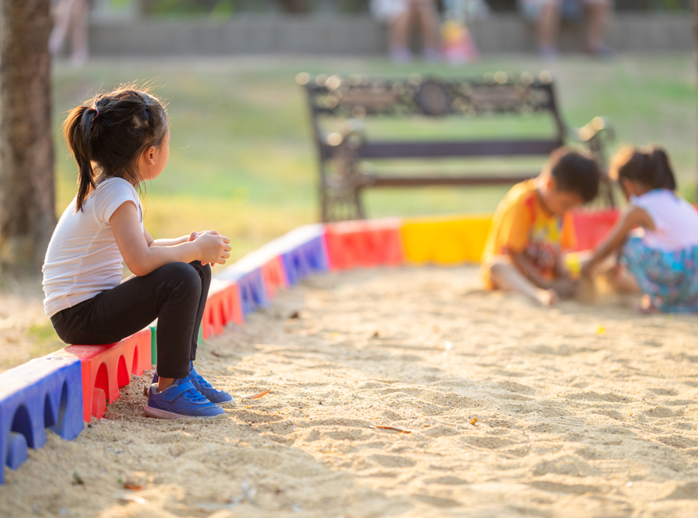
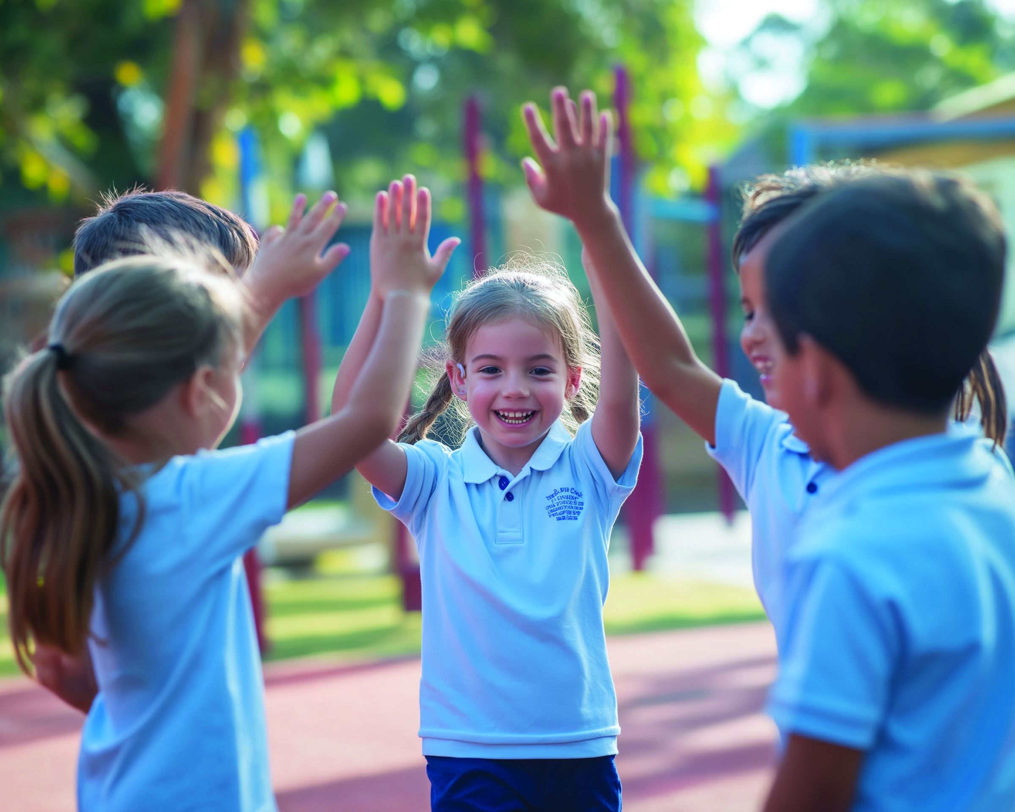
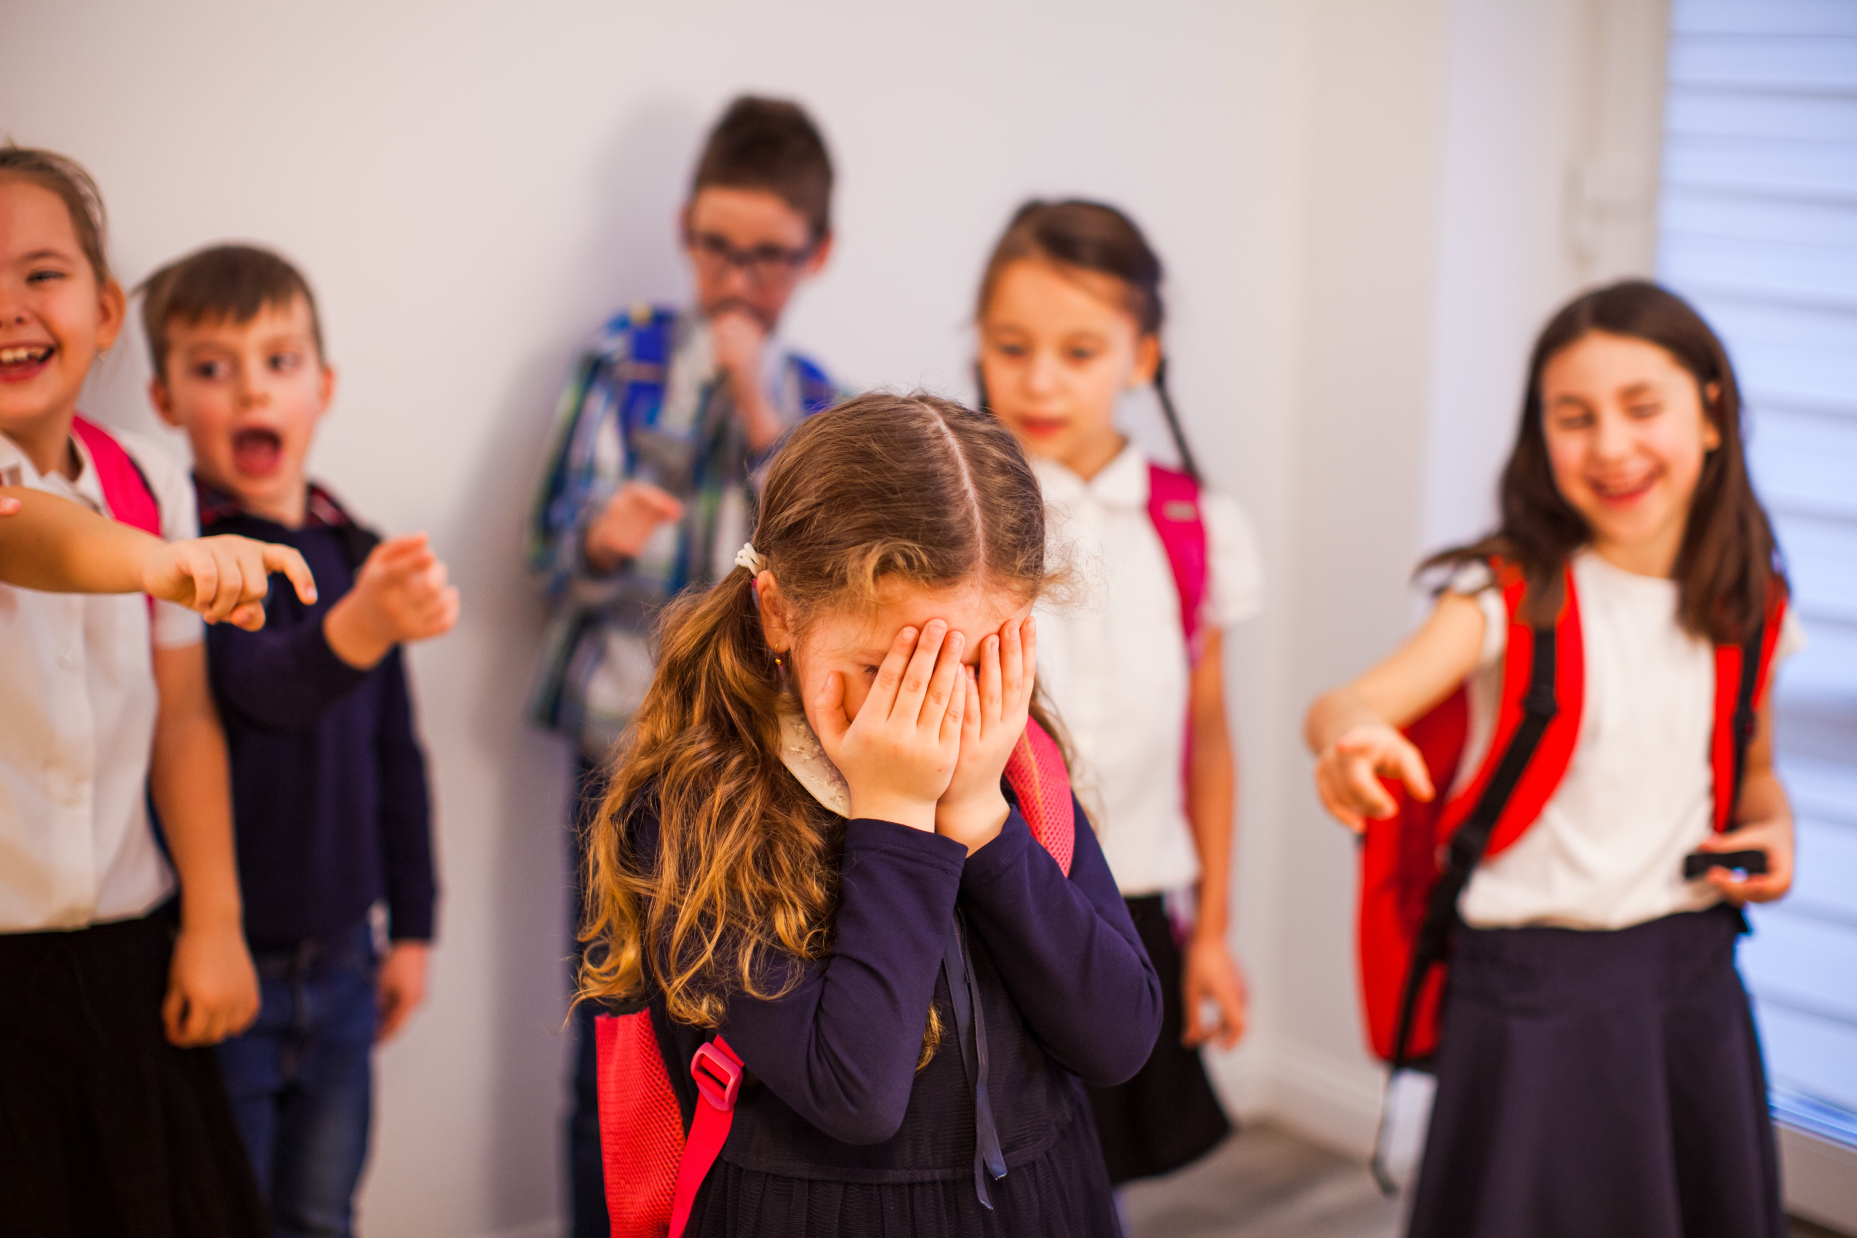



You notice a new student sitting alone at recess. What could you do to help them feel they belong?

Slide 5
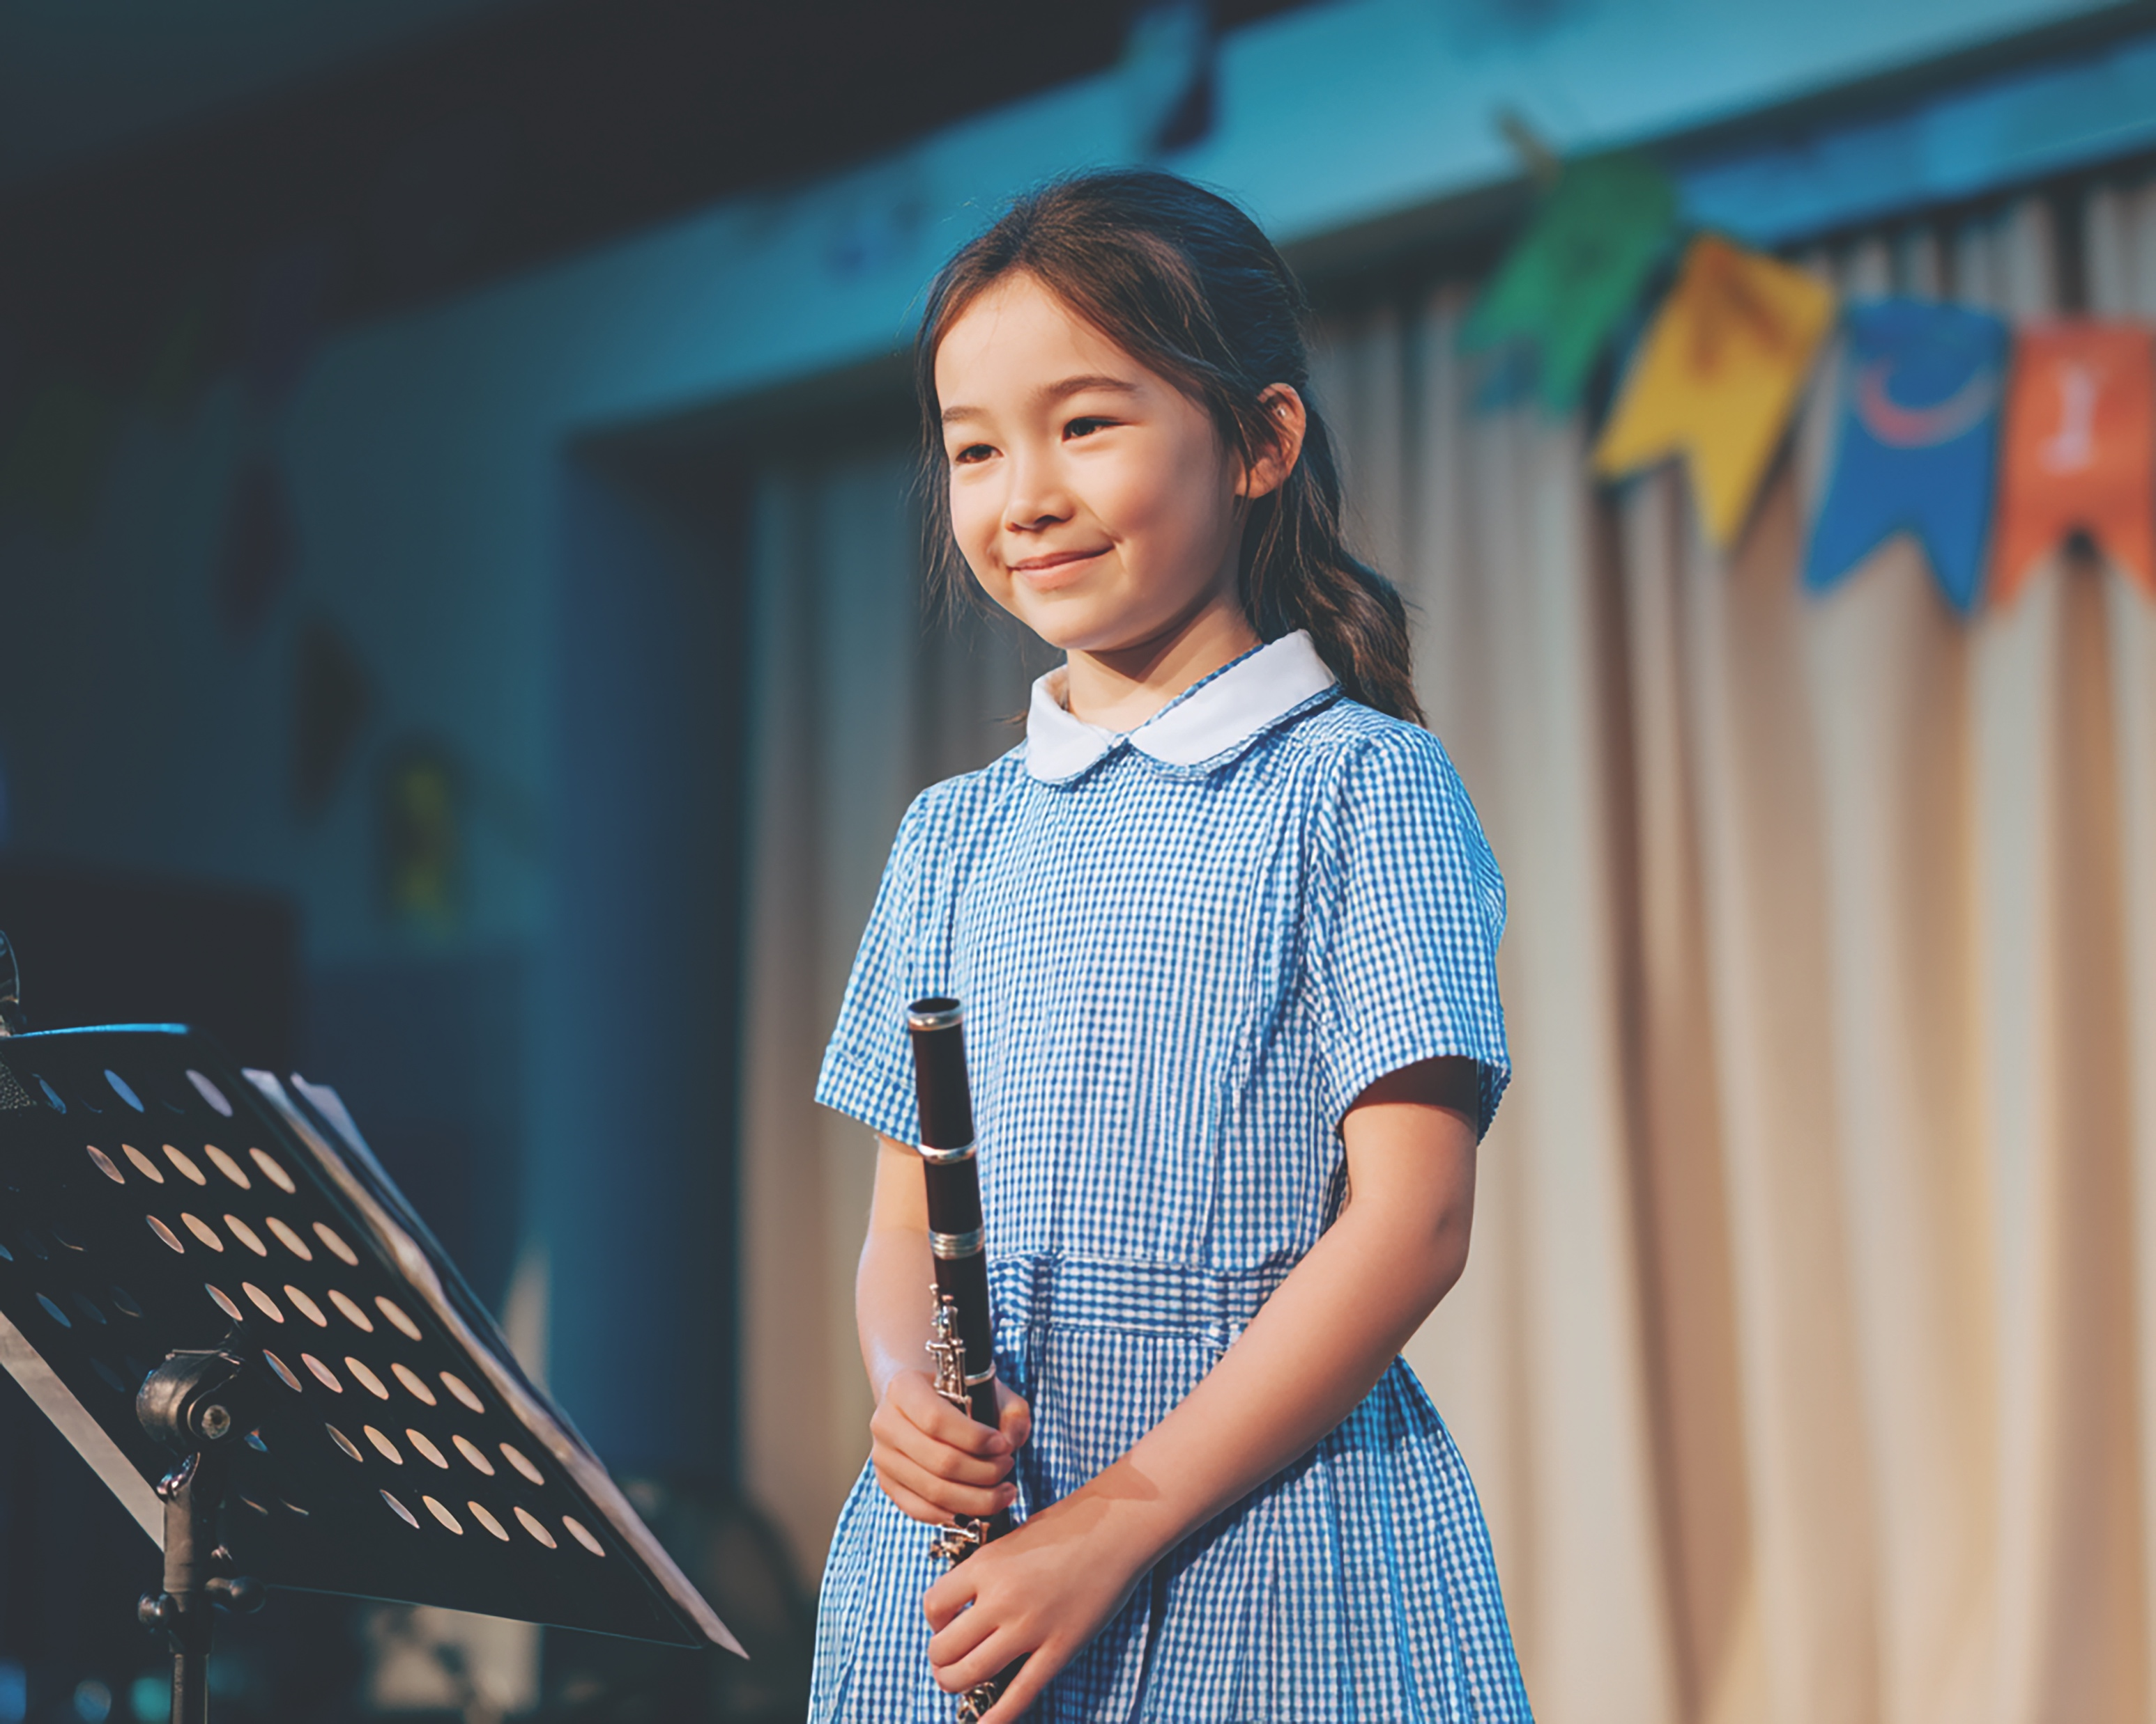
In this lesson, you will share your interests and learn that everyone has different likes.

Slide 6
You will be successful when you can:
say something you like
listen and respond when others share their interests.
You will be successful when you can
Use an ‘I feel’ statement to share your feelings.
Say ‘I feel ____’ using the right feeling word.
Choose a face or gesture that shows how you could feel in different situations.

Slide 7
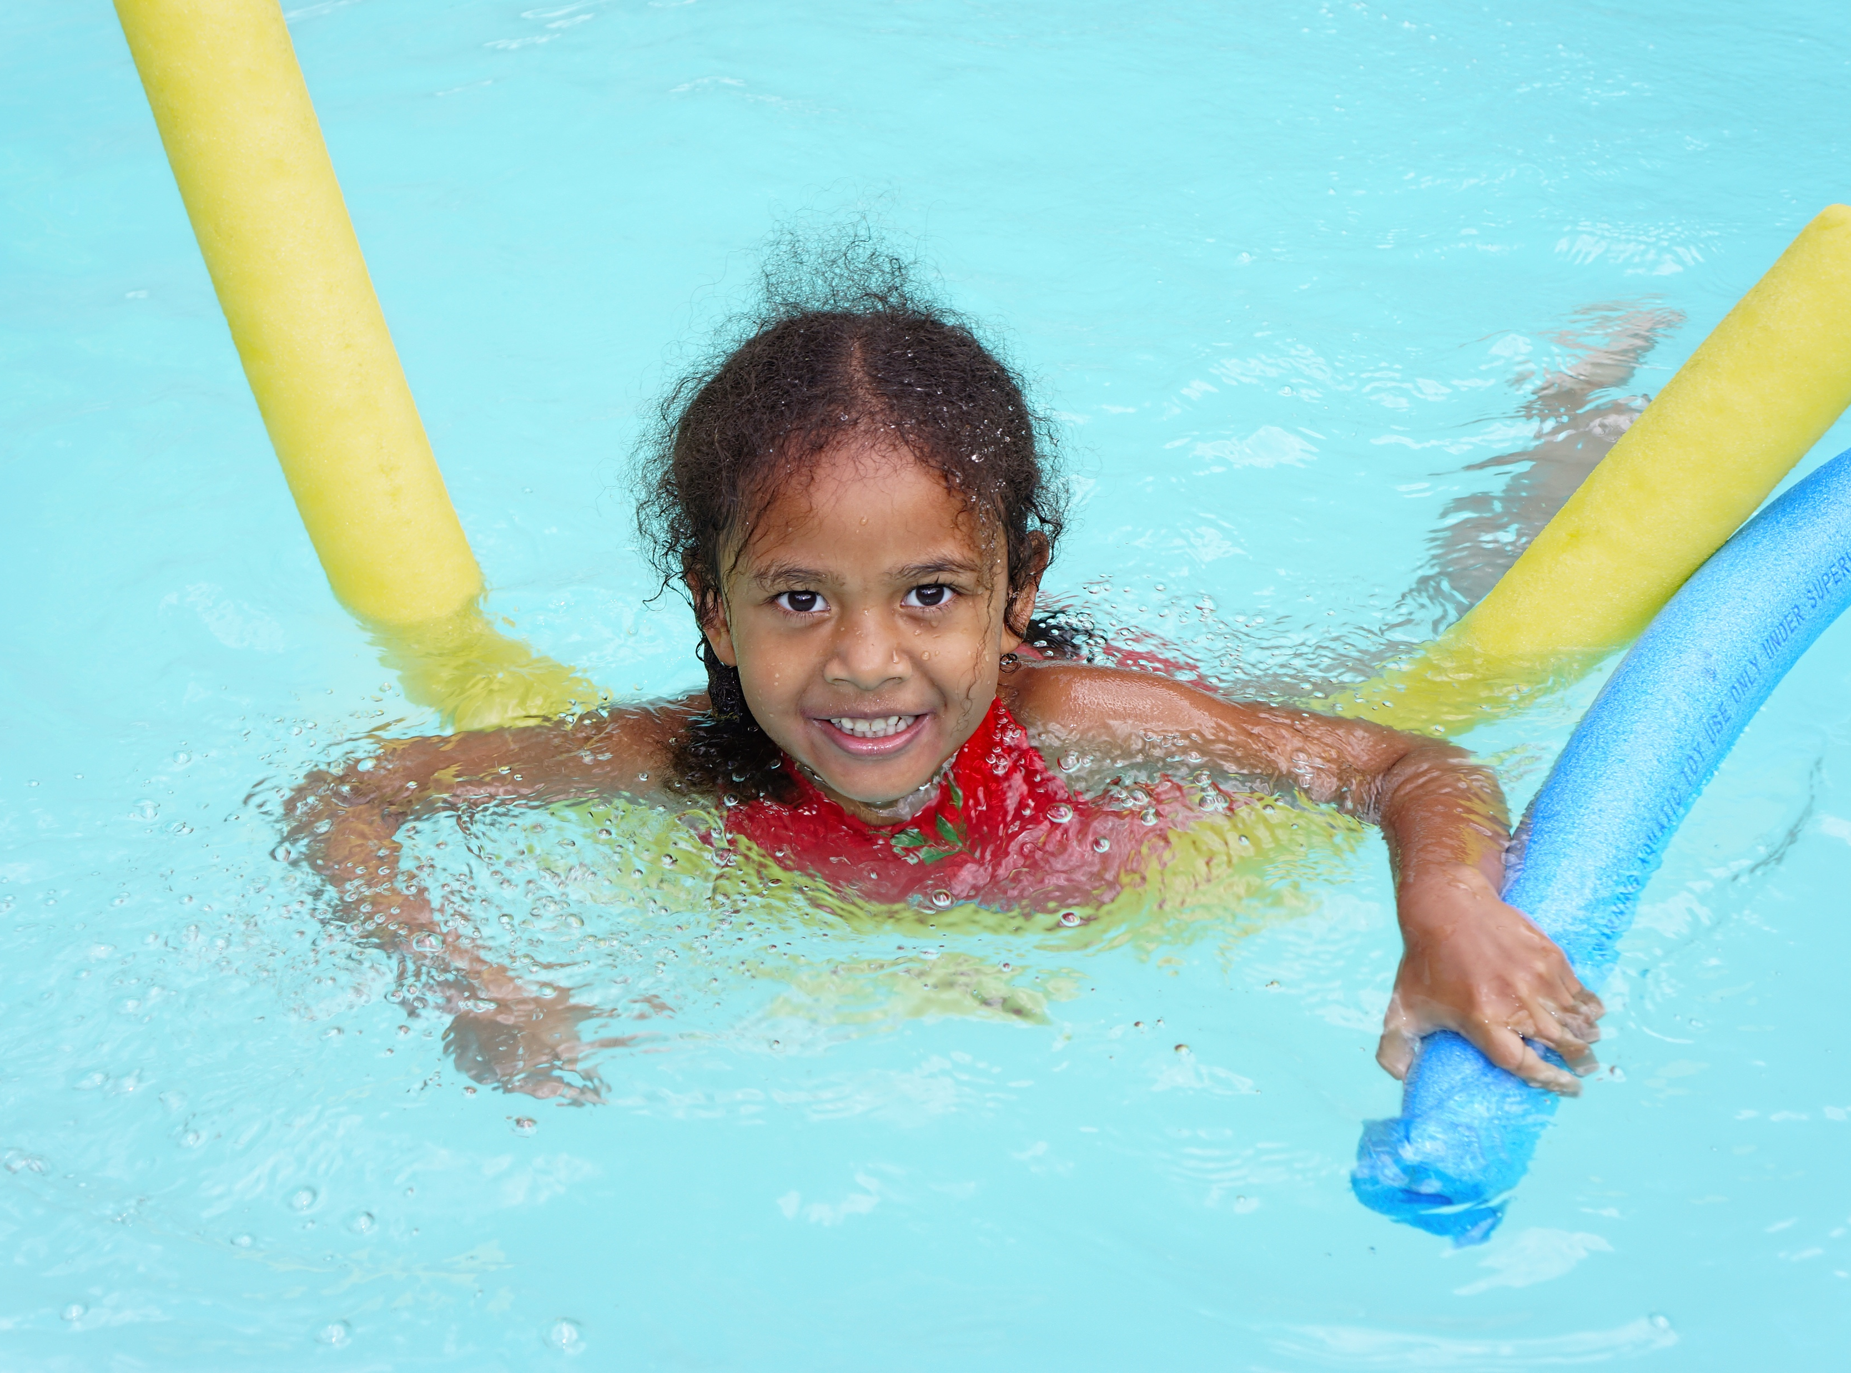
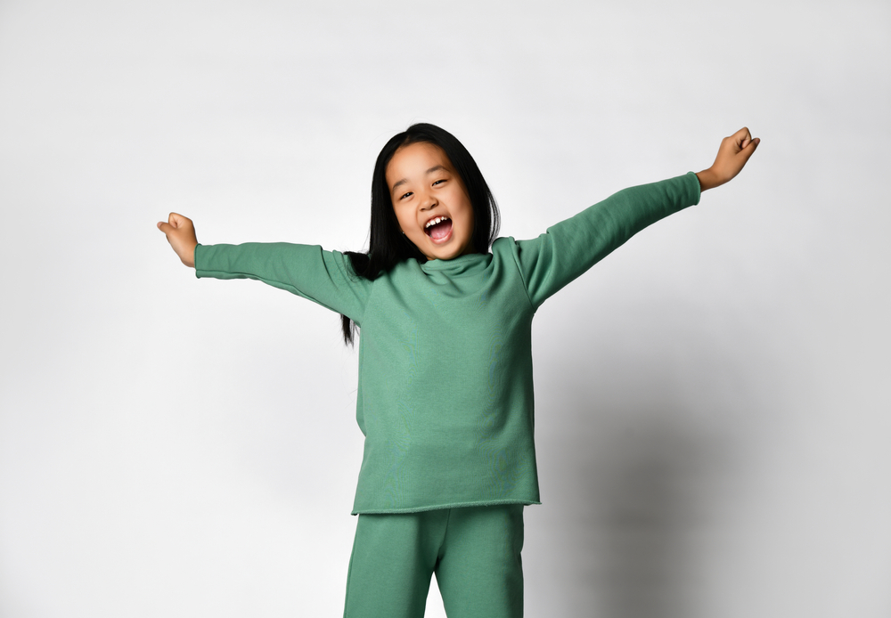
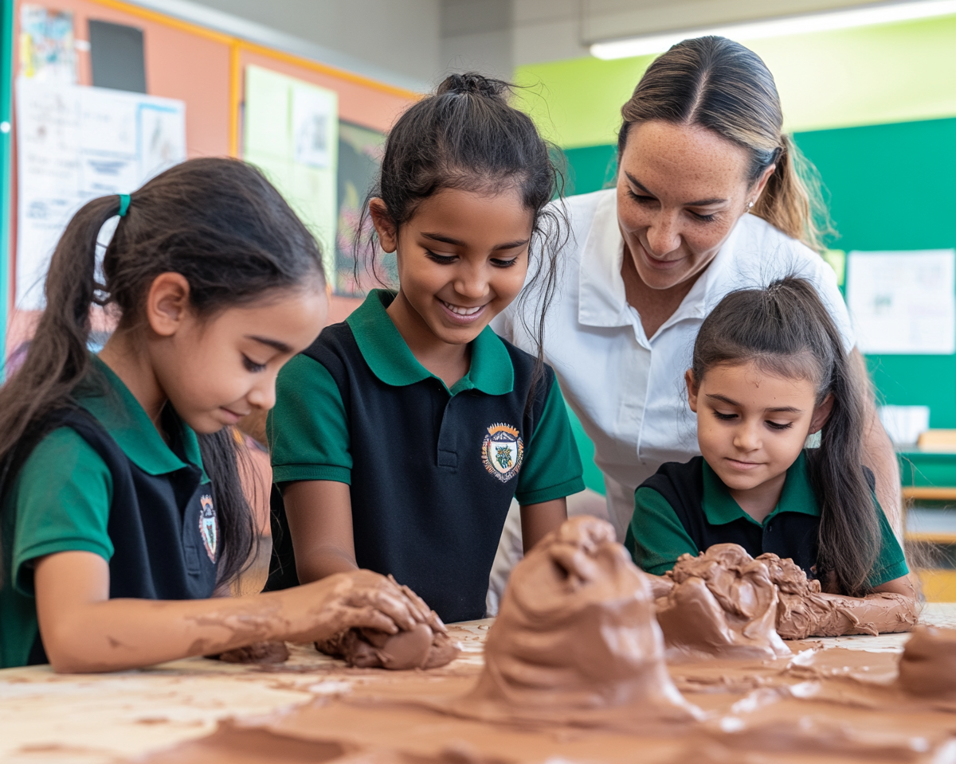
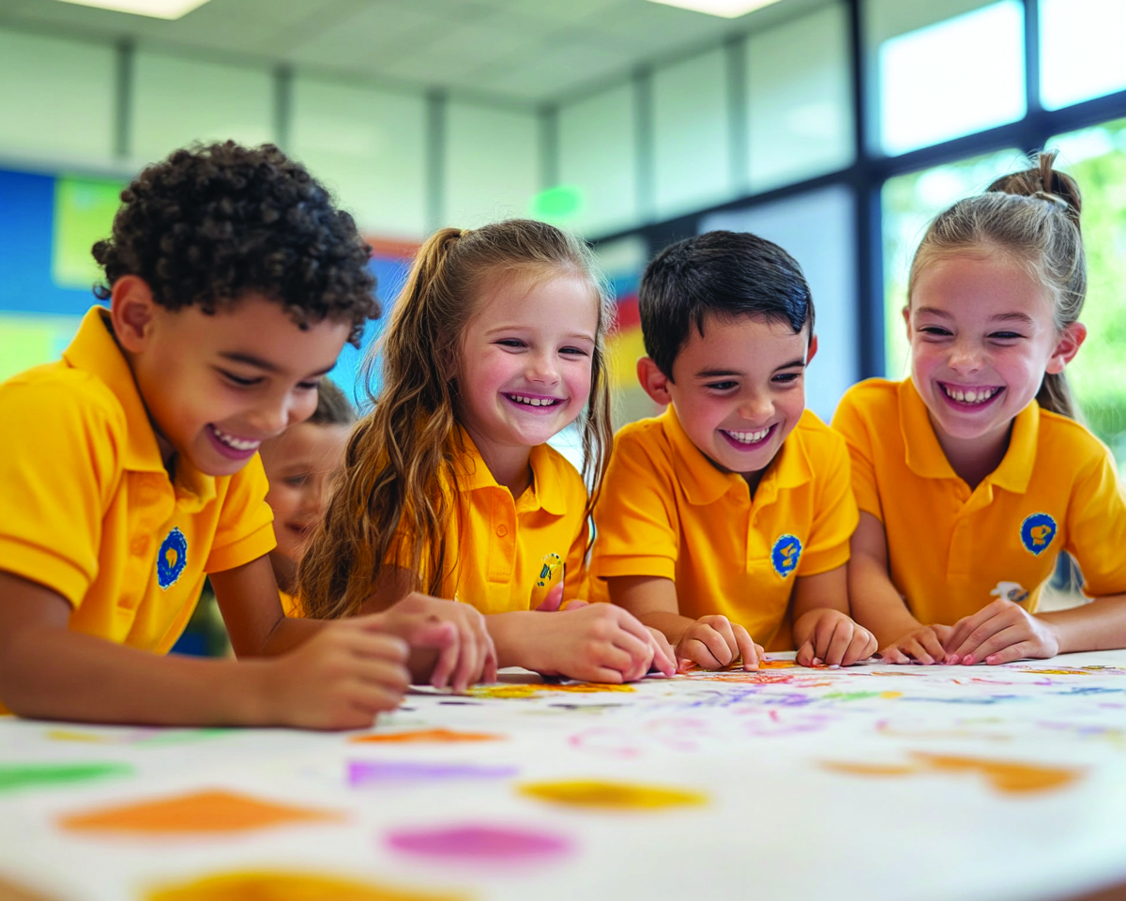

Slide 8
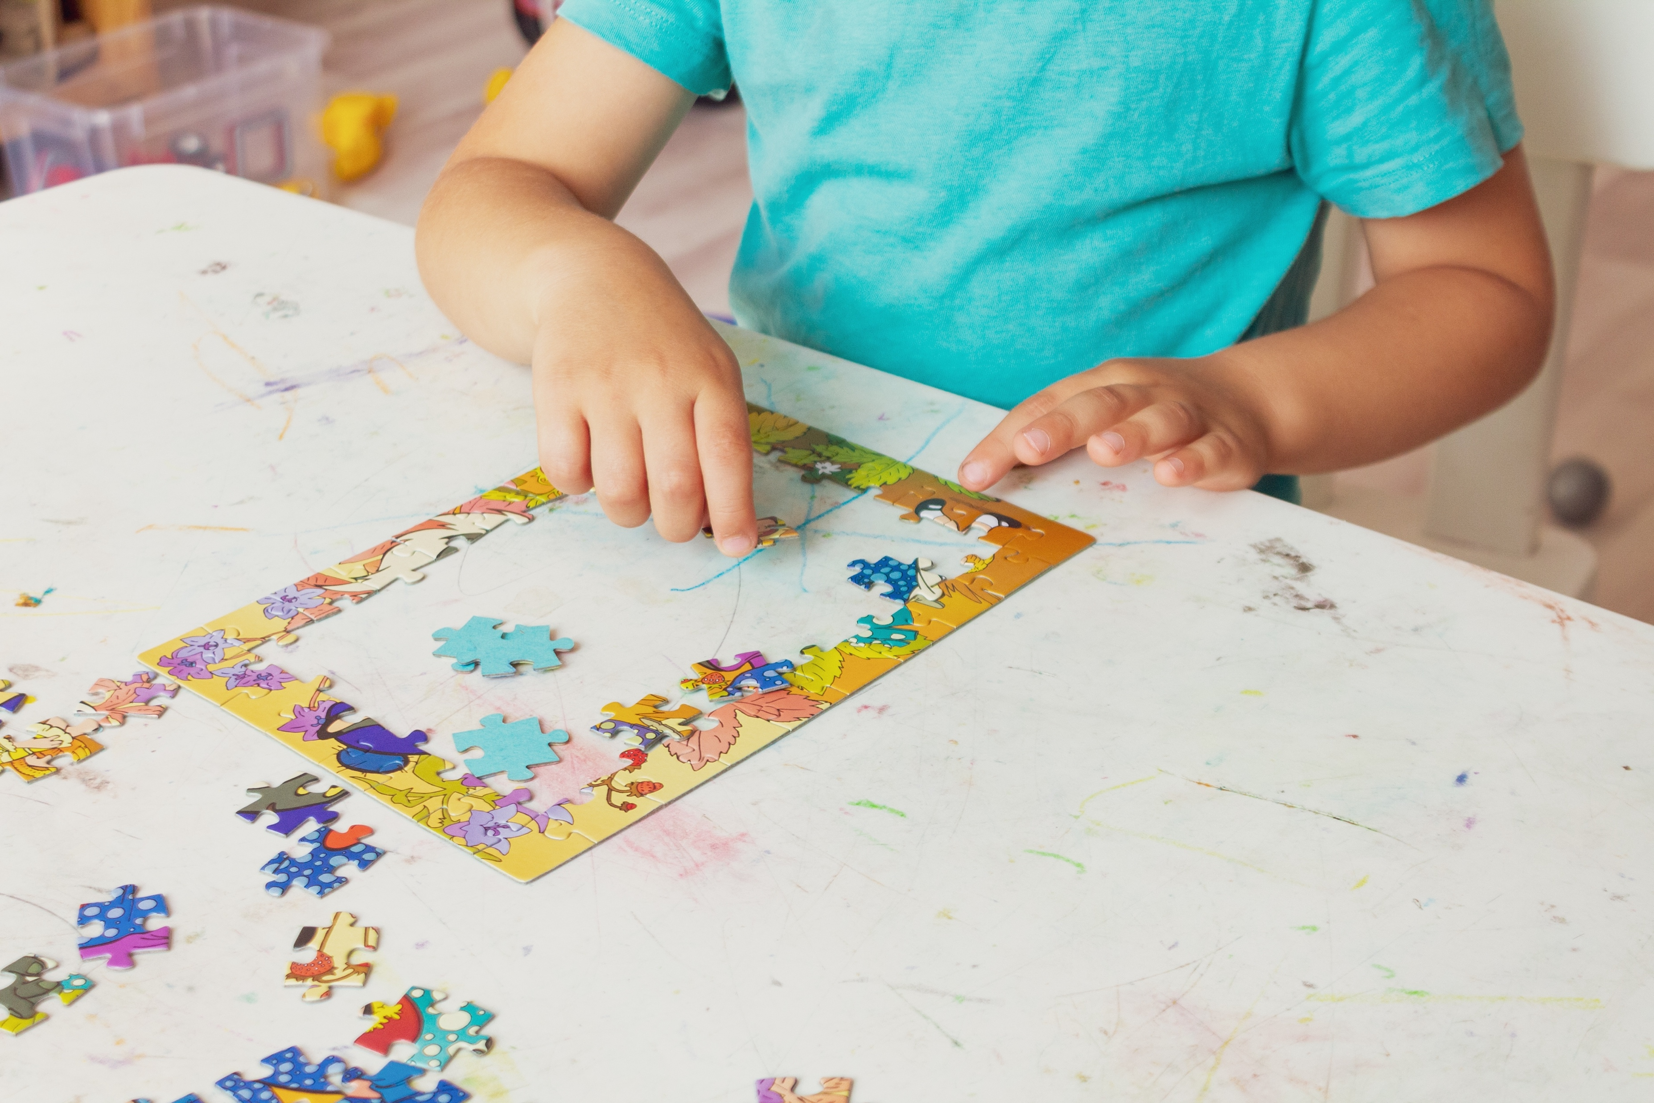
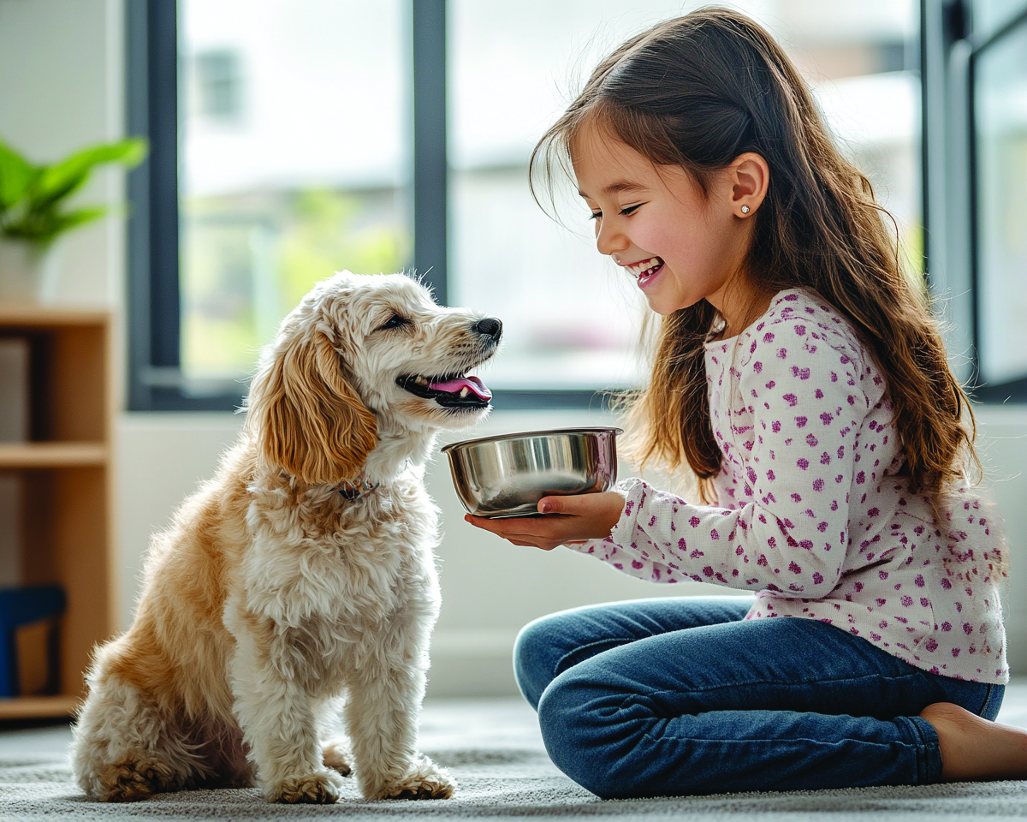
Likes and interests are things you enjoy doing or learning about, or things that make you happy.

Slide 9

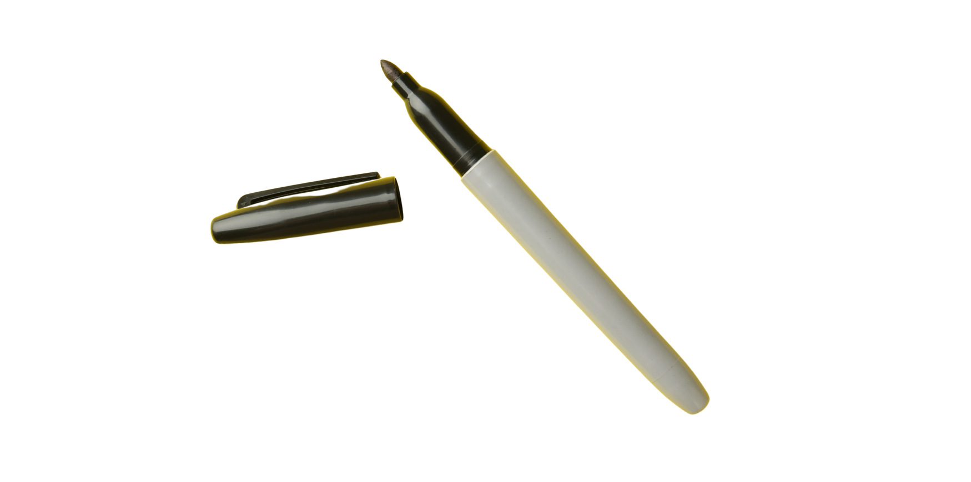

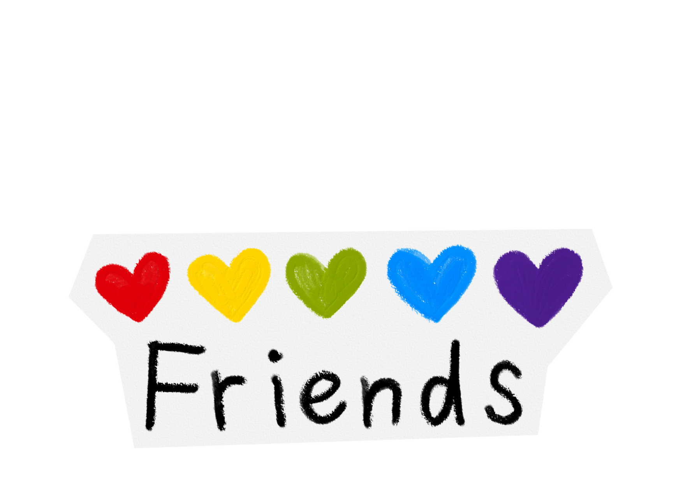


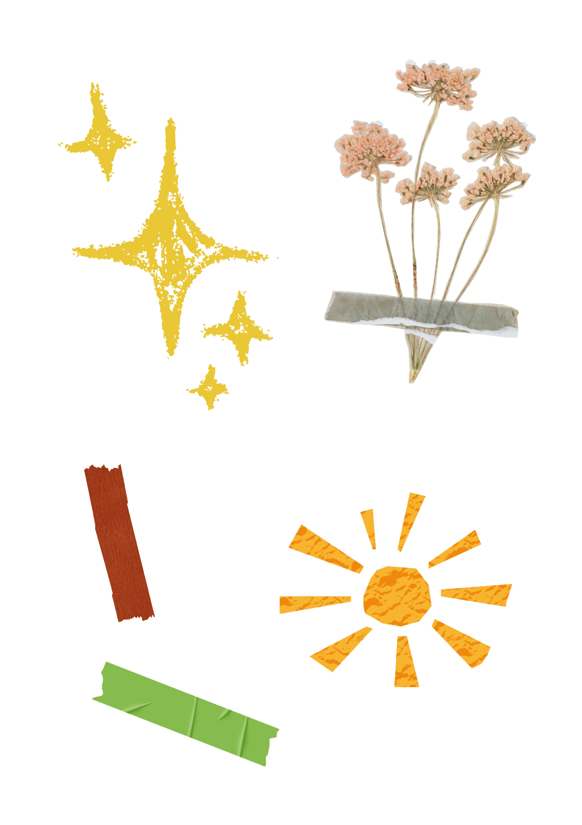
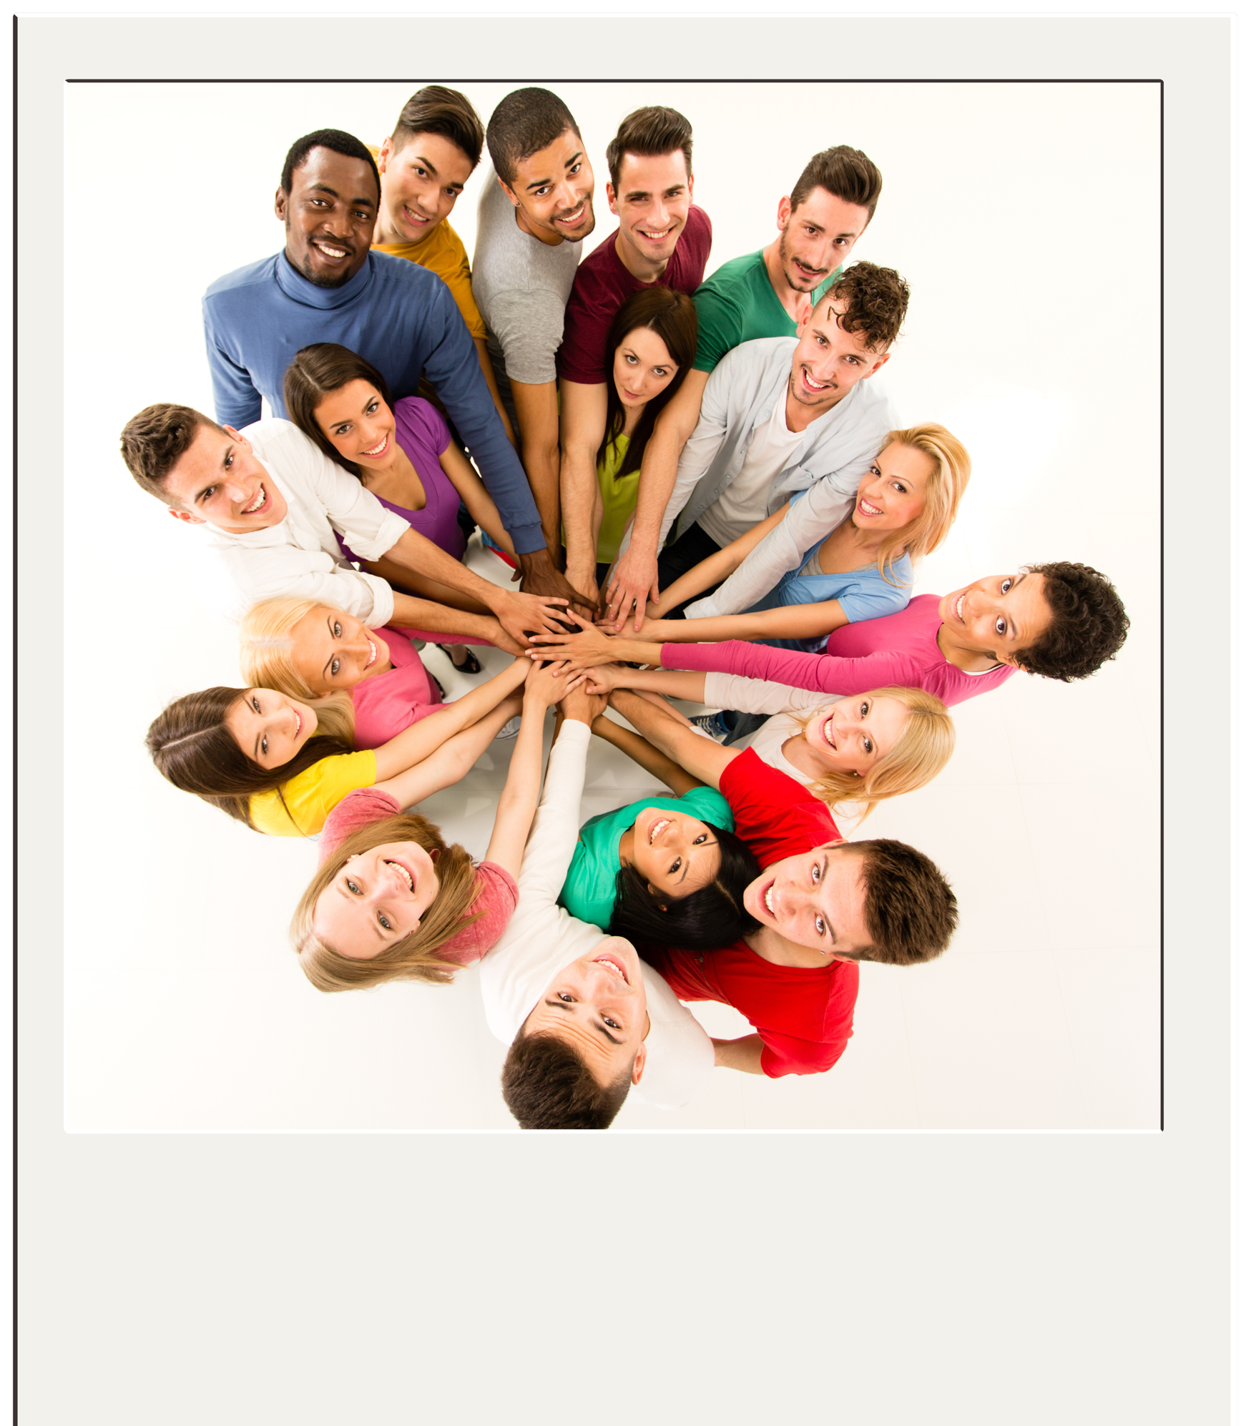
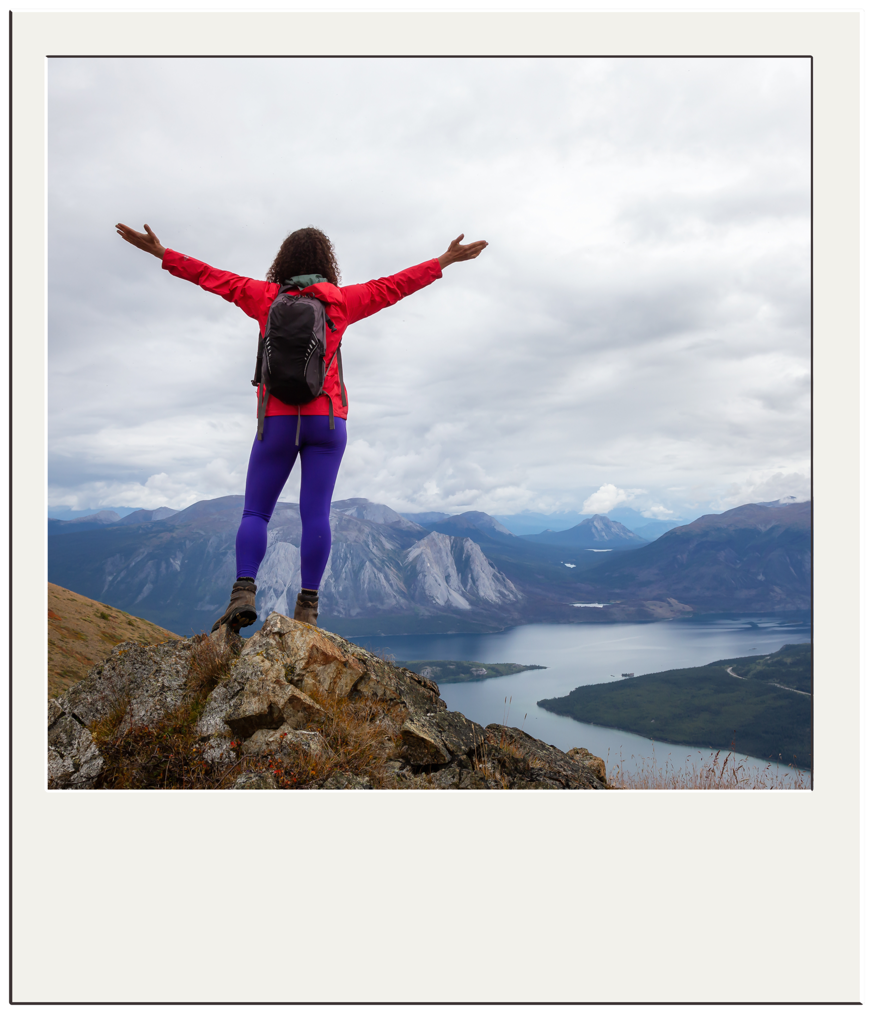
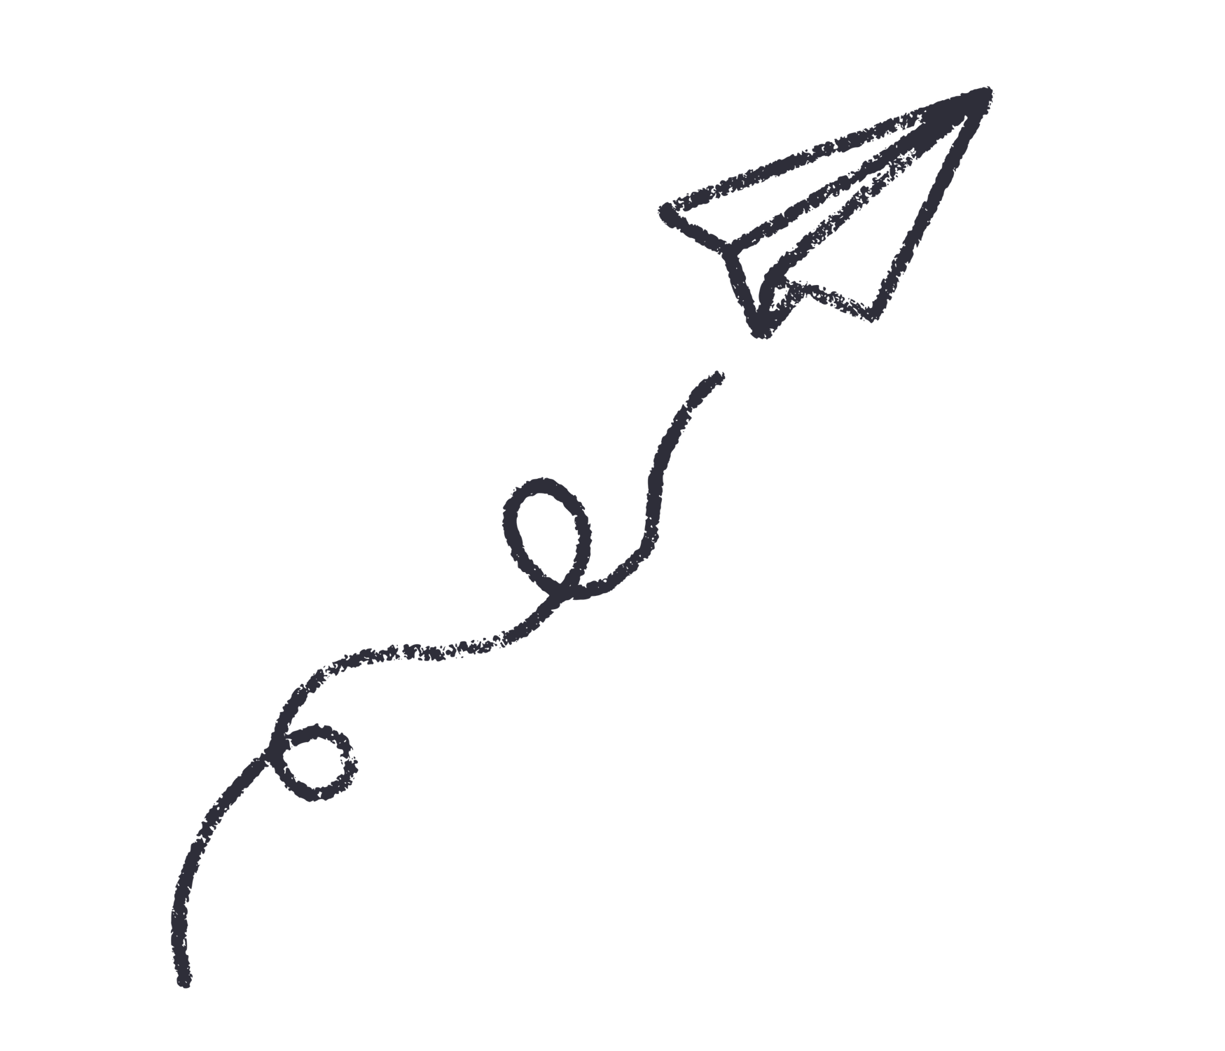



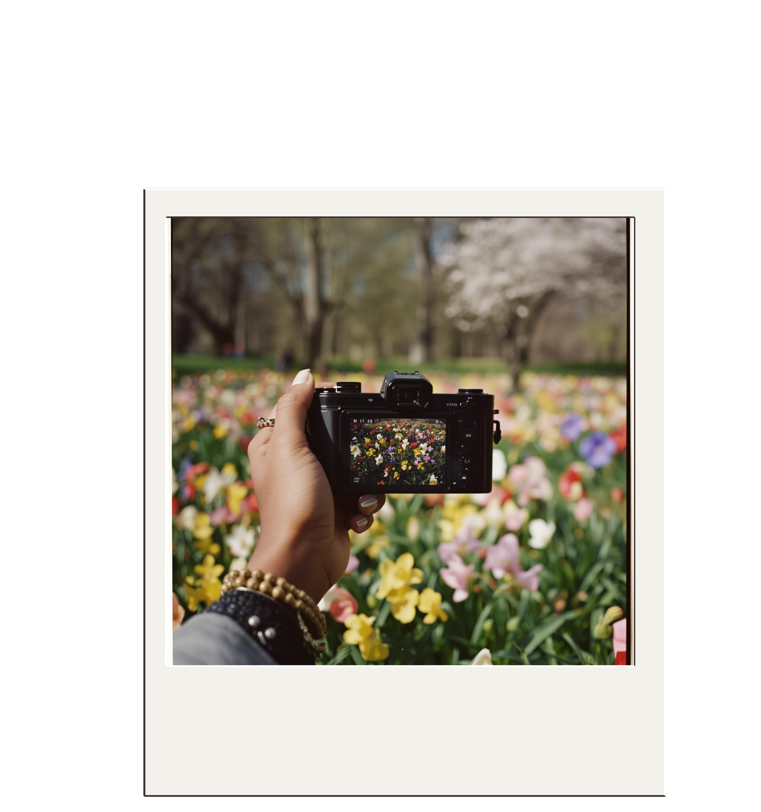



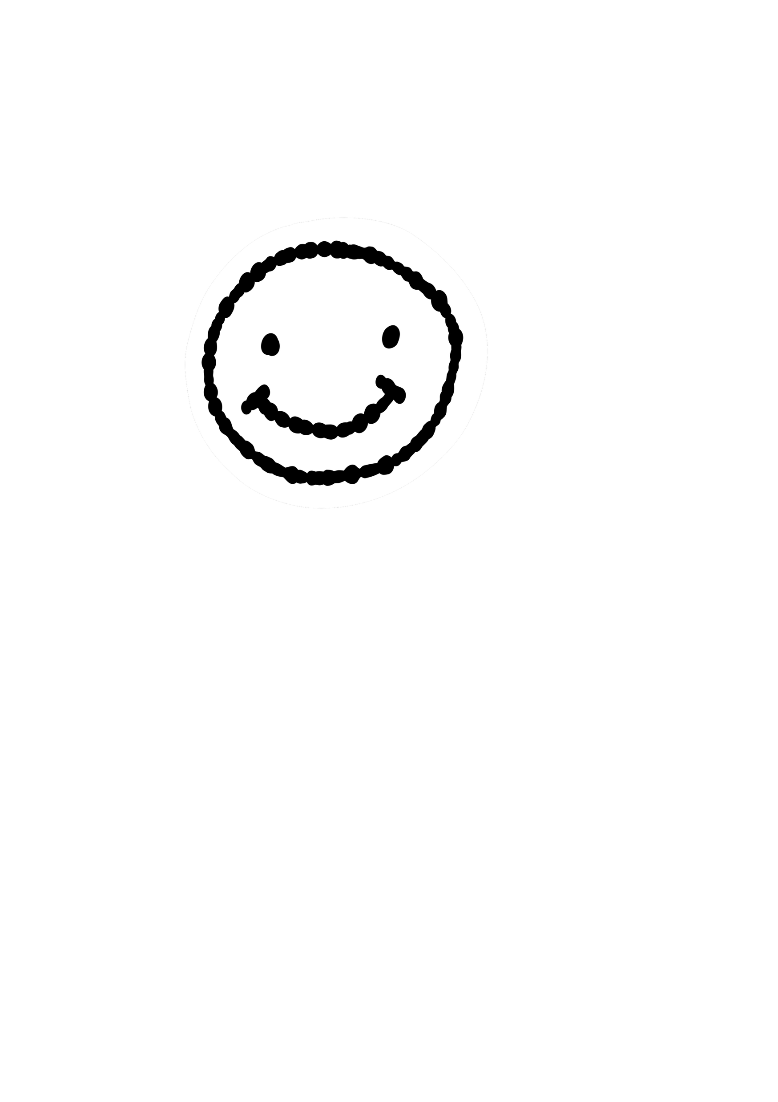

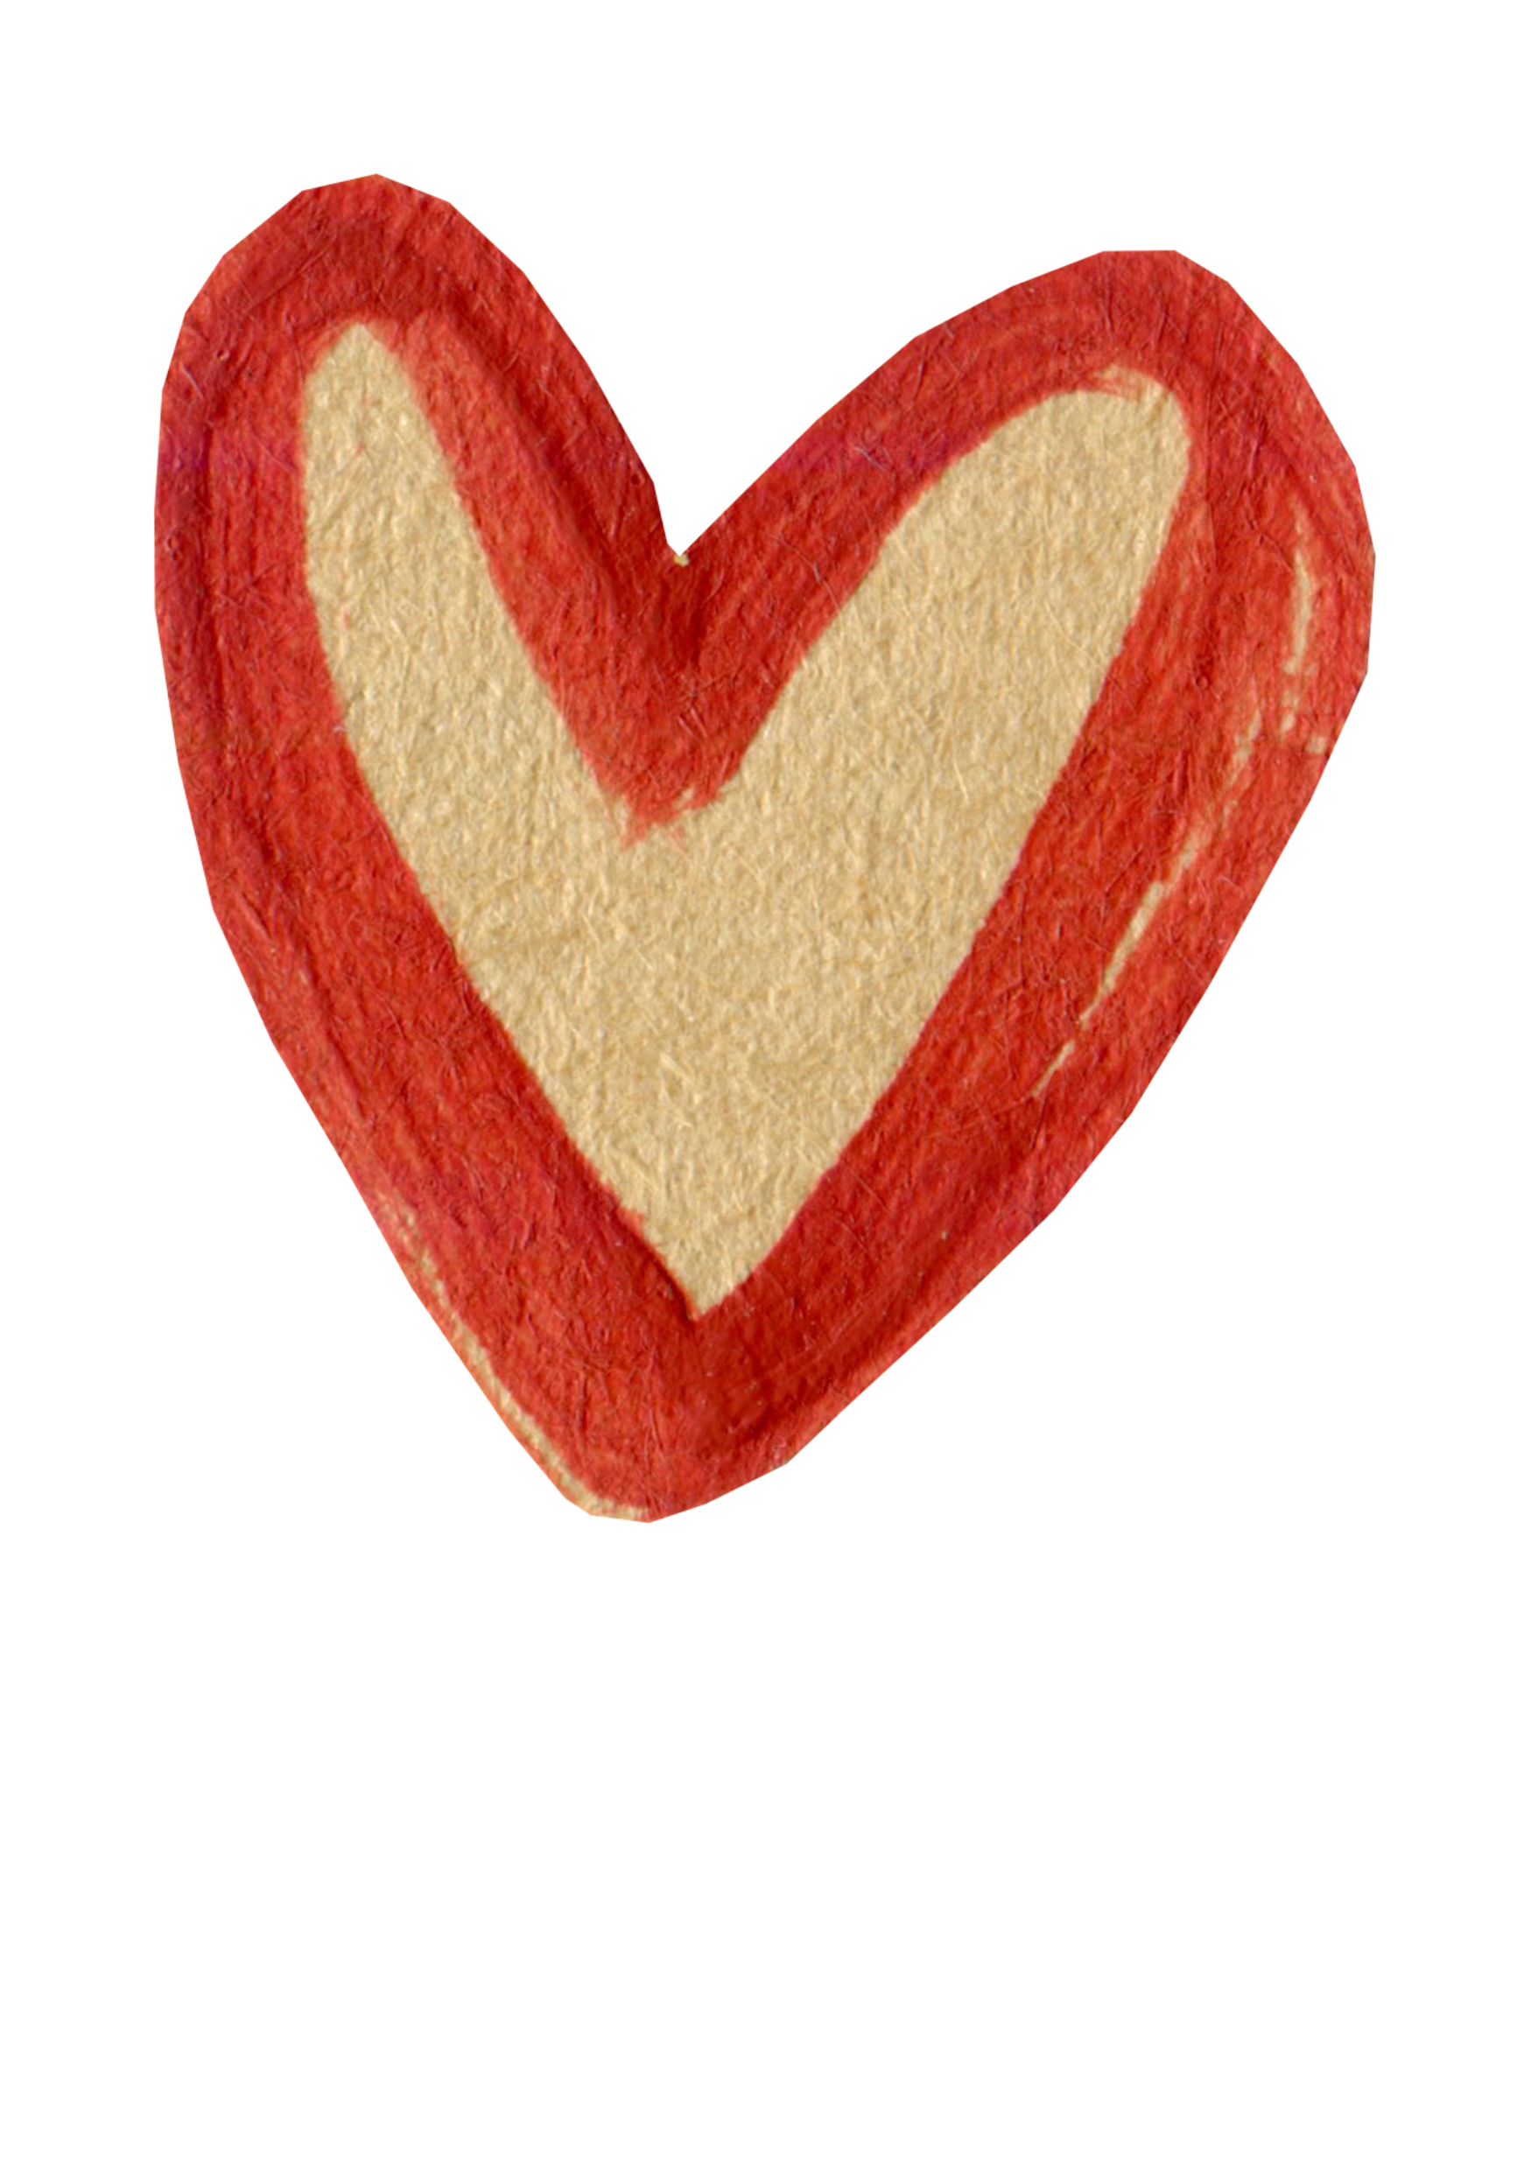
We Are All Different

Slide 10
We Are All Different

Slide 11
We Are All Different

Slide 12
We Are All Different

Slide 13
We Are All Different

Slide 14
We Are All Different

Slide 15
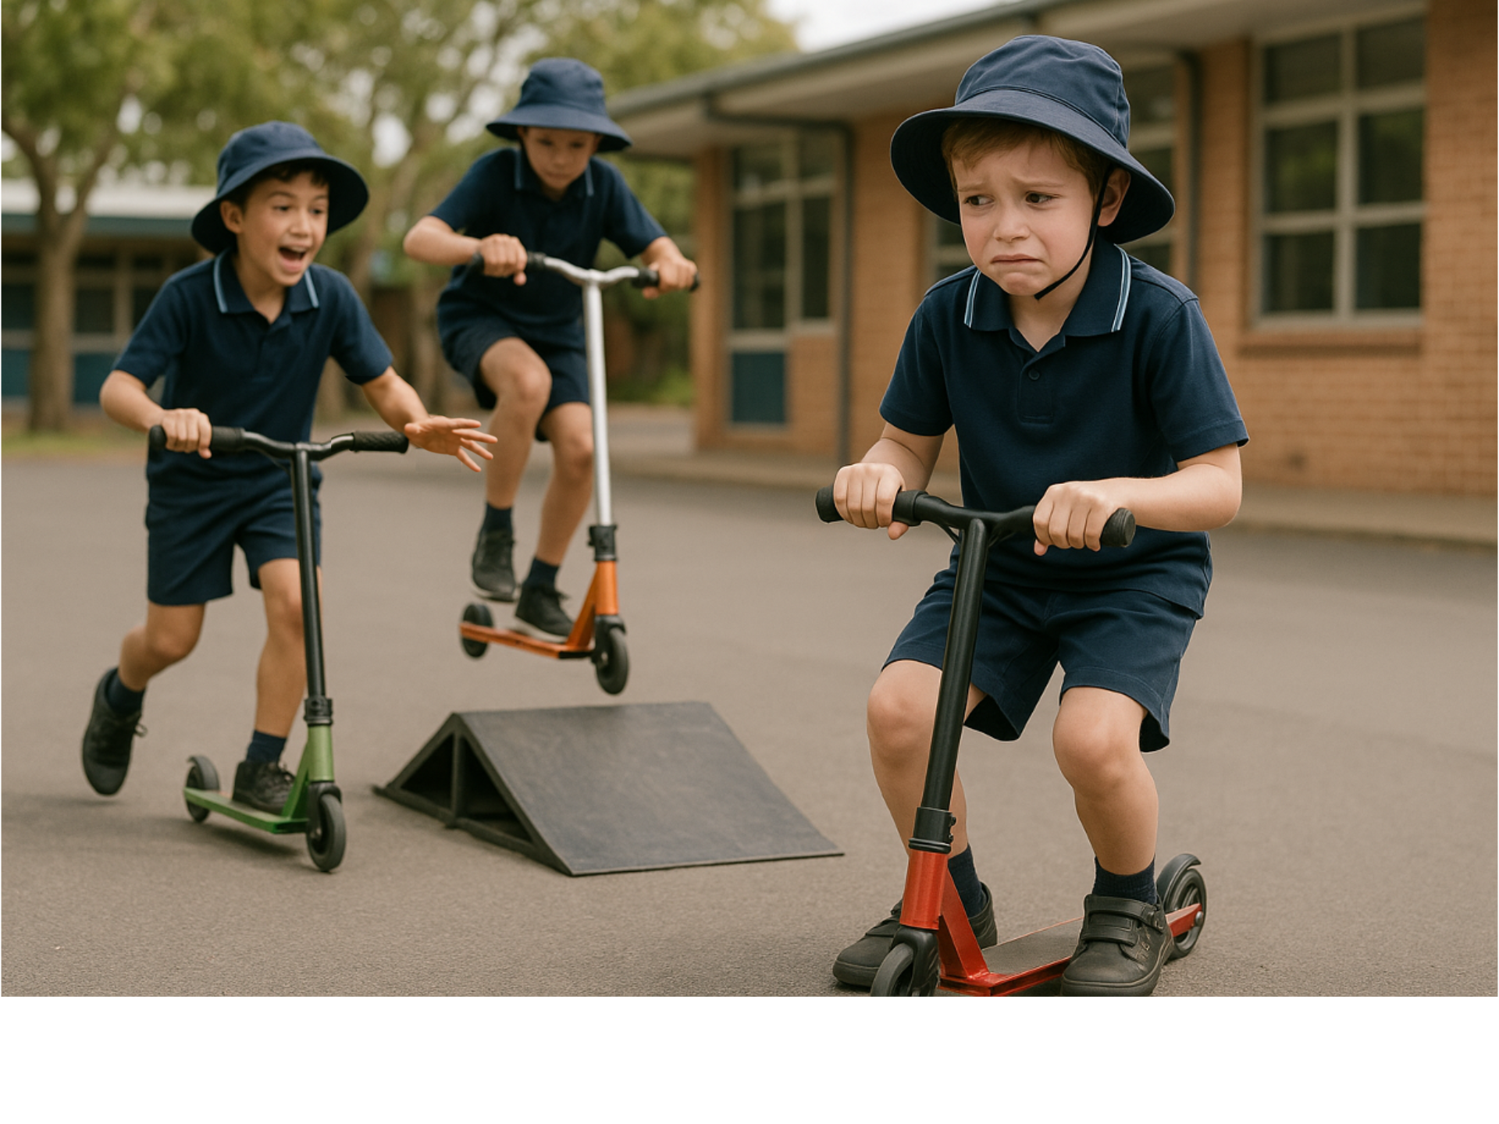
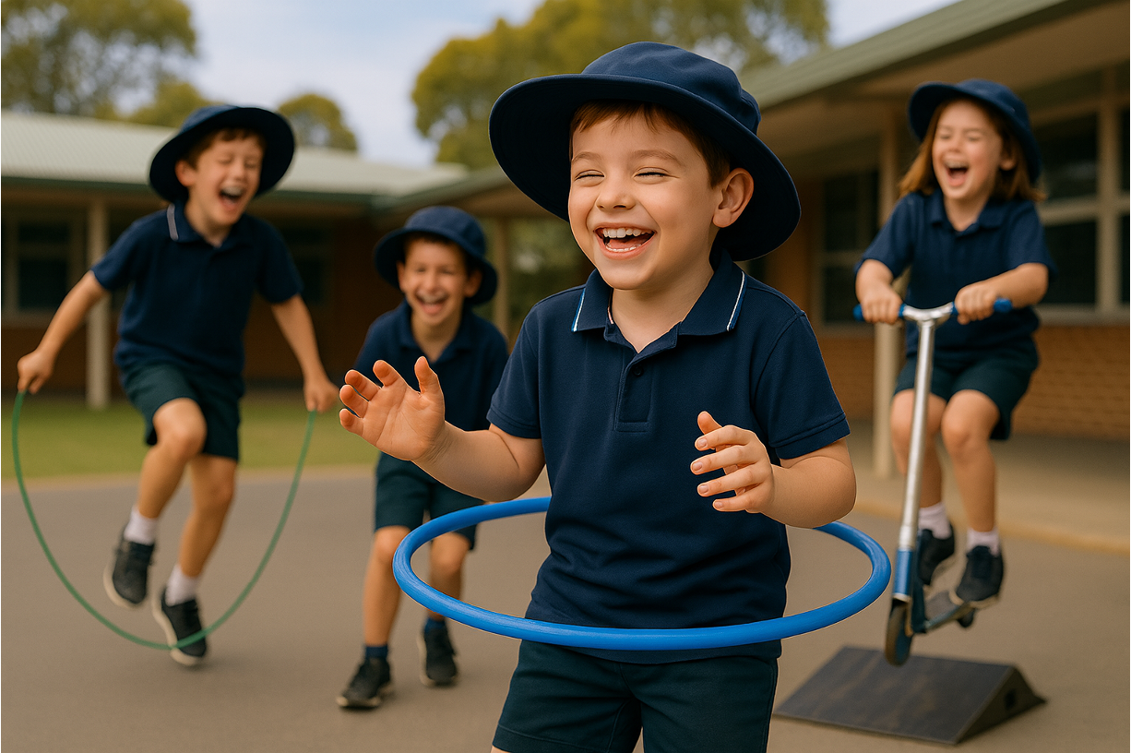
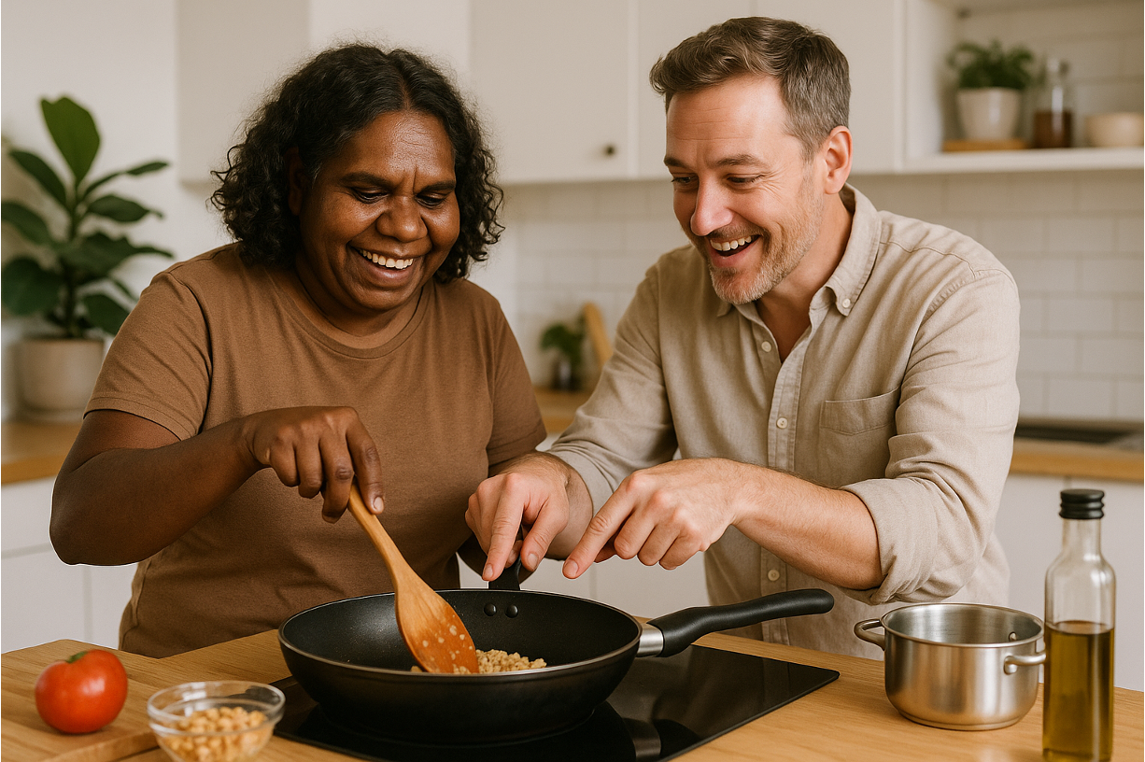
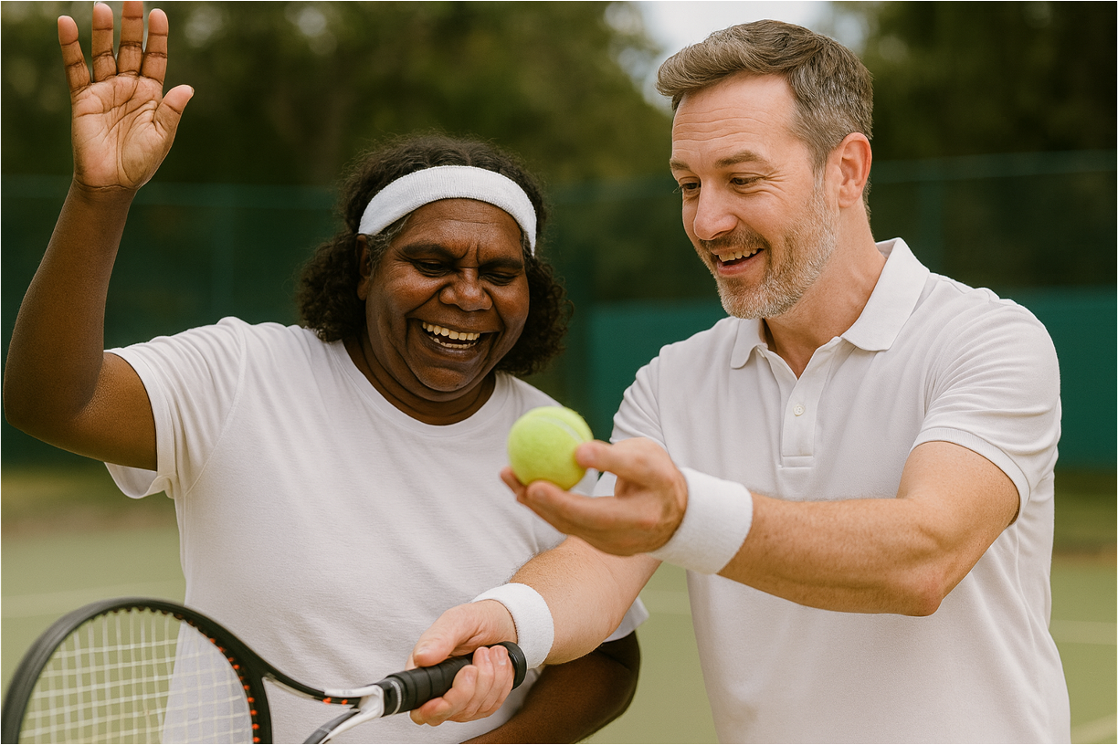
We Are All Different

Slide 16
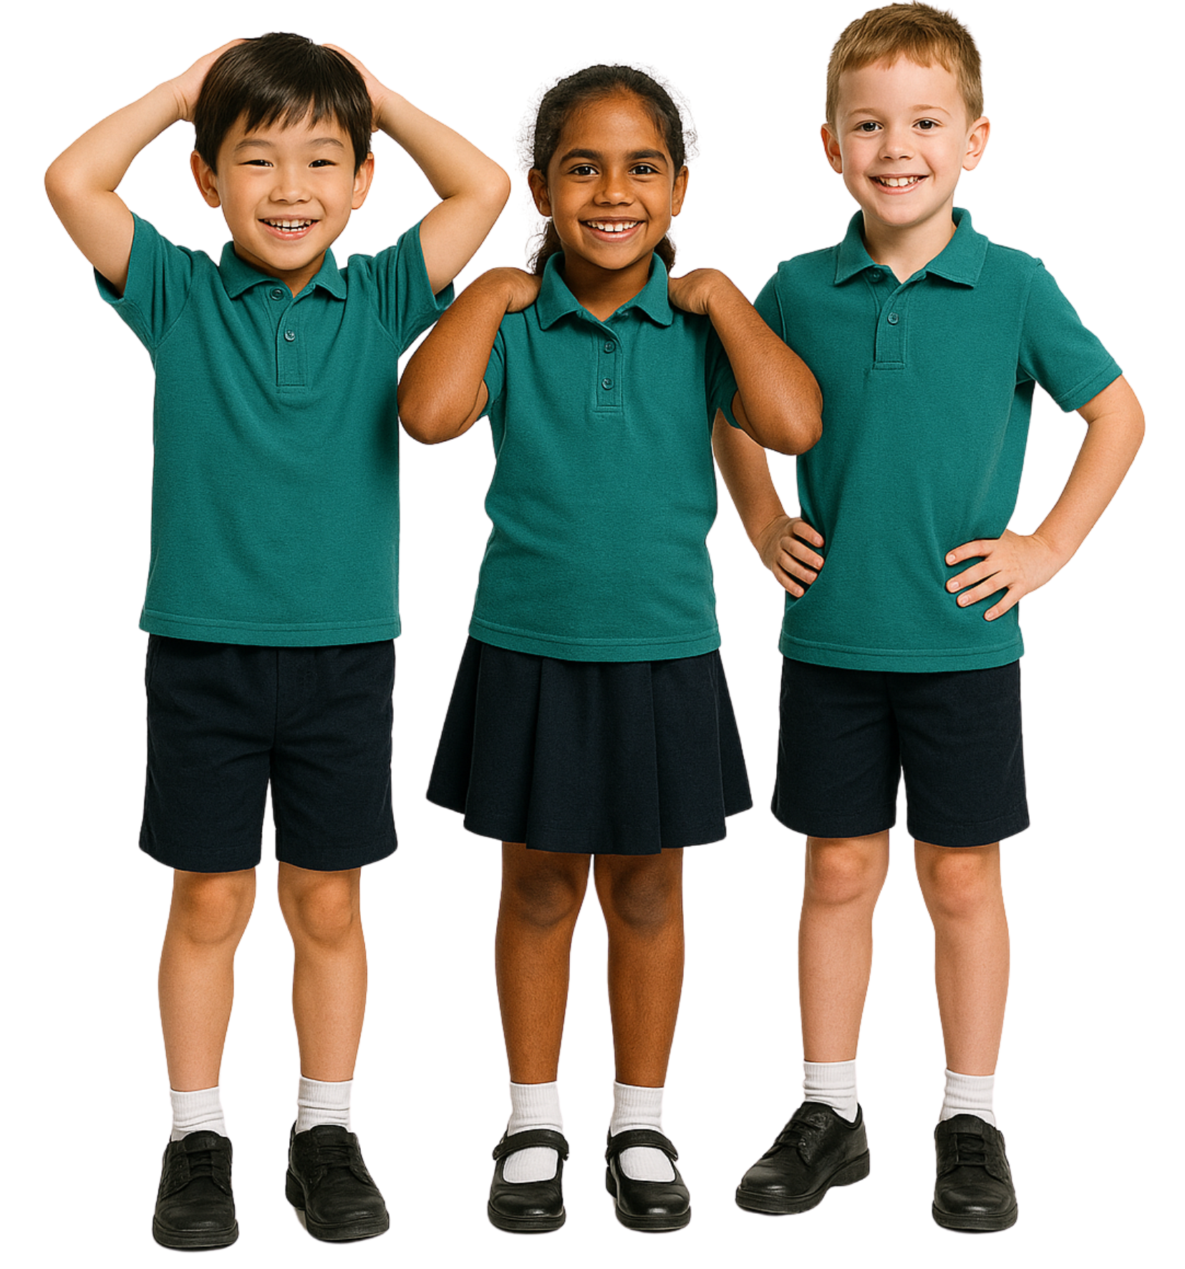
Being Different
Is it okay to have different likes and interests than our friends?
Sometimes
No
Yes

Slide 17
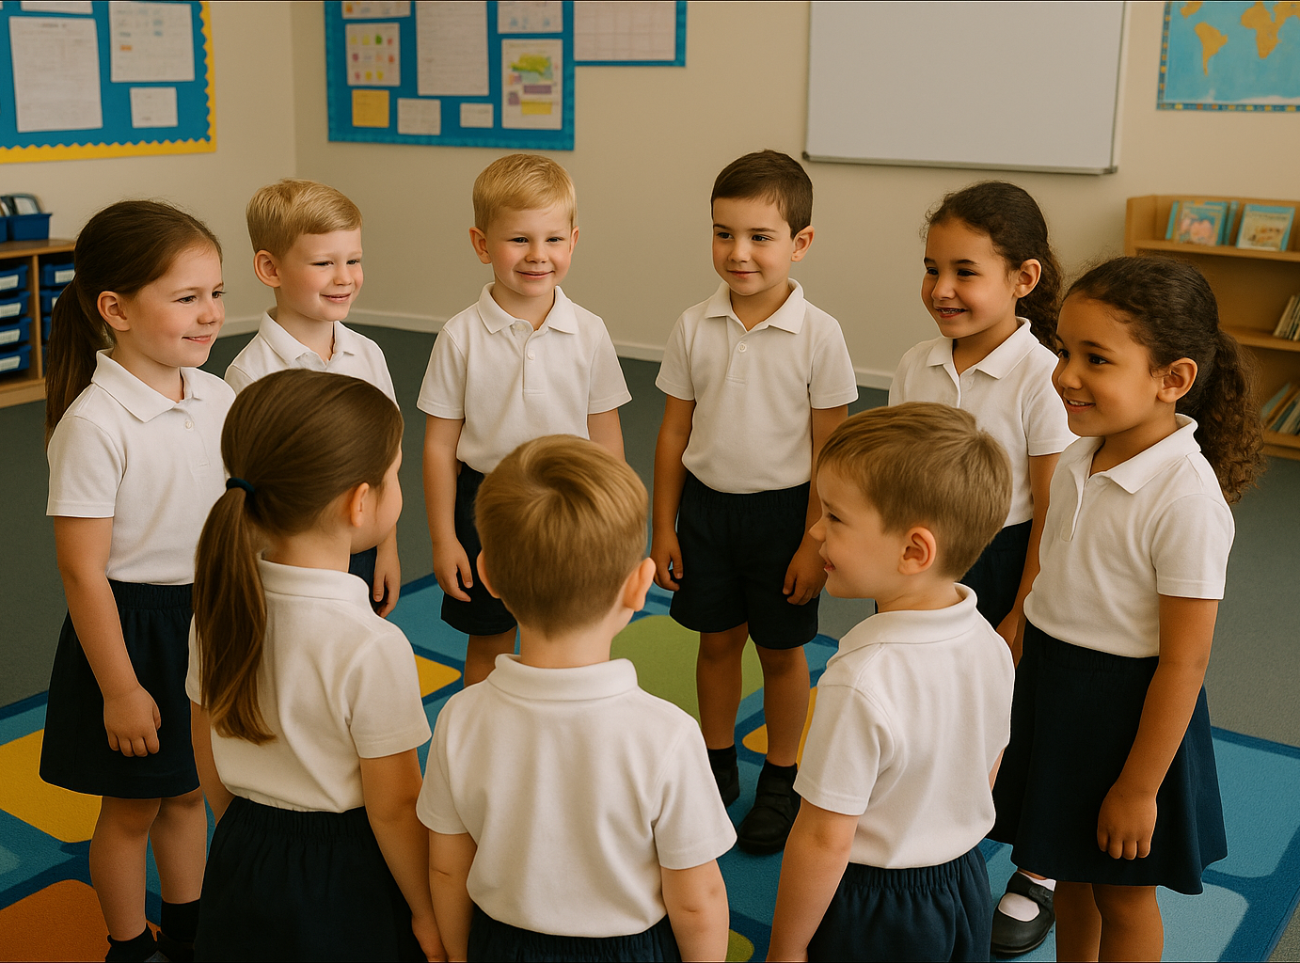
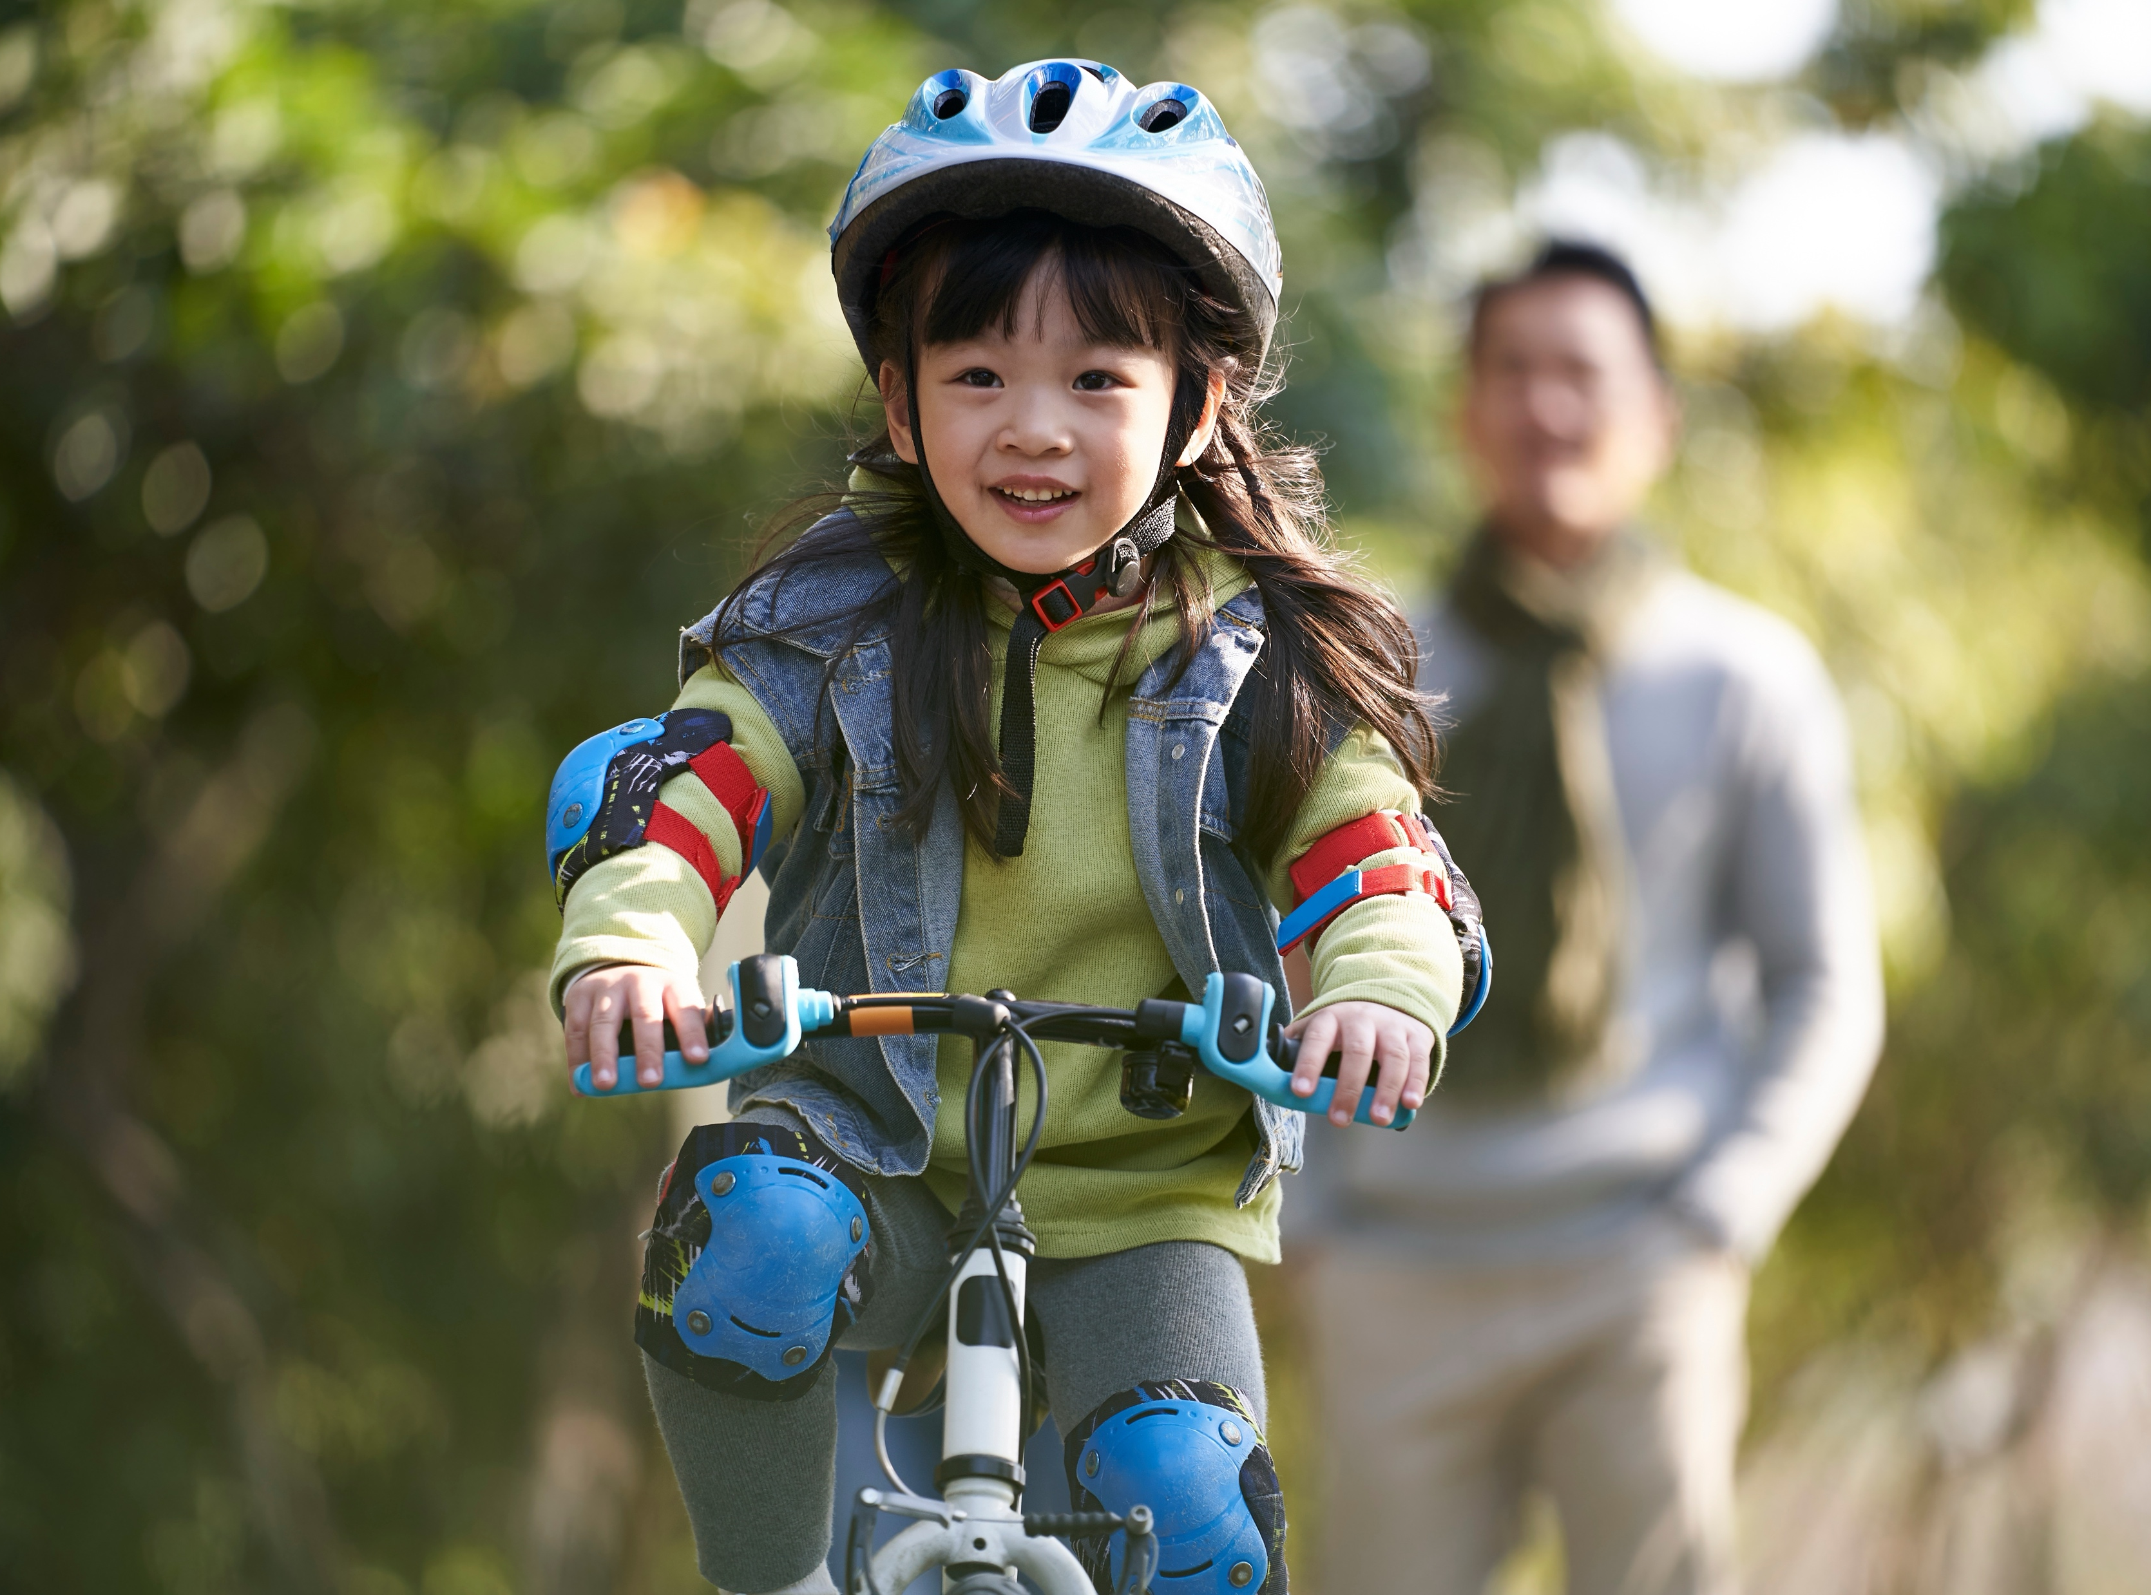
Step into the Circle

Slide 18

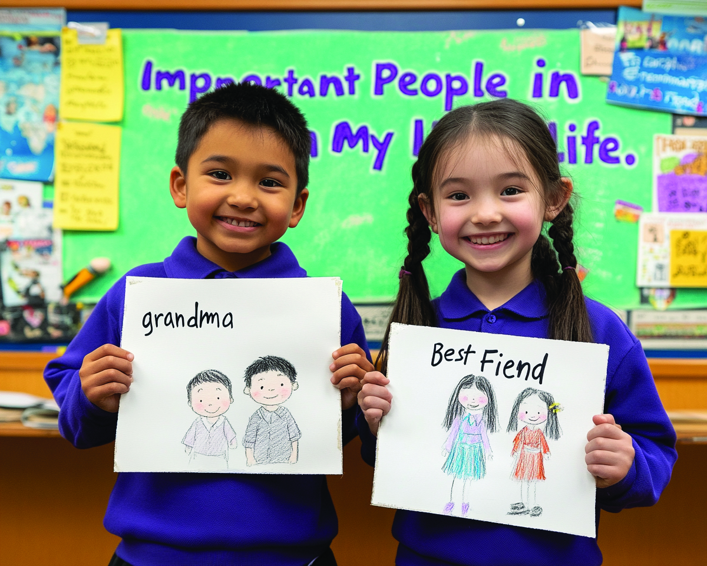
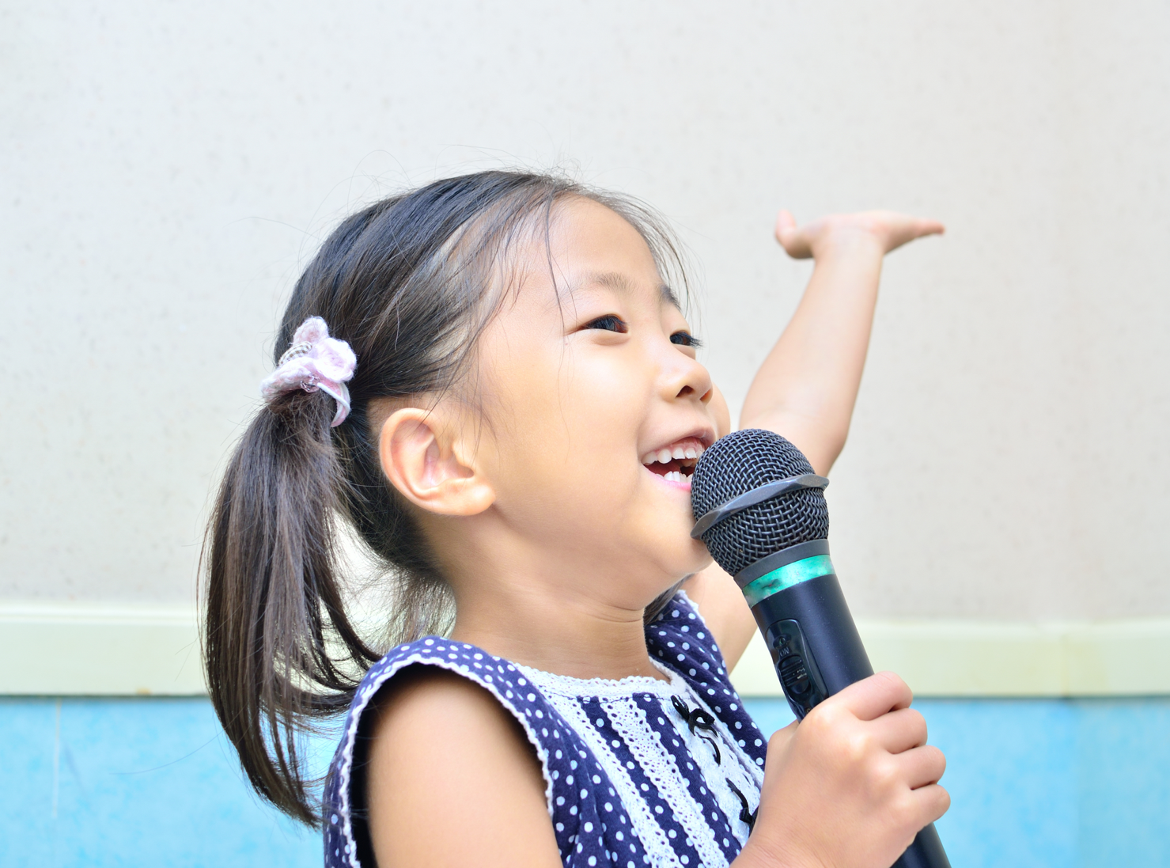
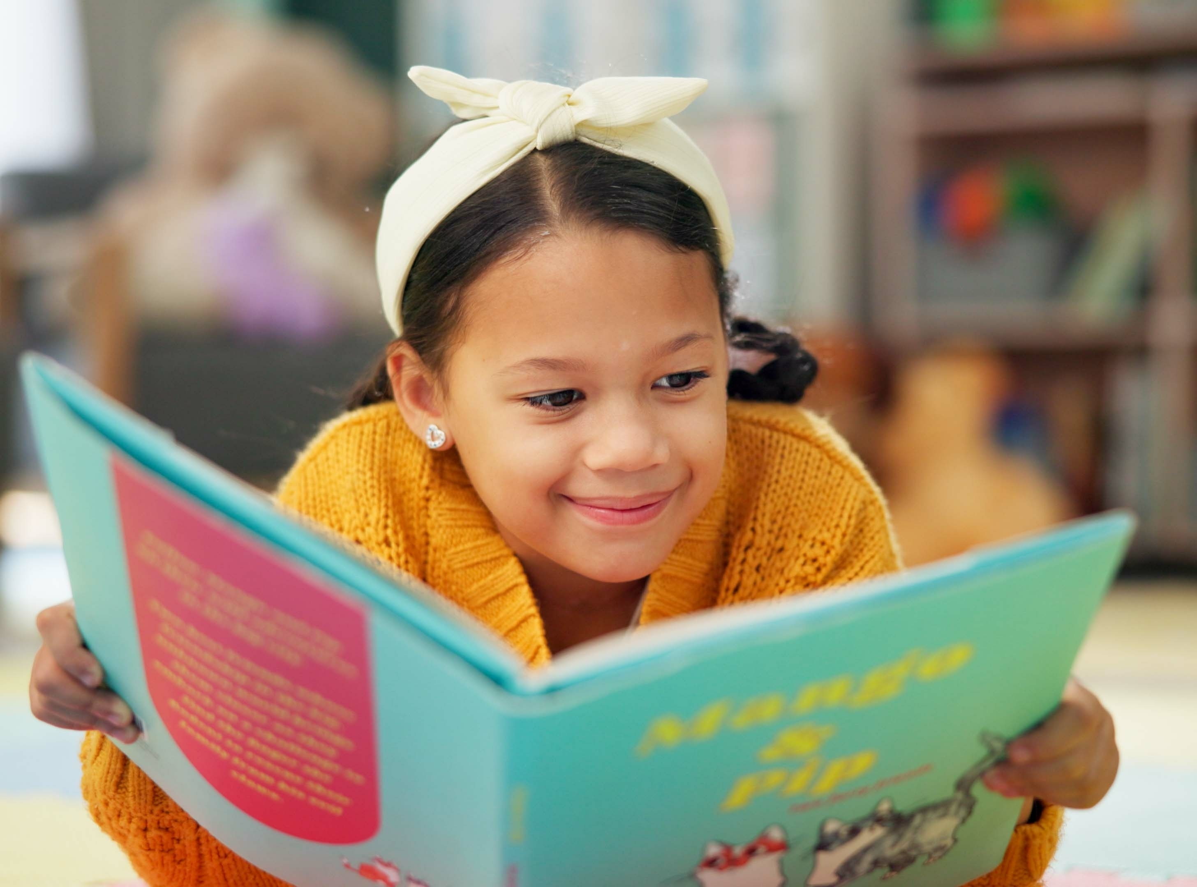
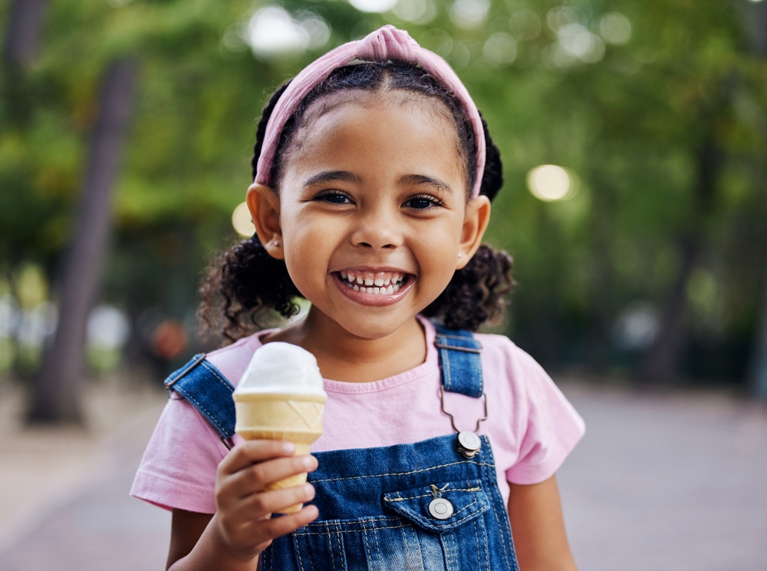
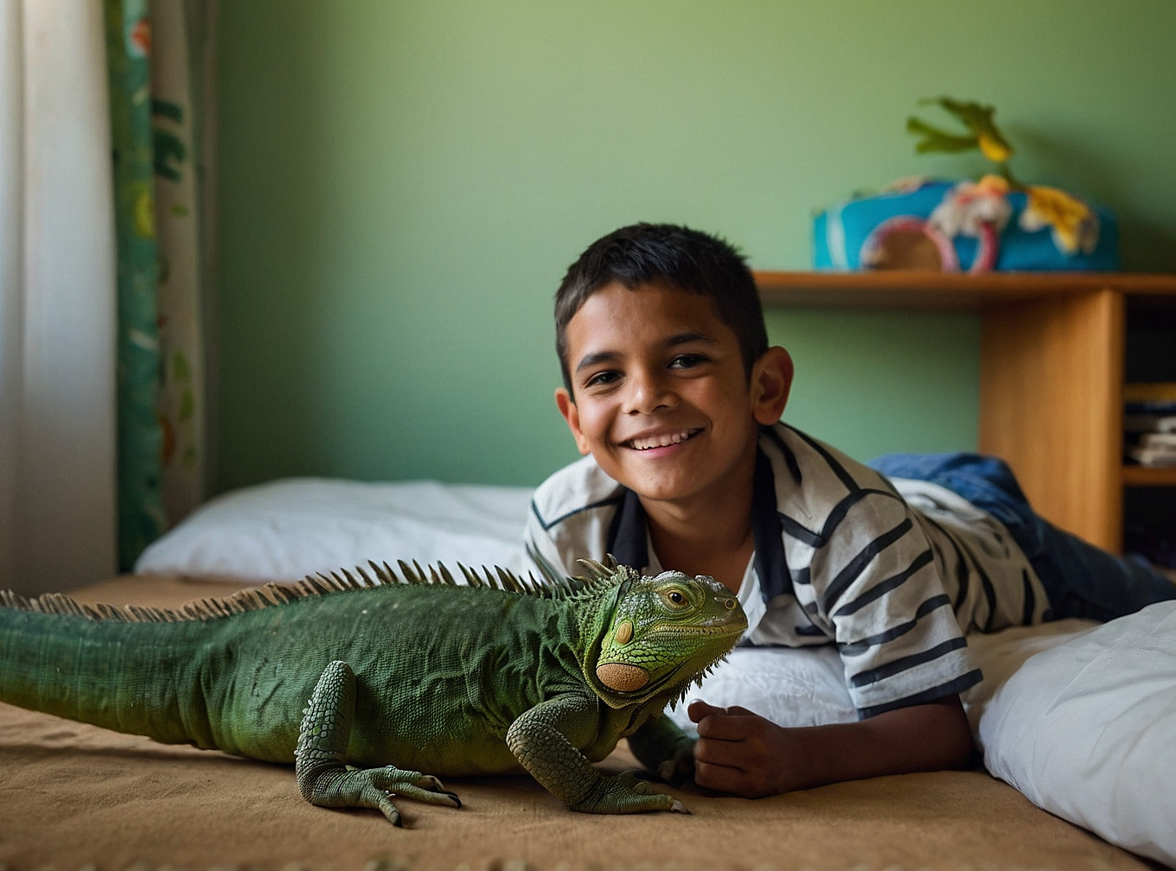
Step into the Circle

Slide 19
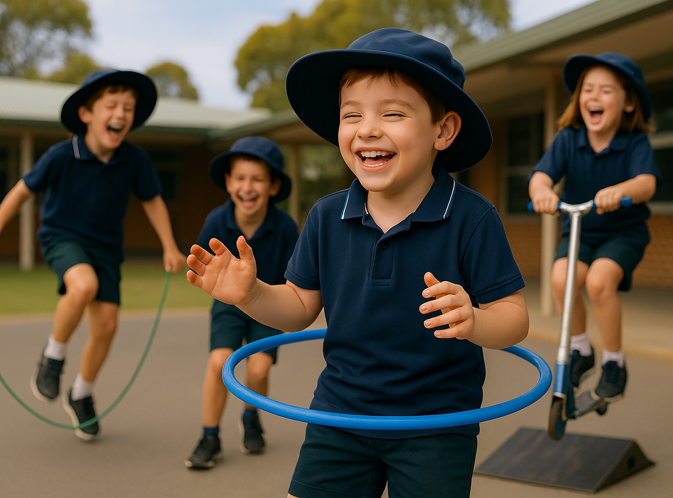
It is okay to have different likes and interests than others because it makes us unique.

Slide 20
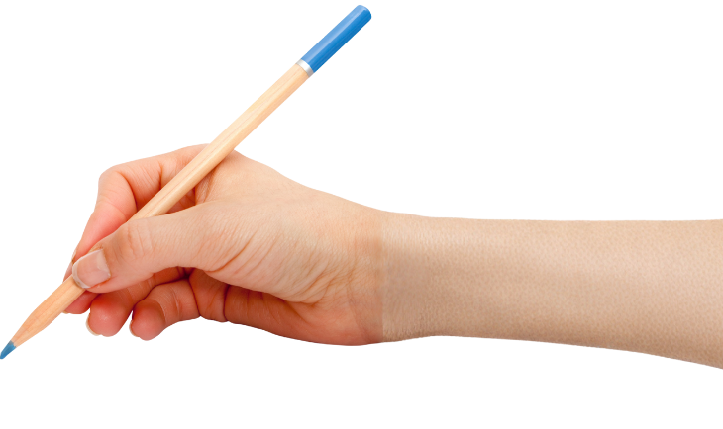

How well did you:
say something you
like
listen and respond when others share their interests?
Notes:
​

Slide 21
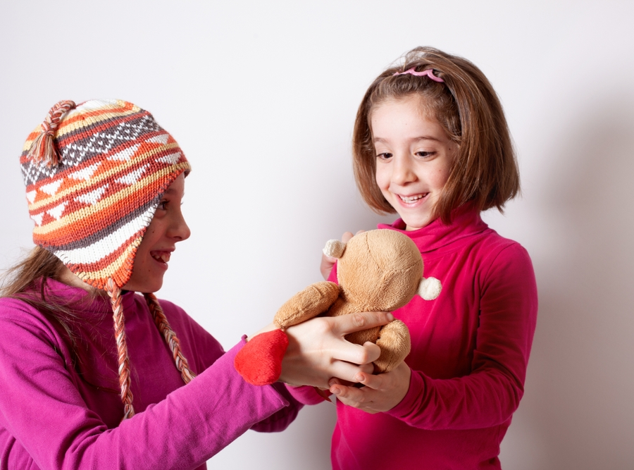
In the next lesson, we will think about places, people or things that help us feel safe and calm.

