Slide 1
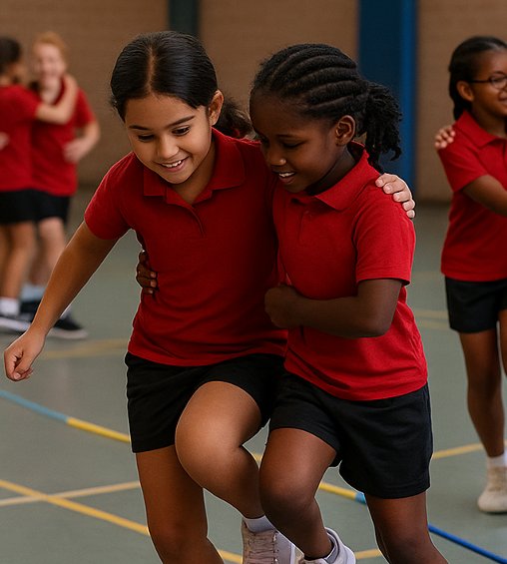
Belonging
Link-Up
Unit 1: Knowing Me, Knowing You
Lesson 1
Lesson 4 (Extension 1) Lesson 5 (Extension 2)

Slide 2
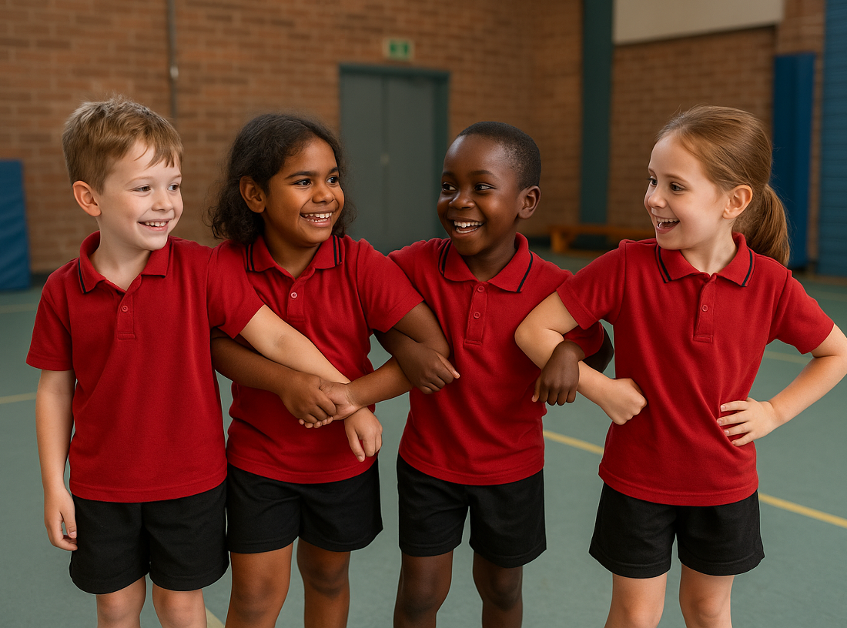
Lesson 1

Slide 3
You will learn, through experience, that belonging can be felt in different ways and that your words and actions can help others feel included.

Slide 4







Slide 6


Slide 7
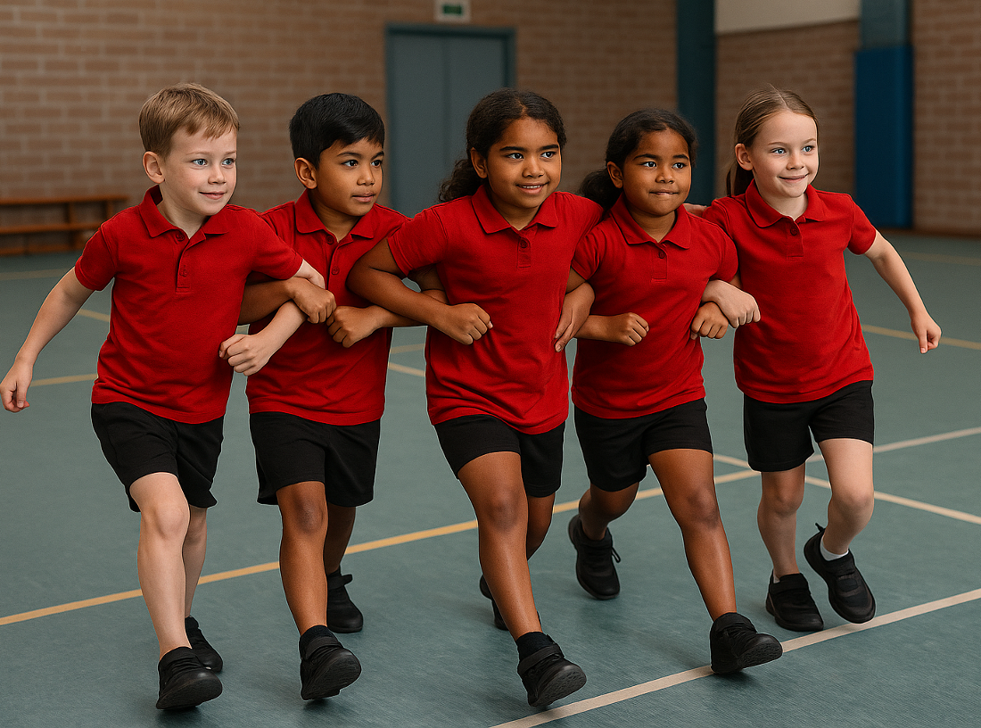
Lesson 4 (Extension 1)

Slide 8
You will practise creating belonging through kind words and actions that make others feel included.

Slide 10


Slide 11
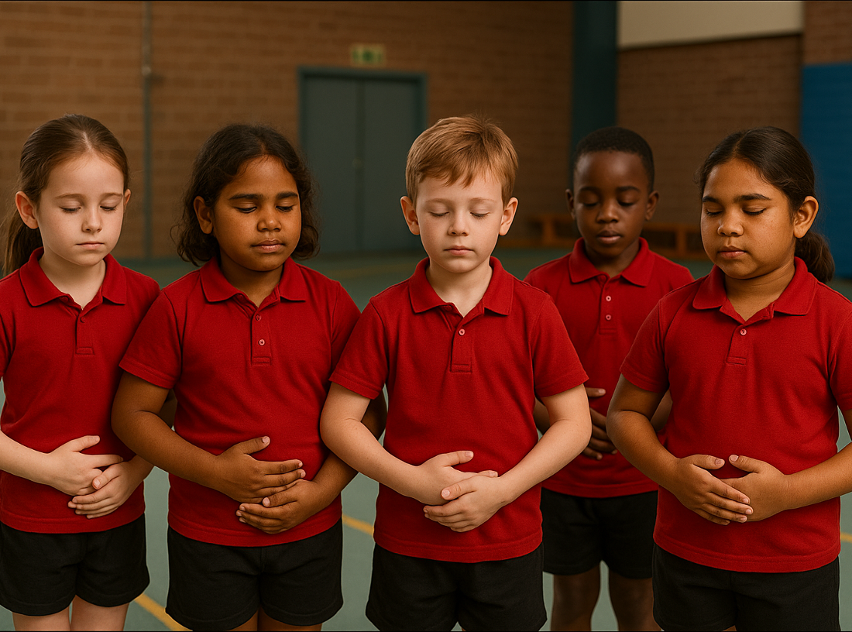
Lesson 5 (Extension 2)

Slide 12
You will identify things that make you feel happy or sad and practise responding with calming or coping strategies.

Slide 14


