Slide 1

Classroom Rule
Unit 1, Week 1
Learn Well

Slide 2
In this lesson, you will learn the classroom rule, ‘Learn Well’.

Slide 3
You will be successful when you can demonstrate the classroom rule, ‘Learn Well’.

Slide 4
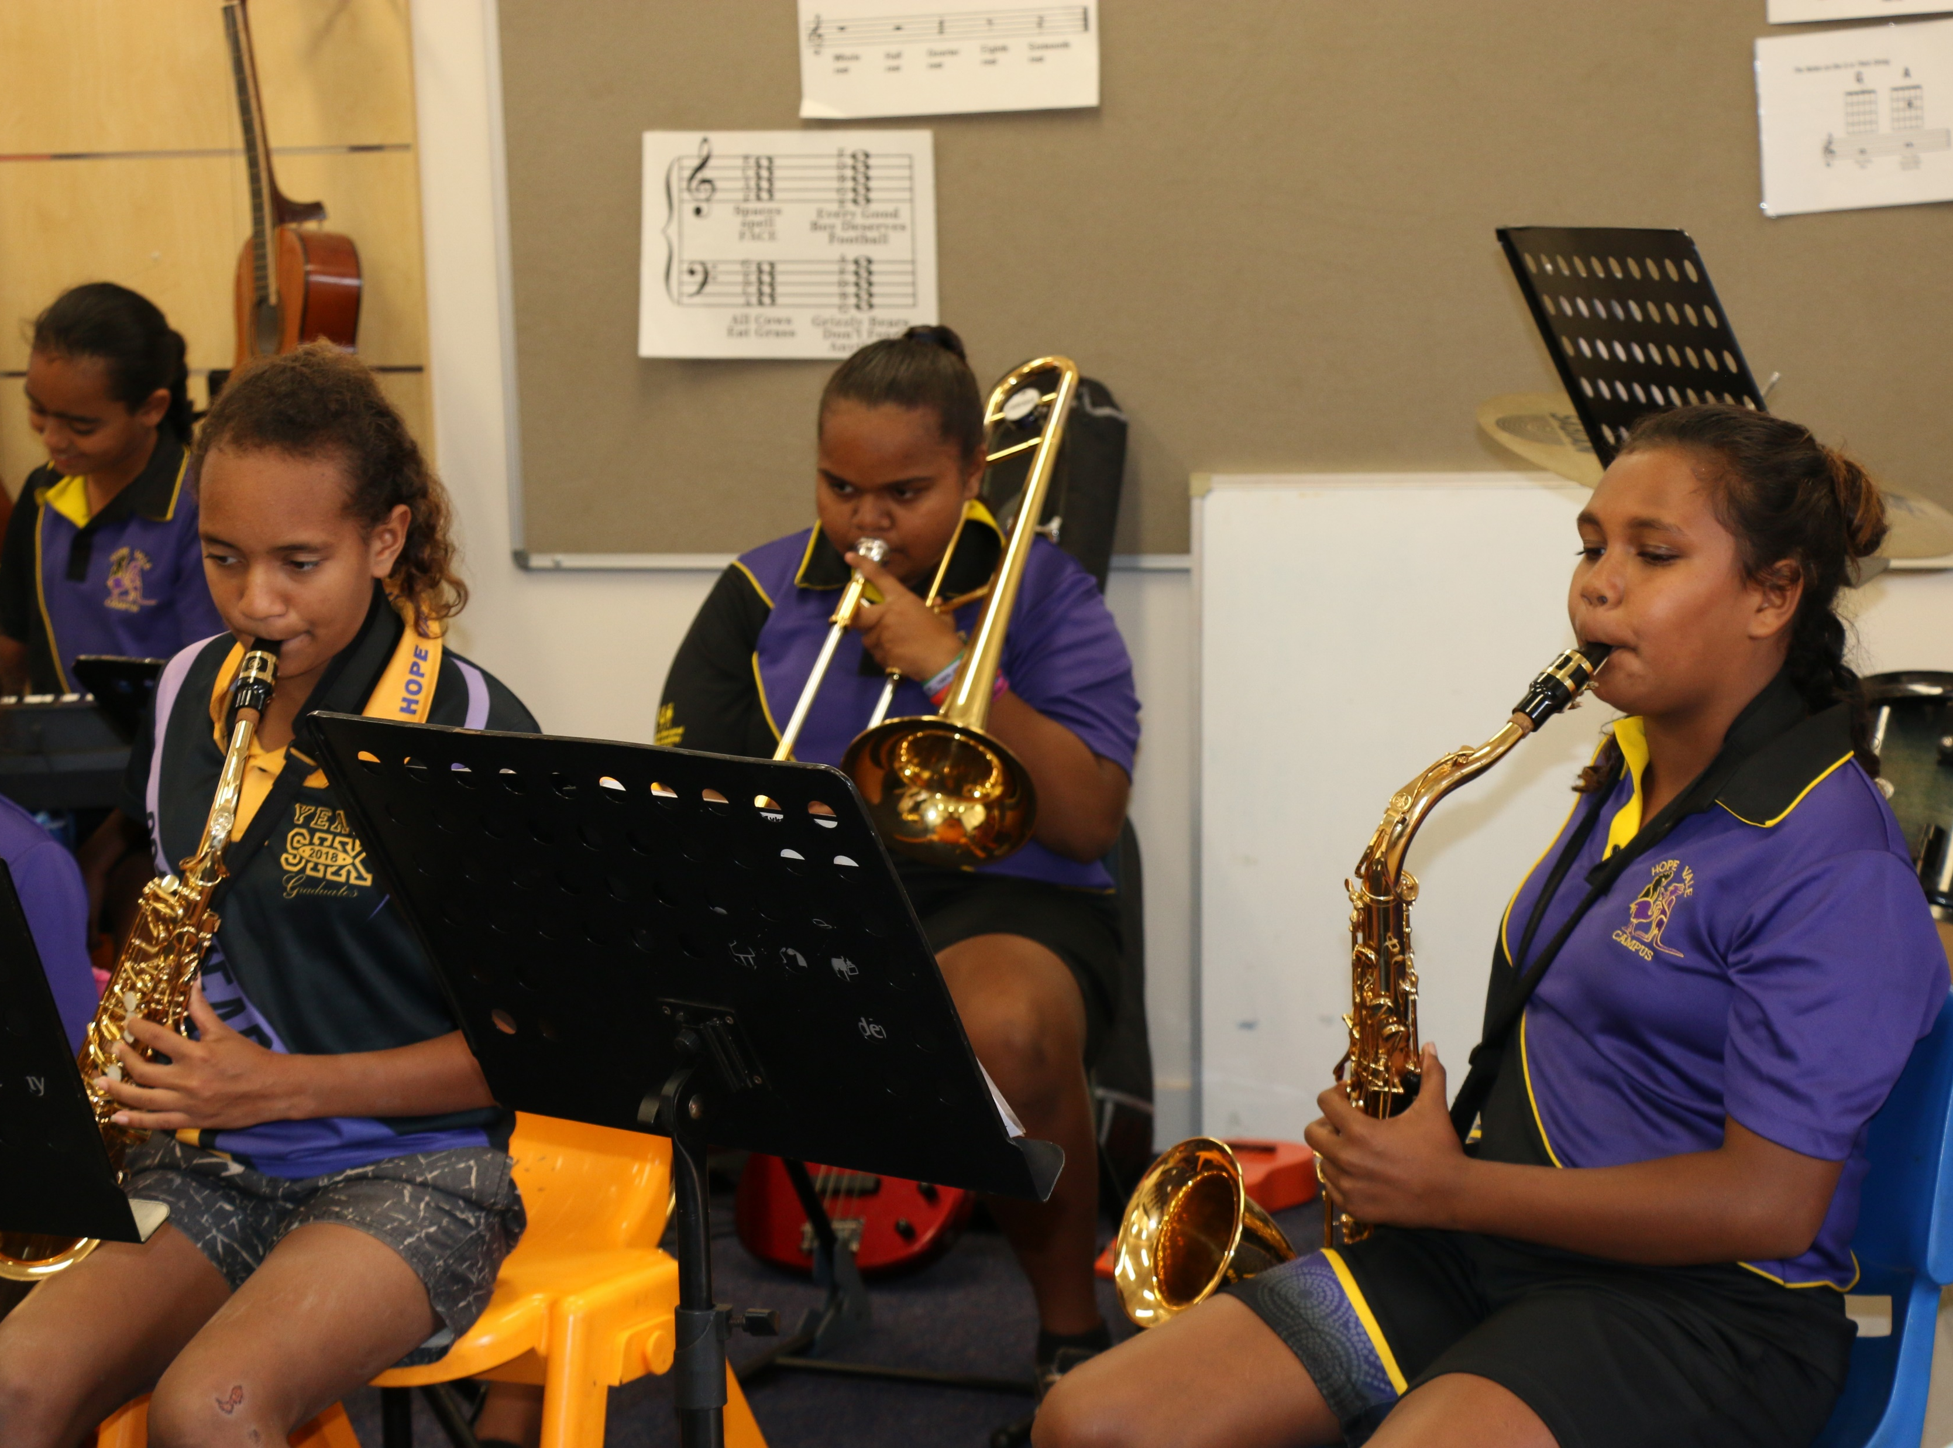
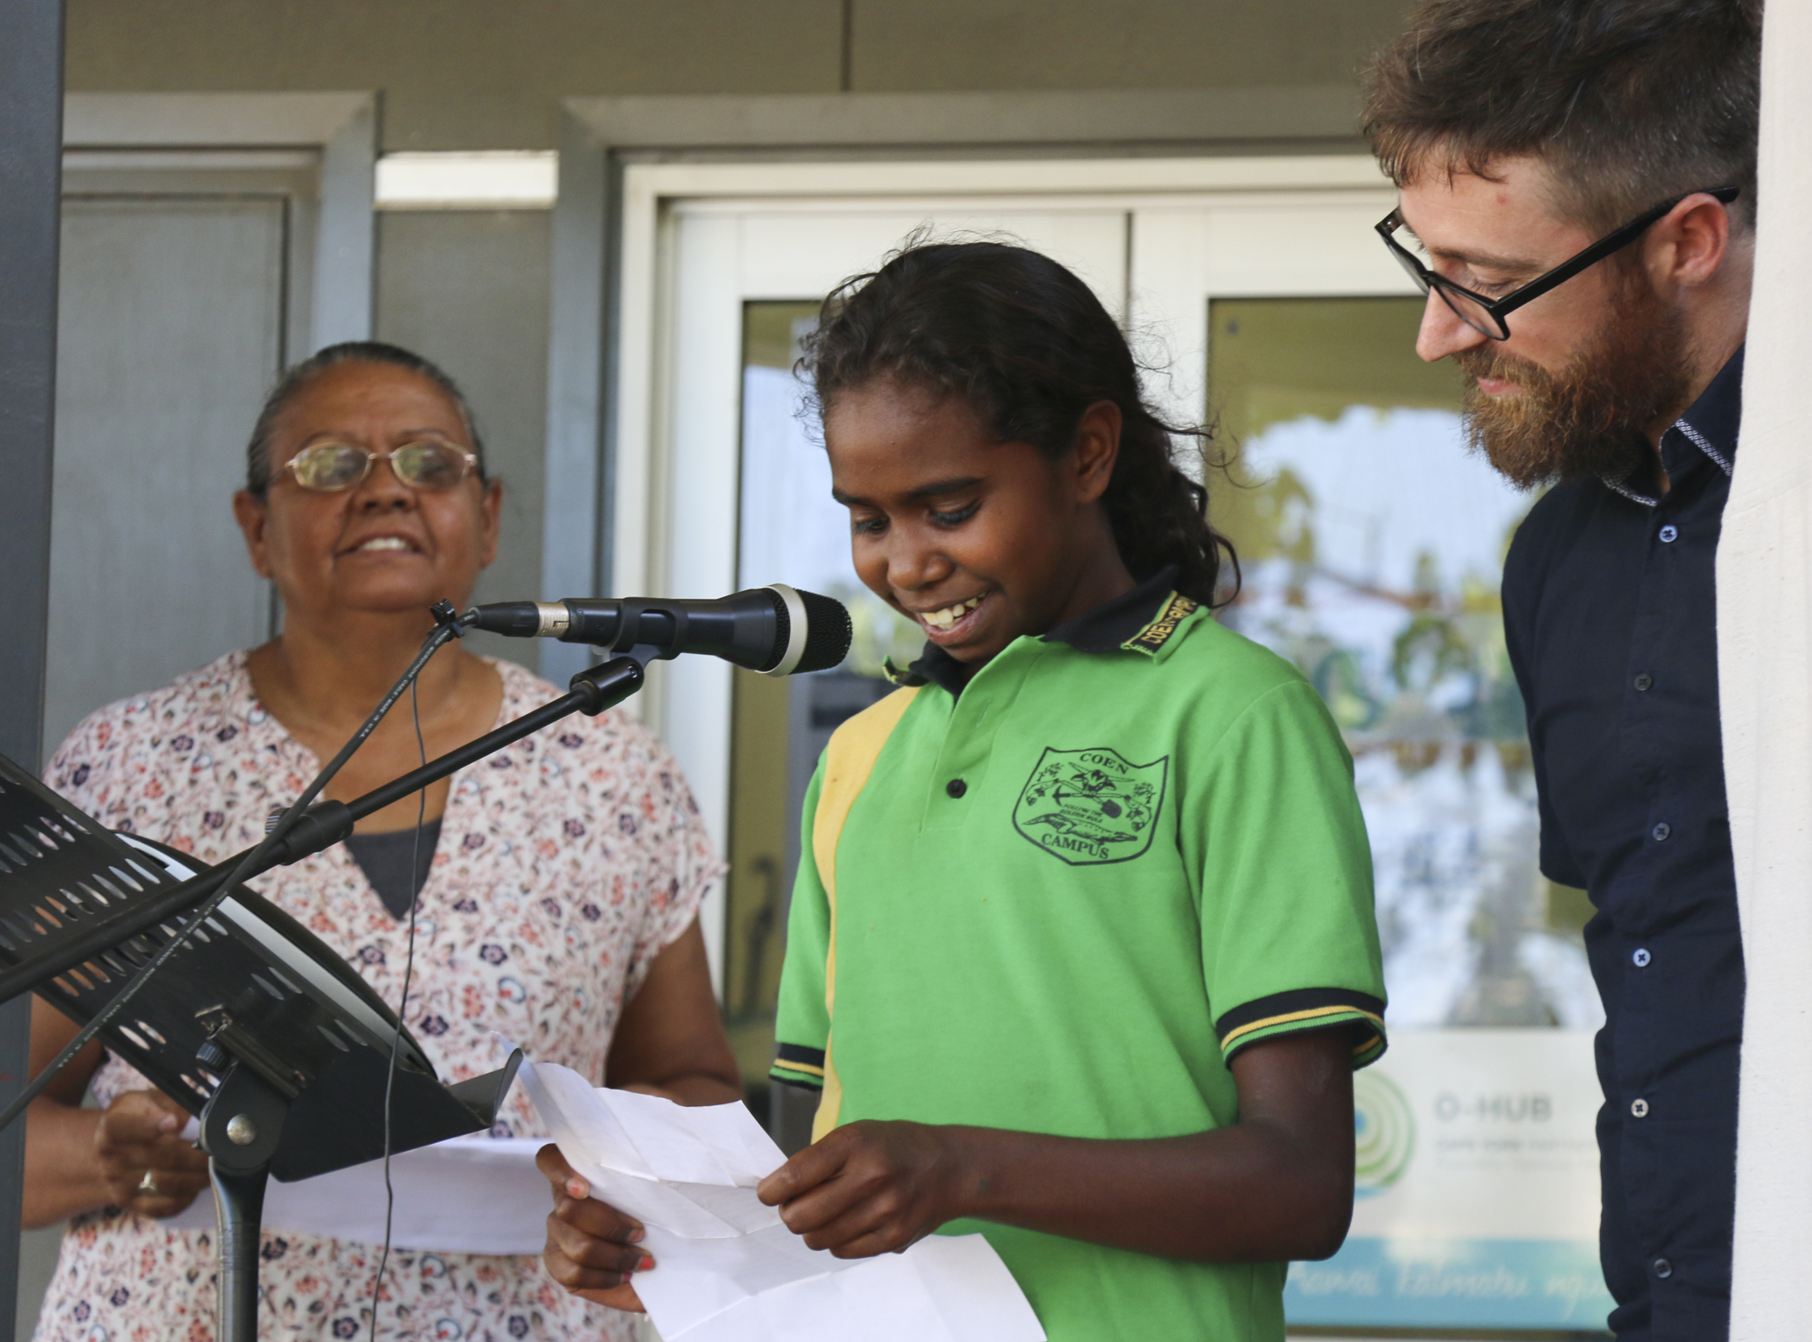

Slide 5
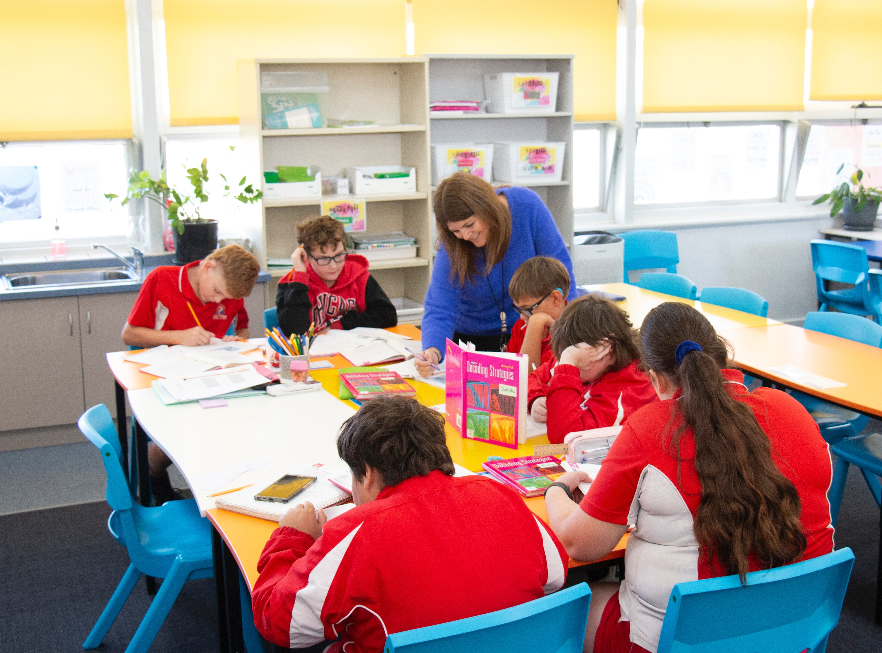
What Are Rules?
Rules tell us what we need to do.

Slide 6


Thumbs Up or Thumbs Down
Following rules help me to learn at school.
yes
no

Slide 7

Learn Well
Our ‘Learn Well’ rules ensure we stay on track and are responsible for our learning.

Slide 8
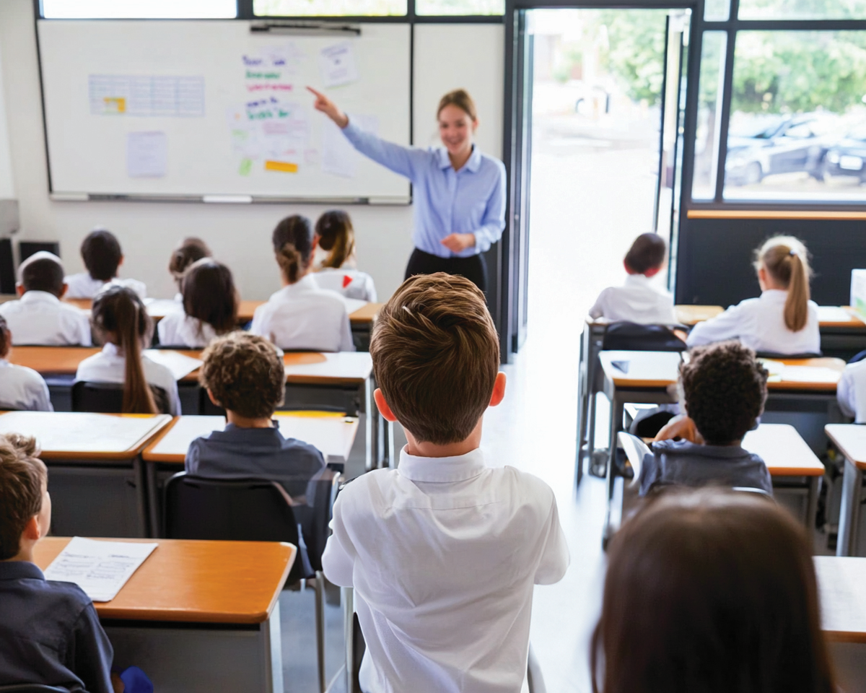
Track the Teacher
We keep our eyes on the teacher when they are talking.

Slide 9
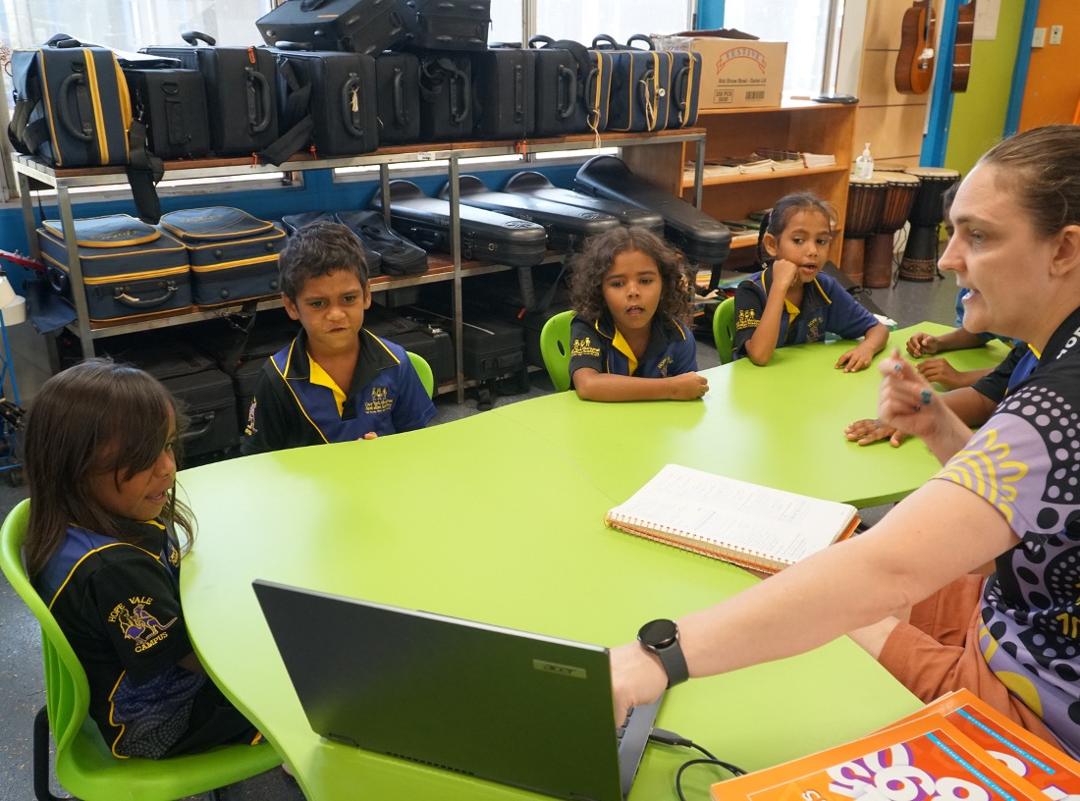
Listen
When we listen, we understand more and show respect.

Slide 10

Respond on Signal
When we respond to a signal together, it feels like we’re all working as a team.

Slide 11
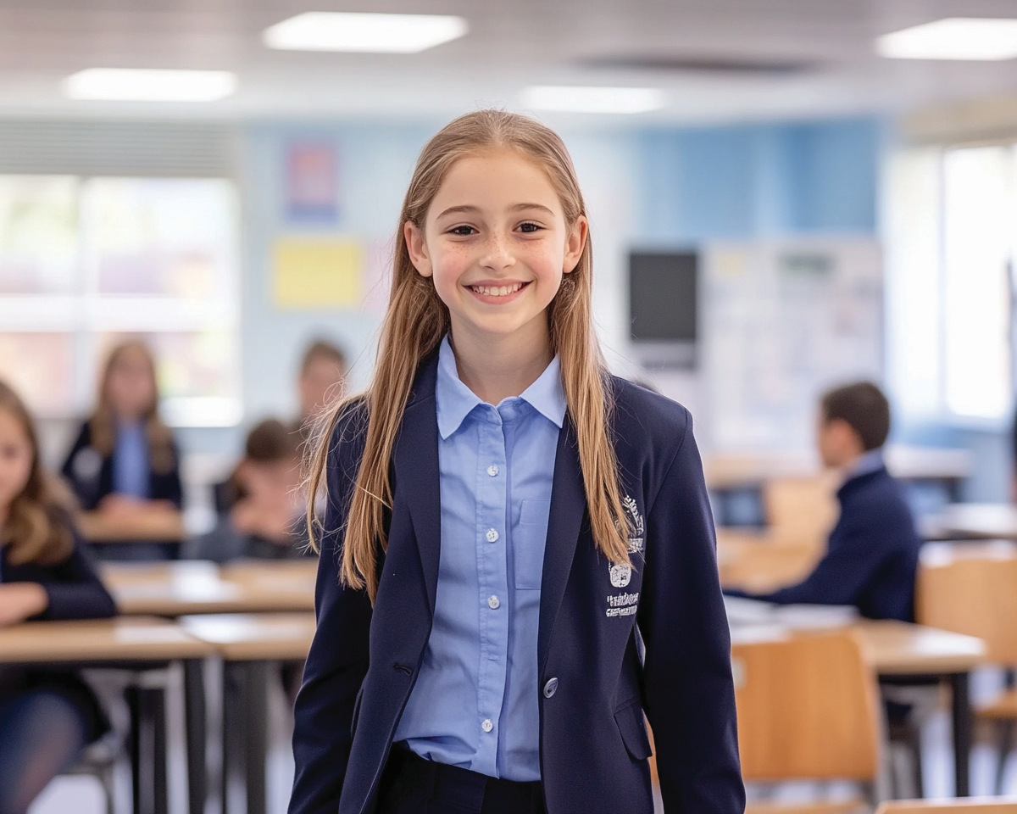
Use Your Speaking Voice
Talk clearly and at a comfortable volume to help others understand.

Slide 12

Complete Independent Work
When we work independently, we learn better and stay focused without distractions.

Slide 13
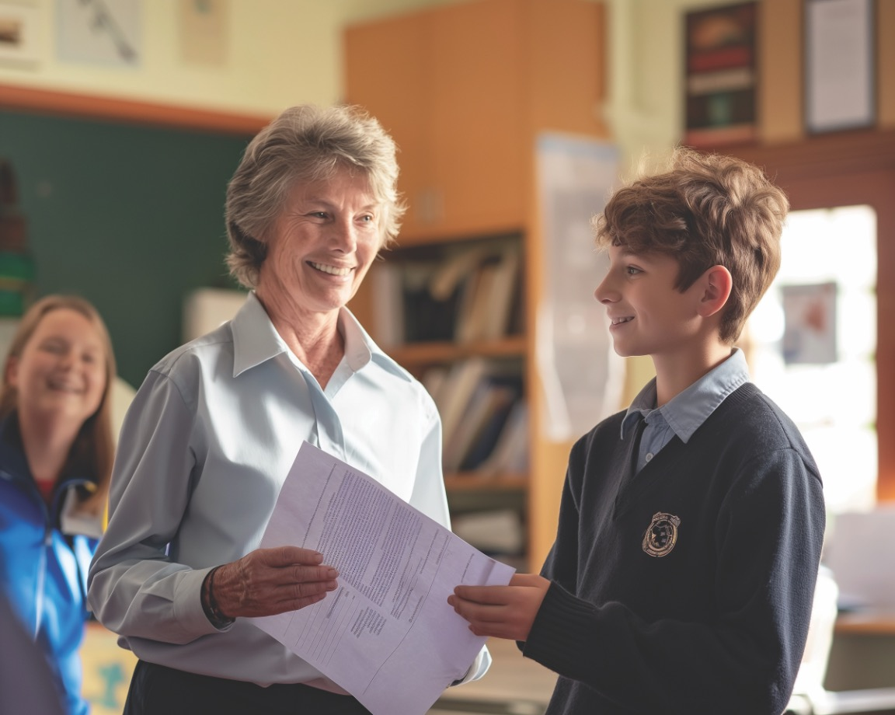
Hand in Completed Work
Submit your finished assignments to the teacher when you are satisfied with them.

Slide 14
Thumbs Up or Thumbs Down
Doing independent work shows you can figure things out by yourself, and people can trust you to do what needs to be done.
yes
no

Slide 15
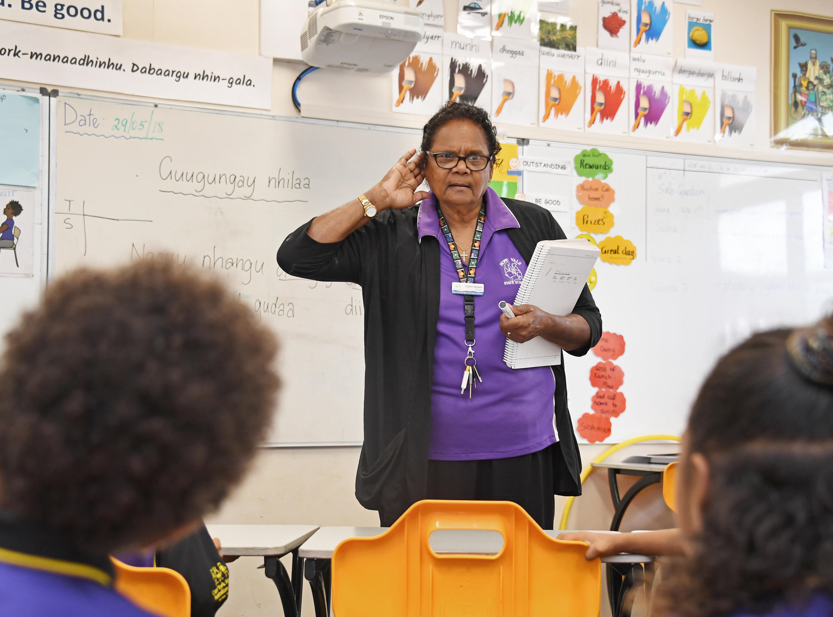
Respond on Signal

Slide 16
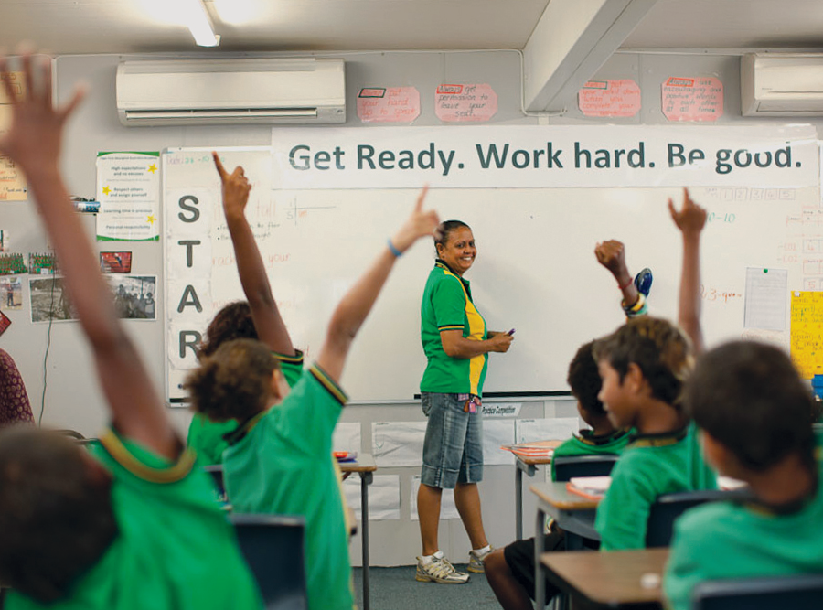
Respond on Signal

Slide 17
Complete Independent Work

Slide 18
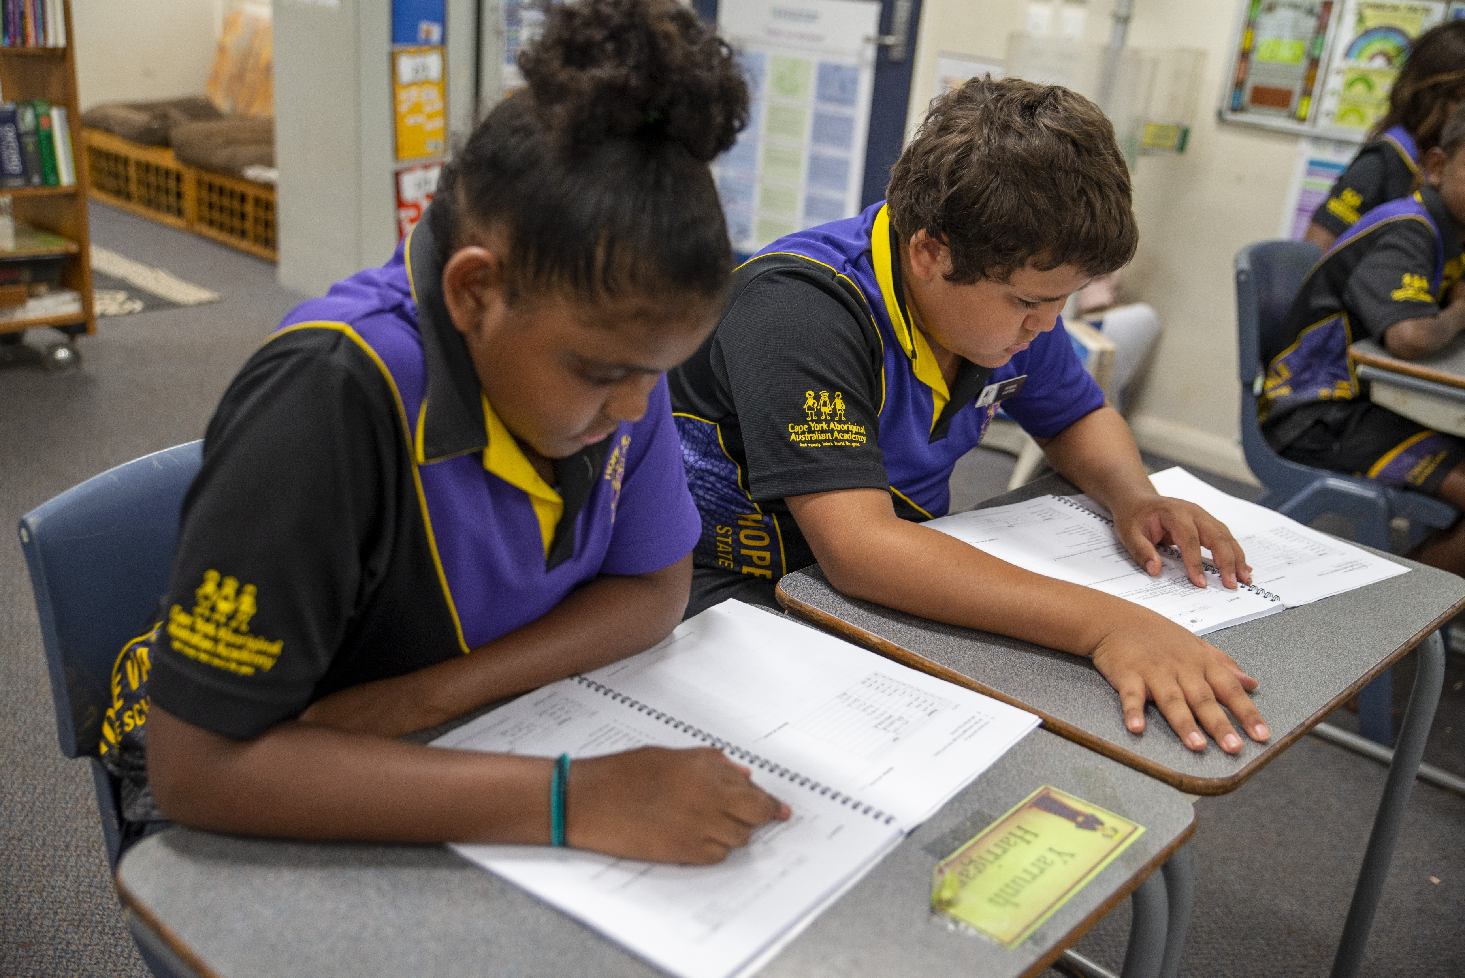
Complete Independent Work

Slide 19
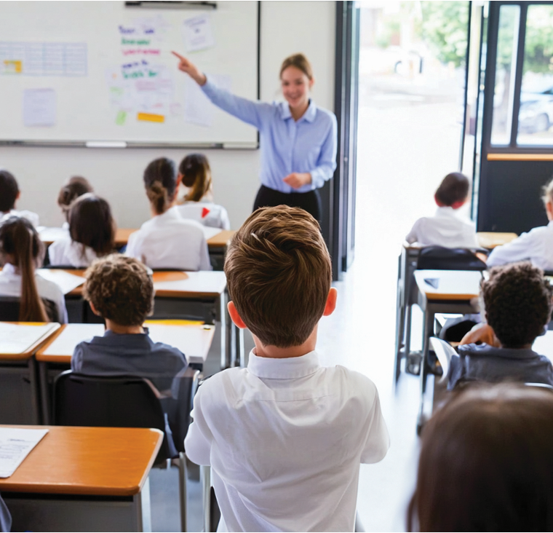

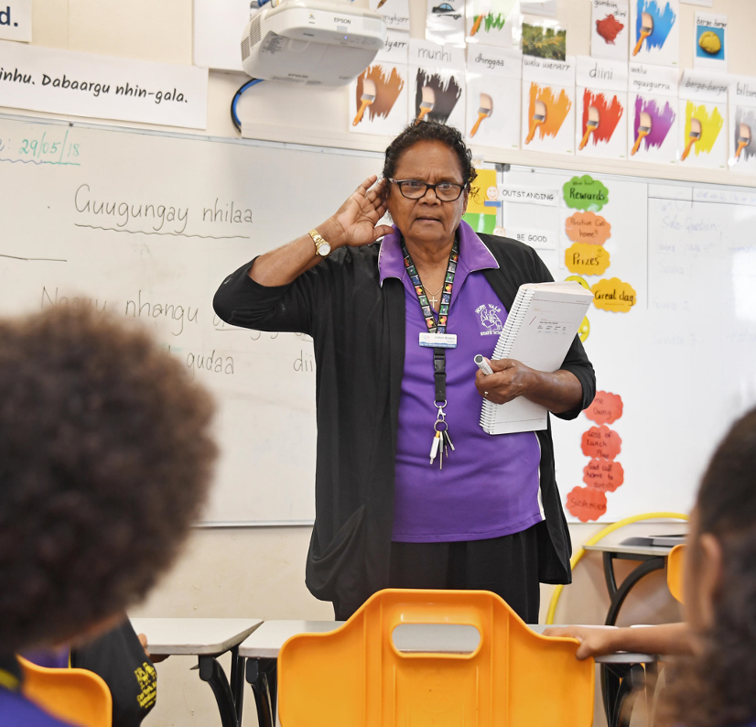
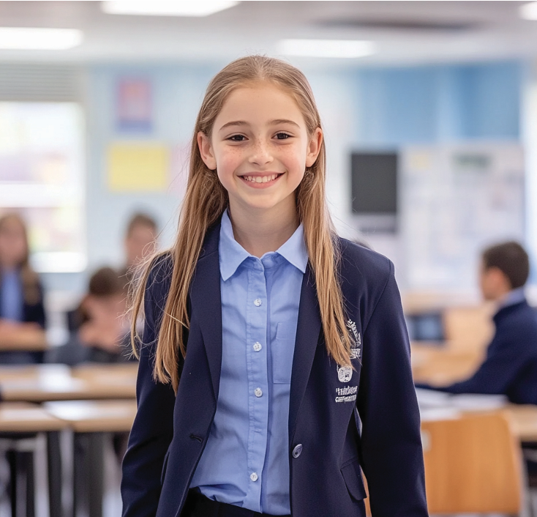

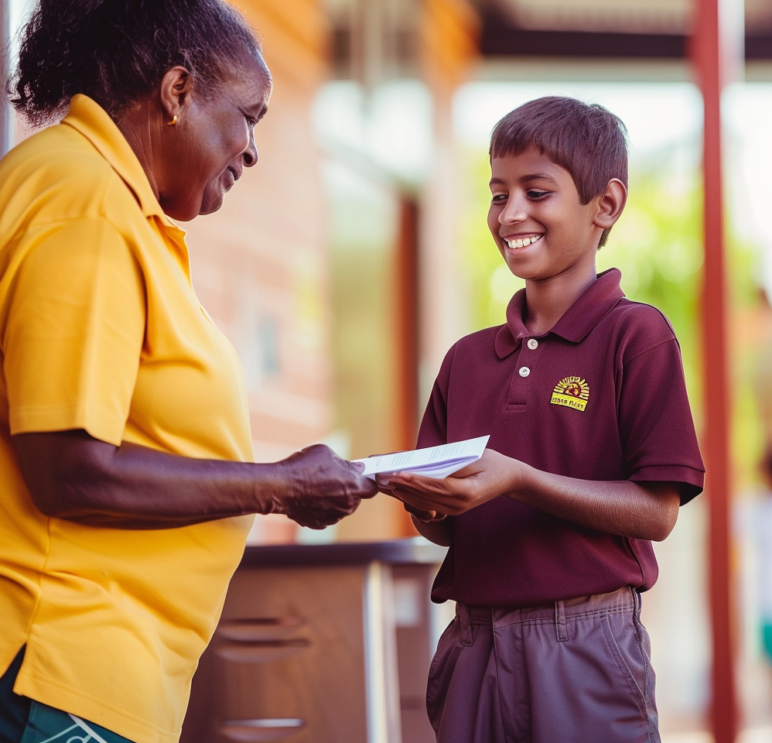
Learn Well

Slide 20
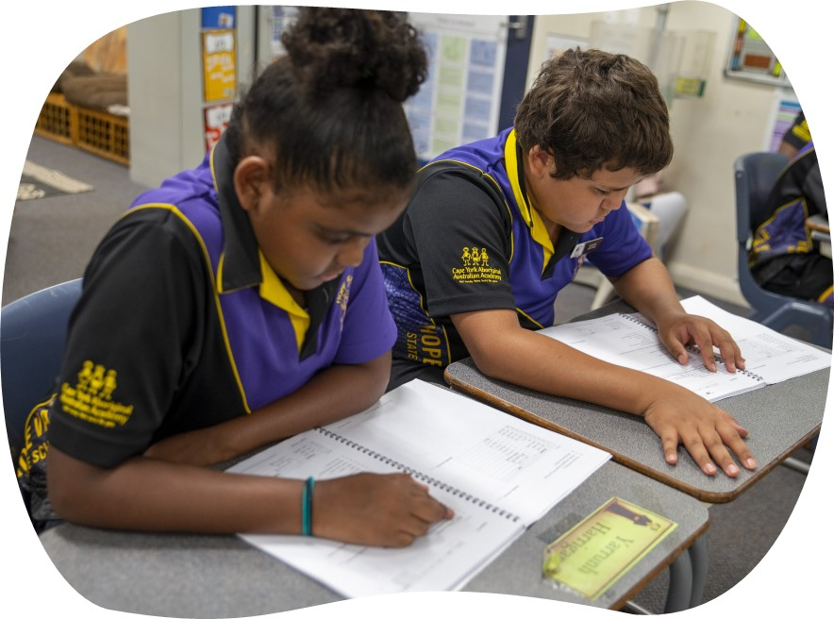

Slide 21

Our ‘Learn Well’ rules ensure we stay on track and are responsible for our learning.

Slide 22

How well did you:
demonstrate the classroom rules, ‘Learn Well’?

